Slide 1
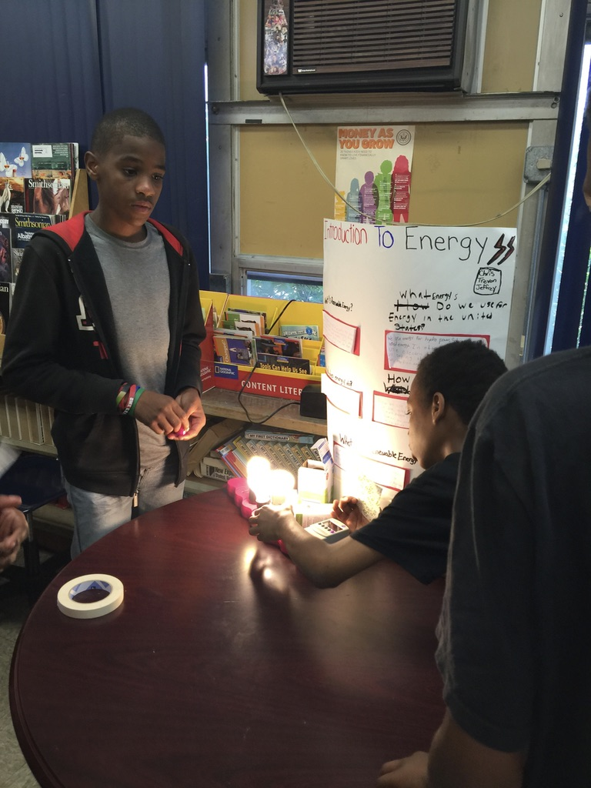
Energy Fair Planning Tips
Heather Hampton, ESP Illinois teacher

Slide 2
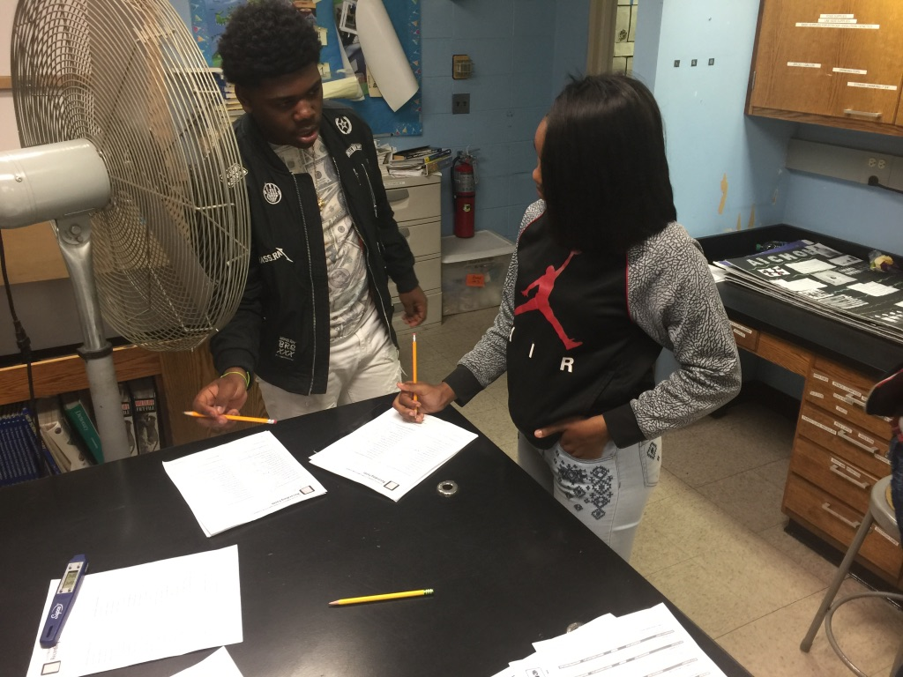
1. Be Organized
Unpack the energy fair boxes prior to Your fair
Decide who will be responsible for Each game
Go over directions and make sure students understand how to play the game
Conduct a class energy game Day AS PRACTICE

Slide 3
2. Use the Press Release Letters
Send the press release letters to local newspapers to announce the fair.
Secure media from local newspapers to take photos of event.

Slide 4
3. Invite Major Stakeholders
Parents
Business owners
Politicians
District Personnel

Slide 5
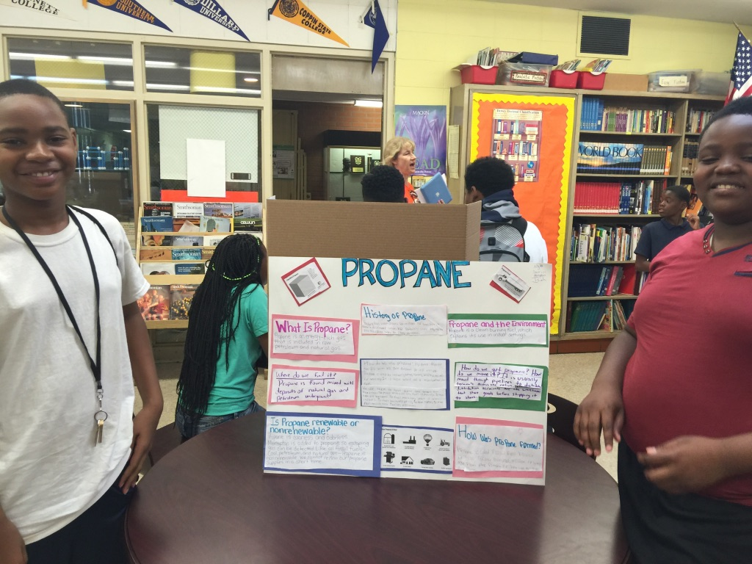
4. Let Go, and Let the Kids Take COntrol
Show what they know
Design/create

Slide 6
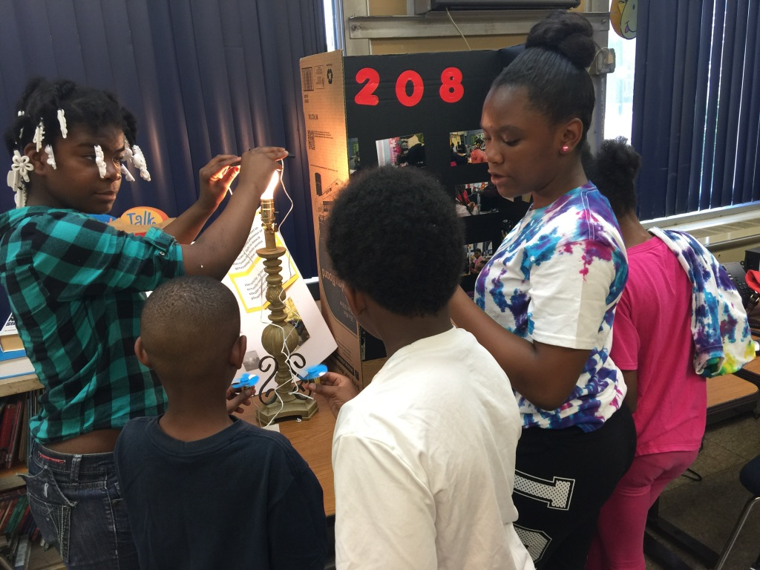
5. Do Not Wait Until the Last Minute to Plan!
Start thinking now about what you want to do
Decide upon a tentative date
Leverage the thinking of your students
ASK FOR HELP

