Slide 1
U.S. Energy Flow, 2012

Slide 2
U.S. Energy Flow 1
Production
Consumption
Energy Analysis- 7/13/17 - ©The NEED Project

Slide 3
U.S. Energy Flow 2
Production
Consumption
Energy Analysis- 7/13/17 - ©The NEED Project

Slide 4
U.S. Energy Flow 3
Production
Consumption
Energy Analysis- 7/13/17 - ©The NEED Project

Slide 5
U.S. Energy Flow 4
Production
Consumption
Energy Analysis- 7/13/17 - ©The NEED Project

Slide 6
U.S. Energy Flow 5
Production
Consumption
Energy Analysis- 7/13/17 - ©The NEED Project

Slide 7
U.S. Energy Flow 6
Production
Consumption
Energy Analysis- 7/13/17 - ©The NEED Project

Slide 8
U.S. Energy Flow 7
Production
Consumption
Energy Analysis- 7/13/17 - ©The NEED Project

Slide 9
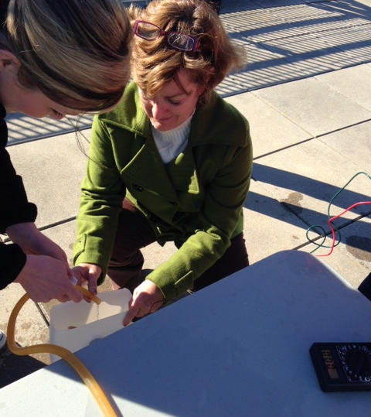
For More Information
The NEED Project
www.need.org
info@need.org
1-800-875-5029
Energy Information Administration
U.S. Department of Energy
www.eia.gov
Energy Analysis- 7/13/17 - ©The NEED Project

Slide 10
NEED IS SOCIAL!
Stay up-to-date with NEED. “Like” us on Facebook! Search for The NEED Project, and check out all we’ve got going on!
Follow us on Twitter. We share the latest energy news from around the country, @NEED_Project.
Follow us on Instagram and check out the photos taken at NEED events, instagram.com/theneedproject.
Follow us on Pinterest and pin ideas to use in your classroom, Pinterest.com/NeedProject.
Follow us on Snapchat to see us live in action at various NEED activities/events, need_project

