Slide 1
Introduction to Electricity
Itty bitty electrons, phenomenal power

Slide 2
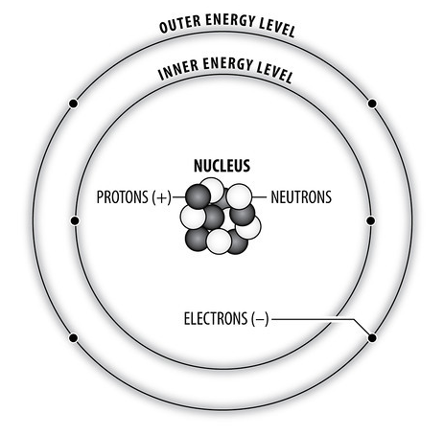
Electricity – a force and source of fun!
Electricity is moving electrons.
Electricity is a secondary source of energy.
Electrons are found in energy levels, and are held in place by an electrical force.
Make these electrons move? You’ve got electricity
Magnets and magnetic fields can make it happen!
Notes:
Atoms have protons (+), neutrons (o), and electrons (-). Protons and neutrons are held in the positively charged nucleus. Electrons are found outside the nucleus.
Electrons closer to the nucleus may be held more tightly because of their attraction to protons. Outer electrons may not be held as tightly.
Electrons can be pushed out of their orbits by applying a force. They can move from one atom to another, creating electricity.
Magnetic fields can provide the force to push electrons in metals that have loosely held electrons (ex. Copper)

Slide 3
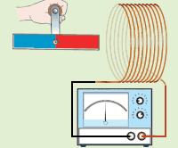
Electricity and Magnetism – a not-so-odd couple
Electricity and magnetism are related. You can’t have one without the other!
Electromagnetism - the interaction of forces occurring between electrically charged particles that can create an electric field or magnetic field
Magnets can create an electric field (electricity).
Electricity can create a magnetic field.
Notes:
Every time a magnetic field changes, an electric field is created. Every time an electric field changes, a magnetic field is created!

Slide 4
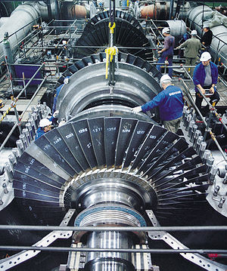
Generators and Power Plants
Power plants use turbine generators to generate electricity
Generator - a device made of coils of wire and magnets; one rotates inside the other.
Rotor – rotating component, attached on a shaft
Stator – stationary component
Turbine - a device with blades, which is turned by a force (wind, water, steam) to convert motion energy into electricity
Notes:
Generators can be configured with either the coil or the magnet as the rotor or stator.

Slide 5
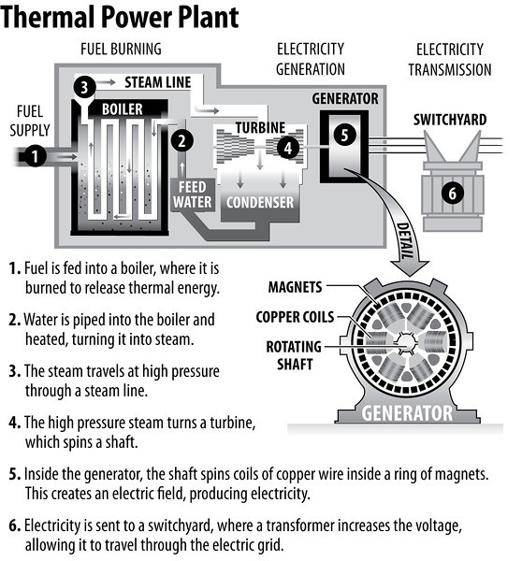
Types of Power Plants
Thermal power plants – use thermal energy to create steam or high pressure fluids to turn a turbine
Coal, natural gas, nuclear, biomass, petroleum, geothermal
PV - radiant energy to electrical energy
CSP (Solar-Thermal) – focused radiant energy to create thermal energy, turn a turbine
Hydropower, Wind – motion energy to electrical energy

Slide 6
Electricity in the U.S.

Slide 7
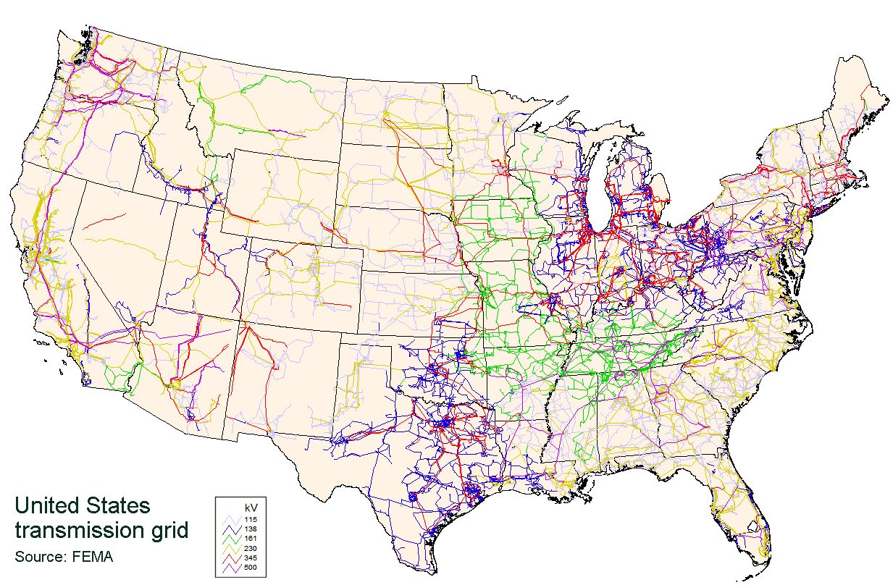
Moving Electricity
Power plant generates electricity
Transformer “steps up” voltage for transmission
Transmission lines carry electricity long distances
Transformer “steps down” voltage at a substation
Local distribution lines carry electricity to homes and businesses
Neighborhood transformers ensure voltage is safe for use in homes
Electricity enters home through a 3-wire cable, monitored by an electric meter
Notes:
Electricity is easy to move, but is easier moved in long distances at a higher voltage. A certain amount of electricity is lost in transmission; stepping up the voltage helps minimize this effect. Electricity leaving the power plant is often from an AC generator (3-phase) at a high voltage, but transformers help it to be at safe levels for the home. (DC is produced by solar, and must be converted to AC for transmission)
Distribution lines can be above ground or below ground.

Slide 8
Loads, Demands, and Utilities
Utility – providers of the electricity
Load – anything that draws power (devices, homes, businesses, industries)
Baseload power - generated power round-the-clock, minimum needed to ensure consumer need is met
Baseload plants usually operate near full capacity
Peak demand – periods of higher demand when additional generation is required
Notes:
Utilities – generate electricity, transport electricity, and/or maintain lines - aim to provide uninterrupted service round- the- clock
Capacity – amount of electricity able to be generated & online, each plant has its own capacity in MW
Utilities must ensure they have 15% more installed capacity (or more) than peak demand requires

Slide 9
NEED IS SOCIAL!
Stay up-to-date with NEED. “Like” us on Facebook! Search for The NEED Project, and check out all we’ve got going on!
Follow us on Twitter. We share the latest energy news from around the country, @NEED_Project.
Follow us on Instagram and check out the photos taken at NEED events, instagram.com/theneedproject.
Follow us on Pinterest and pin ideas to use in your classroom, Pinterest.com/NeedProject.
Introduction to Electricity 2018 ©The NEED Project

