Slide 1
Norms & Expectations
Correct name (first name, last initial please)
Share Video – show your face on screen!
Designate your workspace – seated at a table/desk
Mute if not discussing
Speaker View vs. Gallery View
Join back in if you get dropped out!
Communicate with us!
Use the chat feature
Zoom has buttons* for raising your hand, responding yes or no, clap emoji, thumbs up emoji
*These features vary depending on device used – iPad, tablet, phone, laptop

Slide 2
Before we start!
1. Materials you will need to gather:
Water (ice, room temp, hot)*
Piece of fruit (apple or orange)*
Vinegar*
Matches/lighter*
Pen or pencil
Paper or notebook
Vegetable oil
Corn syrup or honey
Water
*These items are only required for certain science of energy stations. Preview your assigned station to determine which starred items are necessary for you.
2. Please complete the energy knowledge pretest if you have not already. See link provided in the Zoom chat.

Slide 3
NEED Energy Workshop
Sponsored by

Slide 4
What is NEED?
National Energy Education Development
The mission of the NEED Project is to promote an energy conscious and educated society by creating networks of students, educators, and business, government, and community leaders to design and deliver objective, multi-sided energy education programs.
In 2019-2020:
100+ workshops across 565 cities in the U.S.
At least 428,000 students reached utilizing workshop materials and curriculum.

Slide 5
Science of Energy
Forms of Energy
Energy Transformations
Kit Includes Materials for Teacher Demonstration & Six Lab Stations
Four levels Primary, Elementary, Intermediate, and Secondary
Five Class Periods of 45-60 minutes
ConocoPhillips provides a Science of Energy Kit for each participating teacher (or you may opt for a free Oil & Gas Kit instead)
Notes:
Tell them that we’ll start with the Science of Energy. This is a free kit they can opt to receive courtesy of ConocoPhillips (or can receive a free Oil & Gas Kit). Review how the Science of Energy kit is designed to be done in the classroom

Slide 6
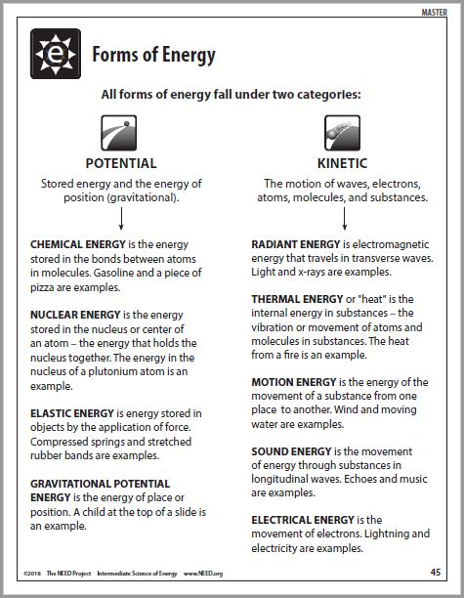
Notes:
Do the Science of Energy Teacher Demonstration. After demonstrating the energy transformation with the containers of sand - review how NEED classifies the different forms of energy. Tell them this black line master is included in the Guides that come with the kit. Have them use the chart to trace backwards the entire energy flow in the demonstration to nuclear energy in the sun.

Slide 7
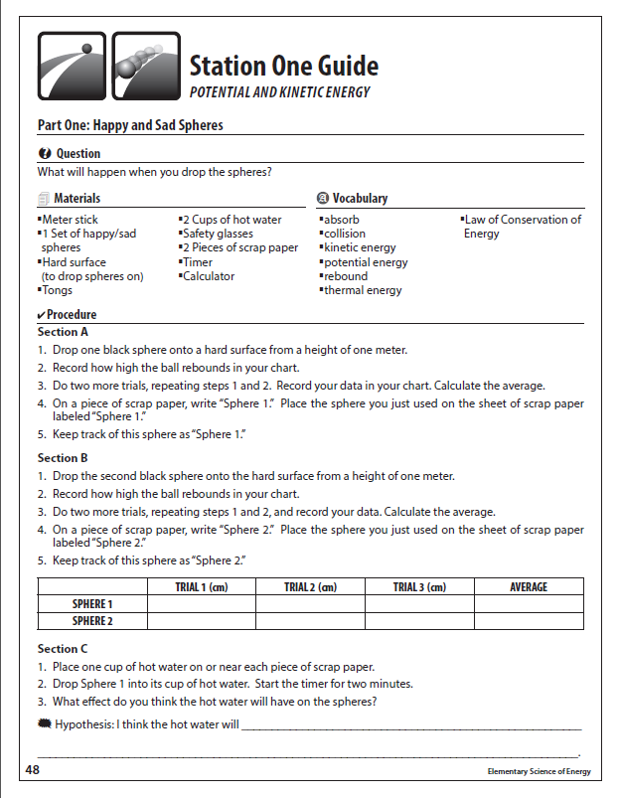
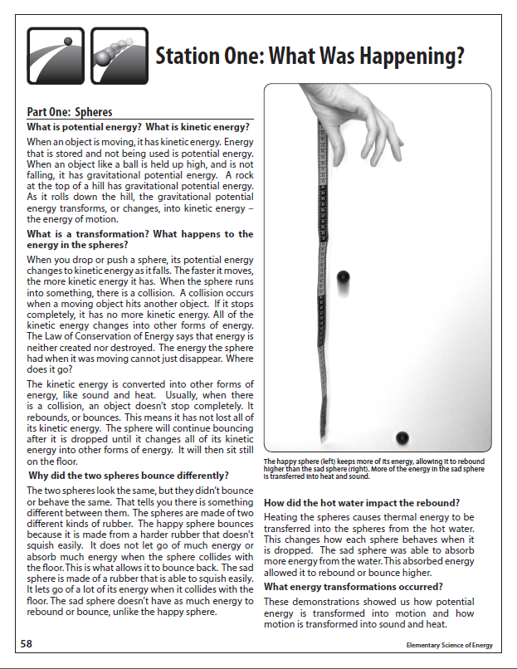
Notes:
Stations are designed as inquiry investigations for students to explore and lead their peers through. Each station has a “What Was Happening” description to help students understand their investigations.

Slide 8
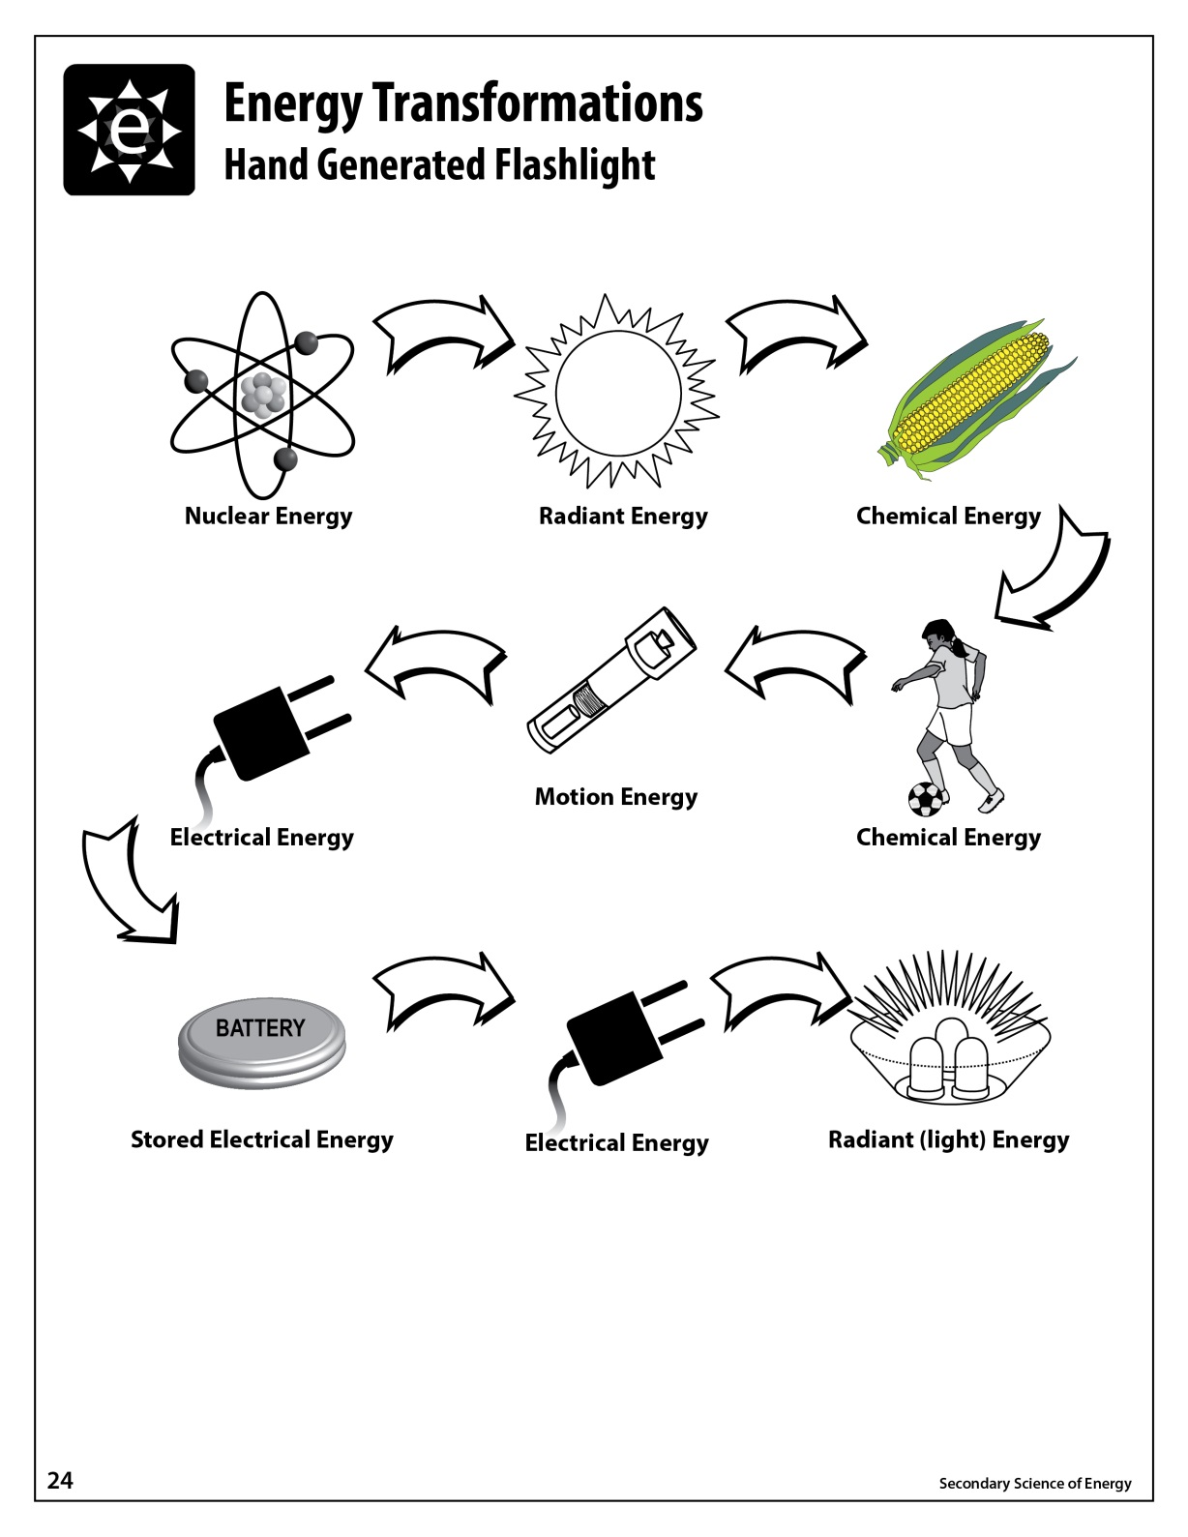
Energy Flows

Slide 9
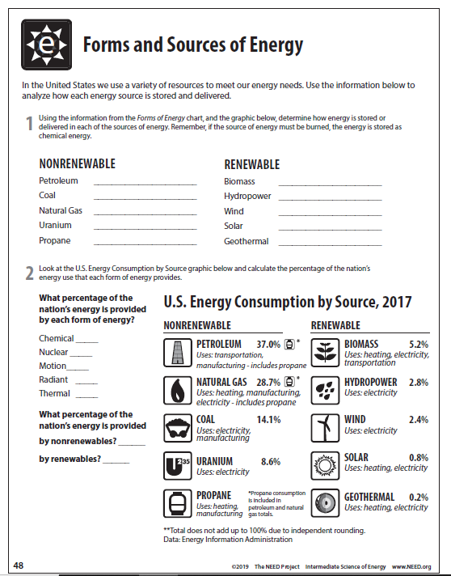
Transition:
Forms to Sources
Chemical
Chemical
Chemical
Motion
Forms - how scientists classify energy
Sources - where we get the energy to make our lives more comfortable, convenient, & enjoyable
Chemical
Motion
Nuclear
Radiant
Chemical
Thermal
85.0%
8.6%
5.2%
0.8%
0.2%*
88.4%
11.4%*
*Total does not equal 100% due to independent rounding.
Notes:
This worksheet which is included in the Science of Energy Guides helps students learn the difference between forms of energy and energy sources and explains how they are related.
Again explain that forms of energy are how scientists classify the different kinds of energy. Energy sources are where we get the energy we use everyday to make our lives more comfortable and convenient. An example of this is the energy we receive from the sun comes in the form of radiant energy. We call this resource (source) solar energy.
Quickly explain how this sheet is used by students. Don’t spend too much time on it. Note that percentages may not equal 100 in total, due to independent rounding of figures.

Slide 10
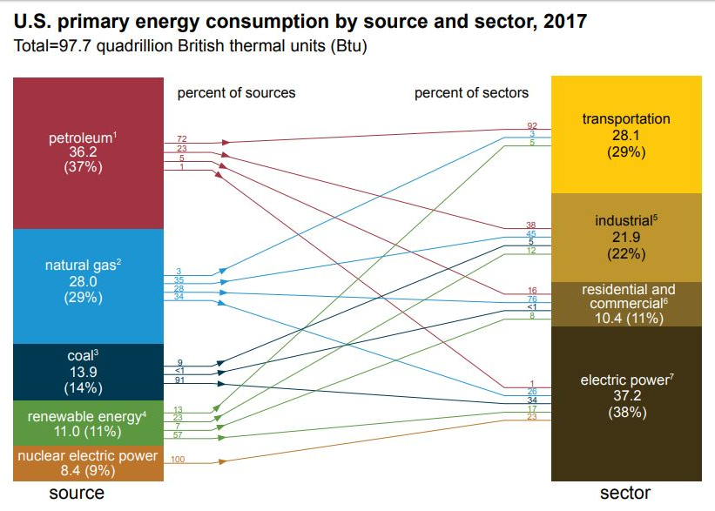
Primary Energy Consumption by Source and Sector - 2017
Source: Energy Information Administration
Notes:
The United States is a highly developed and industrialized society. We use a lot of energy – in homes, in businesses, in industry, and for transportation. The industrial sector uses about one-third of total energy. The residential and commercial sectors combined use even more than this about 41% of all energy. These two sectors include all types of buildings, such as houses, offices, stores, restaurants, hospitals, and places of worship. Energy used for transportation accounts for more than 25% of all energy.

Slide 11
Candy Collector
NO HANDS!

Slide 12
Energy Sources and Electricity
Electric Connections

Slide 14
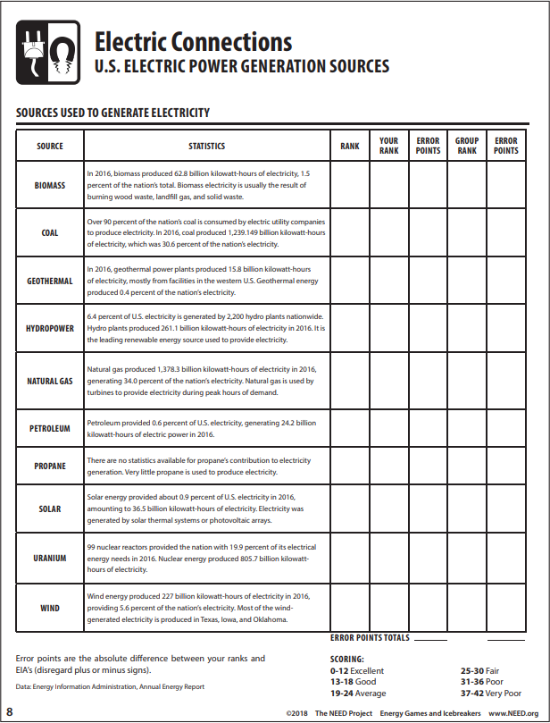
6
2
9
4
1
8
10
7
3
5

Slide 15
Exploring the NEED Website and Distance Learning Tips
www.NEED.org

Slide 16
What does NEED provide?
Curriculum Materials
Professional Development
Teacher Support
Student Recognition
“Kids Teaching Kids” Philosophy
NEED students don’t just read textbooks and answer questions. They are actively engaged in their own learning and in teaching others.

Slide 17
Curriculum Material Levels
Primary (K-2)
Elementary (3-5)
Intermediate (6-8)
Secondary (9-12)
Notes:
Curriculum and kits available for all levels, K-12.

Slide 18
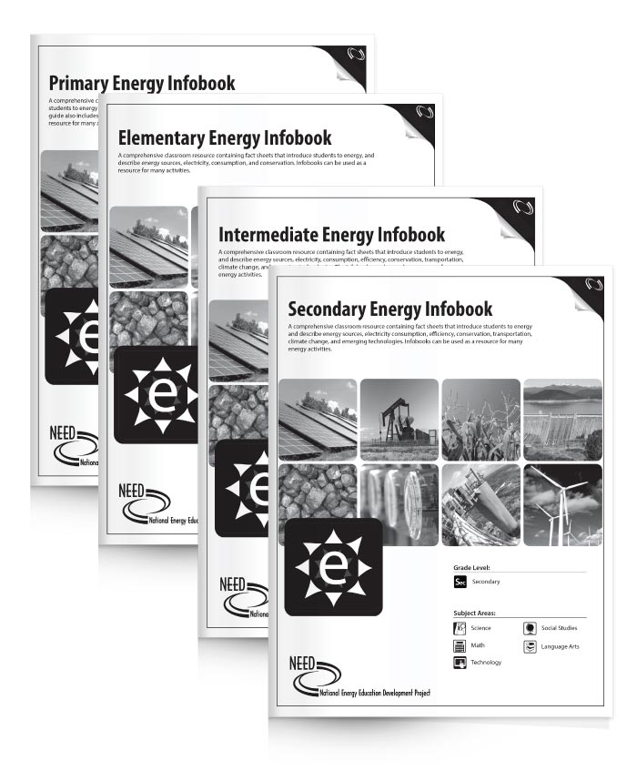
NEED Energy Infobooks
Introduction to Energy
Informational text on energy sources
Global Climate Science
Energy Carriers
Energy Consumption
Efficiency and Conservation
Notes:
Explain that Primary is primarily for non-readers and does not come in class sets. But they do have a copy in their packet. All infobooks are downloadable as e-readers as well.

Slide 19
Curriculum Packet – What’s inside:
Energy Infobooks
Energy Games and Icebreakers
Creative Energy Classroom Fun
Energy Careers Excursion
Stock it Up! Energy Storage Sampler
Energy Sources Exhibition

Slide 20
NEED Resource Catalog
Notes:
Have them take out their catalog. Explain that with their NEED participation, they also can order curriculum guides (not kits, kit consumables or merchandise) free of charge. There are two ways to pick out their free curriculum. The easy way is order the Basic Curriculum Unit for their grade level (page 6). The more involved way is to go through the catalog and choose any six curriculum guides they would like.

Slide 21
NEED Web Resources
www.NEED.org

Slide 22
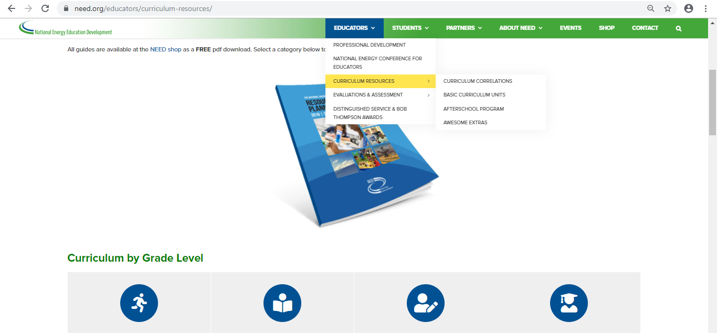
NEED Web Resources
Curriculum Materials

Slide 23
NEED Web Distance Learning Resources
www.NEED.org/distancelearning

Slide 24
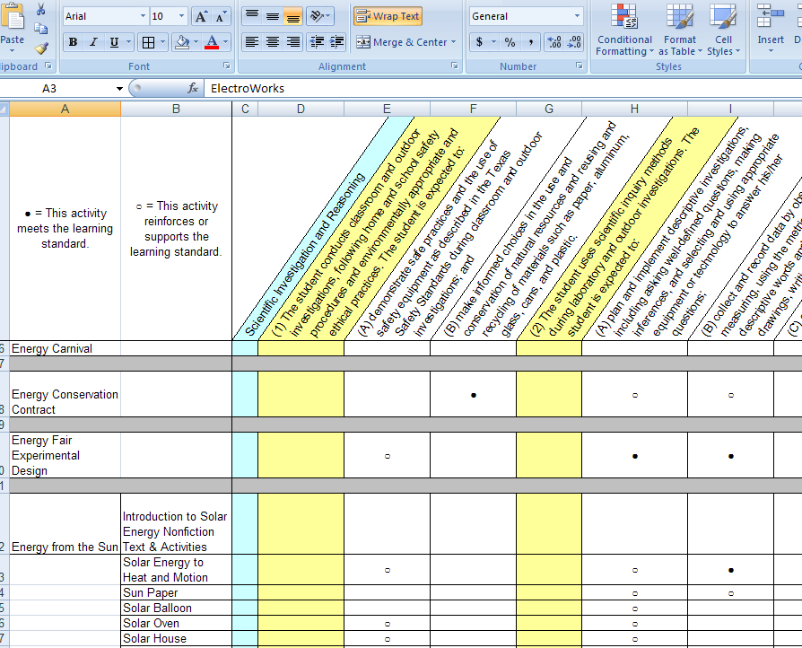
NEED Web Resources
Correlations to State Standards

Slide 25
NEED Web Resources
Pre/Post Energy Poll and Question Bank

Slide 26
Teacher Training
www.NEED.org/events
Notes:
NEED offers workshops and sessions running from one hour at state and NSTA Conferences to a 5 day conference held in July. The most common workshop format is the one day conference like the one we’re doing today.

Slide 27
YOUTH AWARDS FOR ENERGY ACHIEVEMENT
To recognize outstanding achievement and reward student leadership, The NEED Project conducts the National Youth Awards Program for Energy Achievement.
What’s involved?
Students and teachers set goals and objectives and keep a record of their activities. Students create a digital project to submit for judging. In April, digital projects should be uploaded to the online submission site.
Want more info? Check out www.NEED.org/youth-awards for more application and program information, previous winners, and photos of past events.
#NEEDinDC
Notes:
Please show a project. You can download if you have wifi access.

Slide 28
Exploring Oil & Natural Gas

Slide 29
Where are the fossils in Fossil Fuels?
Magnified fossil photos
Fossil fuels were forming before dinosaurs lived…
Notes:
Oil was formed from the remains of sea plants and animals that lived hundreds of millions of years ago– even before dinosaurs! The sea plants and animals died and were buried on the ocean floor under layers and layers of mud and sand. Over millions of years, their remains were buried deeper and deeper. Enormous heat and pressure from these layers helped turn the dead sea plants and animals into oil and gas. That’s why oil and gas are called “fossil” fuels.

Slide 30
Formation
Notes:
Petroleum and natural gas are called fossil fuels because scientists believe they were formed from the remains of prehistoric plants and tiny sea animals. When they died, they sank to the bottom of the sea and were buried by sediment and sand, which turned into sedimentary rock. The layers of plants, sea animals and sedimentary rock continued to build until the pressure and heat from the earth turned the remains into petroleum and natural gas.
Imagine standing on the shore of an ancient sea, a few hundred millions of years ago. A small distance from the shore, there is a jungle of leafy tree ferns, with giant dragonflies flying through the air. In contrast to the hustle and bustle on land and in the air, the surface of the sea appears very quiet. Yet, the quiet surface condition is deceptive. A look below the surface reveals that life and death occur constantly in the blue depths of the sea. Countless millions of tiny microscopic organisms eat, are eaten and die. As they die, their small remains fall as a constant rain of organic matter that accumulates in enormous quantities on the sea floor. There, the remains are mixed in with the ooze and sand that form the ocean bottom.
As the years march by, layer upon layer of sediments build up. Those buried the deepest undergo a transition; they are transformed into rock. Another transition occurs: changed by heat, and by the tremendous weight and pressure of the sediment above the organic material in the rock becomes petroleum.
While petroleum was being formed, major Earth events were occurring elsewhere. Great earthquakes opened huge cracks, or faults, in the Earth’s crust. Layers of rock were folded upward and downward. Molten rock thrust its way upward, displacing surrounding solid beds into a variety of shapes. Vast blocks of the Earth were shoved upward, dropped downward or moved laterally. Some formations were exposed to wind and water erosion and then once again buried. Gulfs and inlets were surrounded by land, and the resulting inland seas were left to evaporate in the sun. Earth’s very shape had been changed.
Meanwhile, the newly born hydrocarbons lay cradled in their source rocks. But as the great weight of the overlying rocks and sediments pushed downward, the petroleum was forced out of its birthplace. It began to migrate. Seeping through cracks and fissures, oozing through tiny connections between the rock grains, petroleum began a journey upward. Some of it eventually reached the surface where it collected in large pools of tar. However, some petroleum did not reach the surface. Instead, its upward migration was stopped by an impermeable layer of rock. It lay trapped far beneath the surface. It is this petroleum and natural gas that today’s oilmen seek.

Slide 31
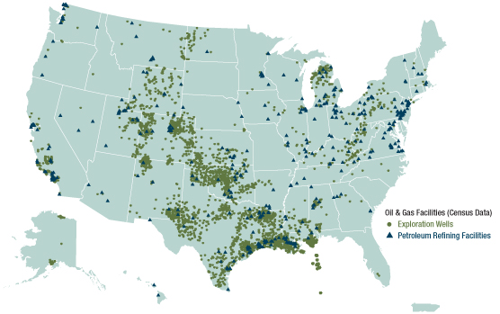
Where are Oil and Gas found in the U.S.?
Image courtesy of EPA
Notes:
An oil field is a region with an abundance of oil wells extracting petroleum (crude oil) and natural gas from below ground.
Many times, these fields are found in basins. A structural basin is a large scale structural formation of rock strata formed by tectonic warping of previously flat lying strata. Structural basins are geological depressions and are the inverse of domes. Some elongated basins are also known as synclines. Structural basins may also be sedimentary basins, which are aggregations of sediment that filled up a depression or accumulated in an area; however, many structural basins were formed by tectonic events long after the sedimentary layers were deposited.
Basins appear on a geological map as roughly circular or elliptical, with concentric layers. Because of the strata dip toward the center, the exposed strata in a basin are progressively younger from outside—in, with the youngest rocks in the center. Basins are often large in areal extent, often hundreds of kilometers wide.

Slide 32
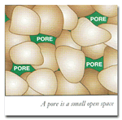
Oil and Gas are found on land and under water…
A pore is a small open space
Notes:
Oil and natural gas are buried beneath the earth’s crust, on land and under oceans.
To find oil and gas, geologists use their knowledge of land and rock formations. Hydrocarbons - crude oil and natural gas - are found in certain layers of rock that are usually buried deep beneath the surface of the earth. In order for a rock layer to qualify as a good source of hydrocarbons, it must meet several criteria. Rock must be porous AND permeable.
Good reservoir rocks have porosity. Porosity is a measure of the openings in a rock, openings in which petroleum can exist.
Another characteristic of reservoir rock is that it must be permeable. That is, the pores of the rock must be connected together so that hydrocarbons can move from one pore to another. Unless hydrocarbons can move and flow from pore to pore, the hydrocarbons remain locked in place and cannot flow into a well. The reservoir must also be trapped in some way.

Slide 33
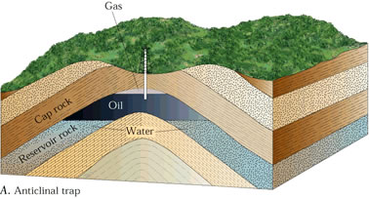
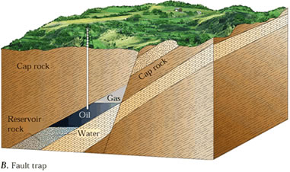
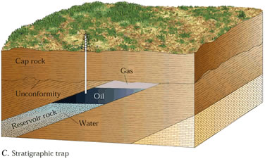
Sedimentary Rock and Petroleum Traps
Notes:
Sedimentary rock is formed by the build up of layers of sand and sediment over time. Since sedimentary rock often has many pores, it is an ideal rock formation to contain oil.
Geologists have classified petroleum traps into two basic types: structural and stratigraphic traps. Structural traps are traps that are formed because of a deformation in the rock layer that contains the hydrocarbons. Two common examples of structural traps are fault traps and anticlines.

Slide 34
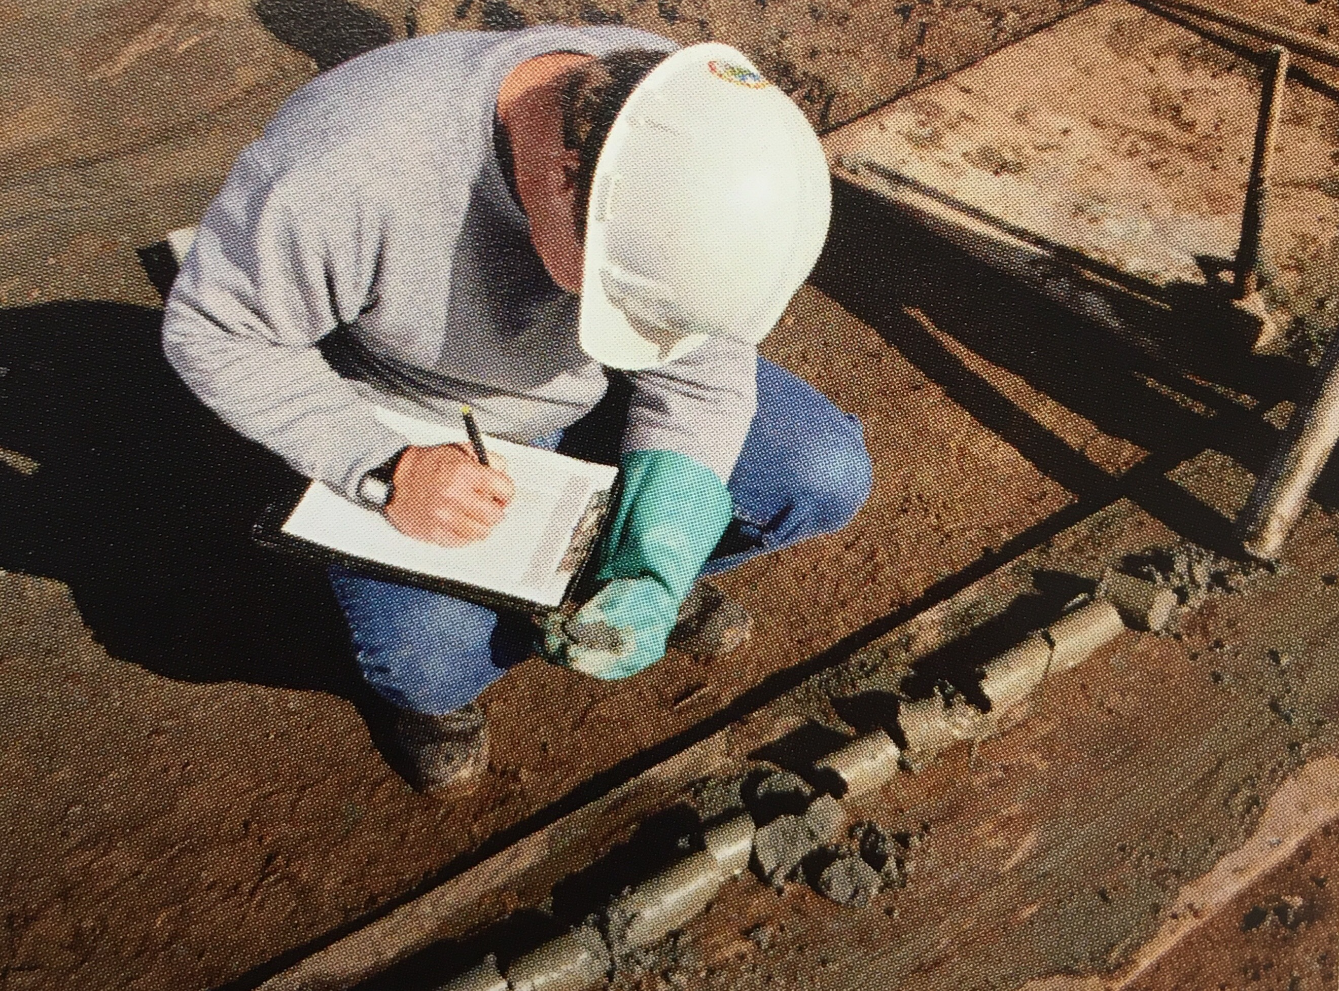
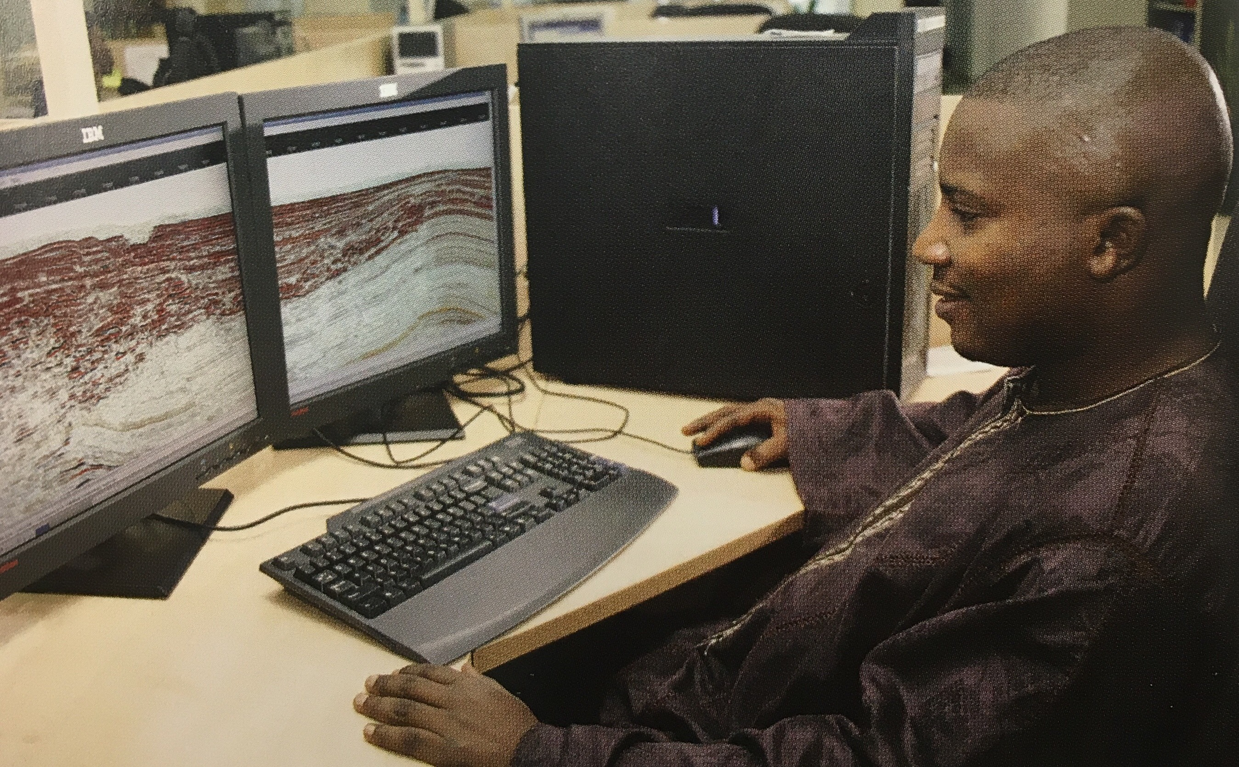
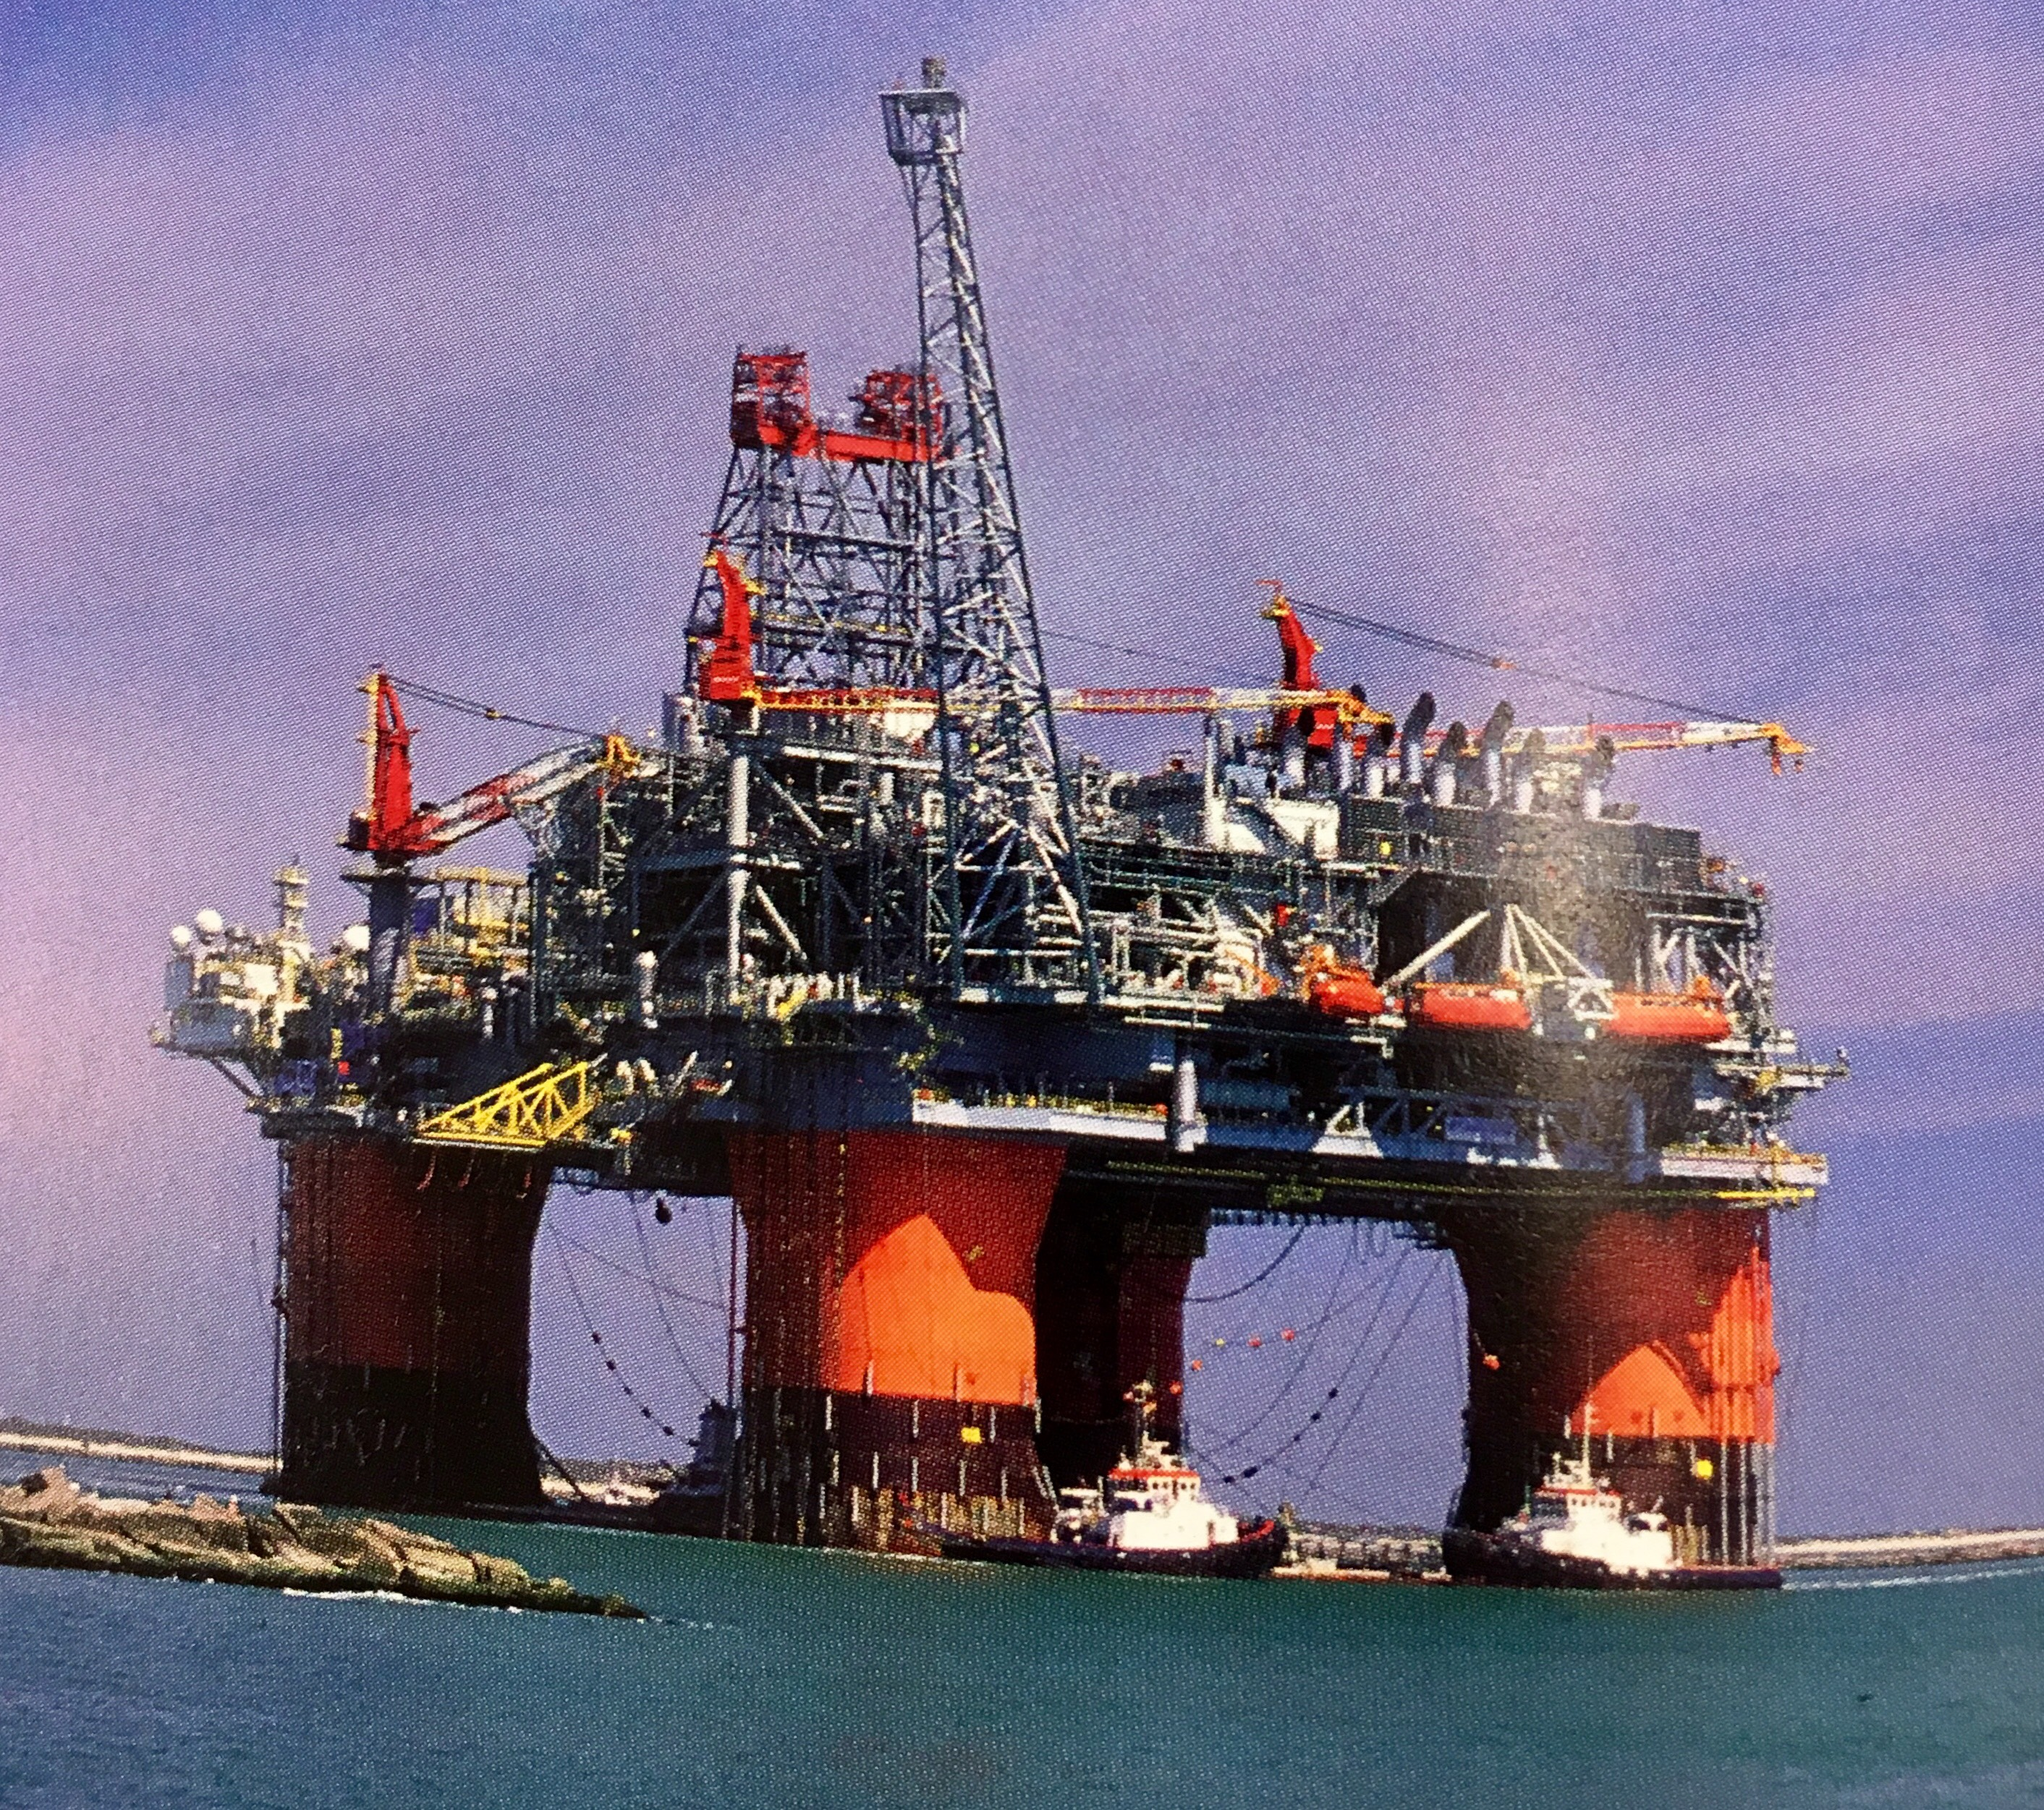
Exploration by Geologists
Images courtesy of Society of Petroleum Engineers
Notes:
The task of finding oil is assigned to geologists. Their task is to find the right conditions for an oil trap—the right source rock, reservoir rock and entrapment.
Modern oil geologists examine core samples, surface rocks and terrain, with the additional help of satellite images. However, they also use a variety of other methods to find oil. They can use sensitive gravity meters to measure tiny changes in the Earth’s gravitational field that could indicate flowing oil, as well as sensitive magnetometers to measure tiny changes in the Earth’s magnetic field caused by flowing oil. They can detect the smell of hydrocarbons using sensitive electronic noses called sniffers.

Slide 35
Seismic Technology
Land
Water
Notes:
Finally, and most commonly, they use seismic technology, creating shock waves that pass through hidden rock layers and interpreting the waves that are reflected back to the surface. Equipment on the surface records the returning sound waves.

Slide 36
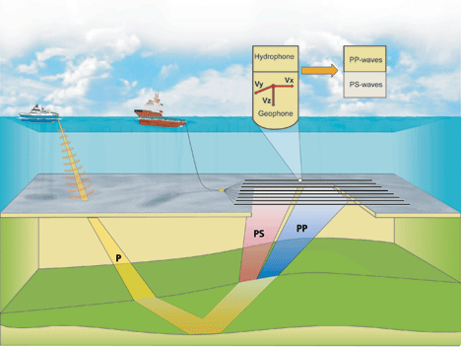
Seabed Seismic
Notes:
Conventional seismic surveys are done by towing sensors on streamers behind a survey vessel.
The hydrophones record compressional sound wave information (pressure or P-waves) as they are bounced back from rock interfaces.
Unfortunately, P-waves are not only influenced by rock types but also by porosity and fluids, which makes it difficult to discriminate between them. However, by deploying geophones in addition to hydrophones on the seabed, it is possible to acquire information on shear waves as well (S-waves).
Unlike their P-wave counterparts, S-waves are almost insensitive to a rock’s fluid content, whether hydrocarbons or water.
The success factor lies in the integration of P- and S-wave data. In this way, geophysicists can vastly improve their ability to distinguish between rock and fluid property effects.
This makes a significant, productive contribution to decreasing exploration risk and improving geophysical reservoir imaging and monitoring.

Slide 37
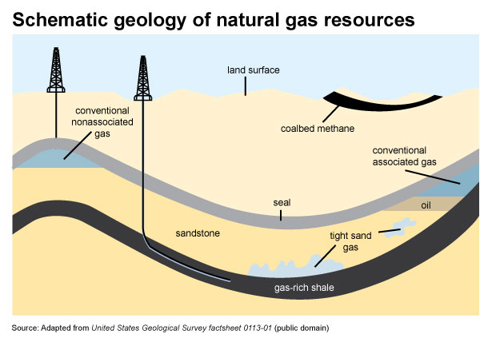

Slide 38
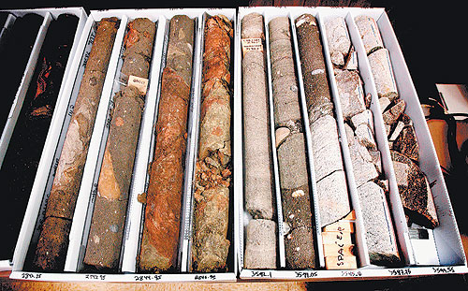
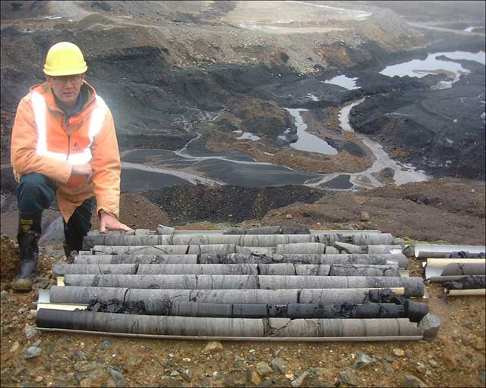
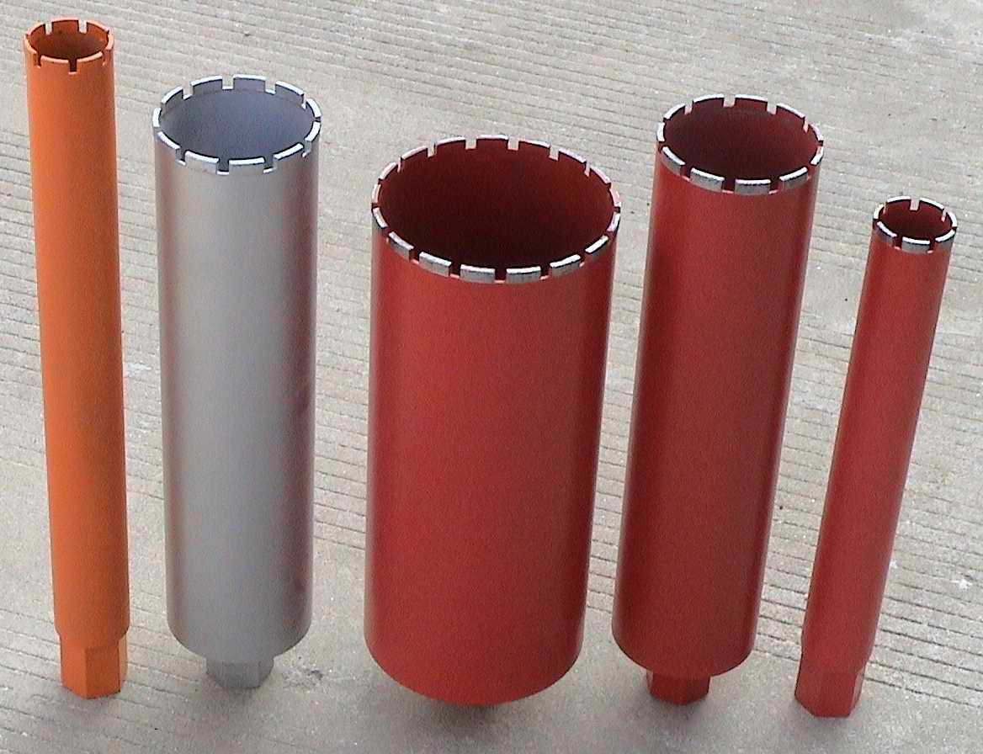
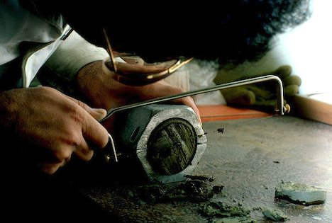
Core Samples
Notes:
Core samples (taking samples of rock to look for characteristics of reservoir rock) is another technique used in underground or undersea exploration and prospecting. A core sample is a roughly cylindrical piece of subsurface material removed by a special drill and brought to the surface for examination. Such a sample is needed to ascertain properties of underground rock, such as its porosity and permeability, or to investigate the peculiar features of a given zone of strata.
Most cores are obtained by drilling into the earth, with a hollow steel tube called a corer. The hole made for the core sample is called a core hole. In the coring process the sample is pushed more or less intact into the tube. Removed from the tube in the laboratory, it is inspected and analyzed by different techniques and equipment depending on the type of data desired.

Slide 39
Exploration and Production by Drilling
Notes:
Locating a suitable site for drilling is just the first step in extracting oil. Before drilling can begin, companies must make sure they have the legal rights to drill. This can take years.

Slide 40
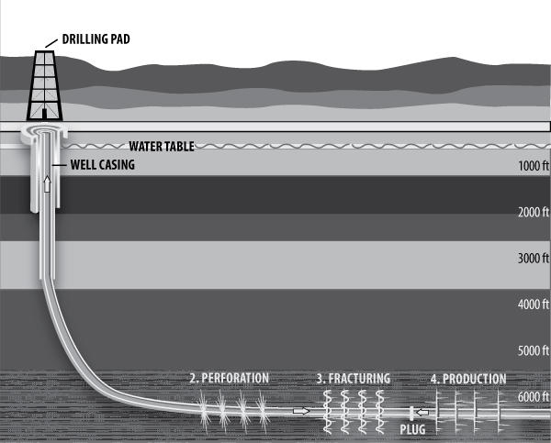
Horizontal Drilling and Hydraulic Fracturing
Increased technology allows us to retrieve “tight” formations.
The drilling process is similar, except for a specialized bit that allows for horizontal drilling.
If oil and gas are trapped, fracturing may be used to allow liquids to flow.
Notes:
During horizontal drilling, a drill is sent vertically underground and then turns to a (nearly) 90 degree angle to drill. Often in this case, the well is then perforated, allowing the oil and natural gas to enter the casing through multiple openings and be pumped to the surface.
When oil and especially natural gas are trapped within tight formations, fracturing is employed. During this process a fluid is injected into the casing under high pressure and exits the perforations creating cracks with in the surrounding rock layers. These cracks allow for pathways that allow the oil and natural gas to escape the formation and move into the casing to be brought to the surface. Often multiple segments of a casing are fracked. A fracking fluid typically contains over 90 % water, some sand, and a small amount of chemicals. The sand or similar particle is used to hold fissures open, but oil and gas can still seep through it. The chemicals used are often proprietary, and most often detergent like in nature.

Slide 41
Production
Christmas Tree
Horse Head Pump
Notes:
Once the wells have been completed, they can go into production. Production wells do not have the complex above ground structures that are in place during drilling. Instead, the wells are capped with smaller units. Ideally, oil and gas are extracted using natural drive, which means there is enough pressure in the well to move the oil and no pumping is needed.
A Christmas Tree, in the petroleum industry, is a series of valves and gauges used to measure and control the flow and pressure of the well.
Other wells do not have enough natural drive to move the oil and gas out of the earth. They must use pumps to lift the liquids to the surface. Typically, this is done with a sucker rod pump, sometimes called a horse head pump.

Slide 42
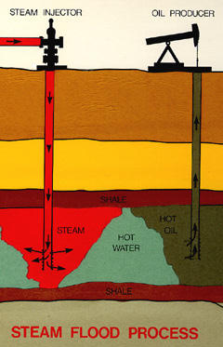
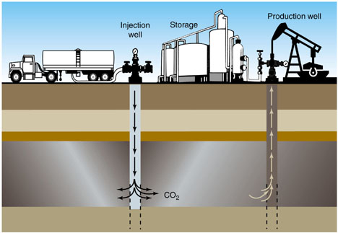
Enhanced Oil Recovery
Notes:
In some cases, the oil may be too heavy to flow. A second hole is then drilled into the reservoir and steam is injected under pressure. The heat from the steam thins the oil in the reservoir, and the pressure helps push it up the well.
Likewise, in some areas, drillers are using captured CO2 to inject into wells. It offers an opportunity to capture and store CO2, while producing oil and gas.

Slide 43
Oil Transport
Notes:
Oil wells are located above oil bearing formations, wherever they are found. Refineries are usually near oil consumption markets, though many are located near major oil producing areas, as well. There are different ways to get oil from the well to the refinery.
Much of the oil is shipped via pipelines. For longer distances, oil is put in tanker trucks or moved by sea on oil tankers.

Slide 44
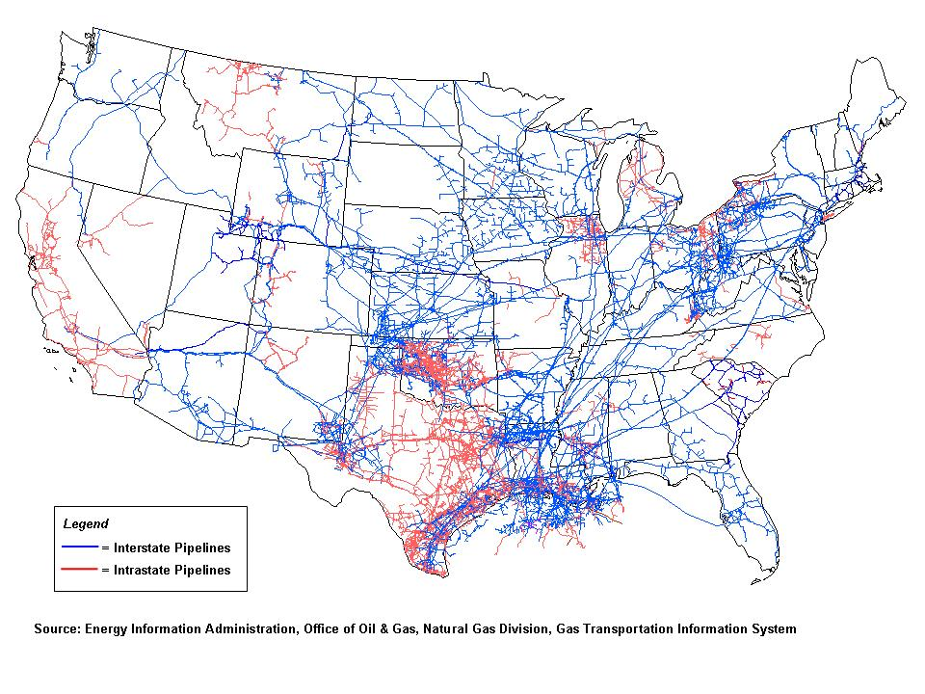
Natural Gas Transport
Notes:
Natural gas is transported primarily via underground pipelines.

Slide 45
Uses of Petroleum and Natural Gas by Economic Sector, 2018
U.S. Petroleum Consumption by Sector
U.S. Natural Gas Consumption by Sector
Data: Energy Information Administration

Slide 46
Summary of Oil and Natural Gas
Advantages
Disadvantages
Widely available
Simple combustion process can directly heat or generate electricity
Inexpensive
Easily distributed—good infrastructure in place
High energy content
Nonrenewable
Greenhouse Gases(CO₂)
Air pollution (byproducts released during combustion)
Price instability and costs rising
Reliance upon imports
Environmental impacts

Slide 47
Oil and Natural Gas Products Activities
Petroleum Ponder
Density
Oil & Gas Careers Round Up

Slide 48
Petroleum Ponder

Slide 49
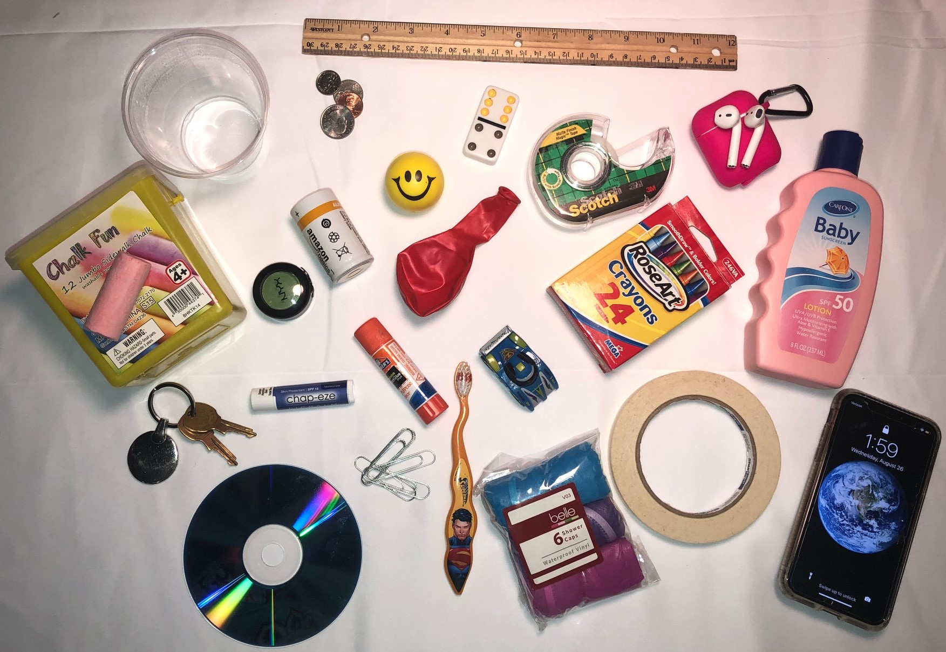
Notes:
Petroleum based - Plastic cup, domino, tape, ear pods, sunscreen, crayons, balloon, stress ball, battery, eye shadow, chalk box, disc, chap stick, glue stick, pull car, toothbrush, shower caps, masking tape, and cell phone. Non-Petroleum – coins, ruler, paperclips, keys, and piece of chalk

Slide 50
Petroleum is used in more products than one may realize…
Anything plastic
Balloons
Camera
CD
Chap Stick®
Chunk of asphalt
Clothing (polyester or nylon)
Comb
Crayon
Deodorant
Dice
Electrical tape
Fake Nails
Fertilizer
Fishing lures
Glue
Golf balls
Lotion
Insect repellent
Lipstick
Makeup
Masking tape
Paint
Shampoo
Shoes
Shoe polish
Sports equipment
Sunglasses
Toothbrush
Toothpaste
Umbrella
Wax paper
…AND MORE!!

Slide 51
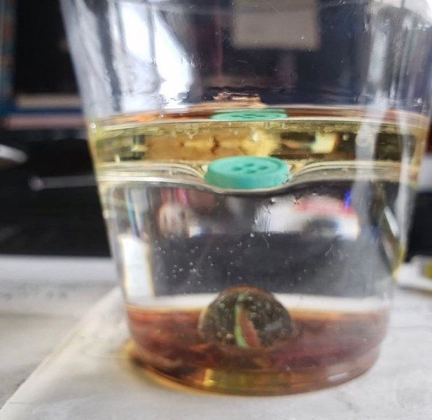
Density

Slide 52
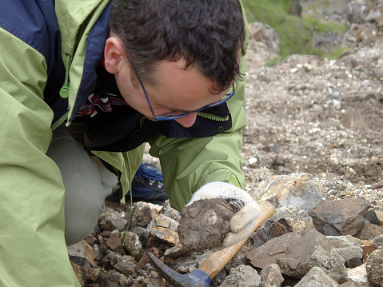
Oil & Gas Careers Round Up

Slide 53
Conservation in the Round
I Have….Who Has…

Slide 54
Visit
energy4me.org
Free Teacher Resource
Classroom Activities
Educational Materials
Lesson Plans
PowerPoint Presentations
Technology Videos
Request a Classroom Speaker
Presented by the Society of Petroleum Engineers

Slide 55
Free Lesson Plans
Download lesson plans that correspond to the book
Hands-on experiments Age-appropriate curriculum Aligned to U.S. educational standards
Presented by the Society of Petroleum Engineers

Slide 56
Classroom Speakers
Request an industry professional to visit your classroom
Classroom presentations Science fair judging Student mentoring (Available in areas with SPE members)
Presented by the Society of Petroleum Engineers

Slide 57
Energy4me.org Classroom Resources
Factual, educational resources on all energy sources
Technology videos Classroom activities PowerPoint presentations
Presented by the Society of Petroleum Engineers

Slide 58
A Big Thank You to ConocoPhillips
www.conocophillips.com

Slide 59
That’s a wrap!
We’re so glad you participated today!
Please click the links for the post test and evaluation in the chat and complete both of them before you leave us today. We’ll need these completed for you to receive your energy kit.
Watch for a follow-up email with hyperlinked agenda, order form details, and if applicable, sub reimbursement/stipend info.
Thank you for attending!!

