Slide 1
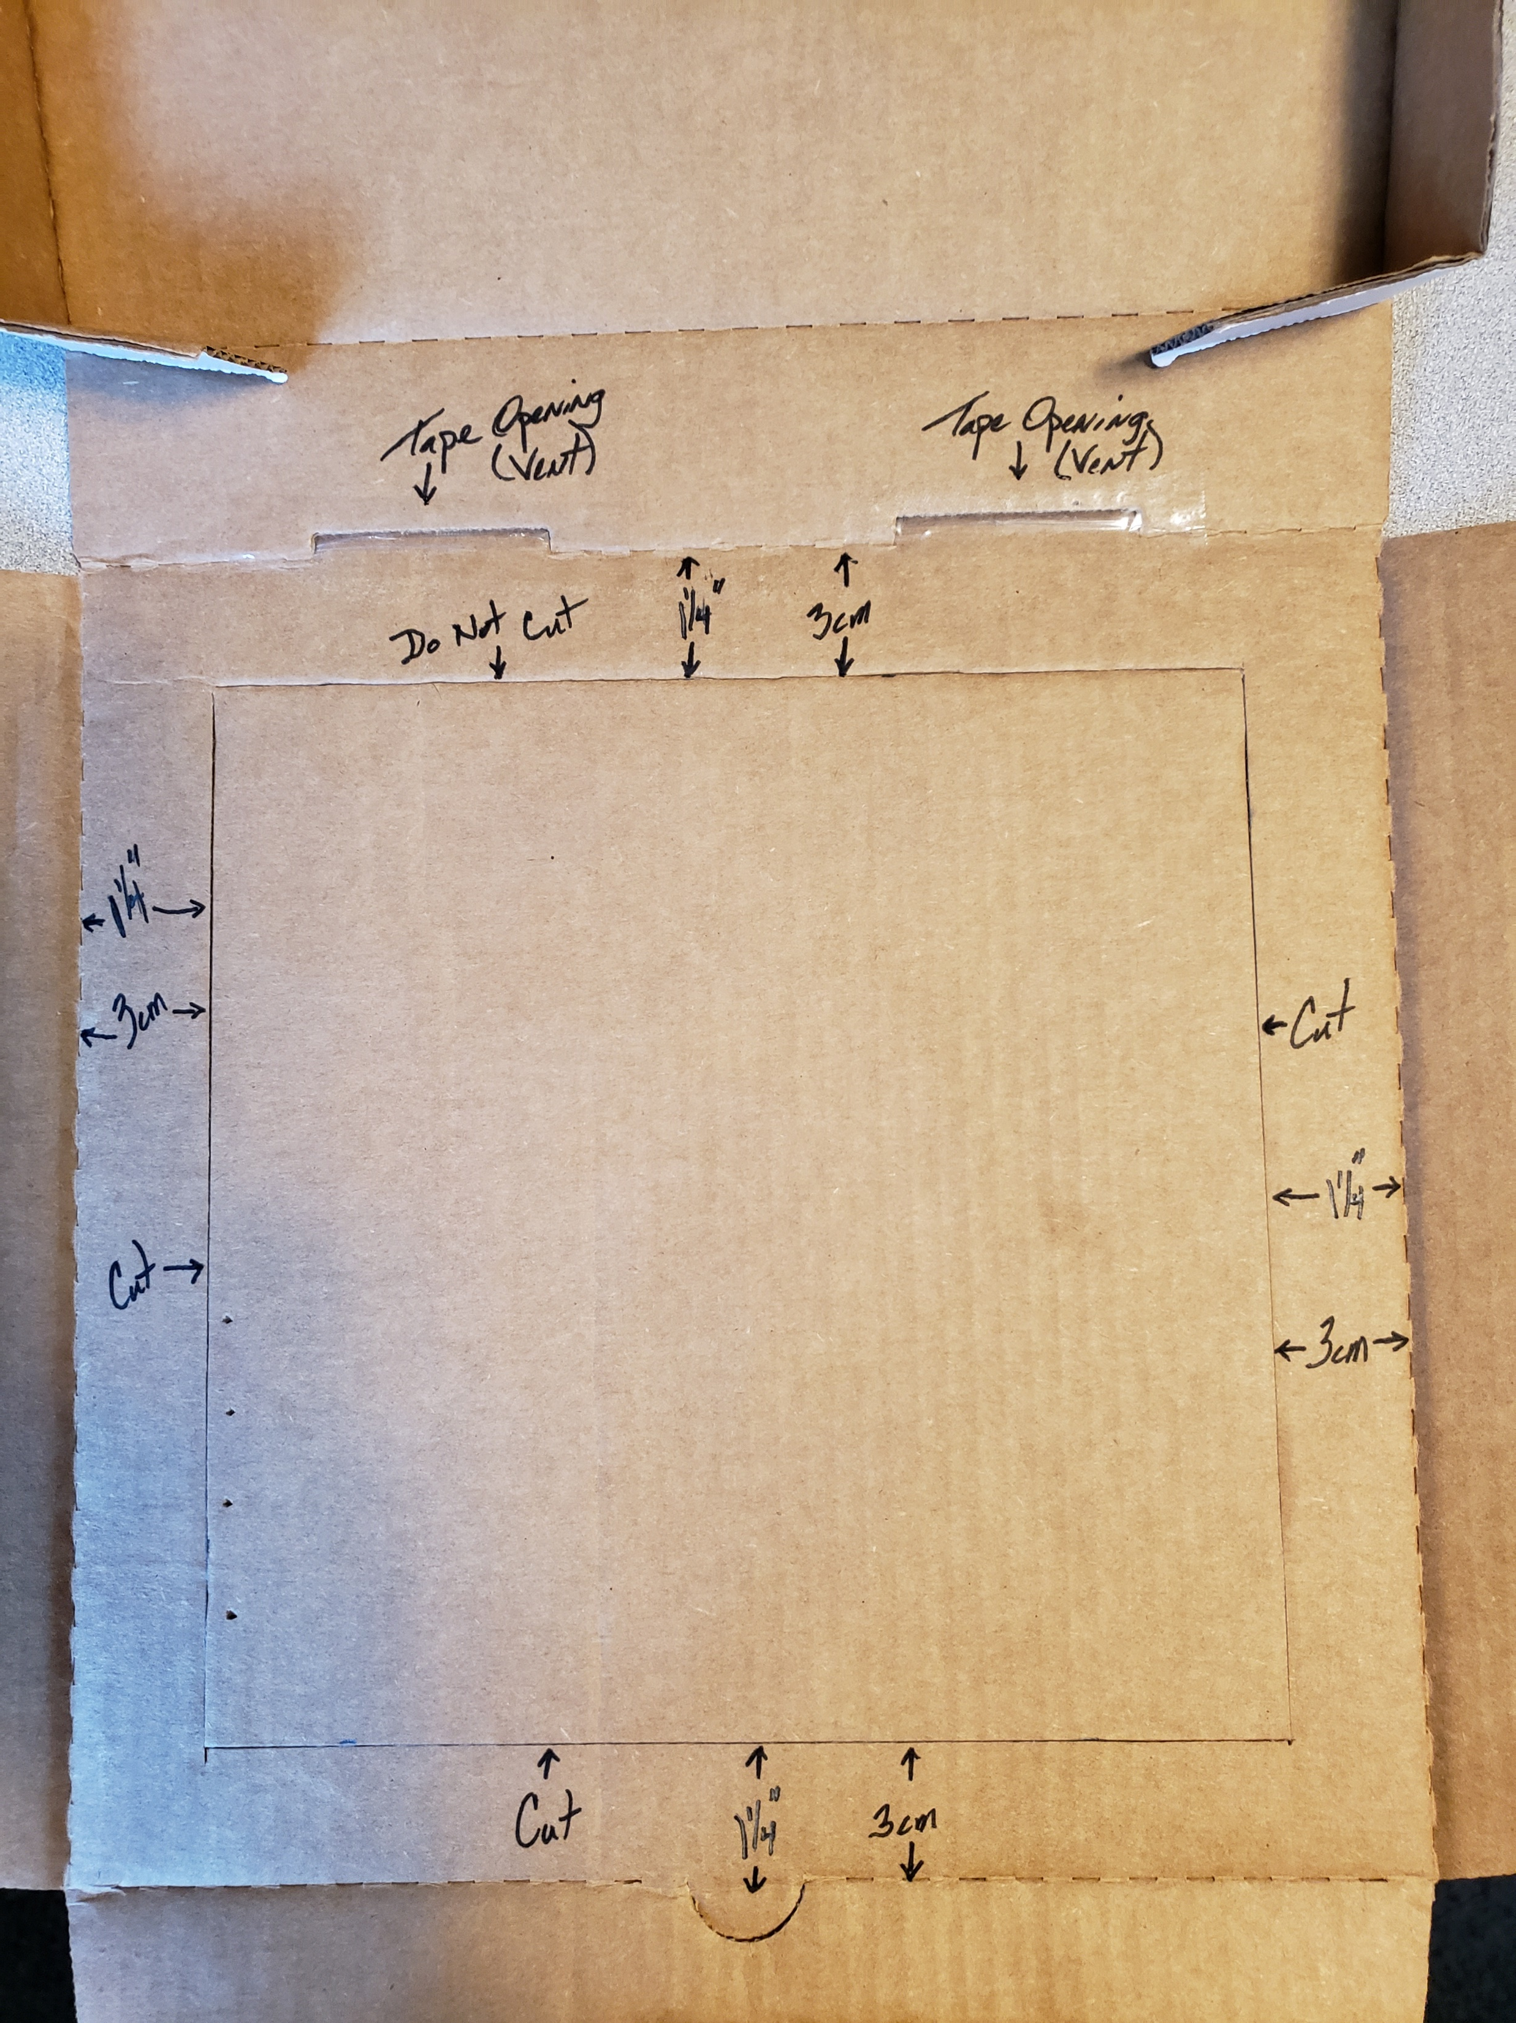
Inside portion of the lid.

Slide 2
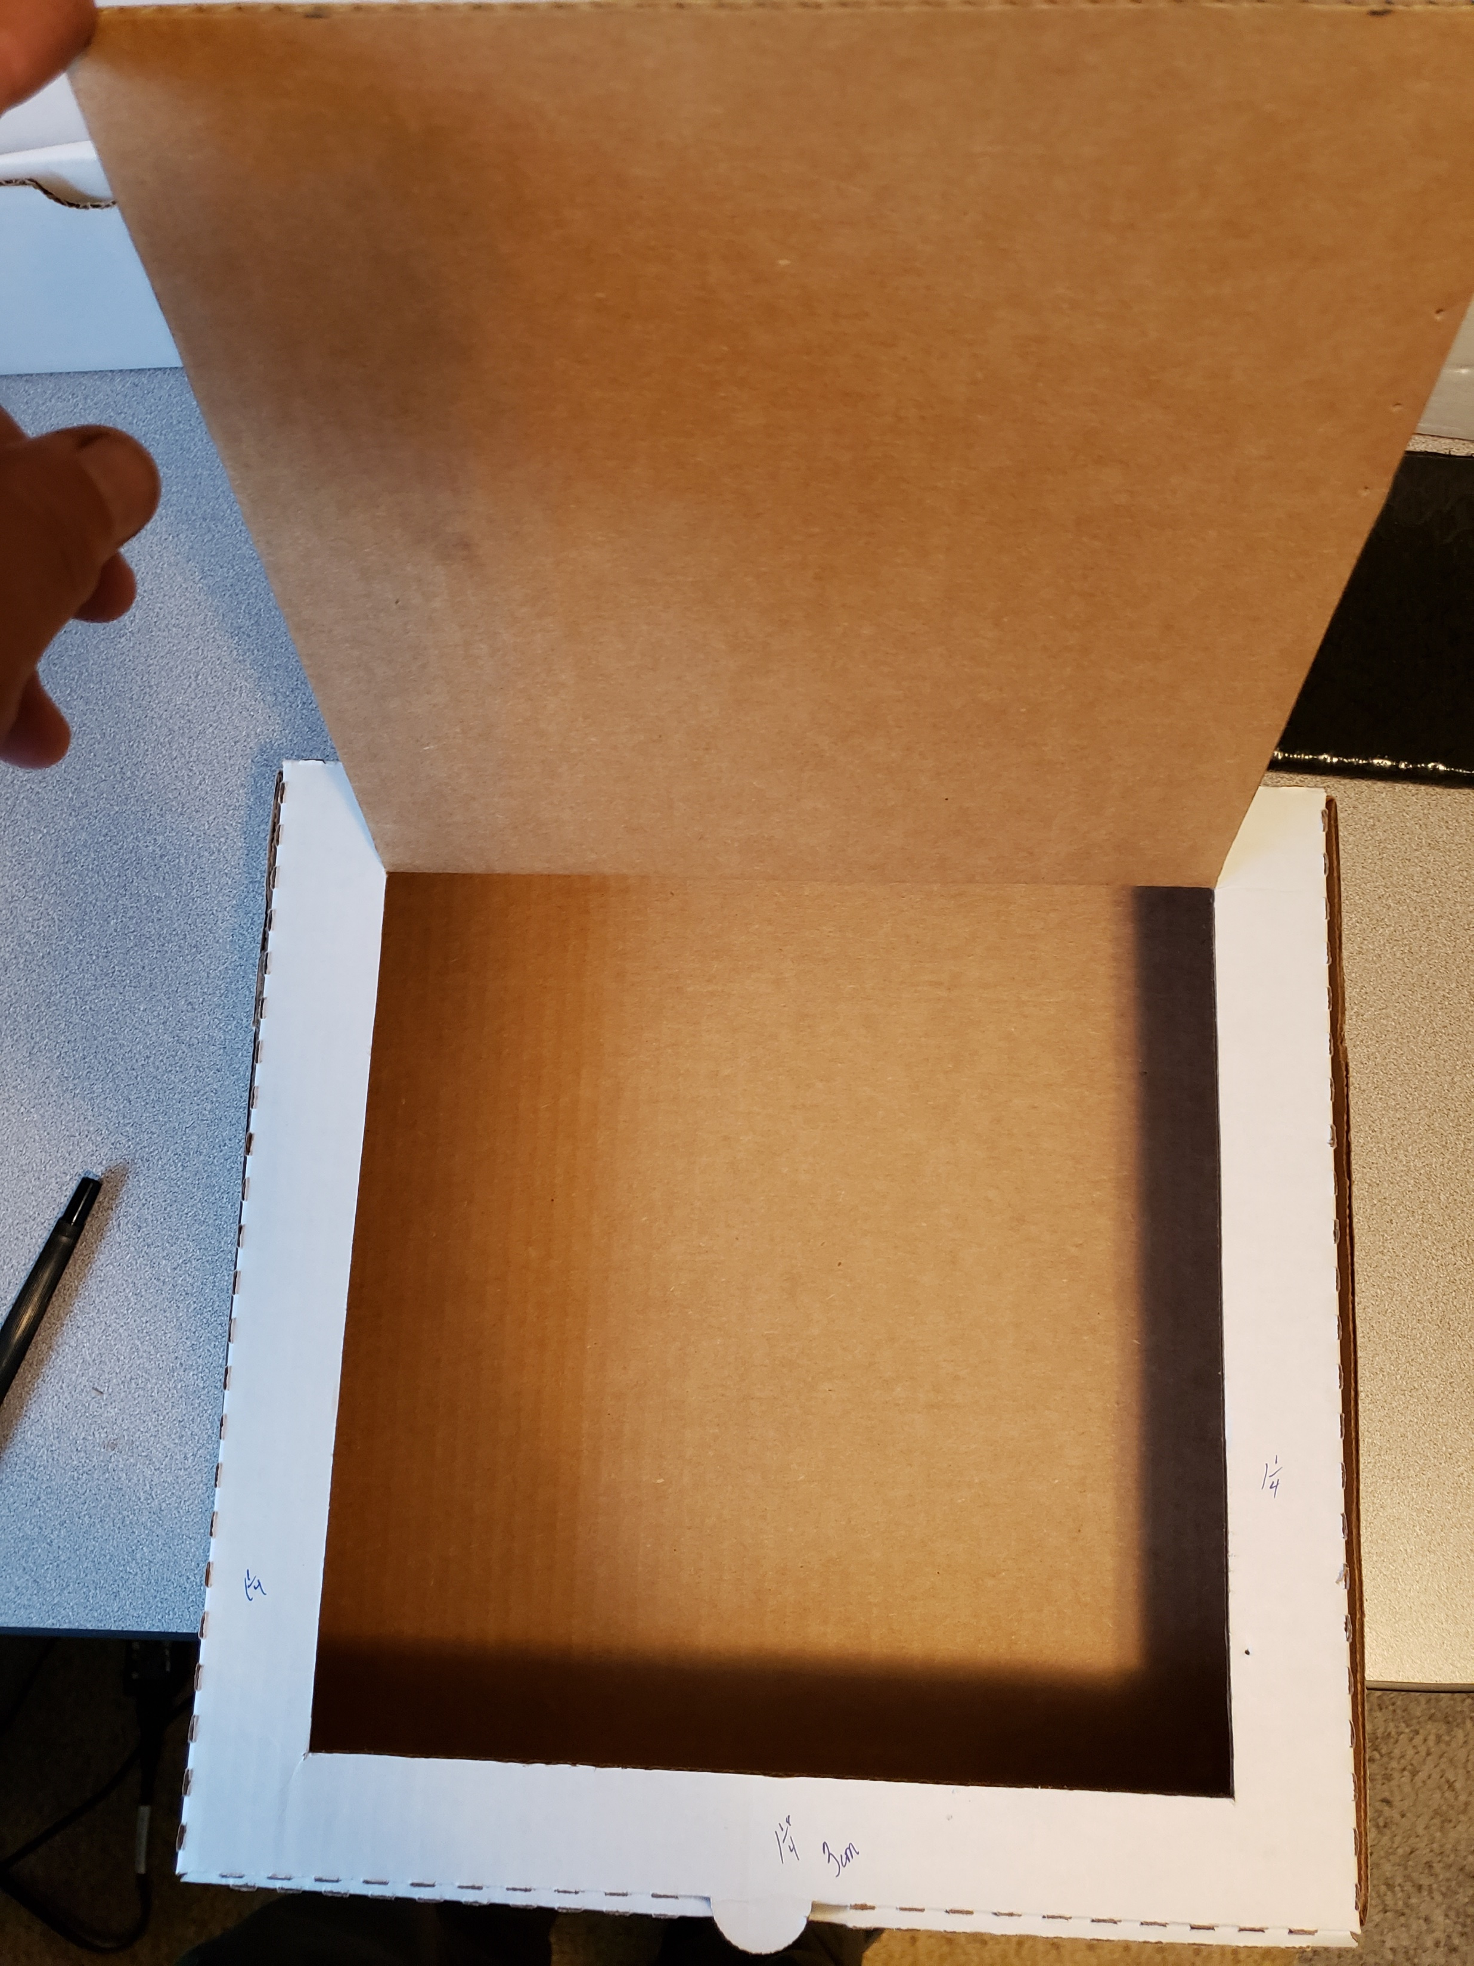

Slide 3
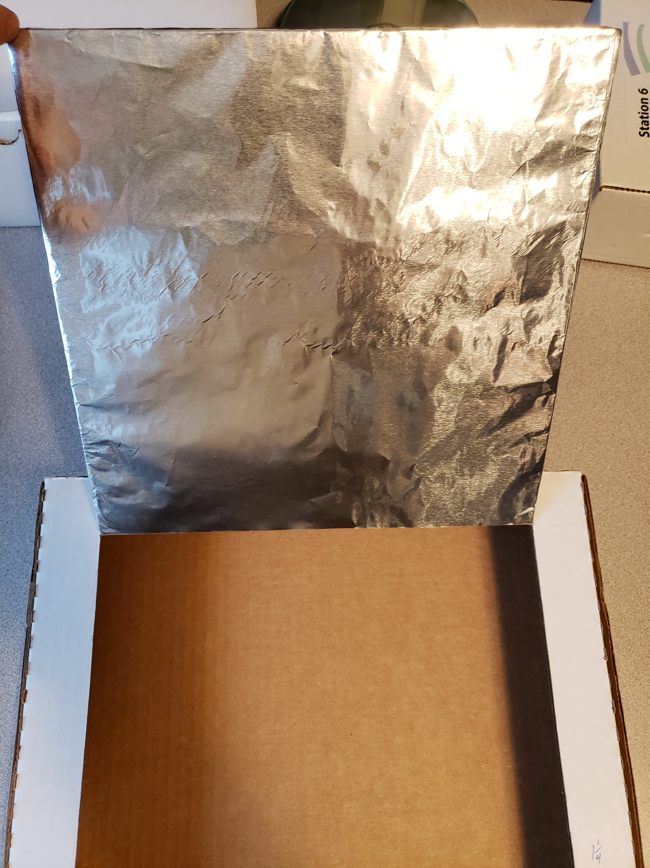

Slide 4
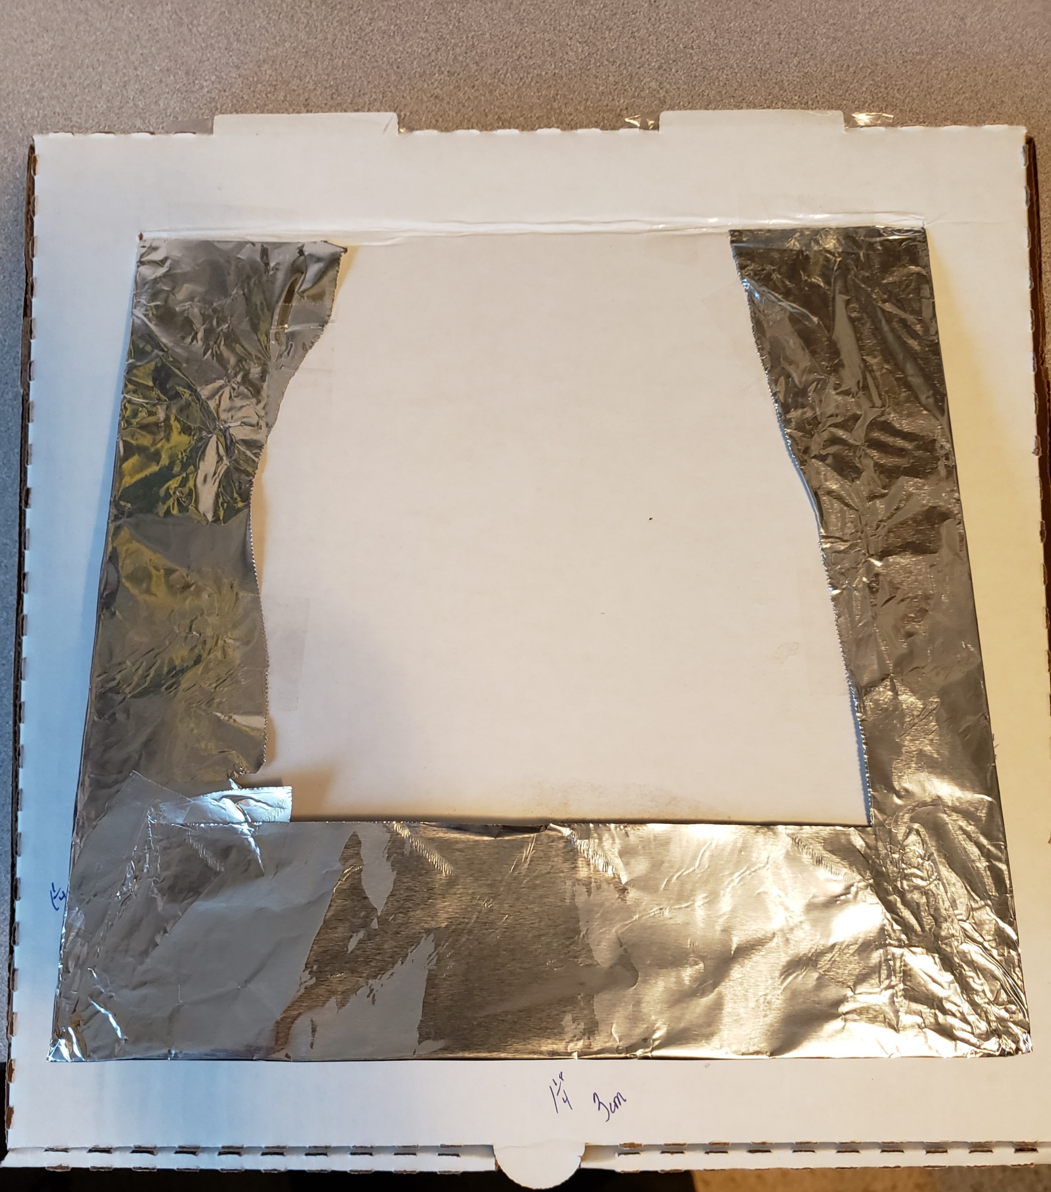
Tape aluminum foil.

Slide 5
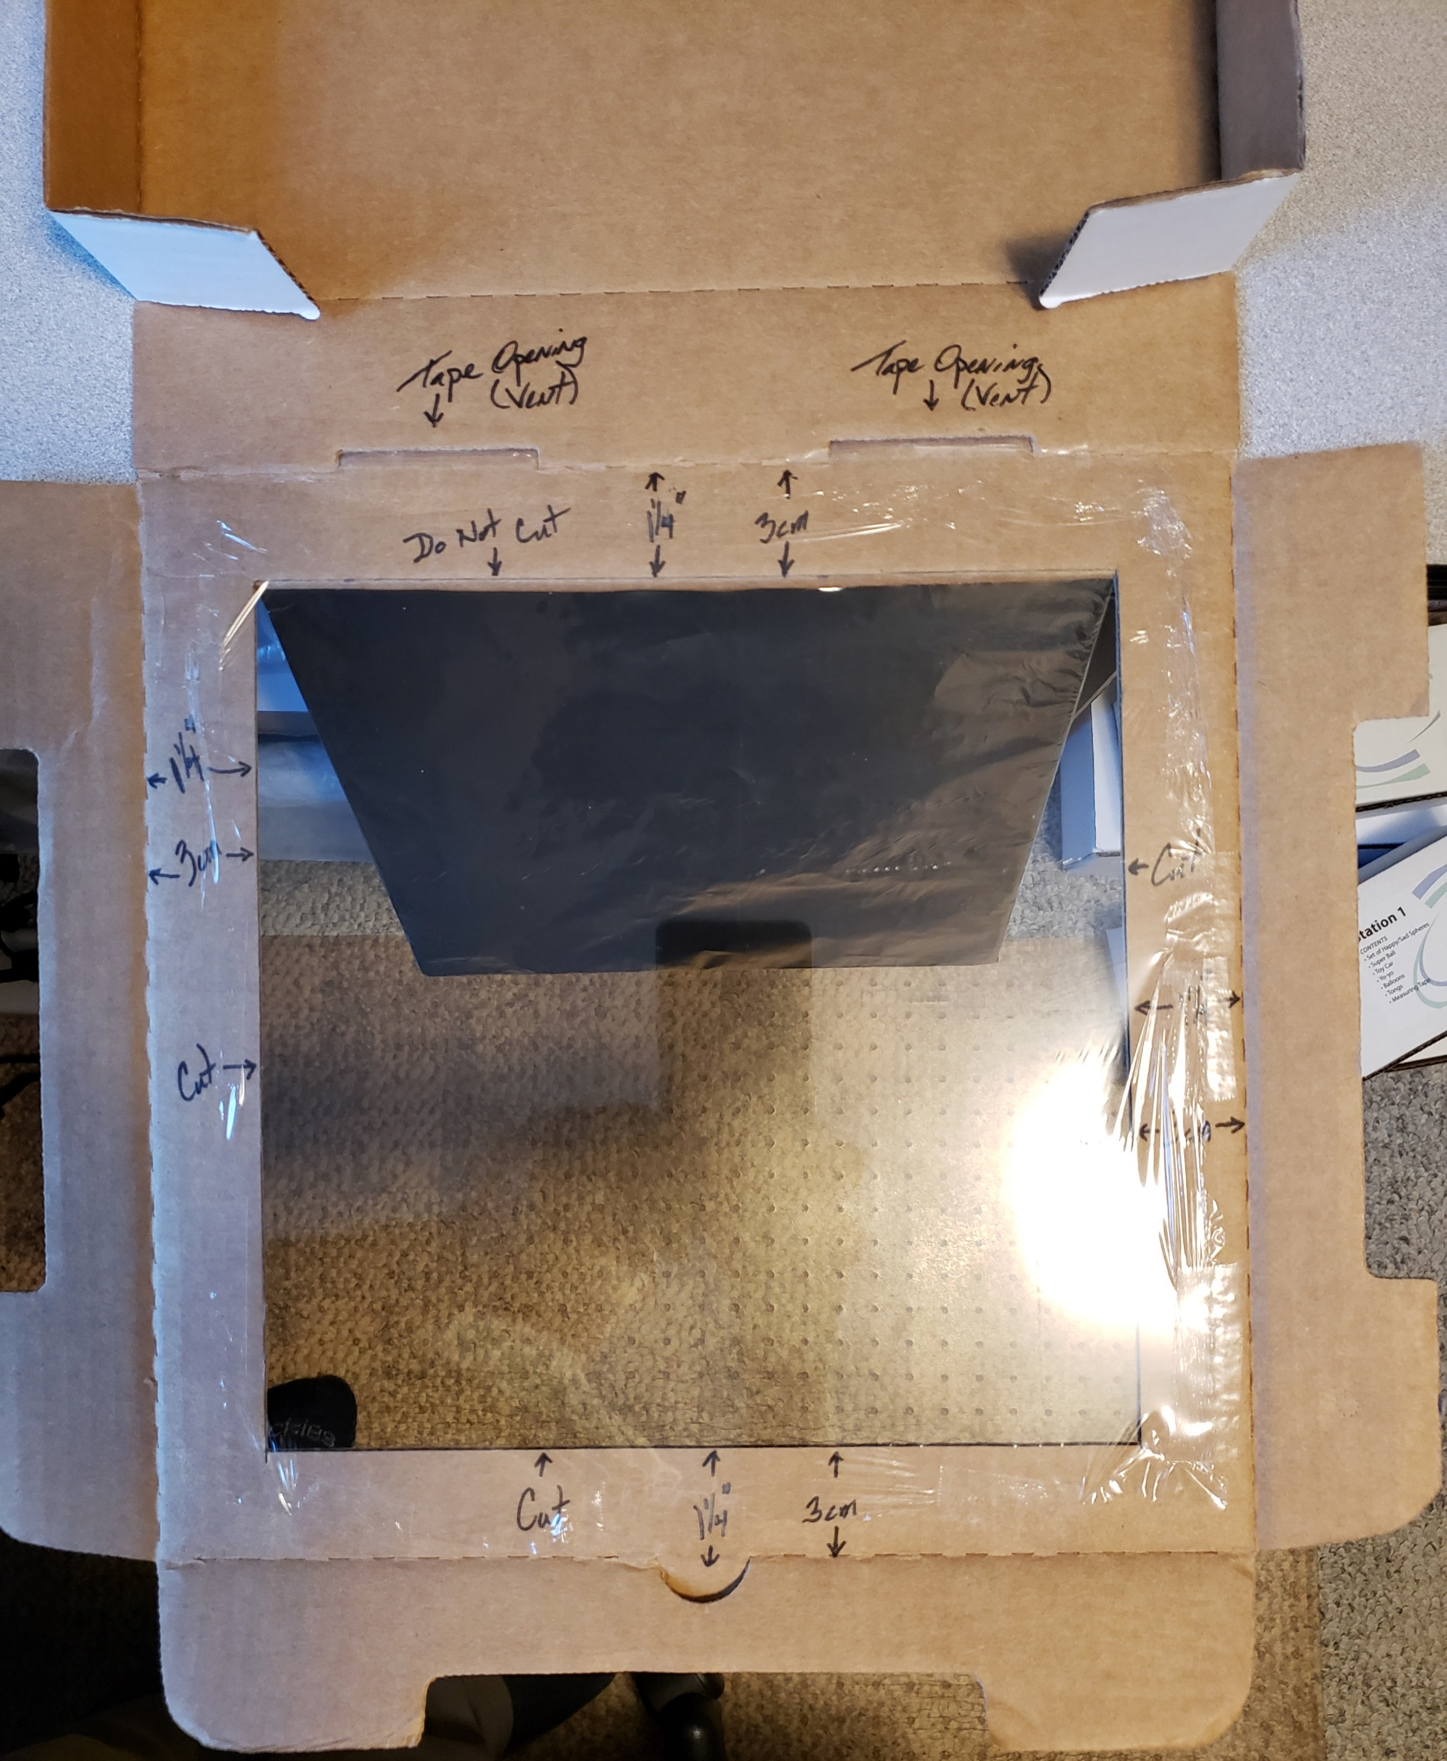
Tape saran wrap to the inside of the lid.

Slide 6
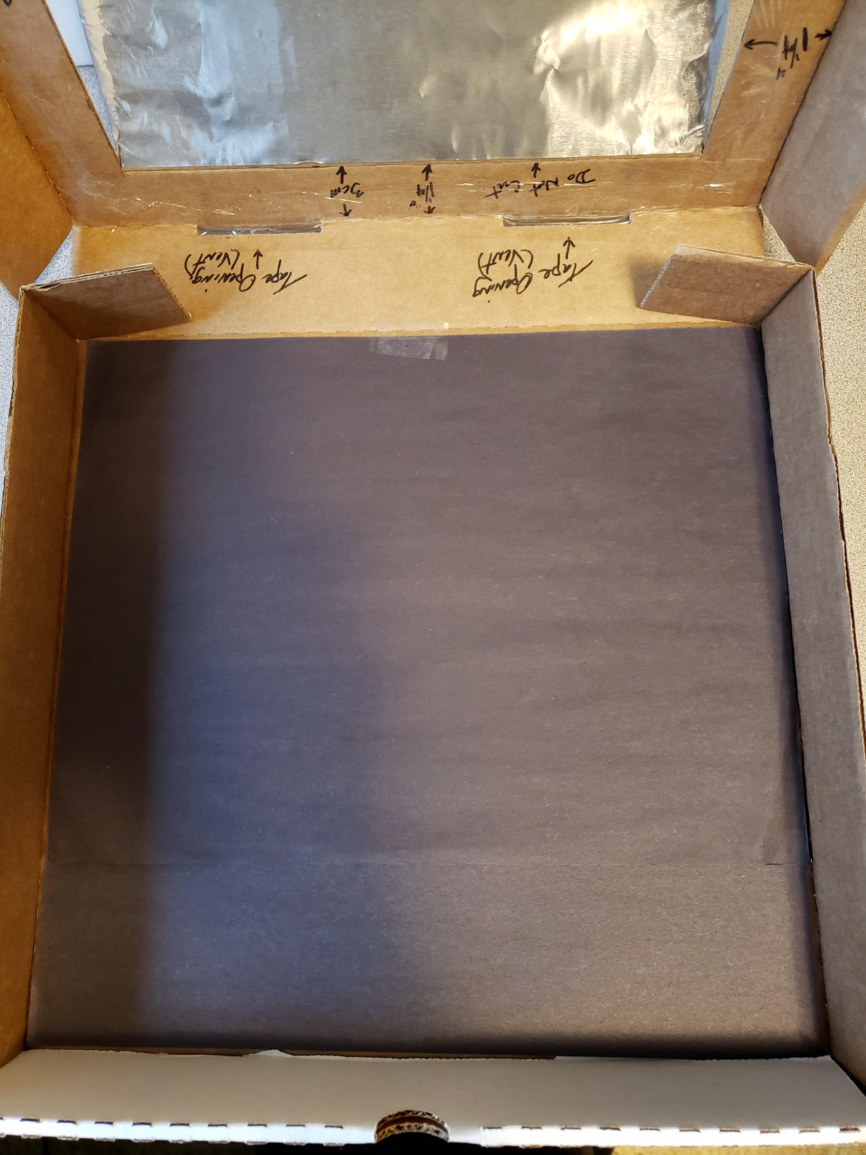
Tape 2 sheets of black paper to inside bottom.

Slide 7
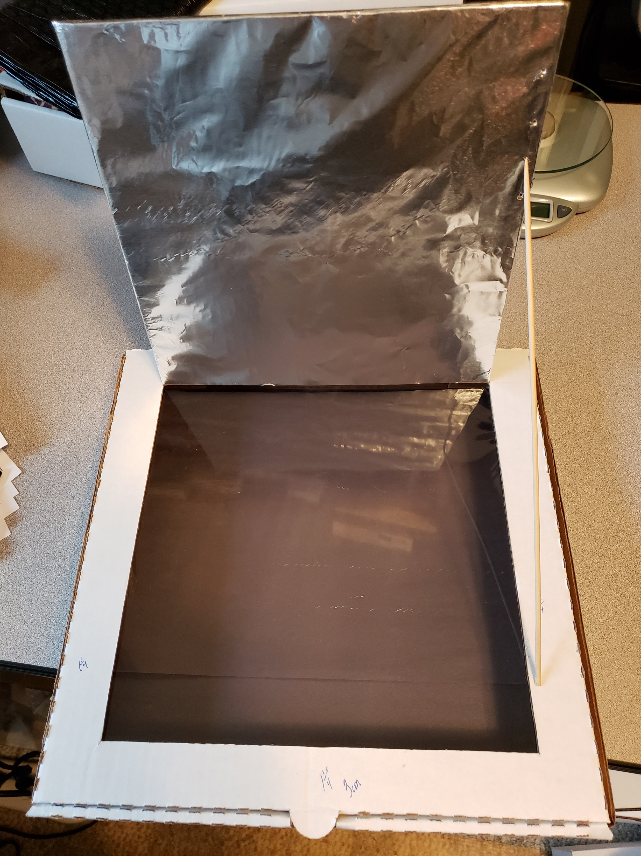
Poke holes using skewer about 1 inch apart. Enlarge using the point of a scissors.
Poke a hole about 1½ inches from edge of cutout.

