Slide 1
Exploring Solar Energy

Slide 2
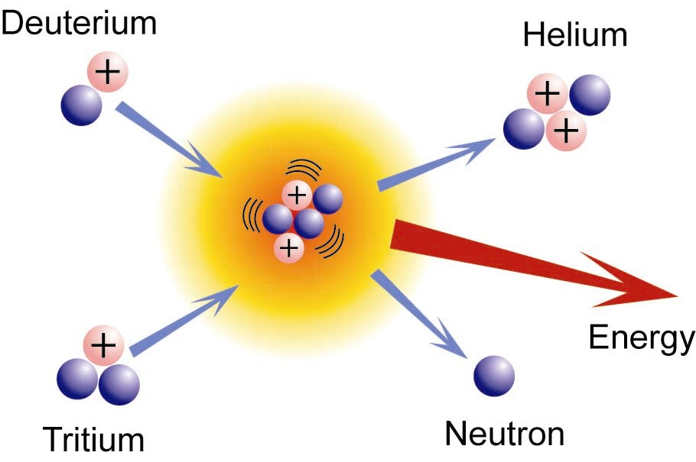
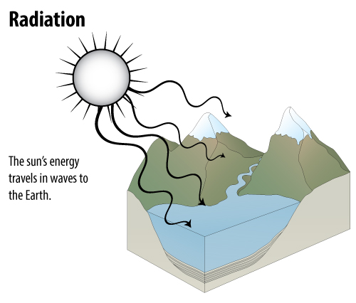
Radiant Energy
Nuclear Fusion

Slide 3
Major Uses of Solar Energy
Daylight
Drying Agricultural Products
Space Heating
Water Heating
Generating Electrical Power
Concentrating Solar Power (CSP)
Photovoltaics

Slide 4
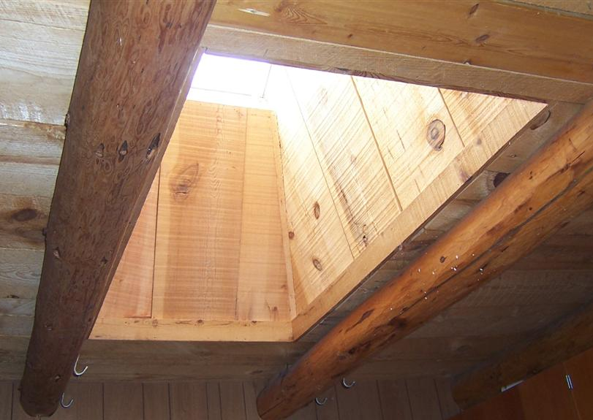
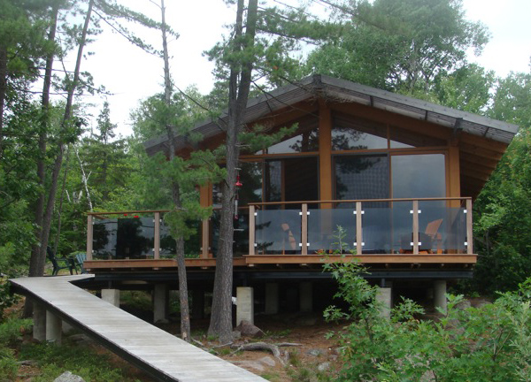
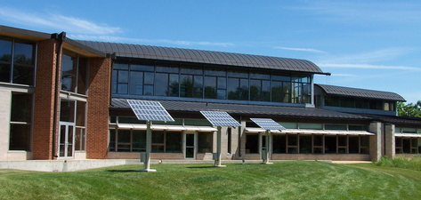

Slide 5
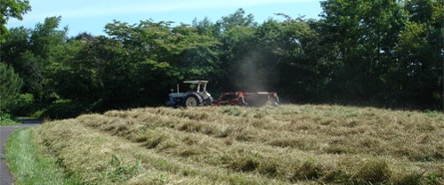
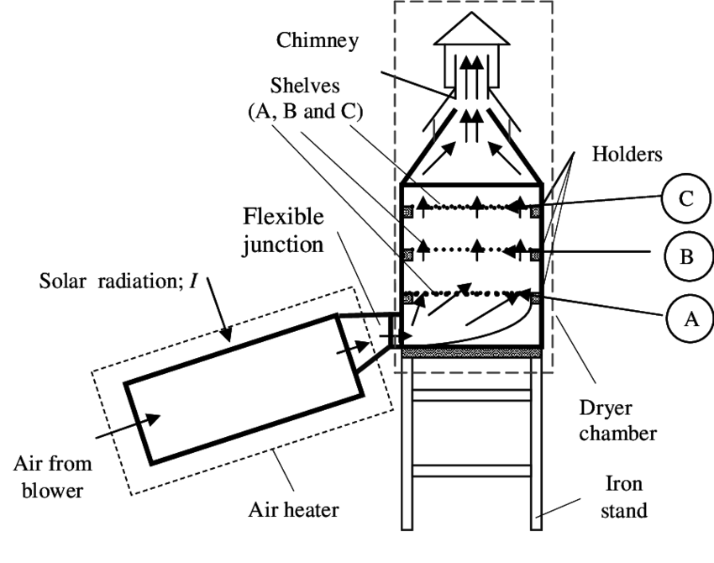
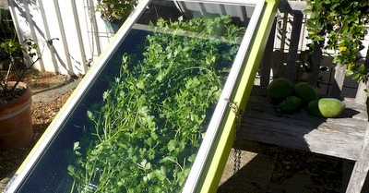
Drying Agricultural Products
Source: Thermal Science, 2014

Slide 6
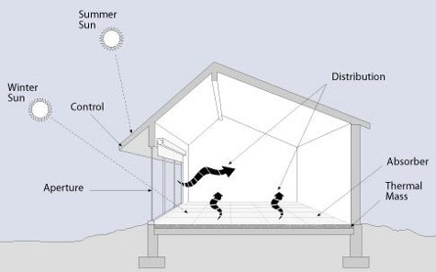
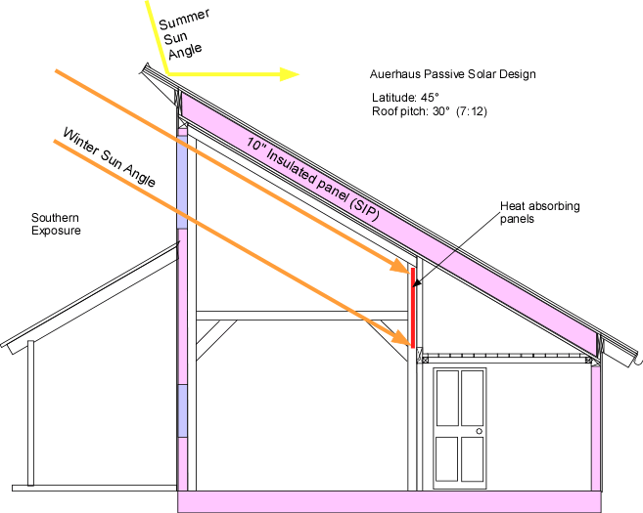
Space Heating Through Passive Solar

Slide 7
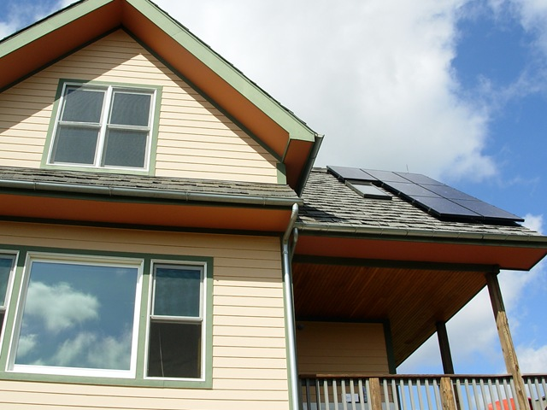
Active Solar Heating

Slide 8
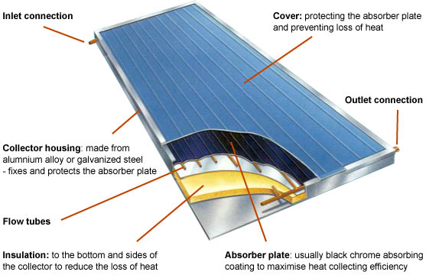
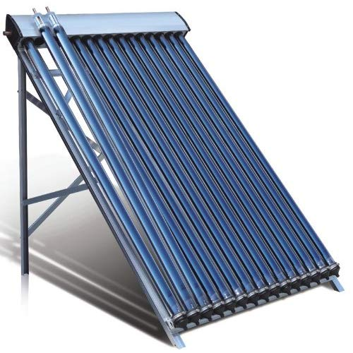
Solar Collector
Glass on outside
Absorbent on inside
Circulating Fluid
© 2019 GreenSpec

Slide 9
Generating Electrical Power
Concentrating Solar Power (CSP)
Trough systems
Power towers
Heat exchanger plus steam turbine
Photovoltaics
Small-scale (buildings) kW production
Large-scale (utilities) MW production
Photoelectric effect

Slide 10
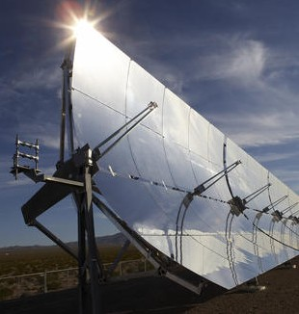
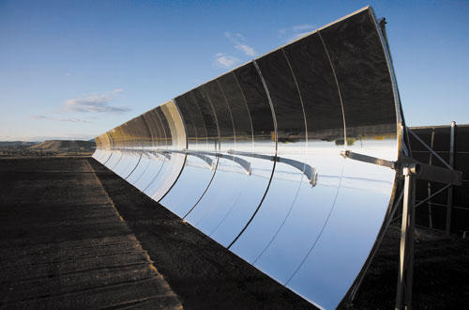
Concentrating Solar Power (CSP)

Slide 11
Ivanpah, Mojave Desert
The United States houses the largest CSP plant in the Mojave Desert.
Ivanpah is operated by NRG. It uses 347,000 garage door-sized mirrors and 173,500 heliostats.

Slide 12
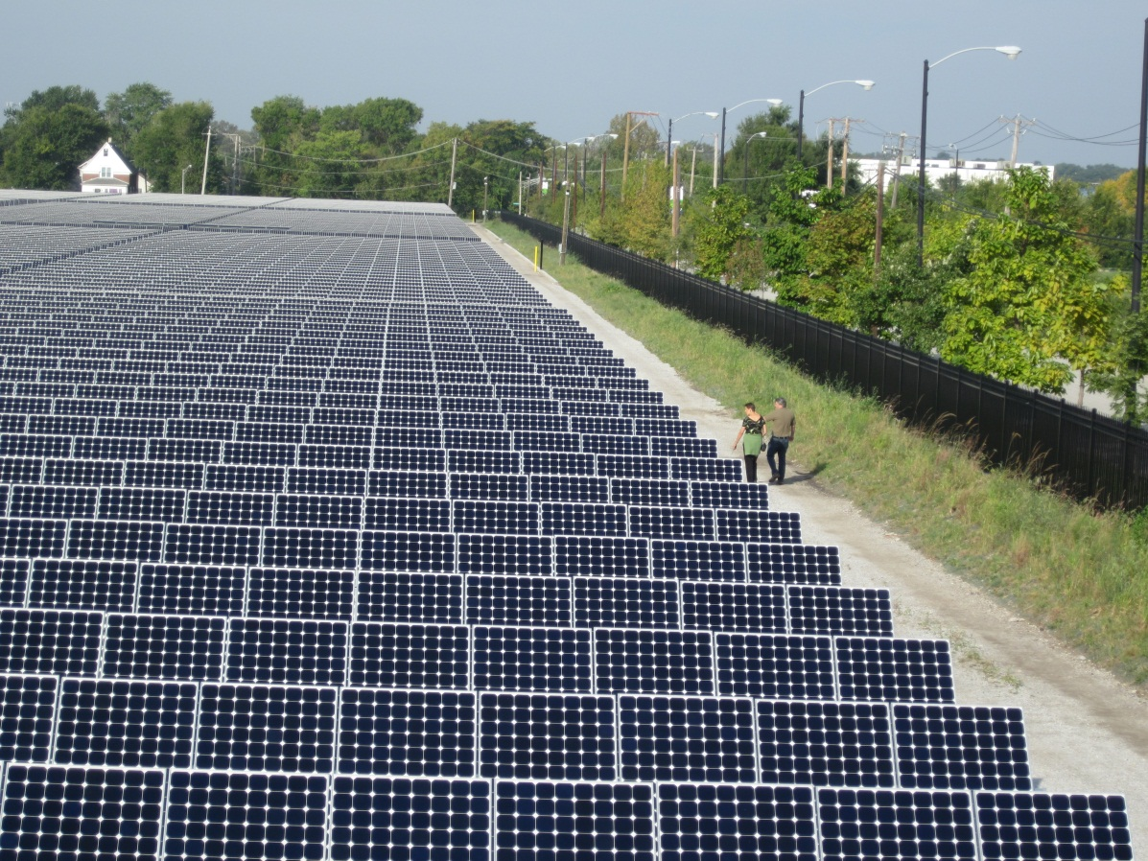
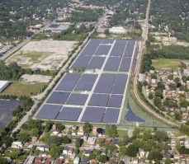
Photovoltaics

Slide 13
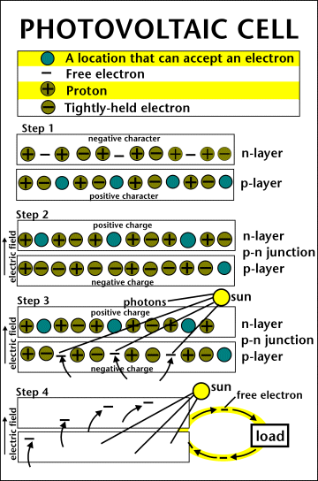
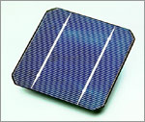
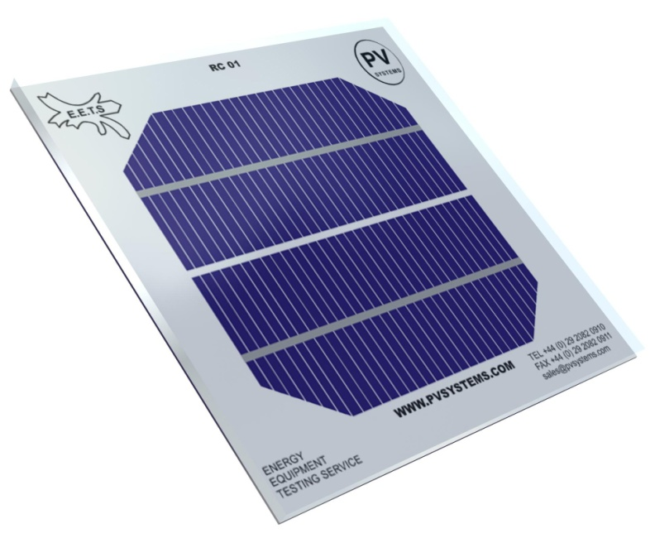
PV Cell

Slide 14
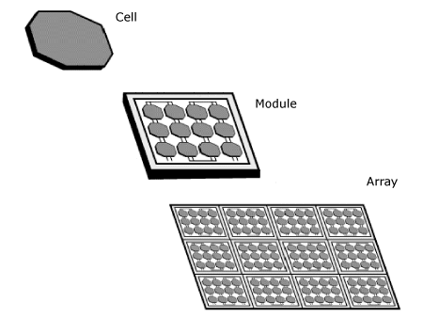
PV Array Components
PV Cells
Modules
Arrays

Slide 15
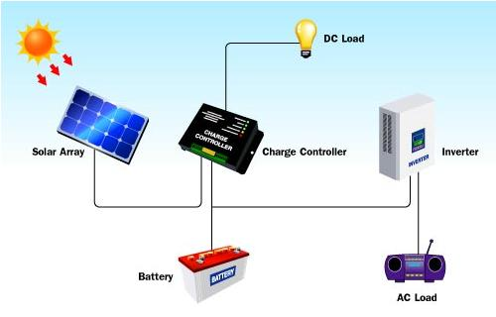
PV System Components

Slide 16
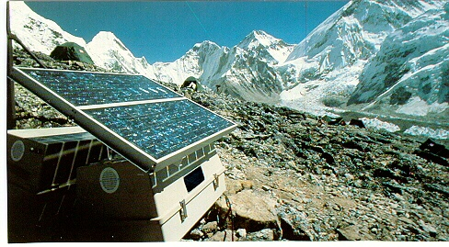
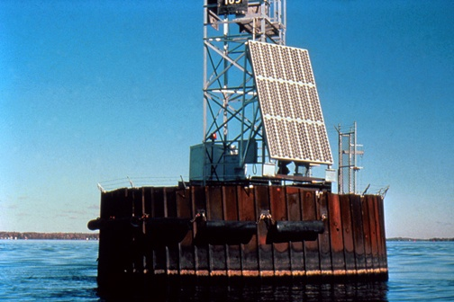
Remote PV Power

Slide 17
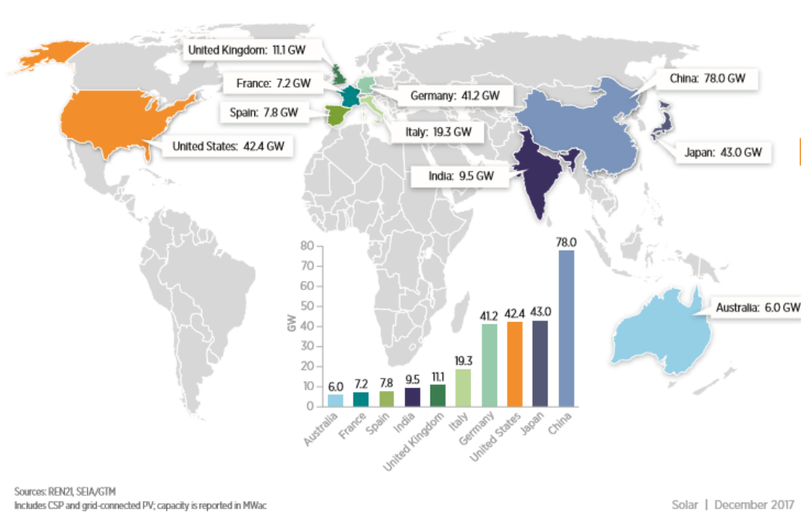
Top Countries for Installed PV Capacity
US Department of Energy, NREL 2016 Renewable Energy Data Book

Slide 18
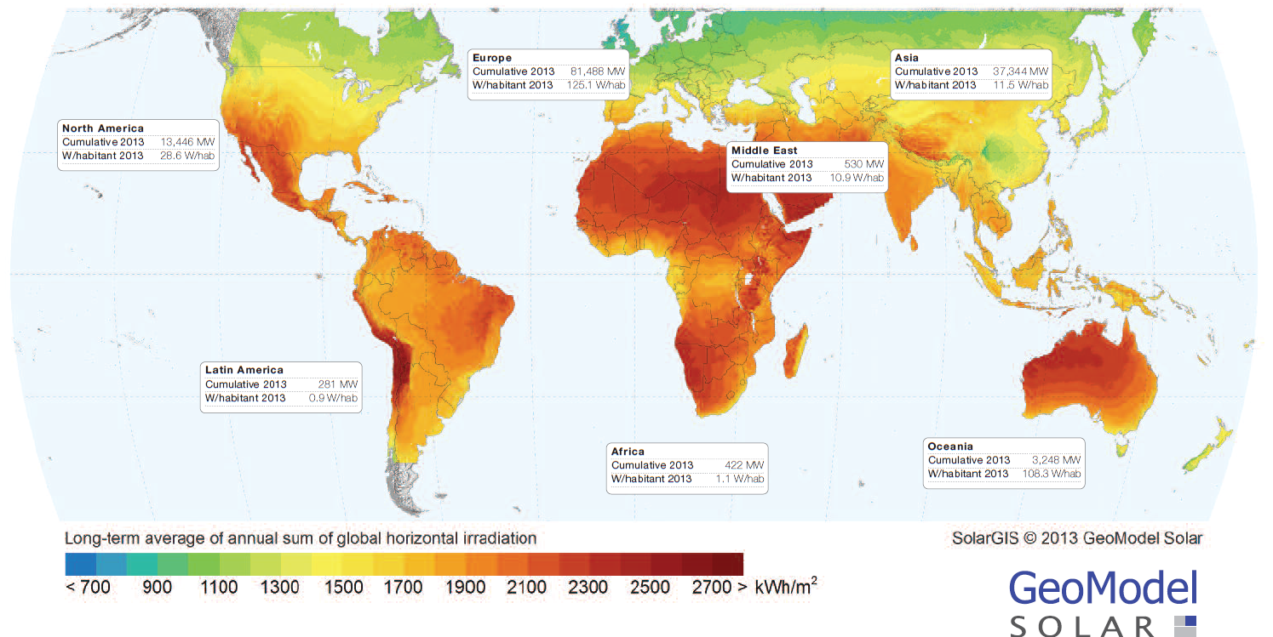
Global Regional PV Installations per Inhabitant
Source: European Photovoltaic Industry Association

Slide 19
Advantages of Solar Energy
Clean
Sustainable
Free
Provide electricity to remote places

Slide 20
Disadvantages of Solar Energy
Less efficient and costly equipment
Part Time
Reliability Depends On Location
Environmental Impact of PV Cell Production

Slide 21
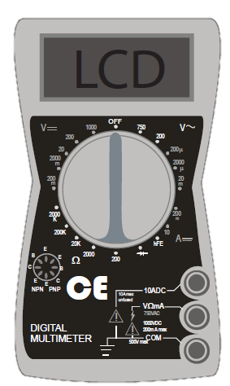
Using a Digital Multimeter
Indicates voltage from alternating current. Do not use.
DC Voltage Scale
DC Current Scale
Resistance Scale. Do not use.

Slide 22
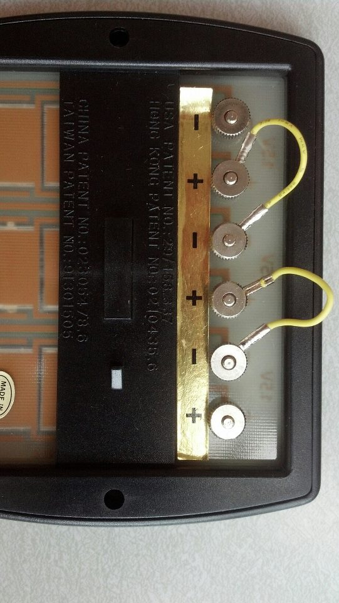
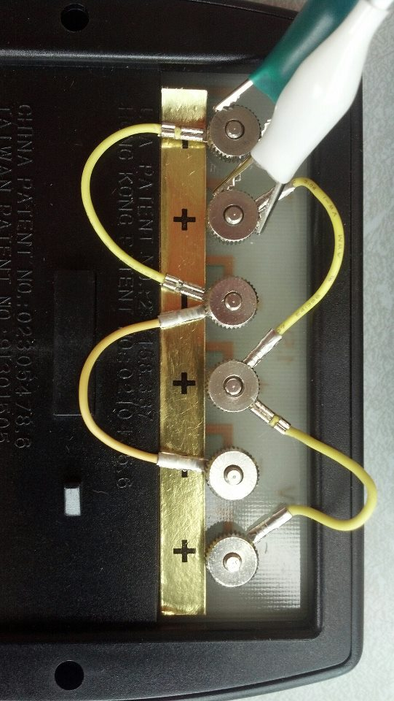
Wiring the PV Modules
Series
Parallel

Slide 23
For More Information
The NEED Project
www.need.org
info@need.org
1-800-875-5029
Energy Information Administration
U.S. Department of Energy
www.eia.gov

