Slide 1
The Science of energy

Slide 2
Teacher Demo
BEFORE
AFTER
CHANGE

Slide 3
Energy
Potential Energy
Stored energy and the energy of position
Kinetic Energy
Motion of waves, electrons, atoms, molecules, and substances

Slide 4
Chemical Energy
Energy stored in the bonds of atoms and molecules
Nuclear Energy
Energy stored in the nucleus of an atom – the energy that holds the nucleus together
Potential Energy
Stored energy and the energy of position
Gravitational Energy
Energy of place or position
Elastic Energy
Energy stored in objects by the application of force.

Slide 5
Radiant Energy
Electromagnetic energy that travels in transverse waves
Thermal Energy
Internal energy in substances – vibration or movement of atoms and molecules in substances
a.k.a. “heat”
Kinetic Energy
Motion of waves, electrons, atoms, molecules, and substances
Sound Energy
Movement of energy through substances in longitudinal waves
Electrical Energy
Movement of electrons
Motion
Movement of substance from one place to another

Slide 6
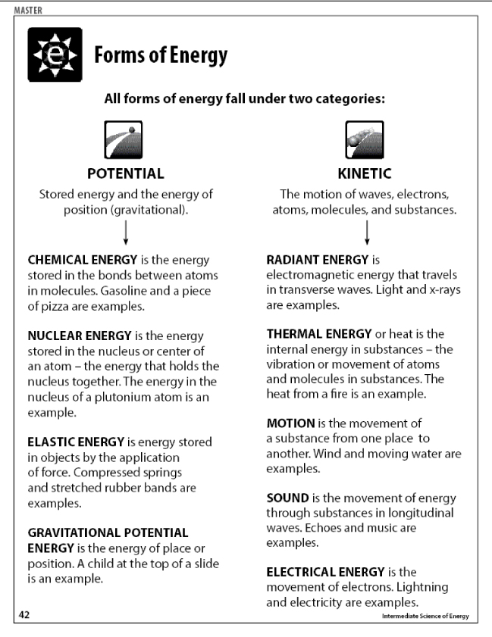

Slide 7
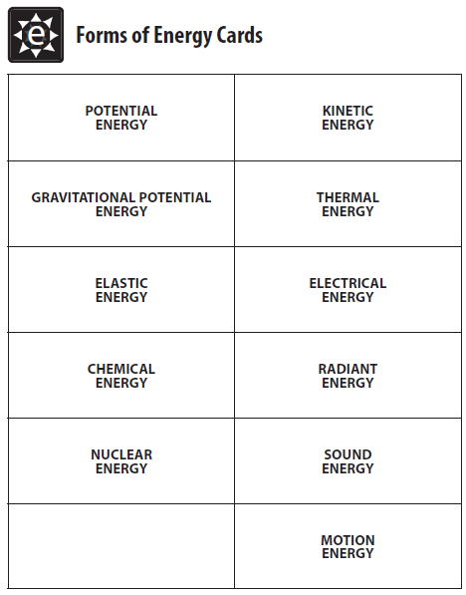
Cut the cards apart; clip them together
Students can use these to help show or work out energy transformations

Slide 9
Turning on the Light in Your Closet
Thermal
Sound
Radiant
Electrical
Motion

Slide 10
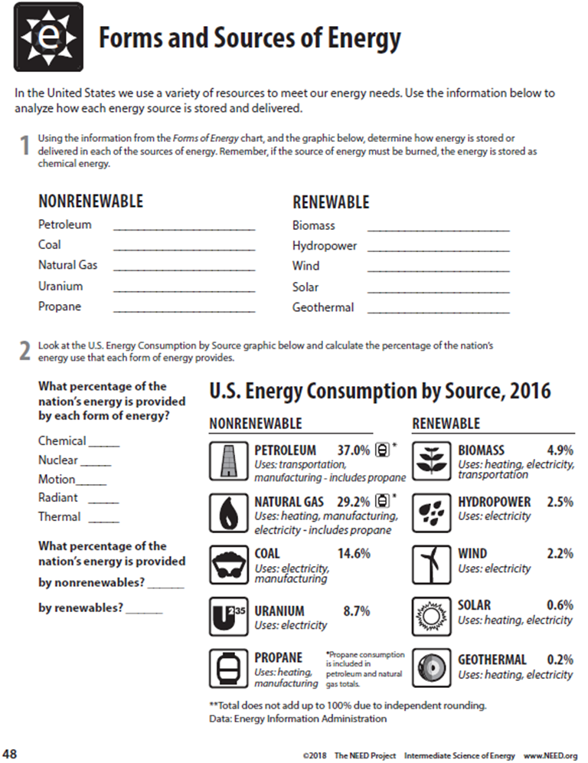
Forms - How Scientists Classify Energy
Sources - Where We Get the Energy To Make Our Lives More Comfortable, Convenient, & Enjoyable

Slide 11
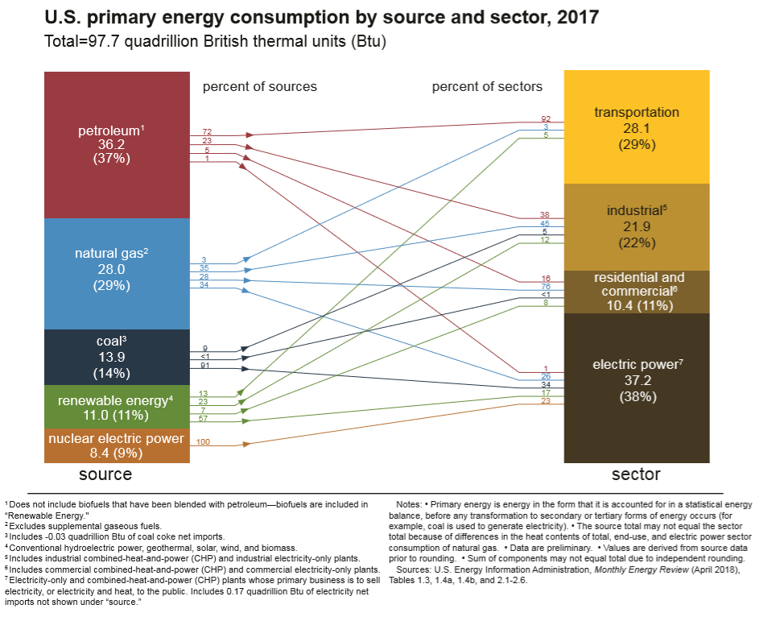

Slide 12
The NEED Project
www.need.org
info@need.org
1-800-875-5029
Energy Information Administration
U.S. Department of Energy
www.eia.gov

