Slide 1
Carbon and the Carbon Cycle

Slide 2
Greenhouse Gases and the Atmosphere
Certain gases in the atmosphere are good at absorbing and trapping heat.
We refer to these as greenhouse gases (GHG).
These gases, make up a small segment of our atmosphere (1%) but have a big impact.
Carbon dioxide (CO₂)
Water vapor (H₂O)
Methane (CH₄)
Nitrous oxide (N₂O)
F-gases (HCFCs, PFCs, and SF₆)
Water Vapor is the most important GHG accounting for 2/3 of all heat trapped by greenhouse gases. But, its levels have remained relatively stable over the years.
The Carbon Cycle 2018 ©The NEED Project

Slide 3
Carbon Dioxide
Carbon Dioxide makes up a very small part of the atmosphere, less than 1%.
Human activity has caused measurable changes in the levels of CO₂ in the atmosphere.
The majority of scientists agree that even small changes have been enough to tip the climate balance.
So let’s explore carbon…
The Carbon Cycle 2018 ©The NEED Project

Slide 4
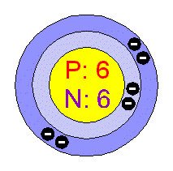
Carbon
Carbon is an abundant element not only on Earth, but also in the sun, stars, comets, and in the atmospheres of other planets.
With four electrons in the outmost energy level, carbon easily bonds with other elements. In fact, there are close to 10 million carbon compounds!
Carbon is a key element in many greenhouse gases such as CO2, methane, and carbon monoxide.
The Carbon Cycle 2018 ©The NEED Project

Slide 5
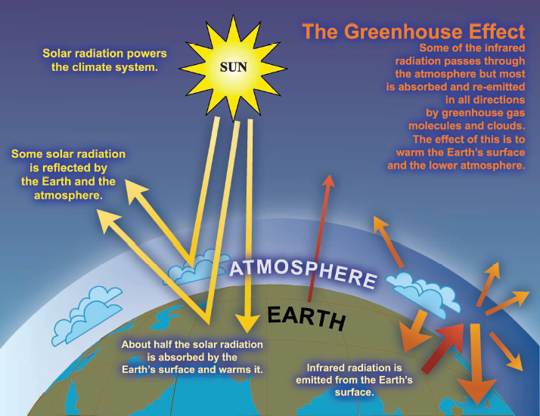
The Greenhouse Effect
Graphic courtesy of IPCC
The Carbon Cycle 2018
©The NEED Project

Slide 6
Carbon Cycle
Carbon cycles between reservoirs or sinks in the Carbon Cycle.
The lithosphere stores the most carbon, some of which is found in fossil fuels. The hydrosphere is the second largest reservoir, followed by the atmosphere, and then the biosphere.
The Carbon Cycle 2018 ©The NEED Project

Slide 7
The Lithosphere
Largest carbon reservoir
Carbon is found primarily in rocks and minerals
Carbon is also found in the form of fossil fuels: petroleum, natural gas, and coal
Prior to the Industrial Revolution carbon left the lithosphere slowly through weathering and volcanism (natural processes)
The Carbon Cycle 2018 ©The NEED Project

Slide 8
The Hydrosphere
Second largest reservoir of carbon
Most of the carbon in this reservoir is found in the world’s oceans, but also in fresh water sources
A subsystem of this reservoir includes marine plants and animals
The Carbon Cycle 2018 ©The NEED Project

Slide 9
The Atmosphere
A smaller amount of carbon is stored in the atmosphere
The only reservoir that exchanges significant amounts of carbon directly with all of the others

Slide 10
The Biosphere
One of the smallest reservoirs
Includes all things that are living, were alive a short time ago, or are derived from living organisms
Carbon in this reservoir is found mainly in the form of carbohydrates and proteins in both living and decaying organisms
The Carbon Cycle 2018 ©The NEED Project

Slide 11
Game Play
Become a carbon atom and see the places you can go!
Each person will be assigned to a reservoir to start.
Fill out the top of your Carbon Tracking Sheet:
Record the round as “pre-industrial revolution” or “present day” based upon teacher instructions.
Record your starting location and read the poster to find out what type of molecule you are and in what item you are found.
Record how many atoms are present in your reservoir.
The Carbon Cycle 2018 ©The NEED Project

Slide 12
Game Play
Become a carbon atom and see the places you can go!
When all at your poster are ready, each atom will draw a card from the stack:
Look at the Reservoir Instruction Sheet on the wall and compare cards. Determine who goes and who stays.
Before moving, record WHERE you are going or if you are staying on your Carbon Tracking Sheet.
When directed, go to your new reservoir or stay put.
The Carbon Cycle 2018 ©The NEED Project

Slide 13
Game Play
Some will travel. Some will never move!
Again, fill out the top of your Carbon Tracking Sheet:
Read the poster to find out what type of molecule you are, in what item you are found, and the process by which you arrived.
Record how many atoms are present in your reservoir.
When all at your poster are ready, each atom will draw a card from the stack:
Look at the Reservoir Instruction Sheet on the wall and compare cards. Determine who goes and who stays.
Before moving, record where you will go, or if you will stay.
Wait for instructions to move.
Repeat for up to 10 rounds.
The Carbon Cycle 2018 ©The NEED Project

Slide 14
For More Information
The NEED Project
www.need.org
info@need.org
1-800-875-5029
Energy Information Administration
U.S. Department of Energy
www.eia.gov
The Carbon Cycle 2018 ©The NEED Project

Slide 15
NEED IS SOCIAL!
Stay up-to-date with NEED. “Like” us on Facebook! Search for The NEED Project, and check out all we’ve got going on!
Follow us on Twitter. We share the latest energy news from around the country, @NEED_Project.
Follow us on Instagram and check out the photos taken at NEED events, instagram.com/theneedproject.
Follow us on Pinterest and pin ideas to use in your classroom, Pinterest.com/NeedProject.
The Carbon Cycle 2018 ©The NEED Project

