Slide 1
Introduction to Climate Change

Slide 2
Four Facts with Respect to Climate Change
Greenhouse gases, including carbon dioxide, decrease thermal energy transfer.
Carbon dioxide levels have increased significantly in the atmosphere since the Industrial Revolution.
Average global temperatures have increased since the Industrial Revolution.
Some predicted effects of climate change are observable today.
Climate Change ©2018 The NEED Project

Slide 3
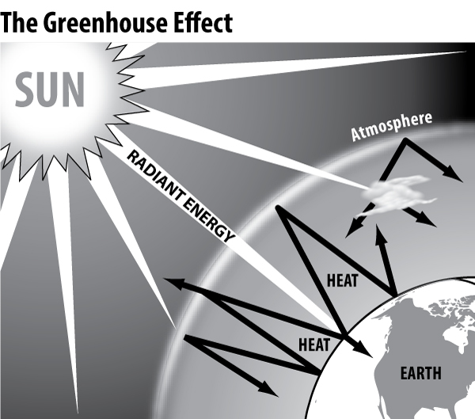
CO₂ and other greenhouse gases slow down thermal energy transfer.
1
A natural greenhouse effect makes life possible on earth
Without some of these greenhouse gases in our atmosphere, the average surface temperature would be about 5ºF/- 15ºC
Climate Change ©2018 The NEED Project

Slide 4
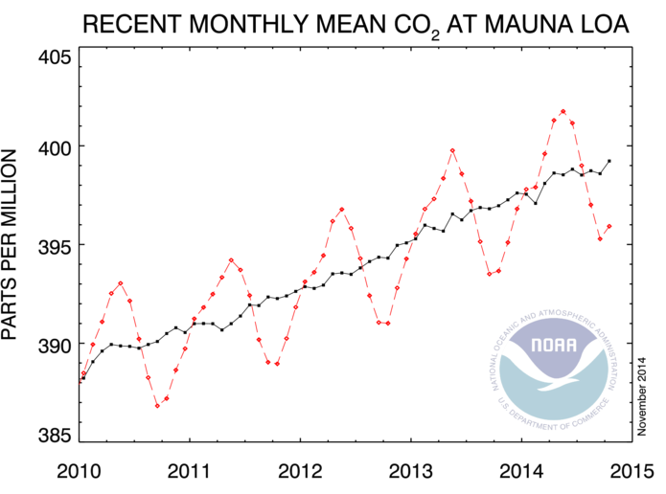
Levels of CO2 have risen substantially since the industrial revolution.
2
National Oceanic & Atmospheric Administration Earth System Research Laboratory Global Monitoring Division
http://www.esrl.noaa.gov/gmd/ccgg/trends/
Climate Change ©2018 The NEED Project

Slide 5
Global temperatures have risen since the Industrial Revolution.
3
Land temperatures have risen an average 1.5°C on land since 1880
The rate of increase in land temperatures since 1979 is double the rate since 1880
Ocean temperatures have risen on average 0.6°C since 1979
Intergovernmental Panel on Climate Change, Fifth Assessment Report, 2013
Climate Change ©2018 The NEED Project

Slide 6
Global Average Temperature and Carbon Dioxide Concentrations, 1744-2013
Climate Change ©2018 The NEED Project

Slide 7
Some predicted effects of climate change are observable today.
4
Sea ice has decreased 3.4 - 4.1% per decade between 1979 and 2012
In 1910 Glacier National Park had almost 150 glaciers; in 2010, that number reduced to 25
Greenland ice sheet lost 34 Gt per year 1992-2001 and lost 215 Gt per year 2002-2011
Increased heat waves since 1950
75 Percent more Category 4 and 5 storms since 1970
Greater drought in Mediterranean and West Africa
Intergovernmental Panel on Climate Change, Fifth Assessment Report, 2013
Climate Change ©2018 The NEED Project

Slide 8
Climate Reports
Some examples of accepted, recognized climate data and reports
Climate Change ©2018 The NEED Project

Slide 9
Climate Reports
Intergovernmental Panel on Climate Change (IPCC)
Fifth Assessment Report:
http://www.ipcc.ch/report/ar5/wg1/
National Oceanic and Atmospheric Administration (NOAA)
Extreme Events web page:​
https://www.ncdc.noaa.gov/climate-information/extreme-events
Other NOAA Science Papers and Publications:​
https://www.ncdc.noaa.gov/climate-information/science-papers-and-publications
U.S. Global Change Research Program
Global Climate Change Impacts in the US (2009):
http://www.globalchange.gov/what-we-do/assessment/previous-assessments/global-climate-change-impacts-in-the-us-2009
Other USGCRP Reports:
http://www.globalchange.gov/publications/reports/scientific-assessments/us-impacts
Climate Change ©2018 The NEED Project

Slide 10
Mitigating Climate Change
Carbon emissions from fossil fuel burning are projected to double in the next 50 years.
-more than tripling of atmospheric CO₂ since pre-industrial time.
This slide and the following slides use information provided by the Princeton University Climate Mitigation Initiative (CMI)
Climate Change ©2018 The NEED Project

Slide 11
So What’s the Problem?
CO₂ Emissions
Energy Demand
:2
x2
-
Energy demand to double worldwide by 2050
Need to cut CO₂ emissions in half by 2050
Climate Change ©2018 The NEED Project

Slide 12
Mitigating Climate Change
To provide long-term climate stability, many environmental scientists recommend stabilizing CO₂ concentrations at 450-500 ppm.
Climate Change ©2018 The NEED Project

Slide 13
CO₂ Concentrations
2100 (current trend)
750 ppm
Forecast Threshold
500 ppm
Present
390 ppm
Pre-industrial
280 ppm
Climate Change ©2018 The NEED Project

Slide 14
500 ppm CO₂
To reach this goal over the next 50 years, it is necessary to keep our future emissions at today’s levels….
…To maintain this level, further emissions reductions are required after 2060.
Climate Change ©2018 The NEED Project

Slide 15
Mitigating Climate Change
Stabilizing emissions over the next 50 years will require trimming projected carbon output by roughly 8 billion tons per year by 2060.
This will prevent a total of ~175 billion tons of carbon from entering the atmosphere.
Climate Change ©2018 The NEED Project

Slide 16
The Wedge Challenge
T
E
H
B
Climate Change ©2018 The NEED Project

Slide 17
Four Kinds of Wedges
“E” - Electricity
“T” – Transportation
“H” – Heat
“B” - Biostorage
LIMITS
Assumptions and Calculations for all Wedges can be found at http://cmi.princeton.edu/wedges/calculations.php
Climate Change ©2018 The NEED Project

Slide 18
A “wedge” is any strategy that eliminates 1 billion tons of CO₂ emissions per year.
An example is doubling
the current average
fuel economy
of our cars.
14
16 GtC/y
Currently projected path
7
Historical
emissions
O
8 GtC/y
Flat path
1.9 →
0
1955
2010
2060
2105

Slide 19
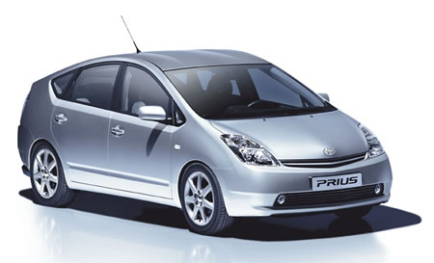
Transportation Efficiency
T
A wedge would be achieved if we…
Double the efficiency of all cars in 2060 from 30 mpg to 60 mpg.
Climate Change ©2018 The NEED Project

Slide 20
Transportation Conservation
T
A wedge would be achieved if we…
Halve the number of miles driven by the world’s cars by 2060.
Climate Change ©2018 The NEED Project

Slide 21
Efficiency in Buildings
E
H
A wedge would be achieved if we…
Cut total building carbon emissions by 25% by 2060.
Climate Change ©2018 The NEED Project

Slide 22
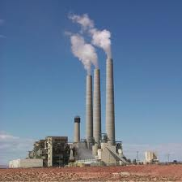
Electricity Generation Efficiency
E
A wedge would be achieved if we…
Double the efficiency (using today’s average) of all coal-fired power plants by 2060.
Climate Change ©2018 The NEED Project

Slide 23
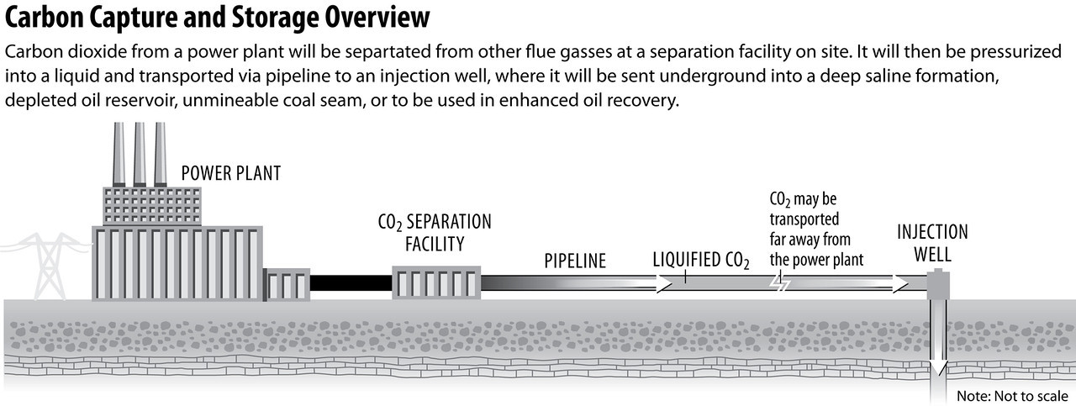
CCS with Coal or Natural Gas Electricity
E
A wedge would be achieved if we…
Apply CCS to 800 large coal or 1,600 large natural gas power plants.
Climate Change ©2018 The NEED Project

Slide 24
Hydrogen Fuel Cell Applications
Climate Change ©2018 The NEED Project

Slide 25
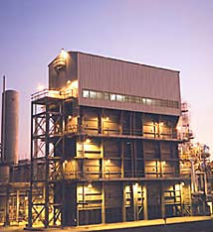
Hydrogen Production from Natural Gas
Steam Methane Reforming (SMR)Process
Gas is pressurized to about 360 psi
Steam at 850ºC is added
The mixture is passed over a catalyst, such as nickel
CH₄ + H₂0 (steam) H₂ + CO + CO₂
Climate Change ©2018 The NEED Project

Slide 26
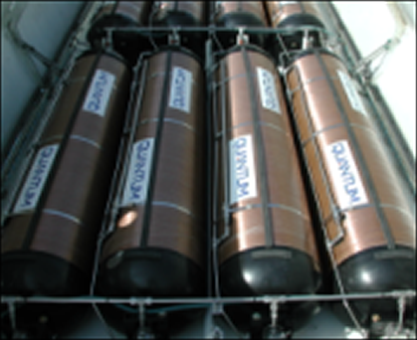
CCUS with Hydrogen from Natural Gas
T
H
A wedge would be achieved if we…
By 2060, we increase the production of hydrogen by 10 times and apply CCUS during production.
Climate Change ©2018 The NEED Project

Slide 27
What are Synfuels?
Coal is heated and combined with steam and oxygen
Carbon monoxide and hydrogen are released and can be processed to make a liquid fuel
Allows use of a domestic resource to fuel gasoline and diesel vehicles
Coal-based synfuels create 2x the CO2 emissions of petroleum-based fuels
Climate Change ©2018 The NEED Project

Slide 28
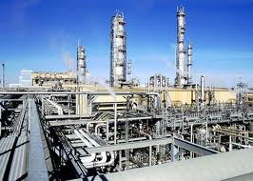
CCS Synfuels
T
H
A wedge would be achieved if we…
Capture the carbon emissions from 180 large synfuel plants by 2060.
Climate Change ©2018 The NEED Project

Slide 29
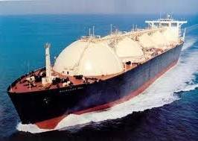
Electricity-Switch from Coal to Natural Gas
E
A wedge would be achieved if we…
Replace 1,400 large coal plants with natural gas plants by 2060.
Climate Change ©2018 The NEED Project

Slide 30
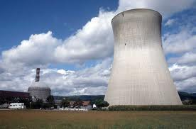
Nuclear Electricity
E
A wedge would be achieved if we…
Replace coal plants with triple the world’s current capacity of nuclear power.
Climate Change ©2018 The NEED Project

Slide 31
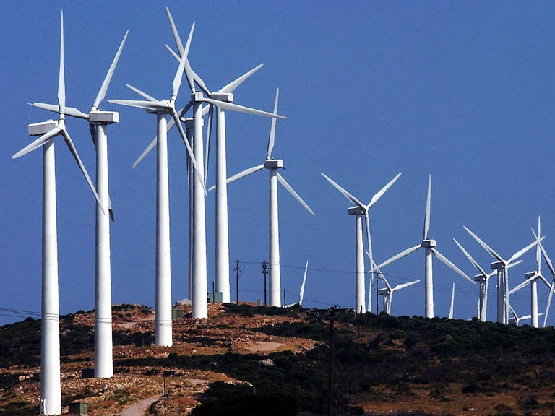
Wind Electricity
E
A wedge would be achieved if we…
Replace coal plants with 10 times today’s wind capacity by 2060.
Climate Change ©2018 The NEED Project

Slide 32
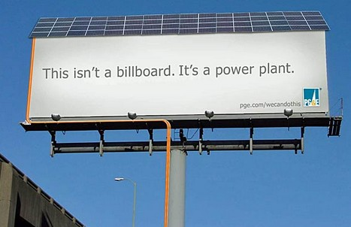
Solar Electricity
E
A wedge would be achieved if we…
Replace coal plants with 100 times today’s solar electric capacity.
Climate Change ©2018 The NEED Project

Slide 33
What is Electrolysis?
Process that separates hydrogen from water
Requires electricity
More energy intensive than SMR, but can utilize low carbon energy sources
Climate Change ©2018 The NEED Project

Slide 34
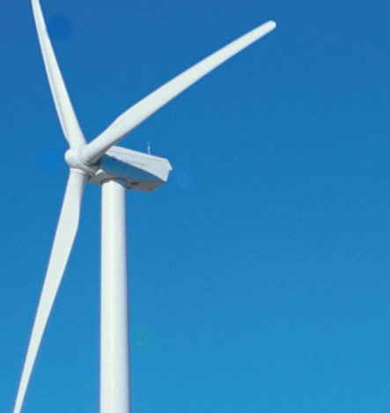
Wind Hydrogen
E
A wedge would be achieved if we…
Increase today’s wind capacity by 26 times to generate hydrogen via electrolysis. The hydrogen would allow us to replace gasoline vehicles with fuel cell vehicles .
Climate Change ©2018 The NEED Project

Slide 35
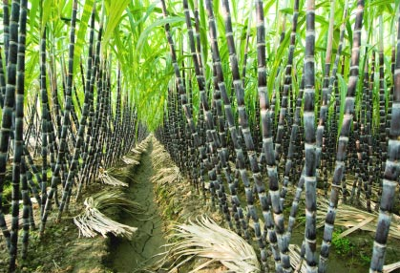
Biofuels
T
H
A wedge would be achieved if we…
Increase today’s ethanol production by about 28 times, and make it sustainable. This production must come entirely from sugarcane, not corn.
Climate Change ©2018 The NEED Project

Slide 36
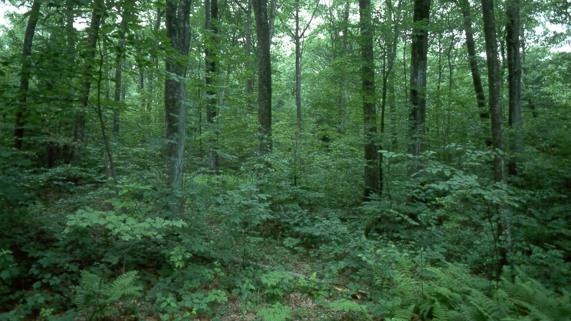
Forest Storage
B
A wedge would be achieved if we…
Halt global deforestation by 2060.
Climate Change ©2018 The NEED Project

Slide 37
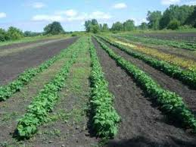
Soil Storage
B
A wedge would be achieved if we…
Apply carbon management strategies to all of the world’s crop lands.
Climate Change ©2018 The NEED Project

Slide 38
Wedge Limits
LIMITS
Total budget of 12 climate bucks
In some cases, the 2nd time you use a wedge its cost increases
See the Wedge Table for all limits
B=3
E=6
H=5
T=5
Climate Change ©2018 The NEED Project

Slide 39
Specific Wedge Limits
You can only use 1 of each of these:
Transportation Conservation
Transportation Efficiency
Electricity Generation Efficiency
Soil Storage
Efficiency in Buildings is ½ H + ½ T
In some cases have a choice of sector when you use a wedge:
CCUS Hydrogen from Natural Gas, CCUS Synfuels, Wind Hydrogen,Biofuels
Climate Change ©2018 The NEED Project

Slide 40
Wedge Colors
E = Pink
H = Yellow
T = Blue
B = Green
Climate Change ©2018 The NEED Project

Slide 41
Wedge Poster Session
What were the most important strategies you used in your solution?
What was the hardest decision you had to make?
Were there any disagreements in your group?
I see you chose a ____ wedge. Did you consider the ______issues associated with that wedge?
Climate Change ©2018 The NEED Project

Slide 42
For More Information
The NEED Project
www.need.org
info@need.org
1-800-875-5029
Energy Information Administration
U.S. Department of Energy
www.eia.gov
Climate Change ©2018 The NEED Project

Slide 43
NEED IS SOCIAL!
Stay up-to-date with NEED. “Like” us on Facebook! Search for The NEED Project, and check out all we’ve got going on!
Follow us on Twitter. We share the latest energy news from around the country, @NEED_Project.
Follow us on Instagram and check out the photos taken at NEED events, instagram.com/theneedproject.
Follow us on Pinterest and pin ideas to use in your classroom, Pinterest.com/NeedProject.
Climate Change ©2018 The NEED Project

