Slide 1
Exploring Solar Energy
Notes:
..The Sun is 93 million miles away.
The tiny fraction of the Sun’s energy hits the Earth (~a hundredth of a millionth of a percent) is enough to meet all our power needs and more. The sun provides more energy in an hour than the U.S. uses in a year.
We call the energy from the sun, solar energy.
Solar energy is transmitted to the earth in the form of radiant energy.
It is vital to us because it provides the world—directly or indirectly– with almost all of its energy.
In addition to providing the energy that sustains the world, solar energy is stored in fossil fuels and biomass, and is responsible for powering the water cycle and producing wind.

Slide 2
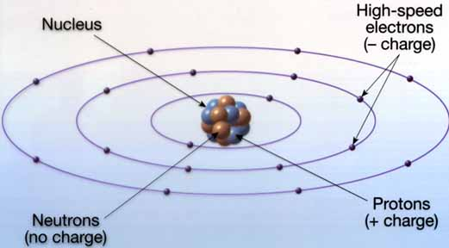
Review: Atomic Structure
Three particles
Nucleus
Electrostatic Force
Strong nuclear force
Notes:
The atom is made of three particles: Protons, which are positively charged; neutrons, which have no electrical charge (neutral); and electrons, which are negatively charged. The neutron is the largest particle, which is slightly larger than a proton. Electrons are tiny compared to protons and neutrons. So, for practical purposes, neutrons and protons are considered to have the same mass. The nucleus is the location of the protons and neutrons. It is the place where the mass of the atom is concentrated, and has an overall positive charge. Moving around the nucleus are the electrons, in pathways called orbitals.
Electrons move at nearly the speed of light. They are bound to the atom because of the electrostatic attraction between them and the protons in the nucleus. Their momentum keeps them from crashing into the center of the atom.
The nucleus stays together in spite of the electrostatic repulsion between the protons. This is because of a fundamental force, called strong nuclear force, that is associated with neutrons. It keeps the nucleus together. The energy required to hold a nucleus together is called binding energy.

Slide 3
Radiant Energy
Nuclear Fusion
Notes:
Under extreme pressure, and at extremely high temperatures, nuclei of atoms and their electrons can separate, forming plasma. In this extremely high energy state, nuclei can get close enough to each other to fuse. When they fuse, they release tremendous amounts of energy. This is what happens in the sun’s core.
The energy produced by fusion can be reabsorbed by other nuclei and re-released in future fusion reactions. Energy released in the core of the sun can take thousands of years to find its way to the surface of the sun.
Once the energy has left the sun, it is radiated as electromagnetic radiation toward space at a speed of 300 million meters per second, or 186,000 miles per second. At that speed, the energy needs only 8 minutes to reach the outer atmosphere of the earth 93 million miles away.
Once it reaches the earth, the incoming solar radiation, or insolation, is absorbed and reflected. The greenhouse effect, a naturally-occurring phenomenon, allows the energy from the sun to remain trapped near the earth’s surface, keeping the temperature of the earth in a comfortable range at night. Without the greenhouse effect, life on earth would be impossible.

Slide 4
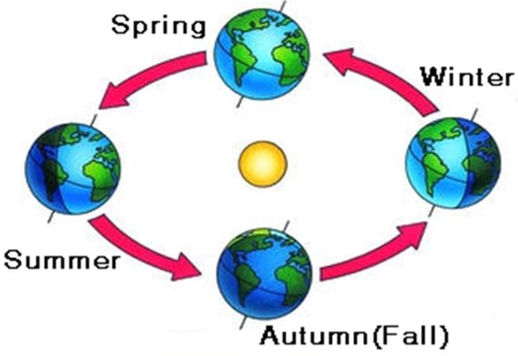
Variances in Solar Radiation
Northern Hemisphere Seasons
Notes:
The amount of insolation that reaches the earth is consistent. However, any given location receives varying amounts due to the tilt, rotation and revolution of the earth, Cloud cover and particulate matter in the atmosphere also play a roll. The time of day, season, latitude, and daily weather patterns all affect the amount of available solar energy in a particular location.

Slide 5
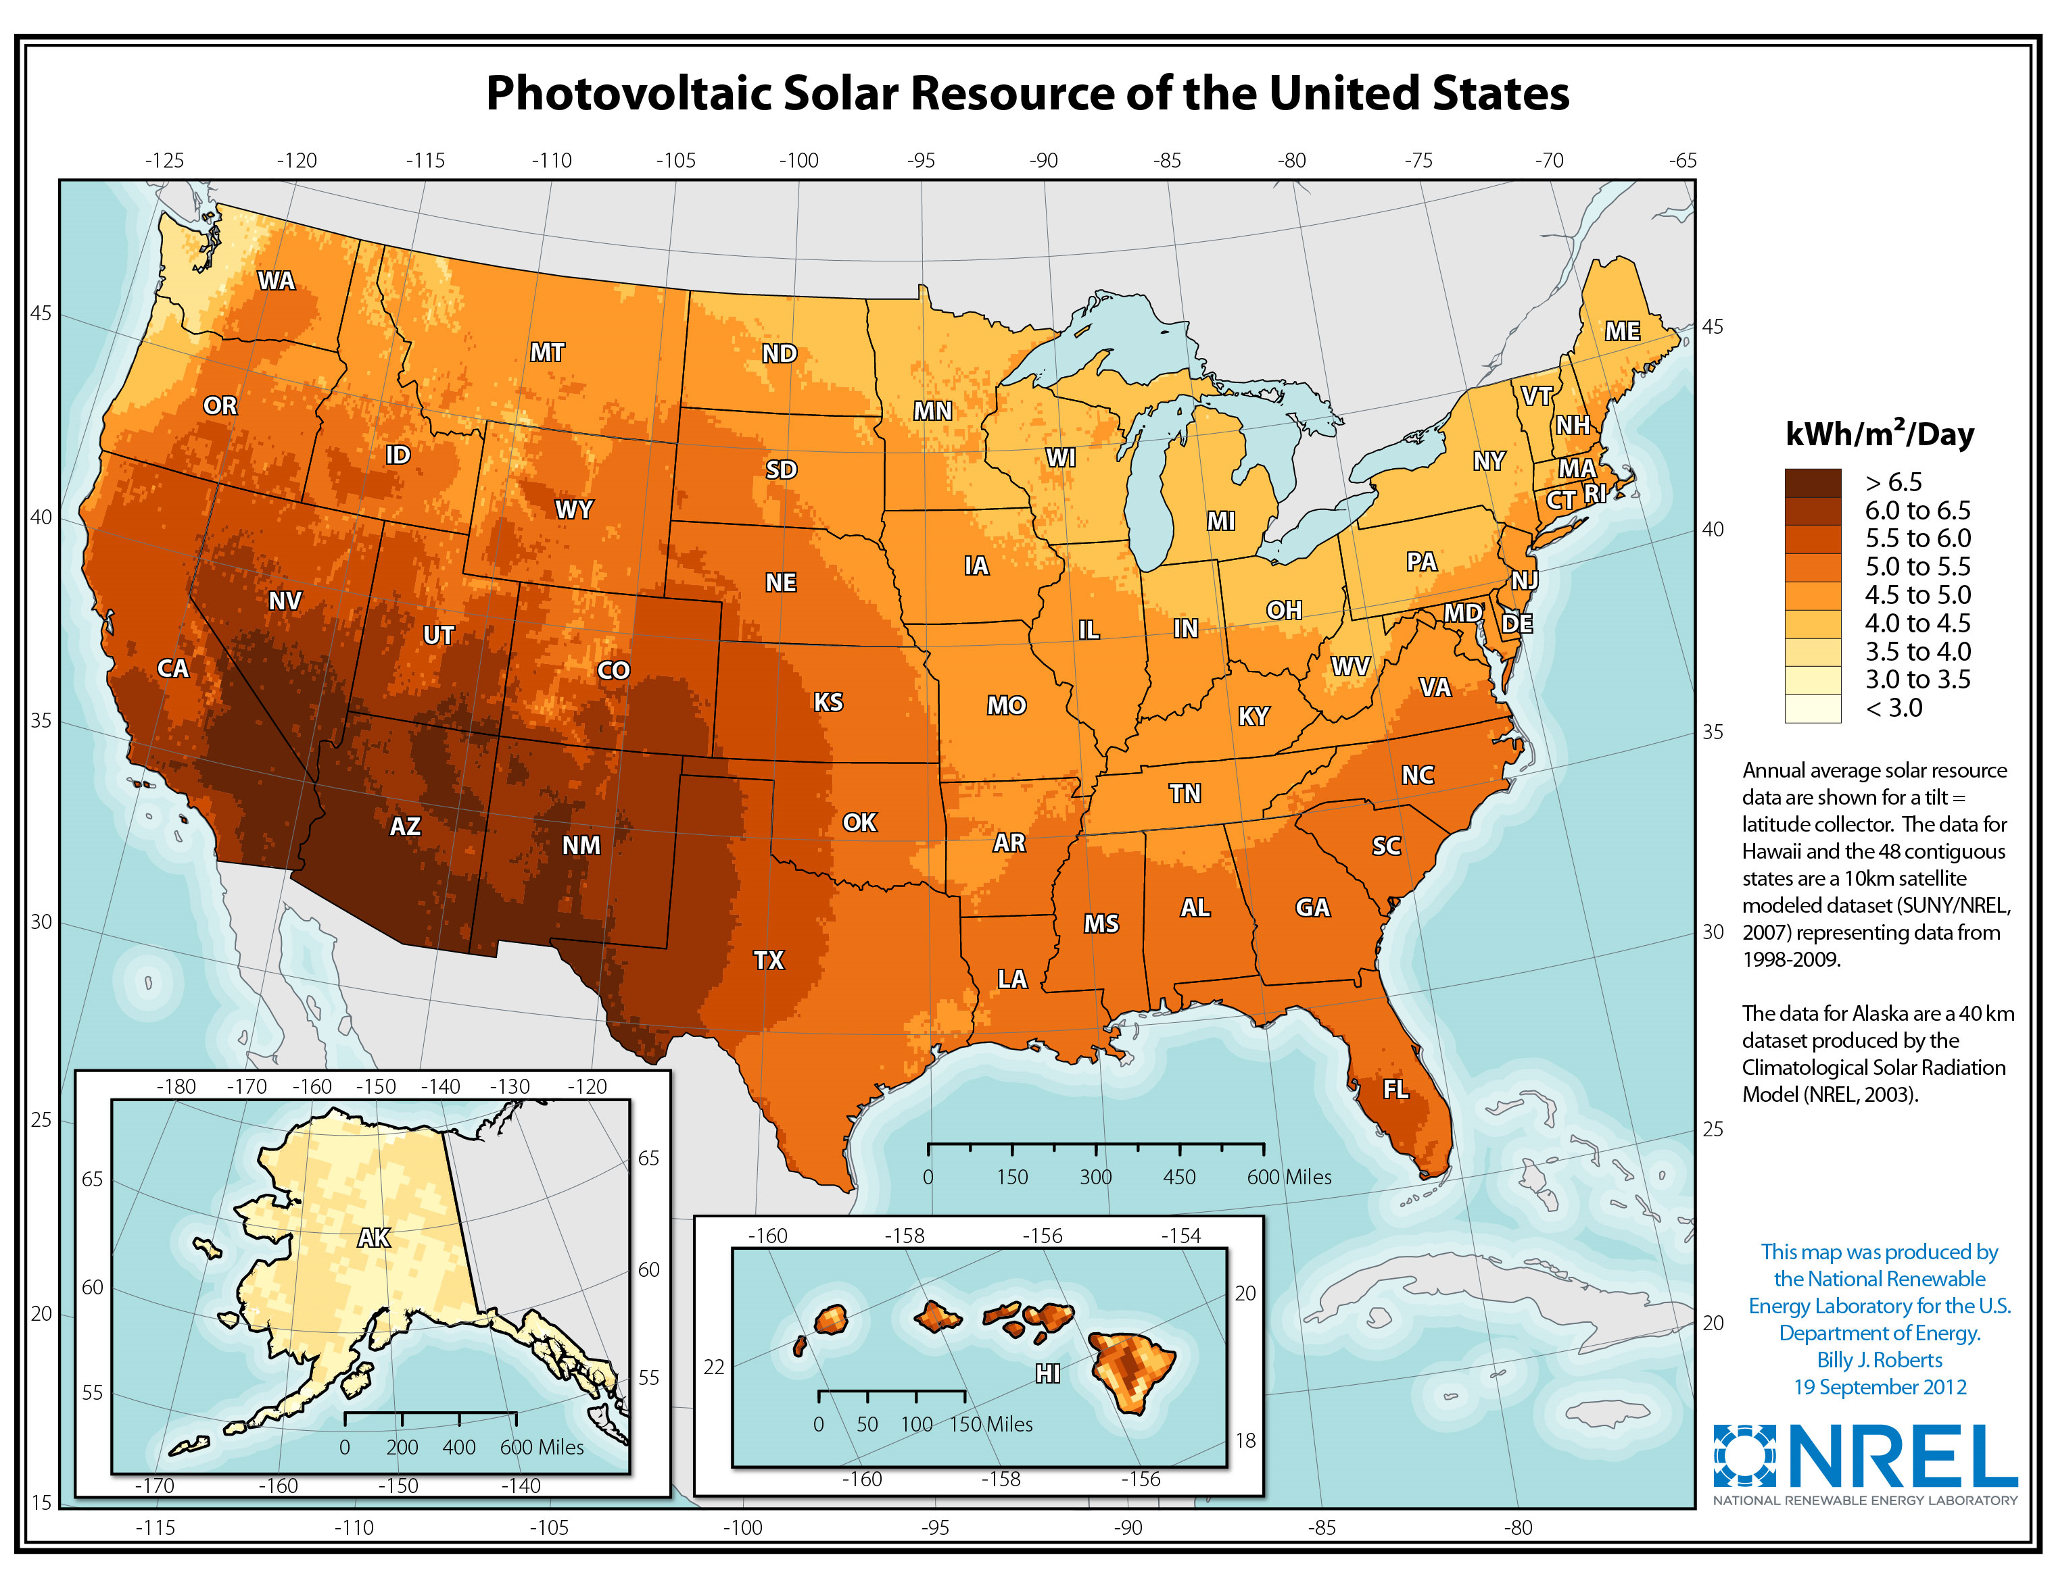
Average Daily Solar Insolation Per Month
Notes:
Due to these four factors, the average number of peak sun hours per day varies from one area of the country to another.
Solar insolation is the solar radiation incident on an area over time.
Solar insolation is expressed in kilowatt-hours per square meter.

Slide 6
Major Uses of Solar Energy
Daylight
Drying Agricultural Products
Space Heating
Water Heating
Generating Electrical Power
Concentrating Solar Power (CSP)
Photovoltaics

Slide 7
Daylighting
Notes:
Daylighting is the practice of using windows and skylights to bring sunlight into your home. Using skylights, tube lights, and large windows on the sunward side of a building helps maximize the amount of light reaching the interior of a building and reduces the need for artificial lights.

Slide 8
Daylighting
Notes:
Langston High School in Arlington, VA and Caywood Elementary in Kentucky use daylighting to keep energy costs down.

Slide 9
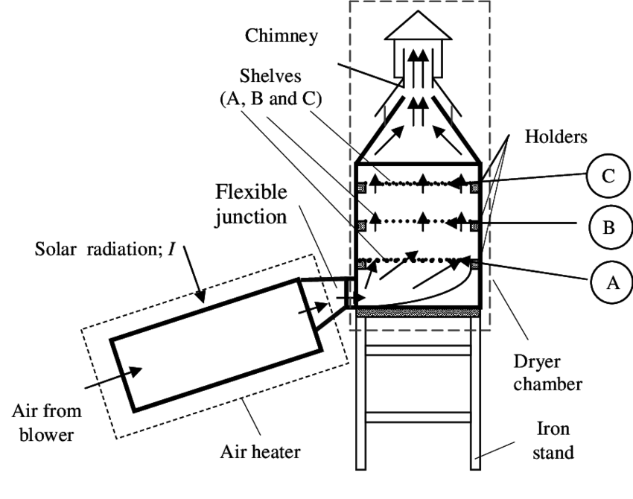
Drying Agricultural Products
Source: Thermal Science, 2014
Notes:
Crops such as wheat and rice have been allowed to dry in the fields for centuries. Hay is mown and allowed to dry in the field before being baled. A small solar collector is used to dry herbs. Agricultural products can be dried in a special tower that uses a solar collector to heat air and channel it through perforated trays of crops, which dries them and carries the moisture out through the top.

Slide 10
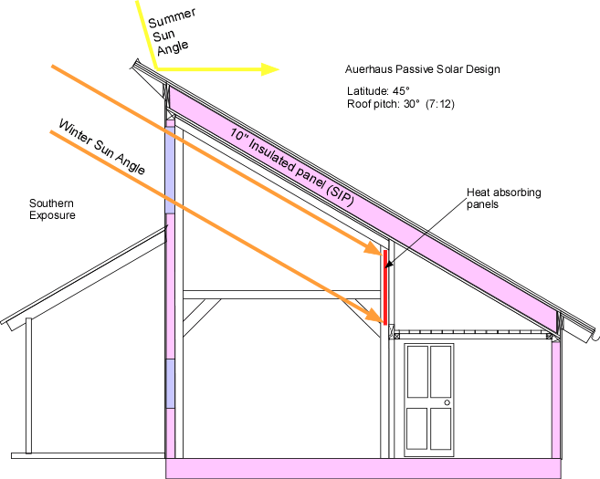
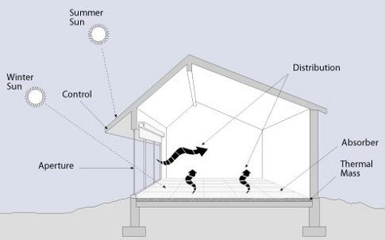
Space Heating Through Passive Solar
Notes:
Passive solar design involves using specific shapes, angles, and building materials to maximize the amount of solar energy allowed into the interior of a building during cold months. Overhangs are used to shield the home from the high, summer sun, but are designed to allow the low, winter sunlight to enter the windows.
Materials, such as concrete and stone, are used to absorb the sun’s energy and store it, releasing it into the home at night after the sun has set. This is called direct gain.
Other features, such as sunspaces and trombe walls, can be used. A sunspace uses glass to trap heat like a greenhouse. The heated air within the sunspace is allowed to circulate throughout the building. A trombe wall is made of absorbing material and is often painted black or covered with glass (or both) to maximize the amount of energy absorbed and keep it locked inside. The thermal energy is released to the building slowly over time, providing warmth throughout the night.

Slide 11
Passive Solar
Notes:
These homes in Montana and California incorporate passive solar design that allows the sun to the home in the winter and cool the home in the summer.

Slide 12
Active Solar Heating
Notes:
The people living in this house enjoy heated water using a solar thermal system.

Slide 13
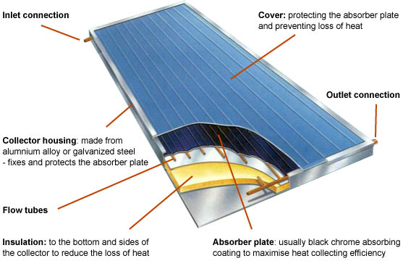
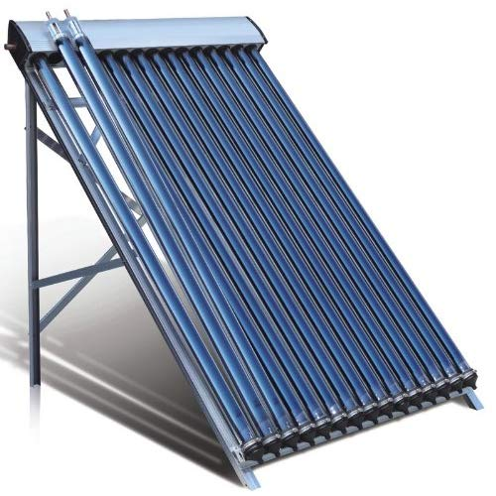
Solar Collector
Glass on outside
Absorbent on inside
Circulating Fluid
© 2019 GreenSpec
Notes:
Flat plate solar collectors are usually large flat boxes with one or more glass covers. Inside the boxes are dark colored metal plates that absorb heat. Air or liquid, such as water, flows through tubes and is warmed by heat stored in the plates. These systems are particularly useful for providing hot water to households.

Slide 14
Solar Thermal Collector Uses
Source: Energy Information Administration Annual Energy Review Figure 10.7
http://www.eia.gov/totalenergy/data/annual/showtext.cfm?t=ptb1007
Notes:
Solar thermal is used most frequently for pool heating in the U.S. This makes up the majority of the residential sector of solar thermal usage.

Slide 15
Generating Electrical Power
Concentrating Solar Power (CSP)
Trough systems
Power towers
Heat exchanger plus steam turbine
Photovoltaics
Small-scale (buildings) kW production
Large-scale (utilities) MW production
Photoelectric effect

Slide 16
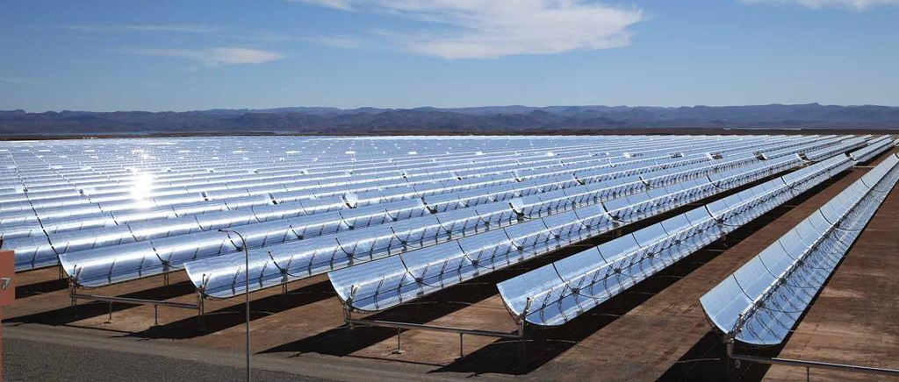
Concentrating Solar Power (CSP)
Solar mirrors at the Noor 1 Concentrated Solar Power plant in Ouarzazate, Morocco. Courtesy Dewa
Notes:
concentrating solar power (CSP) is used in special power plants that use mirrors to convert the sun's energy into high-temperature heat. The heat energy is then used to generate electricity in a steam generator.

Slide 17
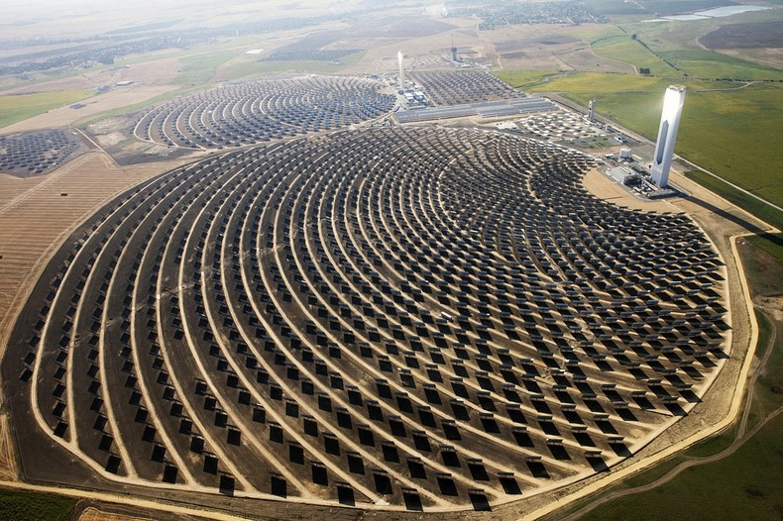
Solar Power Tower
Photo Credit: https://www.flickr.com/photos/beyondcoalandgas/9357649940/
Notes:
One of the world’s largest solar power tower in Seville, Spain, is a CSP plant.
A solar power tower consists of a large field of sun tracking mirrors, called heliostats, which focus solar energy on a receiver atop of a centrally located tower. The enormous amount of energy concentrated at one point (the tower) produces temperatures of approximately 550 C TO 1500 C.

Slide 18
How a Power Tower Works
Notes:
The tracking mirror, or heliostat, focuses the energy towards the receiver. The energy is stored in heated water or molten salt.
The molten salt is used to heat water to produce steam to turn a turbine which produces electricity.
Heated water becomes steam, which is used to move the turbine generator.
Storing heat in molten salt allows the power plant to produce energy when the sun is behind the clouds or at night.

Slide 19
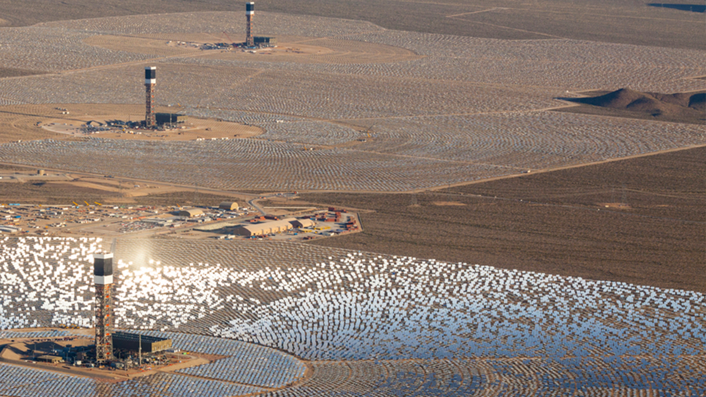
Ivanpah, Mojave Desert
The United States houses the largest CSP plant in the Mojave Desert
It uses 347,000 garage door-sized mirrors and 173,500 heliostats
Ivanpah is operated by NRG
Image courtesy of NRG Energy

Slide 20
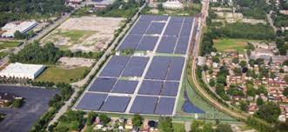
Photovoltaics
Notes:
Exelon City Solar in Chicago, IL – this tracking flat-panel installation has 32,292 panels rated at a total of 10 MW capacity (DC).
Tracking solar panels rotate as the sun moves through the sky to maximize the amount of electricity they can produce.

Slide 21
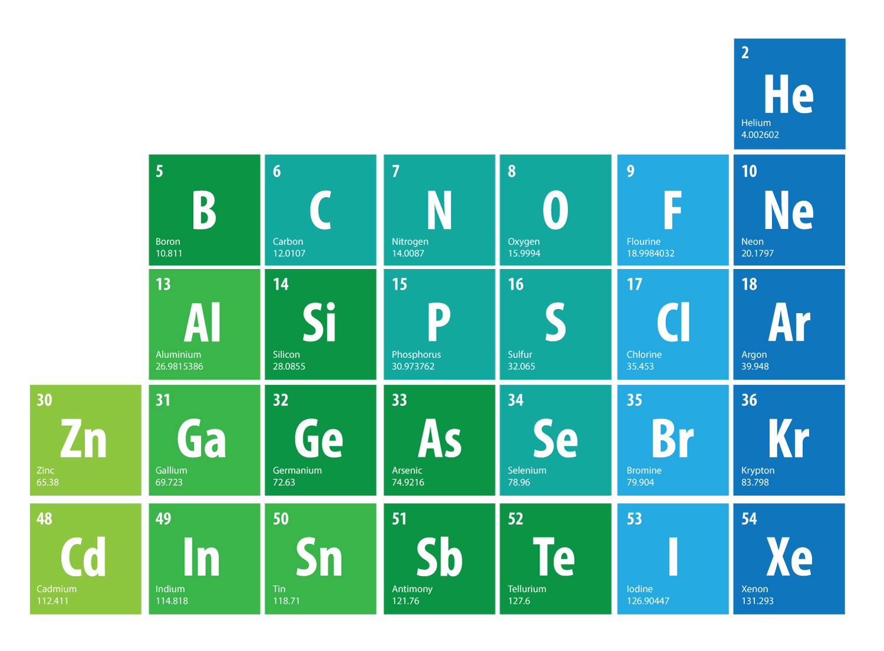
Notes:
Elements are arranged in the periodic table such that groups – columns – of elements have the same numbers of valence (outer) electrons. The valence electrons dictate the chemical behavior of the element. The seafoam green color is a grouping of elements called metalloids that are often used for their semiconductive properties.
Silicon is the most common semiconductor, but germanium is also used. A semiconductor will only conduct electricity under certain conditions, so it’s more easily controlled than something like copper or silver. Silicon has four valence electrons.
Boron, like all elements in its group, has only three valence electrons, which means it can easily accept electrons. Phosphorous, like all elements in its group, has five valence electrons, and can easily lose an electron. These two elements make suitable doping materials in photovoltaic cells because of their ability to give up or accept electrons. Doping materials are substances added in small quantities to a semiconductor to create an imbalance, of sorts, in electron distribution.
Note all three materials and their locations to each other on the periodic table.

Slide 22
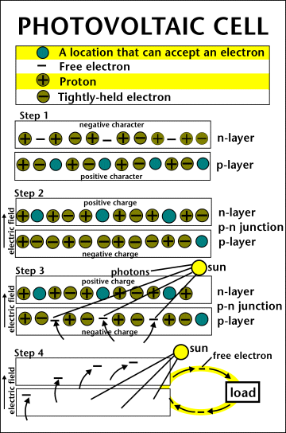
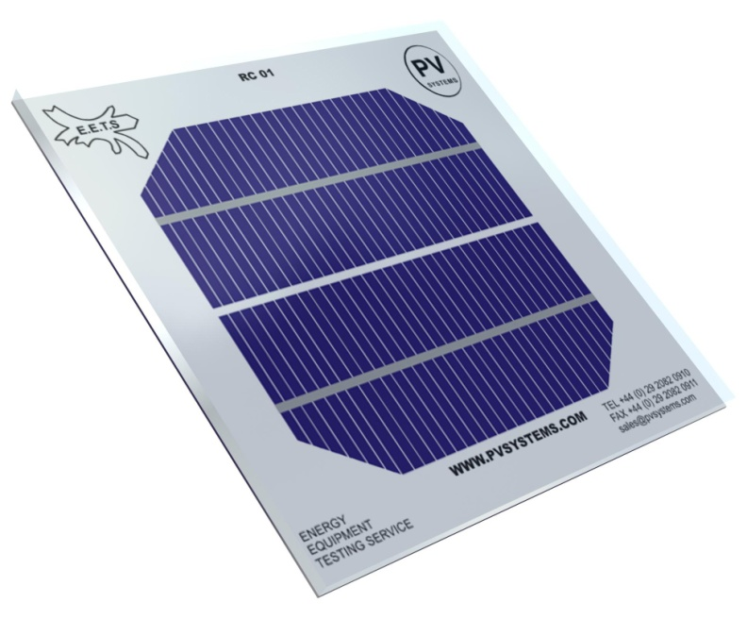
PV Cell
Notes:
The photovoltaic cell is the basic building block of a PV system. Individual cells can vary in sizes from about 1cm to about 10 cm across. Most cells are made with silicon today. Silicon must be purified. This is one of the biggest expenses in the production of solar cells.
A slab (or wafer) of pure silicon is used to make a PV cell. The top of the slab is very thinly diffused with an “n” dopant, such as phosphorous. On the base of the slab, a small amount of a “p” dopant, typically boron, is diffused. The boron side of the slab is 1,000 times thicker than the phosphorous side. The phosphorous has one more electron in its outer shell than silicon, and the boron has one less.
The phosphorous gives the wafer an excess of free electrons; it has a negative character. This is called the n-type silicon (n = negative). The n-type silicon is not charged—it has an equal number of protons and electrons—but some of the electrons are not held tightly to the atoms. They are free to move to different locations within the layer.
The boron gives the wafer a positive character, which will cause electrons to flow toward it. The base of the silicon is called p-type silicon (p = positive). The p-type silicon has an equal number of protons and electrons; it has a positive character, but not a positive charge.
Where the n-type silicon and p-type silicon meet, free electrons from the n-type flow into the p-type for a split second, then form a barrier to prevent more electrons from moving between the two sides. This point of contact and barrier is called the p-n junction.
When both sides of the silicon wafer are doped, there is a negative charge in the p-type section of the junction and a positive charge in the n-type section of the junction due to movement of the electrons and “holes” at the junction of the two types of materials. This imbalance in electrical charge at the p-n junction produces an electric field between the p-type and n-type.
If the PV cell is placed in the sun, photons of light strike the electrons in the p-n junction and energize them, knocking them free of their atoms. These electrons are attracted to the positive charge in the n-type silicon and repelled by the negative charge in the p-type silicon.

Slide 23
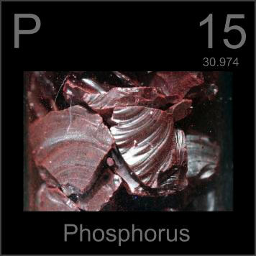
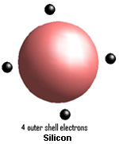
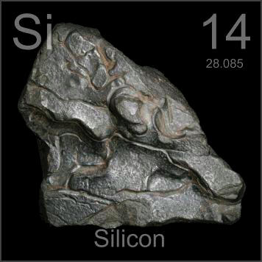
N-type
Notes:
It takes a lot less energy to knock loose one of the "extra" phosphorous electrons because they aren't tied up in a bond with any neighboring atoms. As a result, most of these electrons do break free, and we have a lot more free carriers than we would have in pure silicon. The process of adding impurities on purpose is called doping, and when doped with phosphorous, the resulting silicon is called N-type ("n" for negative) because of the prevalence of free electrons. N-type doped silicon is a much better conductor than pure silicon.

Slide 24
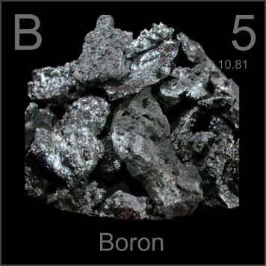
P-type
Notes:
The other side of a typical solar cell is doped with the element boron, which has only three electrons in its outer shell instead of four, to become P-type silicon. Instead of having free electrons, P-type ("p" for positive) has free openings and carries the opposite (positive) charge.

Slide 25
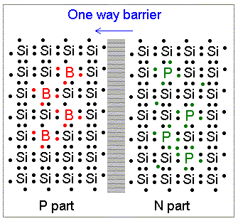
P-N Junction
Notes:
Without an electric field, the cell wouldn't work; the field forms when the N-type and P-type silicon come into contact. The free electrons on the N side see all the openings on the P side, and there's a mad rush to fill them. At the junction, the free electrons and holes mix and form a barrier, making it harder for electrons on the N side to cross over to the P side. Equilibrium is reached, and we have an electric field separating the two sides.
This electric field acts as a diode, allowing (and even pushing) electrons to flow from the P side to the N side, but not the other way around. It's like a hill -- electrons can easily go down the hill (to the N side), but can't climb it (to the P side).
When light, in the form of photons, hits a solar cell, its energy breaks apart electron-hole pairs. Each photon with enough energy will normally free exactly one electron, resulting in a free hole as well. If this happens close to the electric field, or if free electron and free hole happen to wander into its range of influence, the field will send the electron to the N side and the hole to the P side. This causes further disruption of electrical neutrality, and if we provide an external current path, electrons will flow through the path to the P side to unite with holes that the electric field sent there, doing work for us along the way. The electron flow provides the current, and the cell's electric field causes a voltage. With both current and voltage, we have power, which is the product of the two.

Slide 26
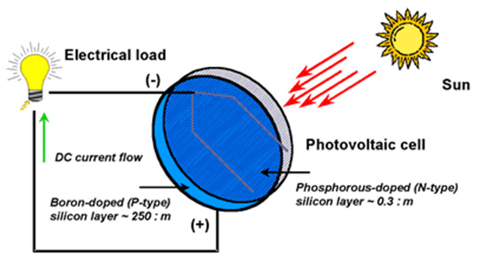
Notes:
A conducting wire connects the p-type silicon to an external load such as a light or battery and then back to the n-type silicon, forming a complete circuit. As the free electrons are pushed into the n-type silicon they repel each other because they are of like charge. The wire provides a path for the electrons to move away from each other. This flow of electrons is an electric current that can power a load, such as a calculator or other device, as it travels through the circuit from the n-type to the p-type.
In addition to the semi-conducting materials, solar cells consist of a top metallic grid or other electrical contact to collect electrons from the semi-conductor and transfer them to the external load, and a back contact layer to complete the electrical circuit.
It is this flow of electrons that produces electrical current.

Slide 27
Conversion Efficiency
Notes:
The conversion efficiency of a PV cell is the proportion of sunlight energy that the cell converts into electrical energy.
This is very important because improving this efficiency is vital to making PV energy competitive with more traditional sources of energy, such as fossil fuels.
The first PV cells were converting light to electricity at 1 to 2 percent efficiency.
Most commercially available PV cells are 17-20% efficient.
Advanced technology PV devices convert 25-45 % of the radiant energy that strikes them into electrical energy.

Slide 28
PV Array Components
PV Cells
Modules
Arrays
Notes:
One PV cell only produces 1 or 2 watts of electricity, which isn't enough power for most applications.
To increase power, groups of solar cells are electrically connected and packaged into weather-tight modules and arrays to provide useful output voltages and currents for a specific power output.
A PV System typically consists of 3 basic components.
PV cells - Electricity is generated by PV cells, the smallest unit of a PV system.
Modules - PV cells are wired together to form modules, or panels, which are usually a sealed unit of convenient size for handling.
Arrays – Groups of panels or modules make up an array.

Slide 29
PV System Components
Notes:
Solar PV System
Solar cells produce direct current (DC), therefore they are only directly used for DC equipment. If alternating current (AC) is needed for AC equipment or backup energy is needed, PV systems require other components in addition to solar modules. These components are specially designed to integrate into solar PV systems. The components of a system are:
Solar Module or Array -- the essential component of any solar PV system that converts sunlight directly into DC electricity.
2. Charge Controller -- regulates voltage and current from solar arrays, charges the battery, prevents the battery from overcharging and also performs controlled over discharges.
3.Battery -- stores current electricity produced from solar arrays for use when sunlight is not available.
4. Inverter -- a critical component of any solar PV system that converts DC power into AC power.
5. Lightning protection -- prevents electrical equipment from damage caused by lightning or induction of high voltage surge. It is required for large size and critical solar PV systems, which include grounding.

Slide 30
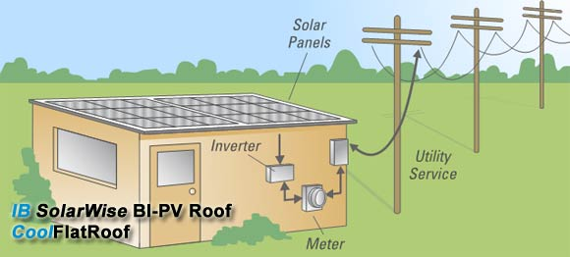
Net Metering
Notes:
A PV system produces DC-current.
The DC current goes into an Inverter where it becomes AC current.
An inverter is connected to your home’s or building’s electric system, and to your meter.
You use all the electricity you need, while all excess electricity goes into the grid.
Electricity that goes into the grid is purchased from you by your utility company through Net Metering, usually at retail price.
While this option is not offered by many utility companies, the number is growing.

Slide 31
Net Metering Participation
Data: EIA Electricity Annual Report
Notes:
Note: The chart counts the number of net-metering customers and does not indicate the generator size or amount of generation. Non-residential includes the commercial and industrial sectors; net-metered generators in these sectors are typically larger than residential generators.

Slide 32
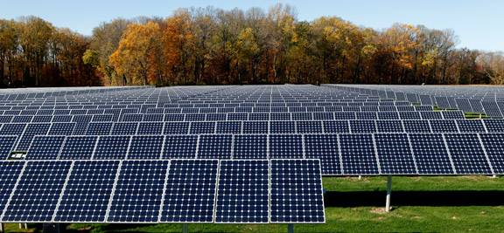
PV Array Fields
(Photo by Tom Grimes Photography for SunPower)
Notes:
In order to generate large amounts of electricity which can be fed into the electric grid, large number of arrays can be wired together to form an Array Field.
Some utility companies in the U.S. are turning to large PV systems to help meet peak power demand and reduce the need for building new power plants.

Slide 33
Remote PV Power
Notes:
Photovoltaic systems are ideal for remote applications where other power sources are impractical or unavailable, such as in the Swiss Alps or on navigational buoys. It is not practical to connect these applications to an electric grid. They are also used to power small, independently placed objects, such as billboards and road signs.

Slide 34
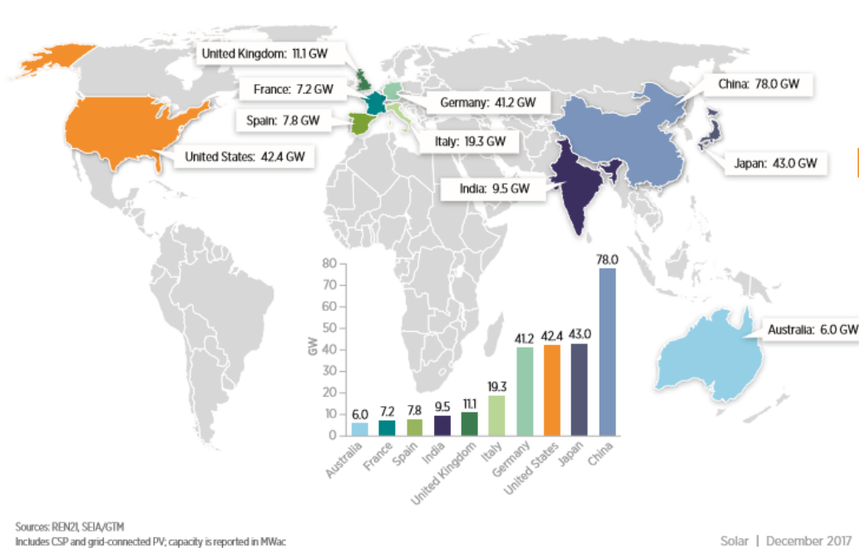
Top Countries for Installed PV Capacity
US Department of Energy, NREL 2016 Renewable Energy Data Book

Slide 35
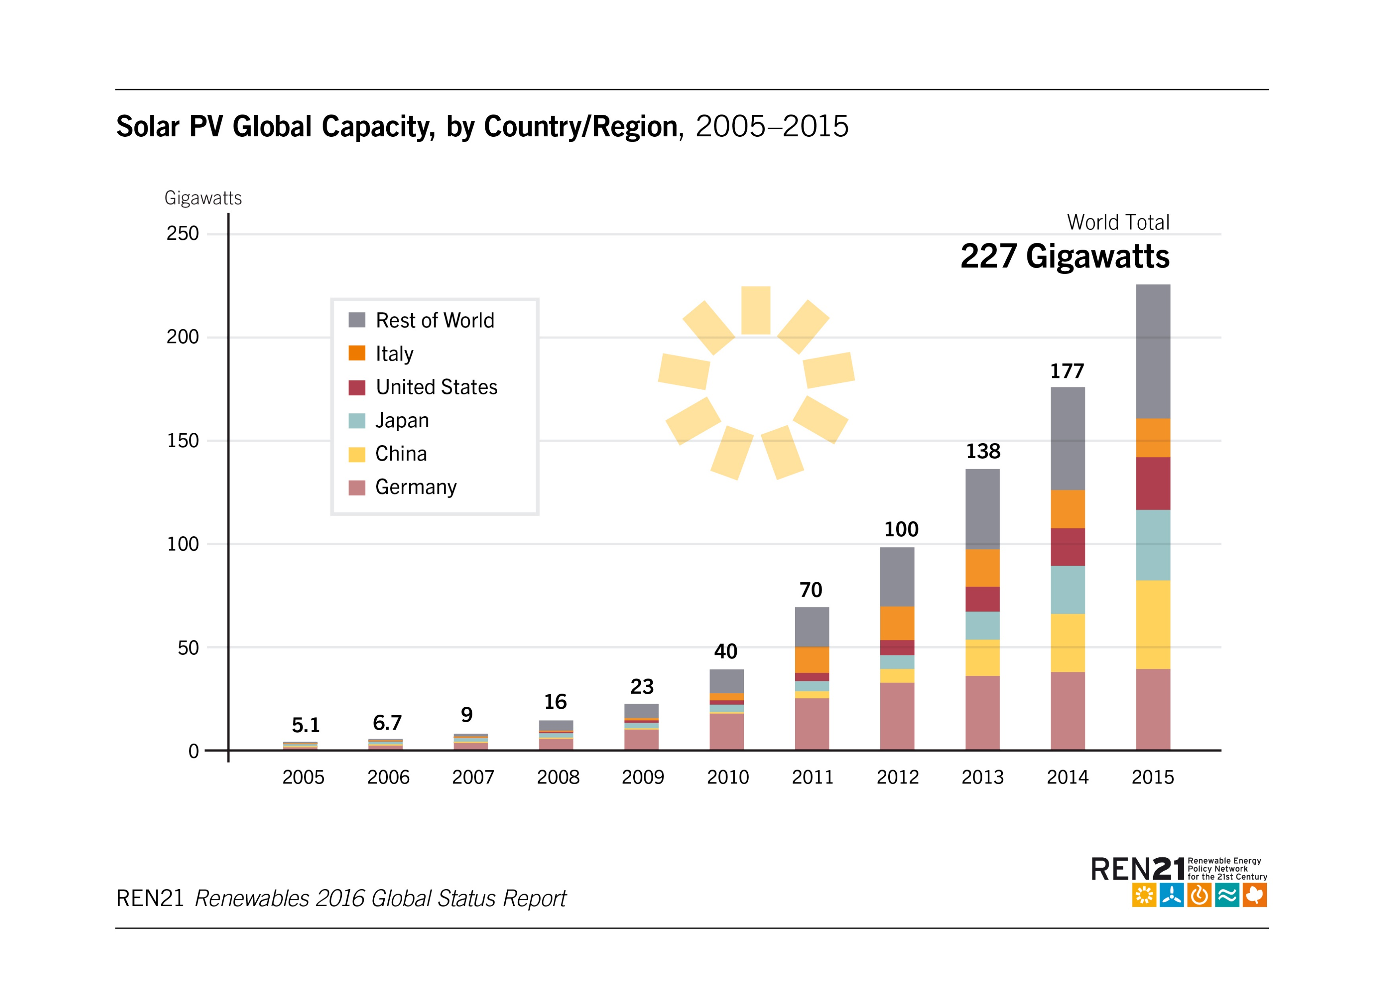
Global PV Growth

Slide 36
Projected Global Photovoltaic Growth
Notes:
Frost & Sullivan expect global cumulative installed PV capacity to reach 446 GW by 2020, according to the Annual Global Power and Energy Outlook.

Slide 37
Advantages of Solar Energy
Clean
Sustainable
Free
Provide electricity to remote places
Notes:
Solar energy produces no air pollution, thermal pollution, or water pollution, and using solar energy does not disrupt the natural environment. The sun shines whether we use the energy or not. Solar energy is a sustainable energy source. Because the sun shines everywhere, and not just where people are, it can be used in places where electricity may not be otherwise available or practical.

Slide 38
Disadvantages of Solar Energy
Less efficient and costly equipment
Part Time
Reliability Depends On Location
Environmental Impact of PV Cell Production
Notes:
Most photovoltaics are only 17-20% efficient. There are some experimental and developmental technologies being used in laboratories and by the space industry that are more efficient, but even those are only up to 43% efficiency. However, no energy is output in delivering the energy source to the PV panel; it is already right there to use, and does not require any initial energy or materials to get it to the site of use.
Because the sun does not shine all the time in any given location, it cannot be counted on for continuous energy. The amount of solar energy available depends on the latitude, climate, time of day, and amount of air pollution present. Clouds or particulate matter in the air will lessen the amount of solar energy available to use in a PV cell. Higher latitudes do not receive as intense of sunlight as more tropical areas, and therefore will not be able to produce as much power through photovoltaics. All of these limit the degree to which photovoltaics can be used.
Another negative aspect to using photovoltaics is in the production of the materials in a PV cell. The entire production process does have a negative environmental impact, primarily from the energy required to produce the PV cell. There is a very small amount of heavy metals, such as lead and cobalt, produced in the purification of the materials being used, but that is far less than the amount of carbon dioxide and other air pollutants produced when the electricity necessary for production is generated. Replacing conventional, fossil fuel based electrical power generation will significantly reduce this impact.

Slide 39
Classroom Photovoltaics
Experiments help students understand the conditions needed for optimal power production
Focus of secondary-level solar curriculum
Use digital multimeters

Slide 40
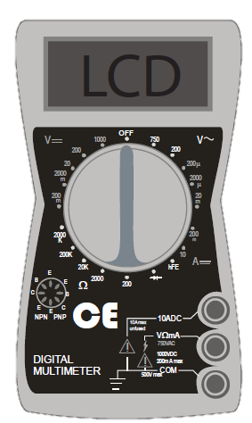
Using a Digital Multimeter
Indicates voltage from alternating current. Do not use.
DC Voltage Scale
DC Current Scale
Resistance Scale. Do not use.
Notes:
DC Voltage
Connect RED lead to VΩmA socket and BLACK to COM.
Set SWITCH to highest setting on DC VOLTAGE scale (1000).
Connect leads to the device to be tested using the alligator clips provided.
Adjust SWITCH to lower settings until a satisfactory reading is obtained.
With the photovoltaic modules and array, the 20 setting usually provides the best reading.
DC Current
Connect RED lead to VΩmA connector and BLACK to COM.
Set SWITCH to 10 ADC setting.
Connect leads to the device to be tested using the alligator clips provided.
Note: The reading indicates DC AMPS; a reading of 0.25 amps equals 250 ma (milliamps).

Slide 41
Wiring the PV Modules
Series
Parallel

Slide 42
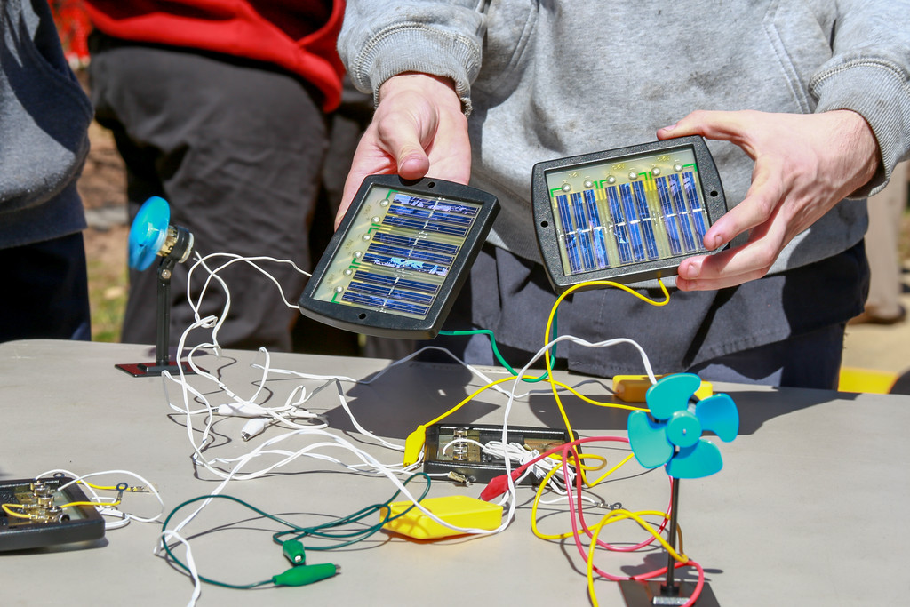
For More Information
The NEED Project
www.need.org
info@need.org
1-800-875-5029
Energy Information Administration
U.S. Department of Energy
www.eia.gov

Slide 43
NEED IS SOCIAL!
Stay up-to-date with NEED. “Like” us on Facebook! Search for The NEED Project, and check out all we’ve got going on!
Follow us on Twitter. We share the latest energy news from around the country, @NEED_Project.
Follow us on Instagram and check out the photos taken at NEED events, instagram.com/theneedproject.
Follow us on Pinterest and pin ideas to use in your classroom, Pinterest.com/NeedProject.
Exploring Solar © 2018 The NEED Project

