Slide 1
Exploring Solar Energy
Notes:
..The Sun is 93 million miles away.
The tiny fraction of the Sun’s energy hits the Earth (~a hundredth of a millionth of a percent) is enough to meet all our power needs and more. The sun provides more energy in an hour than the U.S. uses in a year.
We call the energy from the sun, solar energy.
Solar energy is transmitted to the earth in the form of radiant energy.
It is vital to us because it provides the world—directly or indirectly– with almost all of its energy.
In addition to providing the energy that sustains the world, solar energy is stored in fossil fuels and biomass, and is responsible for powering the water cycle and producing wind.

Slide 2
Radiant Energy
Nuclear Fusion
Notes:
Under extreme pressure, and at extremely high temperatures, nuclei of atoms and their electrons can separate, forming plasma. In this extremely high energy state, nuclei can get close enough to each other to fuse. When they fuse, they release tremendous amounts of energy. This is what happens in the sun’s core.
The energy produced by fusion can be reabsorbed by other nuclei and re-released in future fusion reactions. Energy released in the core of the sun can take thousands of years to find its way to the surface of the sun.
Once the energy has left the sun, it is radiated as electromagnetic radiation toward space at a speed of 300 million meters per second, or 186,000 miles per second. At that speed, the energy needs only 8 minutes to reach the outer atmosphere of the earth 93 million miles away.
Once it reaches the earth, the incoming solar radiation, or insolation, is absorbed and reflected. The greenhouse effect, a naturally-occurring phenomenon, allows the energy from the sun to remain trapped near the earth’s surface, keeping the temperature of the earth in a comfortable range at night. Without the greenhouse effect, life on earth would be impossible.

Slide 3
Major Uses of Solar Energy
Daylight
Drying Agricultural Products
Space Heating
Water Heating
Generating Electrical Power
Concentrating Solar Power (CSP)
Photovoltaics
Exploring Solar ©2018 The NEED Project

Slide 4
Daylighting
Exploring Solar ©2018 The NEED Project
Notes:
Using skylights, tube lights, and large windows on the sunward side of a building help maximize the amount of light reaching the interior of a building and reduce the need for artificial lights.

Slide 5
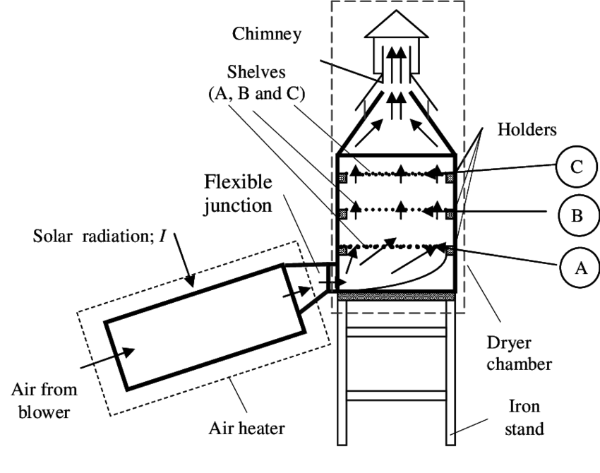
Drying Agricultural Products
Source: Thermal Science, 2014
Exploring Solar ©2018 The NEED Project
Notes:
Crops such as wheat and rice have been allowed to dry in the fields for centuries. Hay is mown and allowed to dry in the field before being baled. A small solar collector is used to dry herbs. Agricultural products can be dried in a special tower that uses a solar collector to heat air and channel it through perforated trays of crops, which dries them and carries the moisture out through the top.

Slide 6
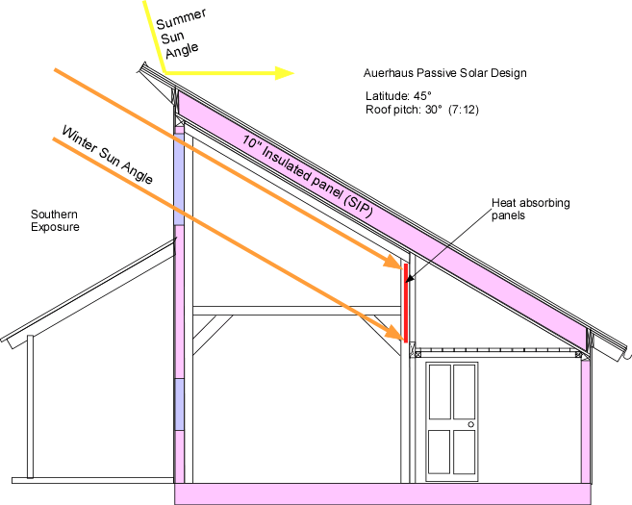
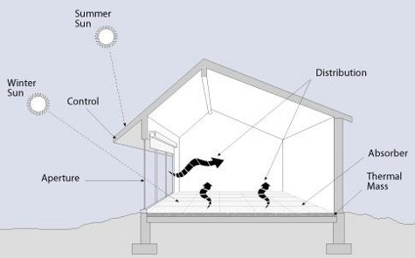
Space Heating Through Passive Solar
Exploring Solar ©2018 The NEED Project
Notes:
Passive solar design involves using specific shapes, angles, and building materials to maximize the amount of solar energy allowed into the interior of a building during cold months. Overhangs are used to shield the home from the high, summer sun, but are designed to allow the low, winter sunlight to enter the windows.
Materials, such as concrete and stone, are used to absorb the sun’s energy and store it, releasing it into the home at night after the sun has set. This is called direct gain.
Other features, such as sunspaces and trombe walls, can be used. A sunspace uses glass to trap heat like a greenhouse. The heated air within the sunspace is allowed to circulate throughout the building. A trombe wall is made of absorbing material and is often painted black or covered with glass (or both) to maximize the amount of energy absorbed and keep it locked inside. The thermal energy is released to the building slowly over time, providing warmth throughout the night.

Slide 7
Active Solar Heating
Notes:
The people living in this house enjoy heated water using a solar thermal system.

Slide 8
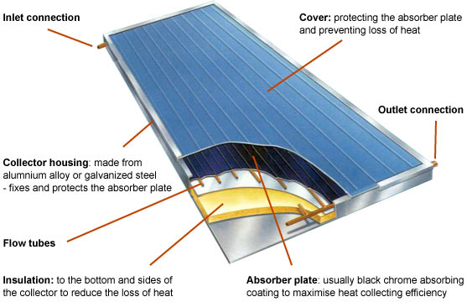
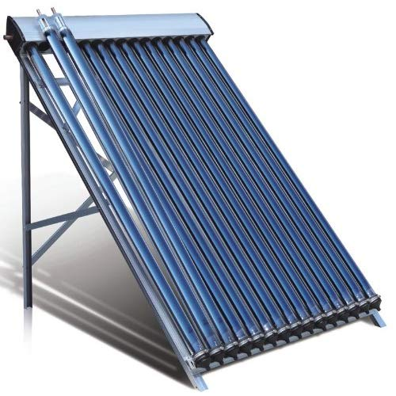
Solar Collector
Glass on outside
Absorbent on inside
Circulating Fluid
© 2019 GreenSpec
Exploring Solar ©2018 The NEED Project
Notes:
Flat plate solar collectors are usually large flat boxes with one or more glass covers. Inside the boxes are dark colored metal plates that absorb heat. Air or liquid, such as water, flows through tubes and is warmed by heat stored in the plates. These systems are particularly useful for providing hot water to households.

Slide 9
Generating Electrical Power
Concentrating Solar Power (CSP)
Trough systems
Power towers
Heat exchanger plus steam turbine
Photovoltaics
Small-scale (buildings) kW production
Large-scale (utilities) MW production
Photoelectric effect
Exploring Solar ©2018 The NEED Project

Slide 10
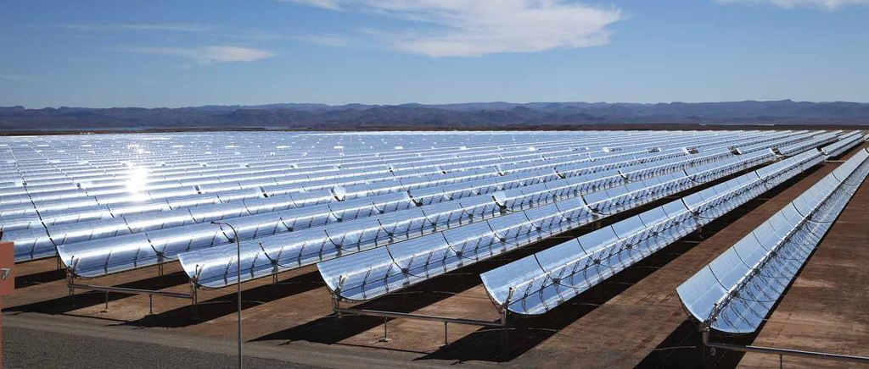
Concentrating Solar Power (CSP)
Solar mirrors at the Noor 1 Concentrated Solar Power plant in Ouarzazate, Morocco. Courtesy Dewa
Exploring Solar ©2018 The NEED Project
Notes:
concentrating solar power (CSP) is used in special power plants that use mirrors to convert the sun's energy into high-temperature heat. The heat energy is then used to generate electricity in a steam generator.

Slide 11
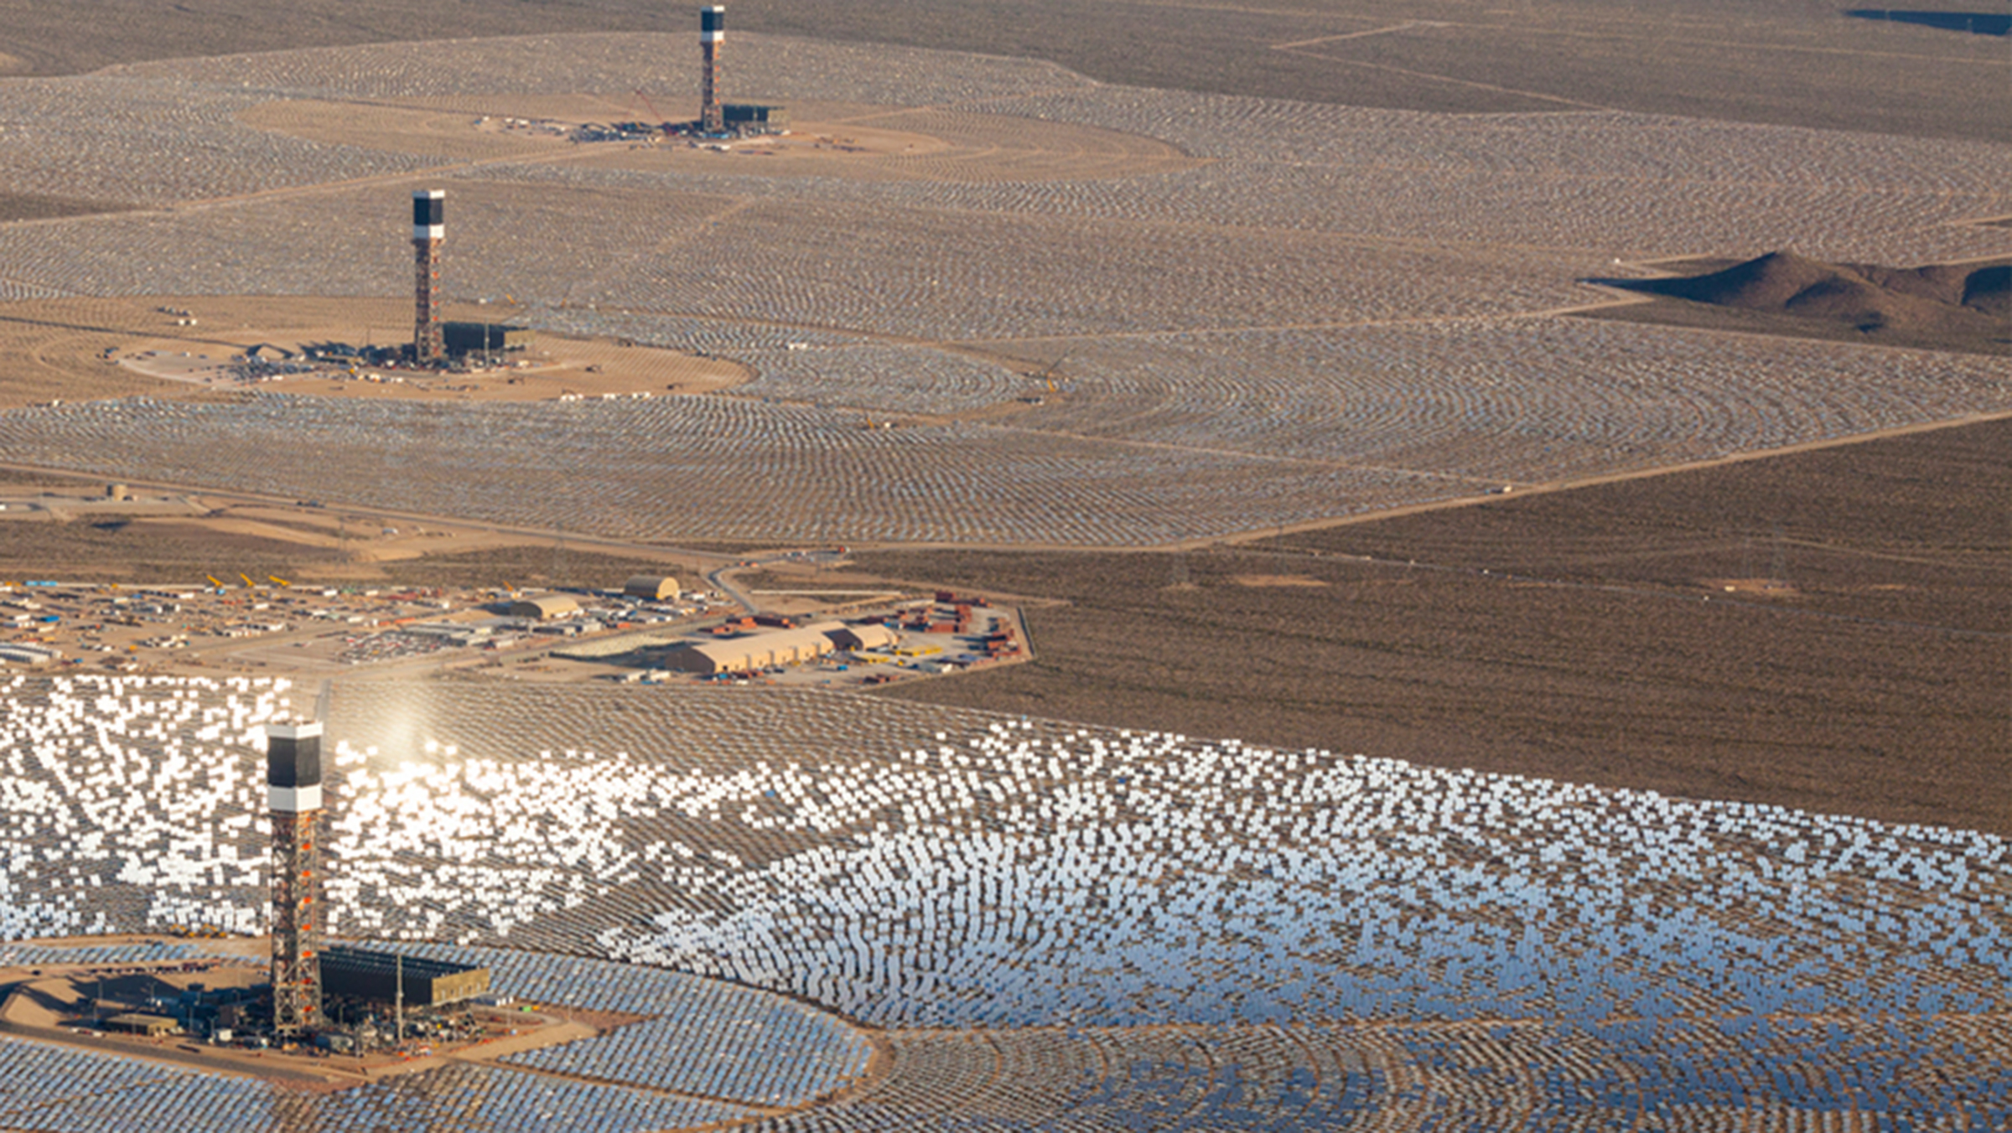
Ivanpah, Mojave Desert
The United States houses the largest CSP plant in the Mojave Desert
It uses 347,000 garage door-sized mirrors and 173,500 heliostats
Ivanpah is operated by NRG
Image courtesy of NRG Energy

Slide 12
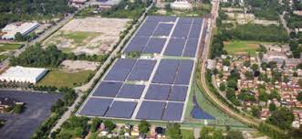
Photovoltaics
Exploring Solar ©2018 The NEED Project
Notes:
Exelon City Solar in Chicago, IL – this tracking flat-panel installation has 32,292 panels rated at a total of 10 MW capacity (DC).
Tracking solar panels rotate as the sun moves through the sky to maximize the amount of electricity they can produce.

Slide 13
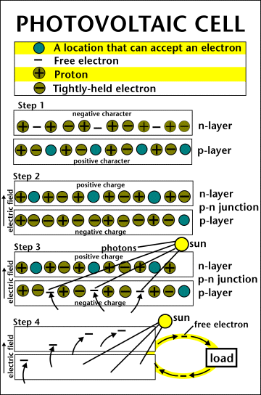
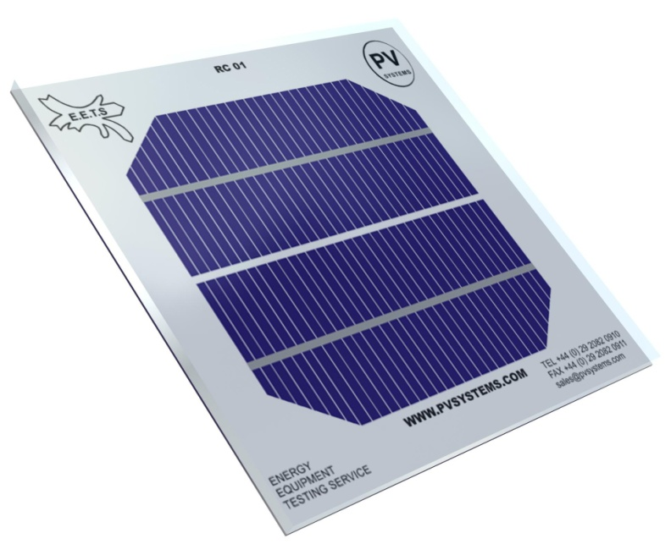
PV Cell
Exploring Solar ©2018 The NEED Project
Notes:
The photovoltaic cell is the basic building block of a PV system. Individual cells can vary in sizes from about 1cm to about 10 cm across. Most cells are made with silicon today. Silicon must be purified. This is one of the biggest expenses in the production of solar cells.
A slab (or wafer) of pure silicon is used to make a PV cell. The top of the slab is very thinly diffused with an “n” dopant, such as phosphorous. On the base of the slab, a small amount of a “p” dopant, typically boron, is diffused. The boron side of the slab is 1,000 times thicker than the phosphorous side. The phosphorous has one more electron in its outer shell than silicon, and the boron has one less.
The phosphorous gives the wafer an excess of free electrons; it has a negative character. This is called the n-type silicon (n = negative). The n-type silicon is not charged—it has an equal number of protons and electrons—but some of the electrons are not held tightly to the atoms. They are free to move to different locations within the layer.
The boron gives the wafer a positive character, which will cause electrons to flow toward it. The base of the silicon is called p-type silicon (p = positive). The p-type silicon has an equal number of protons and electrons; it has a positive character, but not a positive charge.
Where the n-type silicon and p-type silicon meet, free electrons from the n-type flow into the p-type for a split second, then form a barrier to prevent more electrons from moving between the two sides. This point of contact and barrier is called the p-n junction.
When both sides of the silicon wafer are doped, there is a negative charge in the p-type section of the junction and a positive charge in the n-type section of the junction due to movement of the electrons and “holes” at the junction of the two types of materials. This imbalance in electrical charge at the p-n junction produces an electric field between the p-type and n-type.
If the PV cell is placed in the sun, photons of light strike the electrons in the p-n junction and energize them, knocking them free of their atoms. These electrons are attracted to the positive charge in the n-type silicon and repelled by the negative charge in the p-type silicon.

Slide 14
PV Array Components
PV Cells
Modules
Arrays
Exploring Solar ©2018 The NEED Project
Notes:
One PV cell only produces 1 or 2 watts of electricity, which isn't enough power for most applications.
To increase power, groups of solar cells are electrically connected and packaged into weather-tight modules and arrays to provide useful output voltages and currents for a specific power output.
A PV System typically consists of 3 basic components.
PV cells - Electricity is generated by PV cells, the smallest unit of a PV system.
Modules - PV cells are wired together to form modules, or panels, which are usually a sealed unit of convenient size for handling.
Arrays – Groups of panels or modules make up an array.

Slide 15
PV System Components
Exploring Solar ©2018 The NEED Project
Notes:
Solar PV System
Solar cells produce direct current (DC), therefore they are only directly used for DC equipment. If alternating current (AC) is needed for AC equipment or backup energy is needed, PV systems require other components in addition to solar modules. These components are specially designed to integrate into solar PV systems. The components of a system are:
Solar Module or Array -- the essential component of any solar PV system that converts sunlight directly into DC electricity.
2. Charge Controller -- regulates voltage and current from solar arrays, charges the battery, prevents the battery from overcharging and also performs controlled over discharges.
3.Battery -- stores current electricity produced from solar arrays for use when sunlight is not available.
4. Inverter -- a critical component of any solar PV system that converts DC power into AC power.
5. Lightning protection -- prevents electrical equipment from damage caused by lightning or induction of high voltage surge. It is required for large size and critical solar PV systems, which include grounding.

Slide 16
Remote PV Power
Exploring Solar ©2018 The NEED Project
Notes:
Photovoltaic systems are ideal for remote applications where other power sources are impractical or unavailable, such as in the Swiss Alps or on navigational buoys. It is not practical to connect these applications to an electric grid. They are also used to power small, independently placed objects, such as billboards and road signs.

Slide 17
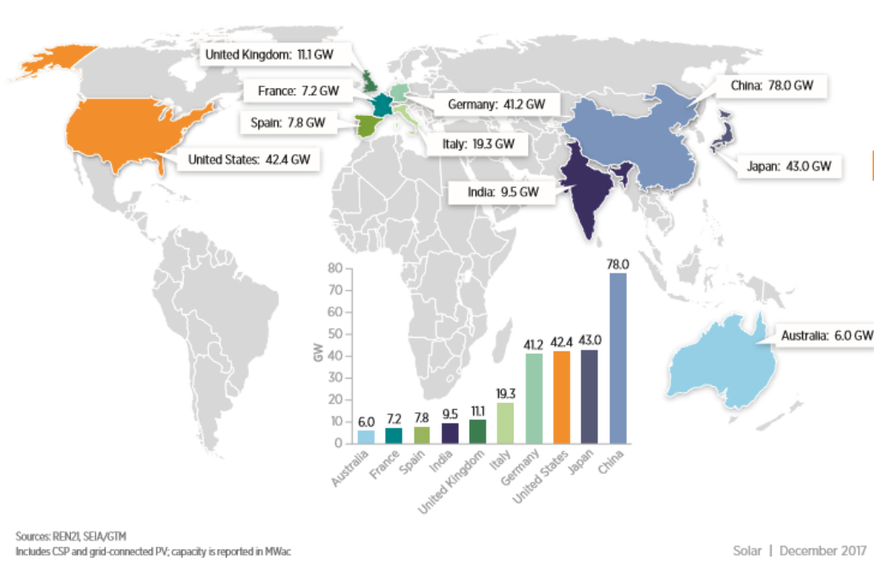
Top Countries for Installed PV Capacity
US Department of Energy, NREL 2016 Renewable Energy Data Book

Slide 18
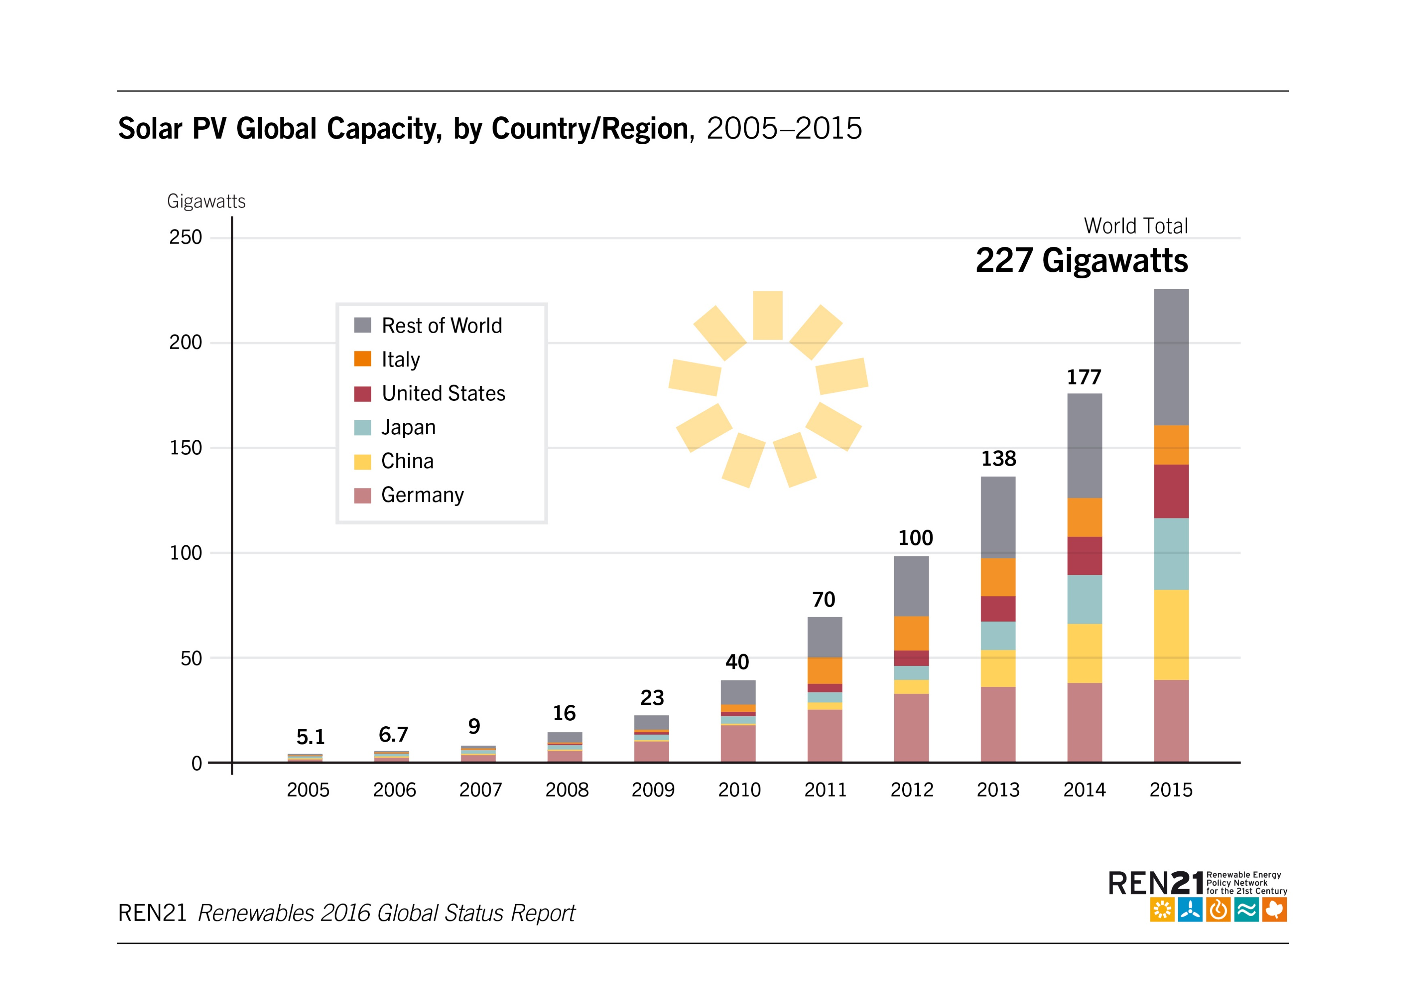
Global PV Growth
Exploring Solar ©2018 The NEED Project

Slide 19
Advantages of Solar Energy
Clean
Sustainable
Free
Provide electricity to remote places
Exploring Solar ©2018 The NEED Project
Notes:
Solar energy produces no air pollution, thermal pollution, or water pollution, and using solar energy does not disrupt the natural environment. The sun shines whether we use the energy or not. Solar energy is a sustainable energy source. Because the sun shines everywhere, and not just where people are, it can be used in places where electricity may not be otherwise available or practical.

Slide 20
Disadvantages of Solar Energy
Less efficient and costly equipment
Part Time
Reliability Depends On Location
Environmental Impact of PV Cell Production
Exploring Solar ©2018 The NEED Project
Notes:
Most photovoltaics are only 17-20% efficient. There are some experimental and developmental technologies being used in laboratories and by the space industry that are more efficient, but even those are only up to 43% efficiency. However, no energy is output in delivering the energy source to the PV panel; it is already right there to use, and does not require any initial energy or materials to get it to the site of use.
Because the sun does not shine all the time in any given location, it cannot be counted on for continuous energy. The amount of solar energy available depends on the latitude, climate, time of day, and amount of air pollution present. Clouds or particulate matter in the air will lessen the amount of solar energy available to use in a PV cell. Higher latitudes do not receive as intense of sunlight as more tropical areas, and therefore will not be able to produce as much power through photovoltaics. All of these limit the degree to which photovoltaics can be used.
Another negative aspect to using photovoltaics is in the production of the materials in a PV cell. The entire production process does have a negative environmental impact, primarily from the energy required to produce the PV cell. There is a very small amount of heavy metals, such as lead and cobalt, produced in the purification of the materials being used, but that is far less than the amount of carbon dioxide and other air pollutants produced when the electricity necessary for production is generated. Replacing conventional, fossil fuel based electrical power generation will significantly reduce this impact.

Slide 21
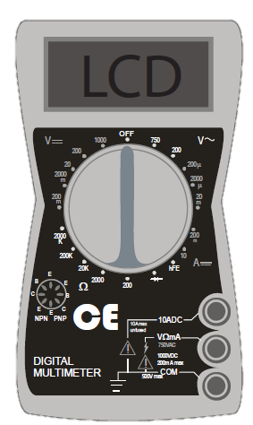
Using a Digital Multimeter
Indicates voltage from alternating current. Do not use.
DC Voltage Scale
DC Current Scale
Resistance Scale. Do not use.
Exploring Solar ©2018 The NEED Project
Notes:
DC Voltage
Connect RED lead to VΩmA socket and BLACK to COM.
Set SWITCH to highest setting on DC VOLTAGE scale (1000).
Connect leads to the device to be tested using the alligator clips provided.
Adjust SWITCH to lower settings until a satisfactory reading is obtained.
With the photovoltaic modules and array, the 20 setting usually provides the best reading.
DC Current
Connect RED lead to VΩmA connector and BLACK to COM.
Set SWITCH to 10 ADC setting.
Connect leads to the device to be tested using the alligator clips provided.
Note: The reading indicates DC AMPS; a reading of 0.25 amps equals 250 ma (milliamps).

Slide 22
Wiring the PV Modules
Series
Parallel

Slide 23
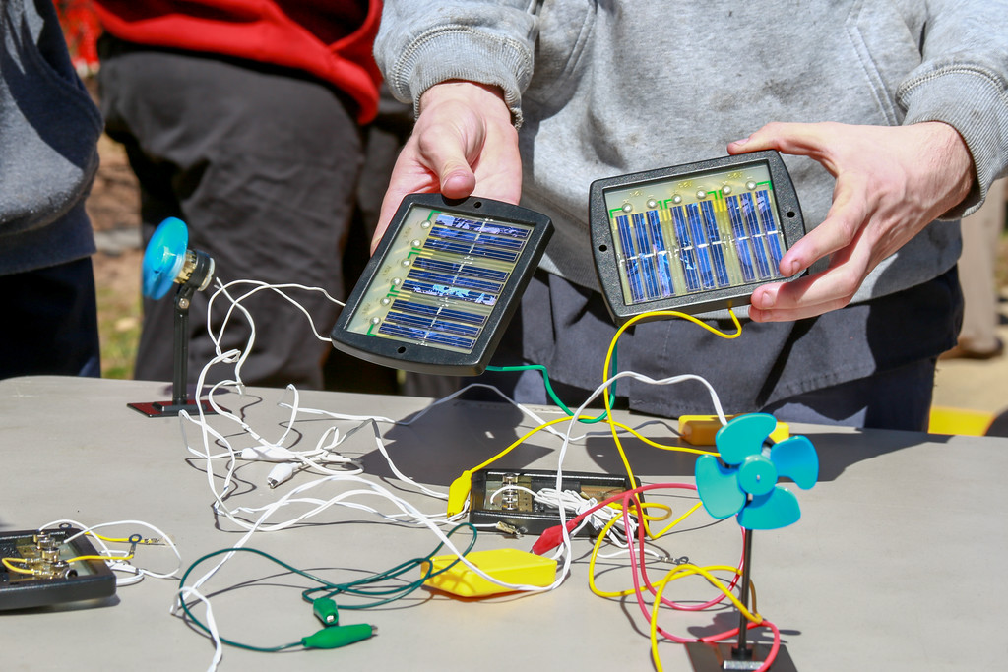
For More Information
The NEED Project
www.need.org
info@need.org
1-800-875-5029
Energy Information Administration
U.S. Department of Energy
www.eia.gov

Slide 24
NEED IS SOCIAL!
Stay up-to-date with NEED. “Like” us on Facebook! Search for The NEED Project, and check out all we’ve got going on!
Follow us on Twitter. We share the latest energy news from around the country, @NEED_Project.
Follow us on Instagram and check out the photos taken at NEED events, instagram.com/theneedproject.
Follow us on Pinterest and pin ideas to use in your classroom, Pinterest.com/NeedProject.

