Slide 1
The Science of Energy

Slide 2
Teacher Demo
BEFORE
AFTER
CHANGE
The Science of Energy ©2018 The NEED Project
Notes:
Do the Science of Energy Teacher Demonstration. This demonstration can be conducted in degrees C or degrees F. It is sometimes easier to use Fahrenheit, as it will show a greater difference in temperature.

Slide 3
Energy
Potential Energy
Stored energy and the energy of position
Kinetic Energy
Motion of waves, electrons, atoms, molecules, and substances
Notes:
Review how the forms of energy are classified. Use the Forms of Energy handout to begin this discussion.

Slide 4
Forms of Energy
POTENTIAL
Stored energy and the energy of position (gravitational).
CHEMICAL ENERGY is the energy story in the bonds between atoms in molecules. Gasoline and a piece of pizza are examples.
NUCLEAR ENERGY is the energy stored in the nucleus or center of an atom – the energy that holds the nucleus together. The energy in the nucleus of a plutonium atom is an example.
ELASTIC ENERGY is energy stored in objects by the application of force. Compressed springs and stretched rubber bands are examples.
GRAVITATIONAL POTENTIAL ENERGY is the energy or position.
A child at the top of a slide is an example.
KINETIC
The motion of waves, electrons, atoms, molecules, and substances.
RADIANT ENERGY is electromagnetic energy that travels in transverse waves. Light and x-rays are examples.
THERMAL ENERGY or heat is the internal energy in substances – the vibration or movement of atoms and molecules in substances. The heat from a fire is an example.
MOTION is the movement of a substance from one place to another. Wind and moving water examples.
SOUND is the movement of energy through substances in longitudinal waves. Echoes and music are examples.
ELECTRICAL ENERGY is the movement of electrons. Lightning and electricity are examples.
All forms of energy fall under two categories:
Potential
Kinetic
The Science of Energy ©2018 The NEED Project

Slide 5
Chemical Energy
Energy stored in the bonds of atoms and molecules
Nuclear Energy
Energy stored in the nucleus of an atom – the energy that holds the nucleus together
Potential Energy
Stored energy and the energy of position
Gravitational Energy
Energy of place or position
Elastic Energy
Energy stored in objects by the application of force.

Slide 6
Radiant Energy
Electromagnetic energy that travels in transverse waves
Thermal Energy
Internal energy in substances – vibration or movement of atoms and molecules in substances a.k.a. “heat”
Kinetic Energy
Motion of waves, electrons, atoms, molecules, and substances
Sound Energy
Movement of energy through substances in longitudinal waves
Electrical Energy
Movement of electrons
Motion
Movement of substance from one place to another

Slide 7
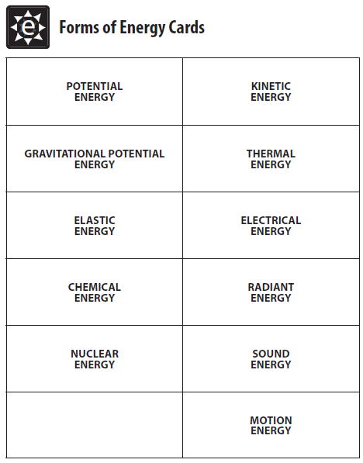
Energy Cards (Elementary SOE)
Cut the cards apart; clip them together
Students can use these to help show or work out energy transformations
Notes:
These cards are found in the Elementary SOE guide, but may be helpful for learners of any age. Some suggestions include: copying multiple sets per student to allow for complex flows, consider copying potential cards in one color and kinetic in another, etc.

Slide 8
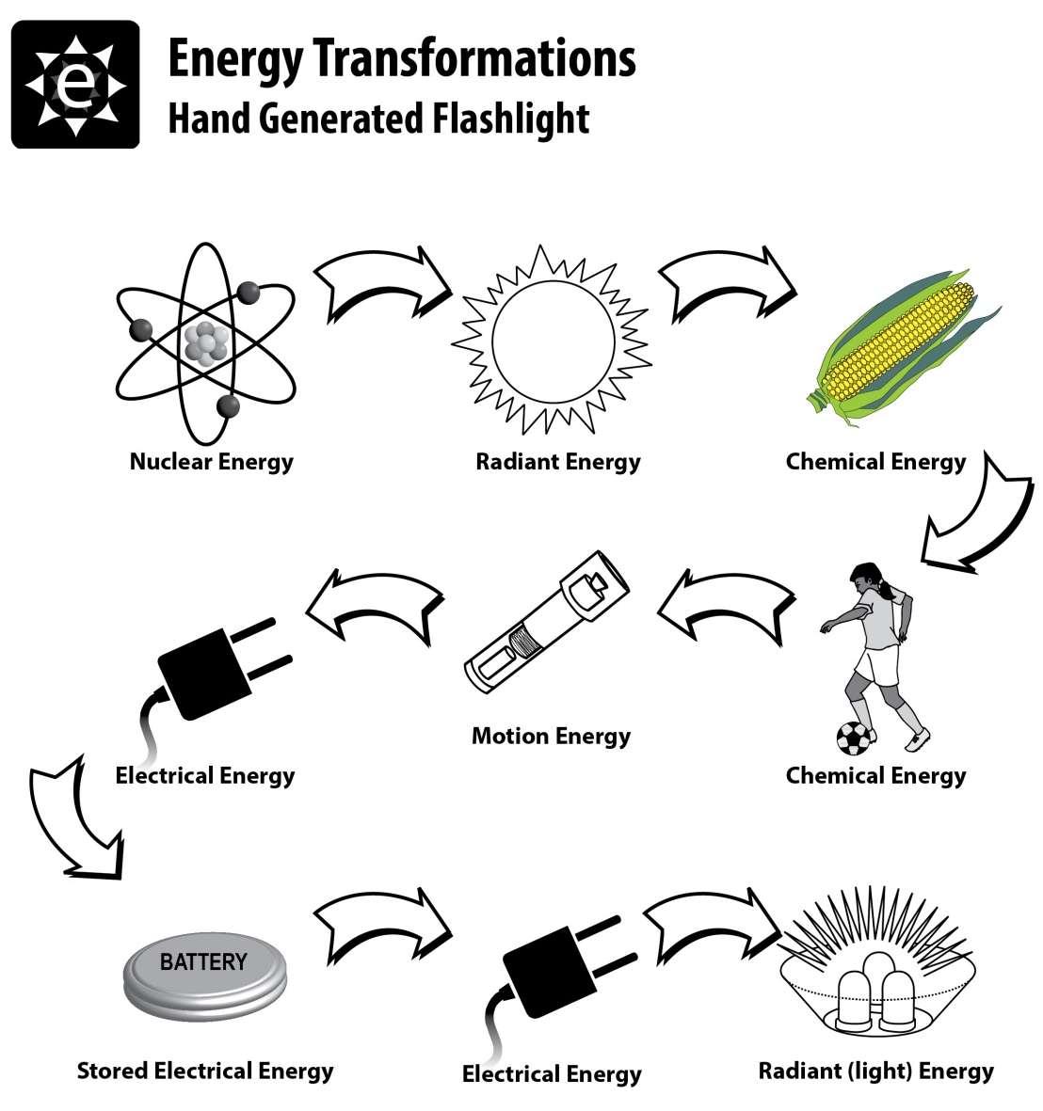
The Science of Energy ©2018 The NEED Project

Slide 9
Turning on the Light in Your Closet
Thermal
Sound
Radiant
Electrical
Motion
The Science of Energy ©2018 The NEED Project

Slide 10
Transition:
Forms to Sources
Chemical
Chemical
Chemical
Motion
Forms - how scientists classify energy
Sources - where we get the energy to make our lives more comfortable, convenient, & enjoyable
Chemical
Motion
Nuclear
Radiant
Chemical
Thermal
85.7%
8.7%
4.7%
0.6%
0.2%
89.5%
10.4%
The Science of Energy ©2018 The NEED Project
Notes:
This worksheet which is included in both Science of Energy Guides helps students learn the difference between forms of energy and energy sources and explains how they are related.
Again explain that forms of energy are how scientists classify the different kinds of energy. Energy sources are where we get the energy we use everyday to make our lives more comfortable and convenient. An example of this is the energy we receive from the sun comes in the form of radiant energy. We call this resource (source) solar energy.
Quickly explain how this sheet is used by students. Don’t spend too much time on it. Note that percentages may not equal 100 in total, due to independent rounding of figures.

Slide 11
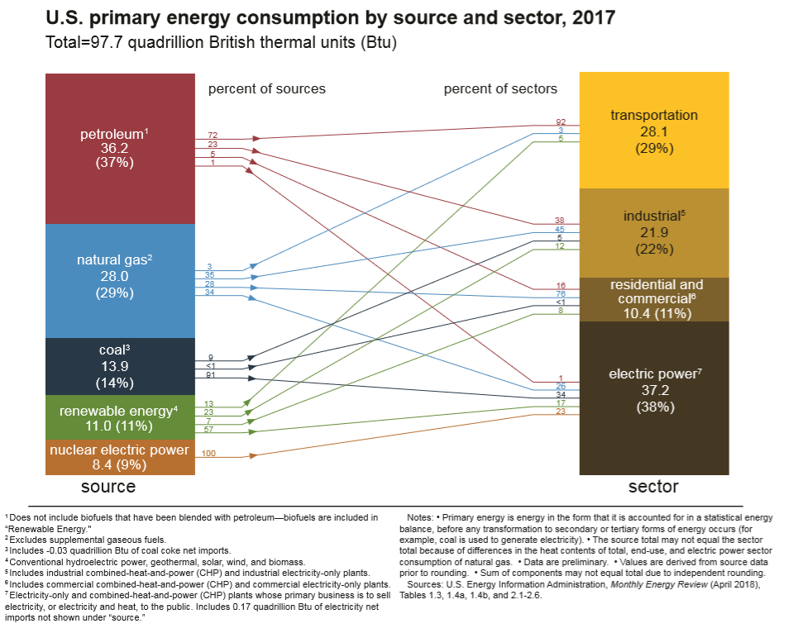
U.S. Primary Energy Flow by Source and Sector, 2017 (Quadrillion BTU)
©2018 The NEED Project

Slide 12
For More Information
The NEED Project
www.need.org
info@need.org
1-800-875-5029
Energy Information Administration
U.S. Department of Energy
www.eia.gov

Slide 13
NEED IS SOCIAL!
Stay up-to-date with NEED. “Like” us on Facebook! Search for The NEED Project, and check out all we’ve got going on!
Follow us on Twitter. We share the latest energy news from around the country, @NEED_Project.
Follow us on Instagram and check out the photos taken at NEED events, instagram.com/theneedproject.
Follow us on Pinterest and pin ideas to use in your classroom, Pinterest.com/NeedProject.
The Science of Energy - 2018 ©The NEED Project

