Slide 1
Shark Tank: The Girls Inc. Edition
April 27, 2016

Slide 2
Community Project
5th & 6th grade girls collaborated to create a Prototype cell phone app to inspire their friends and family members to conserve energy.
Through the PEEP program, students learned about the science of energy, energy sources, and energy conservation/efficiency.
The cell phone apps were then shared with friends and family members to engage their interest in purchasing the app.

Slide 3
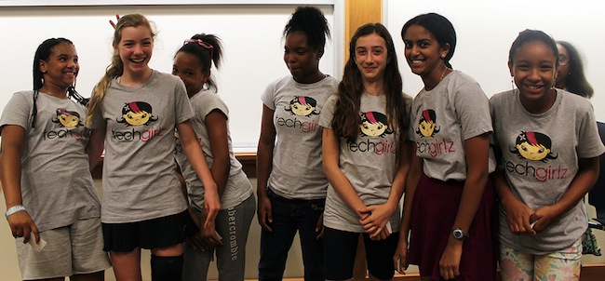
Designing Mobile Apps
April 5: Brainstorming
April 12: Creating User Journeys: Designing the user experience
April 19: Creating prototypes & Sharing
April 27: Community presentations!

Slide 4
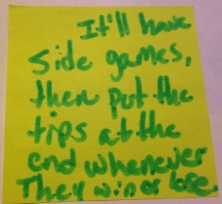
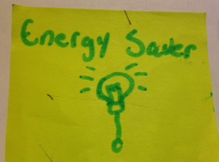
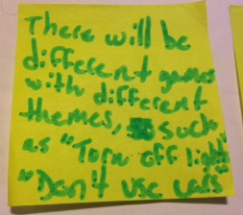
Energy Saver
Melany Tavarez
Vivian
Libryah Peterson
Check out the app: https://popapp.in/projects/571660ff6f20f0695f218cd4/preview

Slide 5
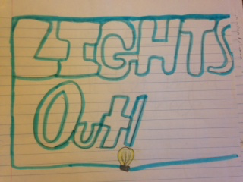
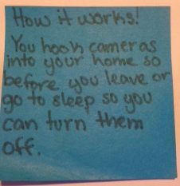
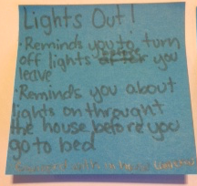
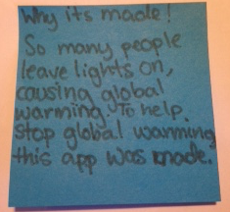
Lights Out!
Meadow Livingston
Check out the app: https://popapp.in/projects/57165da3451d90c2460a22b8/preview

Slide 6
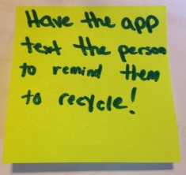
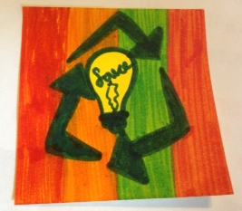
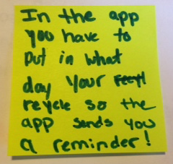
Recycle Reminder!
Marisol Diaz
Tiffany Nguyen
Noeliz Soto
Destini Velez
Check out the app: https://popapp.in/projects/57201040606542f14a3e6b81/preview

Slide 7
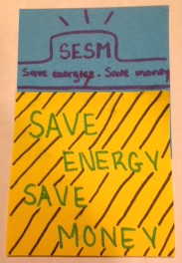
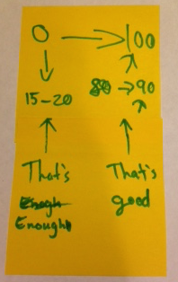
Save Energy Save Money
Han Duong
Tina Nguyen
Selena
Check out the app: https://popapp.in/projects/5720130c207da3801fbe5e39/preview

Slide 8
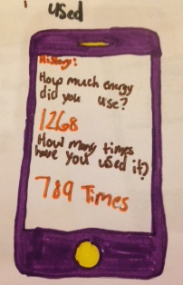
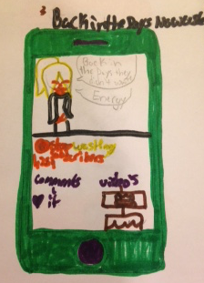
Ways to Save Energy
Alyssa S. Burgess
Check out the app: https://popapp.in/projects/572019841e019ddd3e4d7290/preview

Slide 9
