Slide 1
THE CHEMISTRY INDUSTRY AND ENERGY EFFICIENCY

Slide 2
CHEMISTRY’S ROLE IN YOUR LIFE
Synthetic materials prolong and improve our quality of life
Many products improve energy efficiency
Insulation minimizes thermal energy transfer in homes and refrigerators
Fertilizers reduce energy usage by increasing crop yield
Efficient lighting materials made by chemistry industry reduce electricity consumption

Slide 3
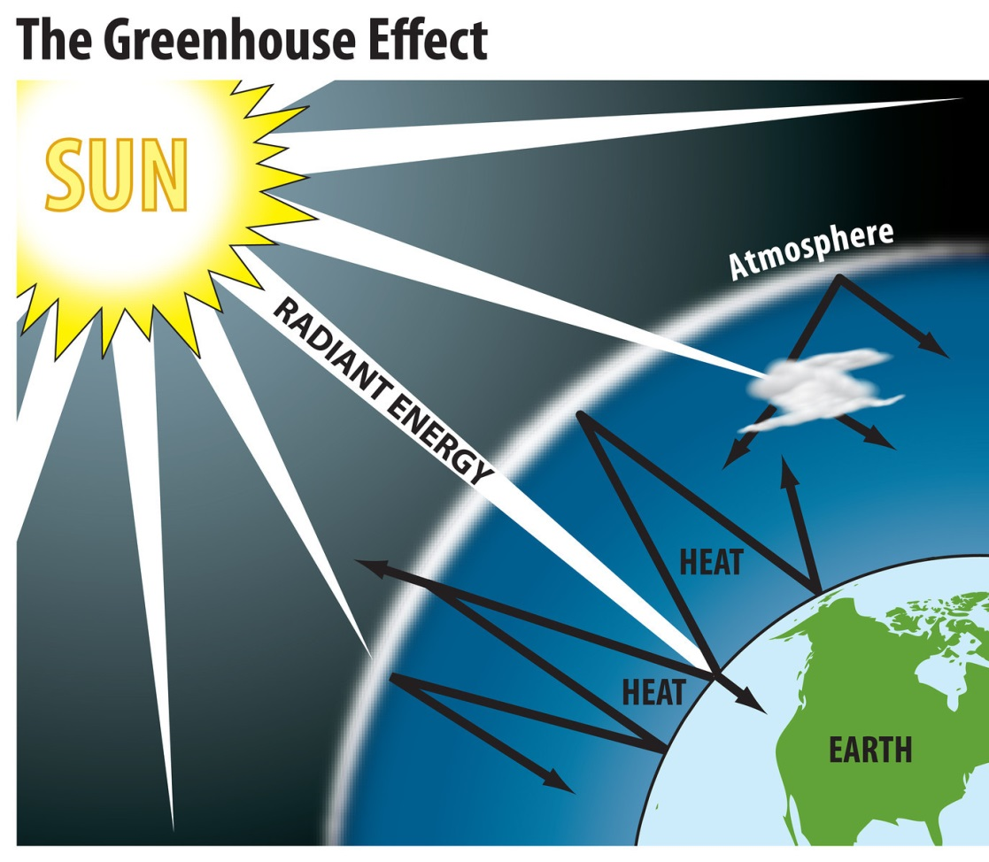
CLIMATE CHANGE
Electromagnetic radiation travels from the sun through space and strikes surfaces on the earth
Radiant energy is absorbed and some transformed into thermal energy which radiates back out into space
Some of that thermal energy is absorbed and trapped in molecules of greenhouse gases in the atmosphere
These warmed gases increase the temperature of the atmosphere

Slide 4
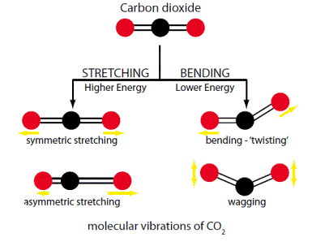
GREENHOUSE GASES
CO₂, H₂O, CH₄, and NO are greenhouse gases
They hold energy because of the flexibility of the bonds in the molecule
Stretching, bending, twisting, rotation, and vibration of bonds allows kinetic energy to be stored
Nitrogen and oxygen gases do not have the same flexibility in the bonding structure as the greenhouse gases.

Slide 5
NUTRIENT CYCLES
The exchange of elements from biotic to abiotic reserves in a ecosystem
Those elements that are cycled are water, carbon, nitrogen, phosphorous.
The imbalance of nutrients with these cycles presents problems for the ecosystem
Human activity has made a great impact on these cycles.

Slide 6
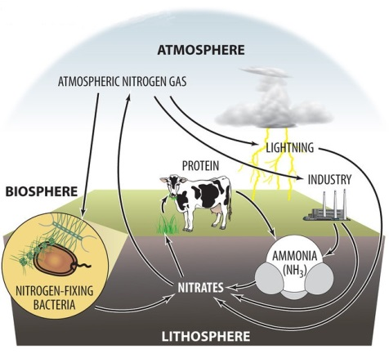
NITROGEN CYLCE
Atmosphere – Nitrogen gas (N₂)
Lithosphere – Nitrates and ammonia
Biosphere – Proteins and Nucleic Acids
Nitrogen fixation
Hydrosphere – Nitrates

Slide 7
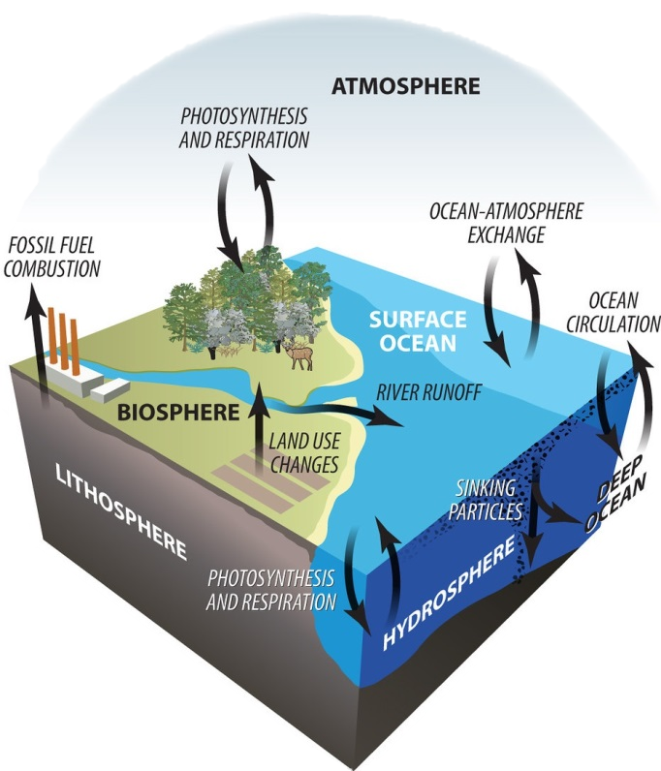
CARBON CYCLE
Lithosphere – carbonates, fossil fuels
Hydrosphere – carbonates and dissolved carbon dioxide gas
Biosphere – carbohydrates, proteins, nucleic acids
Atmosphere – carbon dioxide and methane

Slide 8
For More Information
The NEED Project
www.need.org
info@need.org
1-800-875-5029
Energy Information Administration
U.S. Department of Energy
www.eia.gov
Climate Change- 7/13/17 - ©The NEED Project

Slide 9
NEED IS SOCIAL!
Stay up-to-date with NEED. “Like” us on Facebook! Search for The NEED Project, and check out all we’ve got going on!
Follow us on Twitter. We share the latest energy news from around the country, @NEED_Project.
Follow us on Instagram and check out the photos taken at NEED events, instagram.com/theneedproject.
Follow us on Pinterest and pin ideas to use in your classroom, Pinterest.com/NeedProject.
Follow us on Snapchat to see us live in action at various NEED activities/events, need_project

