Slide 1
Windows, Insulation, and Lighting

Slide 2
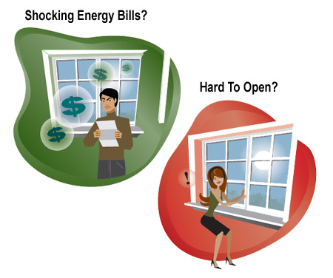
Are Your Windows …

Slide 3
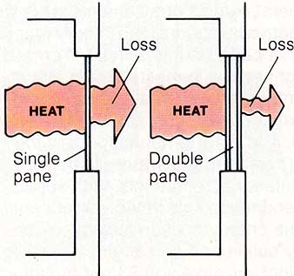
Types of Windows

Slide 4
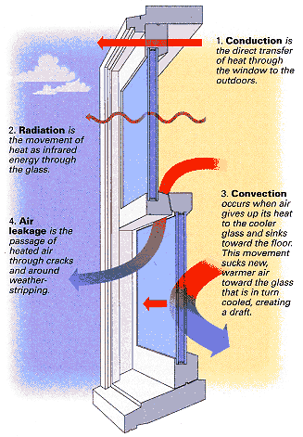
Four Things to Consider
Conduction
Radiation
Convection
Air Leakage

Slide 5
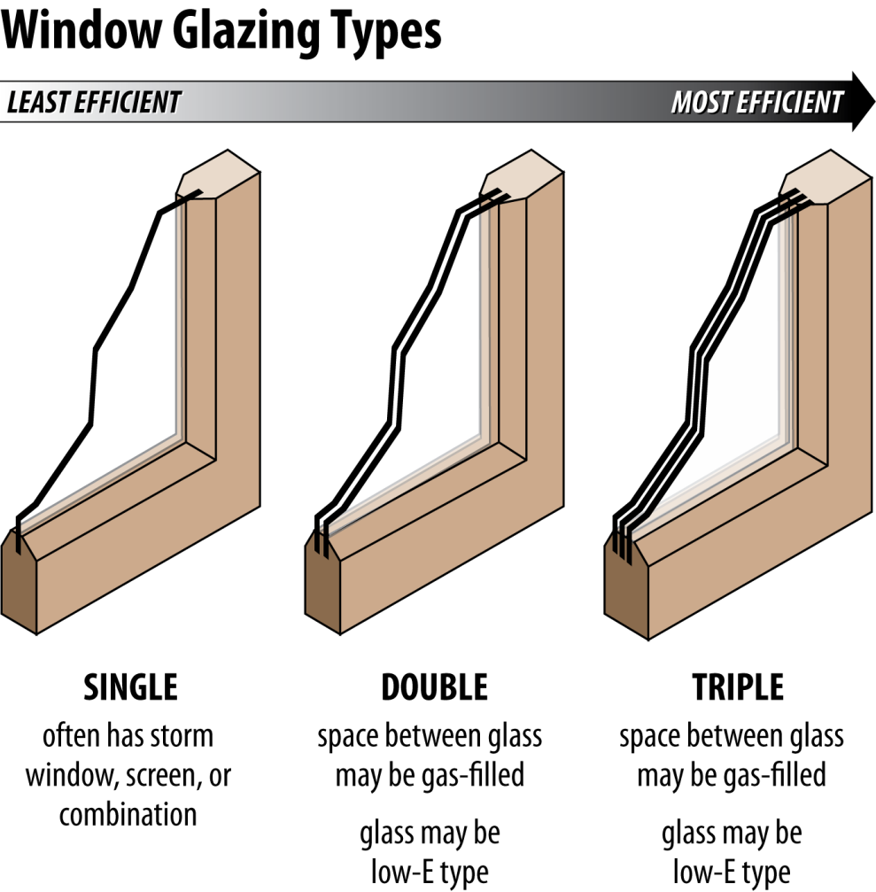
What type of windows do you have at your house?

Slide 6
Double Pane Window

Slide 7
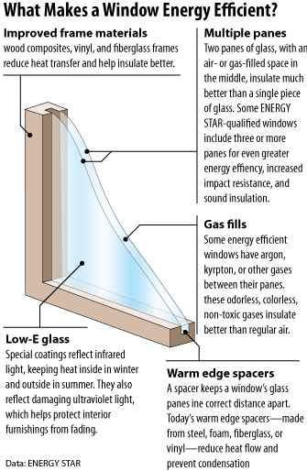
What Makes a Window Energy Efficient

Slide 8
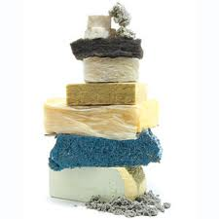
Insulation

Slide 9
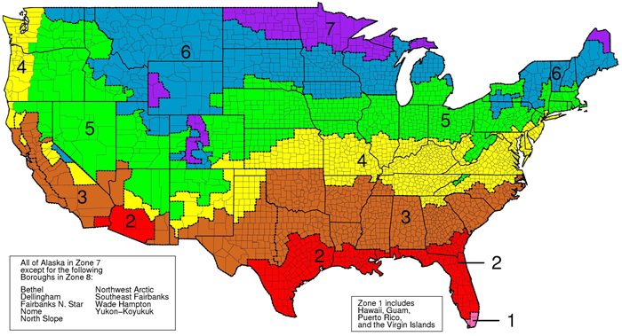
Where You Live (zone) is Key…

Slide 10
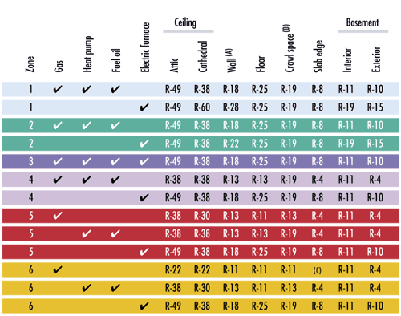
Insulation Requirements

Slide 11
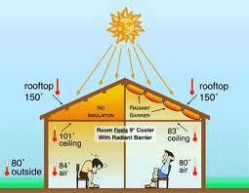
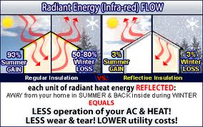
Why do we need insulation?

Slide 12
Heat Loss

Slide 13
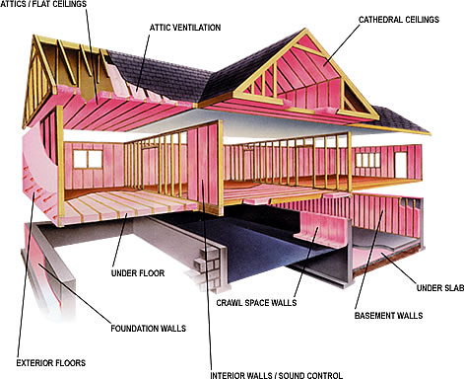
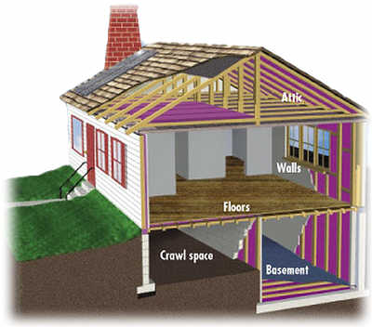
Where should insulation be?

Slide 14
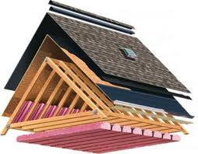
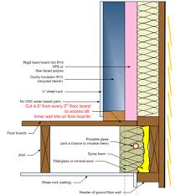
How it’s built …. roof and walls

Slide 15
For More Information
The NEED Project
www.need.org
info@need.org
1-800-875-5029
Energy Information Administration
U.S. Department of Energy
www.eia.gov

Slide 16
NEED IS SOCIAL!
Stay up-to-date with NEED. “Like” us on Facebook! Search for The NEED Project, and check out all we’ve got going on!
Follow us on Twitter. We share the latest energy news from around the country, @NEED_Project.
Follow us on Instagram and check out the photos taken at NEED events, instagram.com/theneedproject.
Follow us on Pinterest and pin ideas to use in your classroom, Pinterest.com/NeedProject.
Follow us on Snapchat to see us live in action at various NEED activities/events, need_project

