Slide 1
Building Science

Slide 2
ENERGY
The ability to do work or cause change.
THERMAL ENERGY
A form of kinetic energy
The internal energy of substances.
TEMPERATURE
A way to measure kinetic energy
Average kinetic energy of particles in a substance.

Slide 3
Transferring Thermal Energy
Transfer via Direct Contact
Conduction
Thermal energy always transfers from high temperature to low temperature.
Convection
Radiation
Transfer via Flowing Fluid
Transfer via Energy Waves
Building Science 2018 ©The NEED Project
Notes:
Thermal energy is always moving. It flows from areas of higher temperature to areas of lower temperature. Heat transfer occurs via conduction, convection, and radiation.

Slide 4
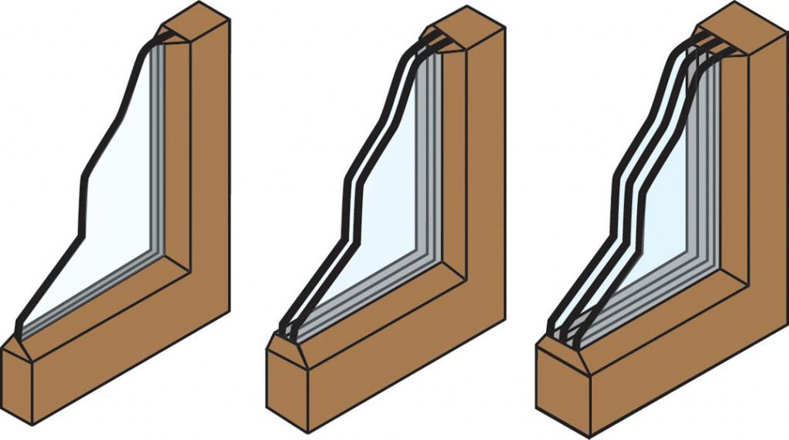
Insulators…
…block conduction by being discontinuous fibers made from poor conductors
…block convection by trapping small air pockets and blocking air flow
…block radiation by being reflective
Building Science 2018 ©The NEED Project

Slide 5
High Temperature = Fast Particles
((((((((((( ))))))))))))
((((((((((( ))))))))))))
((
((
((
))
(((( ))))
((
))
(((( ))))
(((( ))))
((((((((((( ))))))))))))
((
((
))
((((((((((( ))))))))))))
((
))
))
(((( ))))
(((( ))))
(((( ))))
(((( ))))
((((((((((( ))))))))))))
((
))
(((( ))))
((((((((((( ))))))))))))
((
))
((
))
Solid
(((( ))))
((((((((((( ))))))))))))
((((((((((( ))))))))))))
Liquid
Gas
((((((((((( ))))))))))))
(((((((((((((((((((( ))))))))))))))))))))))
(((((((((((((((((((( ))))))))))))))))))))))
(((((((((((((((((((( ))))))))))))))))))))))
(((((((((((((((((((( ))))))))))))))))))))))
(((((((((((((((((((( ))))))))))))))))))))))
Hot Gas
(((((((((((((((((((( ))))))))))))))))))))))
(((((((((((((((((((( ))))))))))))))))))))))
(((((((((((((((((((( ))))))))))))))))))))))
Building Science 2018 ©The NEED Project

Slide 6
Temperature and Moisture
Hotter gases can hold more moisture
((((((((((( ))))))))))))
((((((((((( ))))))))))))
((((((((((( ))))))))))))
((((((((((( ))))))))))))
((((((((((( ))))))))))))
((((((((((( ))))))))))))
((((((((((( ))))))))))))
((((((((((( ))))))))))))
Gas
((((((((((( ))))))))))))
(((((((((((((((((((( ))))))))))))))))))))))
(((((((((((((((((((( ))))))))))))))))))))))
(((((((((((((((((((( ))))))))))))))))))))))
(((((((((((((((((((( ))))))))))))))))))))))
(((((((((((((((((((( ))))))))))))))))))))))
Hot Gas
(((((((((((((((((((( ))))))))))))))))))))))
(((((((((((((((((((( ))))))))))))))))))))))
(((((((((((((((((((( ))))))))))))))))))))))
(((((((((((((((((((( ))))))))))))))))))))))
Building Science 2018 ©The NEED Project

Slide 7
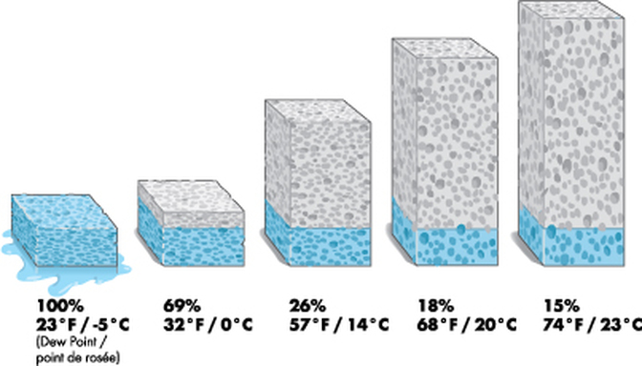
Relative Humidity
Building Science 2018 ©The NEED Project
Notes:
Relative humidity measures the amount of water vapor in the air relative to the amount of water vapor the air is able to hold, which depends, in part, on the temperature of the air. Relative humidity levels that are too high can contribute to the growth and spread of unhealthy biological pollutants, such as mold and mildew.

Slide 8
Electricity
Electrons are always moving.
Electrical conductors have overlapping electron shells – allow for free movement of electrons through material.
Electricity is a purposeful, directional transfer of energy in electrons through a conductor.
A Coulomb (C) is the unit for measuring the amount of electrical charge, whether positive or negative.
An Ampere (A) is the unit for measuring how many Coulombs move past a point in a second – current.
A Volt (V) is the unit for measuring the potential (ability) for a charge to move - voltage.
Building Science 2018 ©The NEED Project

Slide 9
Electrical Current
Electrons do not “flow through” a conductor – not a row of soldiers marching in line.
Electrons move and bump along through a conductor, passing their energy to each other and sometimes moving through the conductor.
The work is done by the electrons.
More electrons = greater current = more work can be done
Measured in Amperes, or simply Amps.
Building Science 2018 ©The NEED Project

Slide 10
Voltage
The potential for an electron to move is its voltage
Analogous to the pressure of water
High voltages give electrons the ability to do difficult work
Building Science 2018 ©The NEED Project

Slide 11
Voltage x Current = Power
Power = rate (speed) at which work is done
Power is measured in Watts (W)
High voltage with low current = do a little bit of difficult work
Low voltage with high current = do a lot of easy work
Electricity from the utility is measured in kilowatt-hours (kWh)
One kilowatt-hour is 1,000 watts used in one hour
Both of these scenarios could require the same amount of power.
Building Science 2018 ©The NEED Project

Slide 12
Common Residential Lighting Types
Incandescent
Fluorescent
Light-emitting Diode (LED)
Lumens is the light given off by a bulb.
Watts is the amount of energy it takes to operate the bulb.
To compare bulbs, compare lumens, not watts!
Building Science 2018 ©The NEED Project

Slide 13
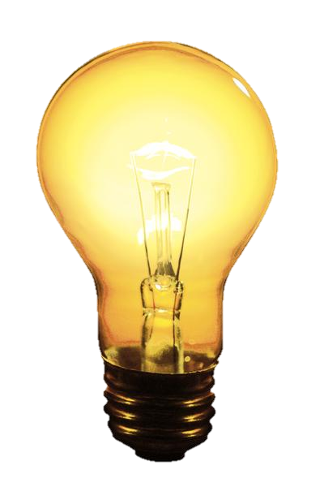
Incandescent Lighting
Produce light by getting hot
Friction of electrons in filament
Incandesces
Exceptionally inefficient – 10% electrical energy is transformed to light (90% not used for light)
Generally unchanged since Edison
“Energy Efficient” incandescent bulbs have bubble of inert gas around filament
“Energy Efficient” bulbs use 25% less energy for same lumens as traditional incandescent
Building Science 2018 ©The NEED Project

Slide 14
Fluorescent Lighting
Two-step lighting process
Mercury vapor absorbs electrical energy and its electrons get energized
Energized Hg electrons release energy as UV light
Phosphor coating on inside absorbs UV light
Energized phosphor electrons release energy as visible light
Image credit: http://www.safespectrum.com/light_fluorescent.php
Building Science 2018 ©The NEED Project

Slide 15
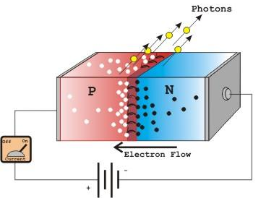
Light-emitting Diodes (LEDs)
Solid, very efficient
Works like a PV cell in reverse
Current will only flow in one direction
Current energizes electrons and they move from N-type across depletion zone to P-type
Electrons then return to lower energy state and release energy as light
Image credit: http://www.imagesco.com/articles/photovoltaic/photovoltaic-pg4.html
Building Science 2018 ©The NEED Project

Slide 16
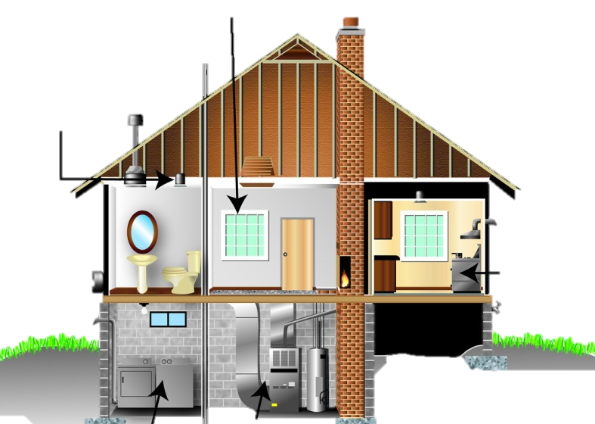
Building Envelope
All the systems of a building combine to determine its energy efficiency.
Lighting
A Building is a System
Electrical Appliances and Devices
HVAC Systems

Slide 17
Building Science
All systems have to be in good working order to be efficient
Air flow in and out of building must be regulated
Entire building envelope must be properly insulated
Interruptions in building envelope (doors, windows, light fixtures, chimneys, etc.) must be properly sealed
HVAC must be cleaned and maintained
Proper and efficient lighting should be used
Building Science 2018 ©The NEED Project

Slide 18
What’s Happening Here?

Slide 19
Attic Air Sealing
Before
After
Building Science 2018 ©The NEED Project

Slide 20
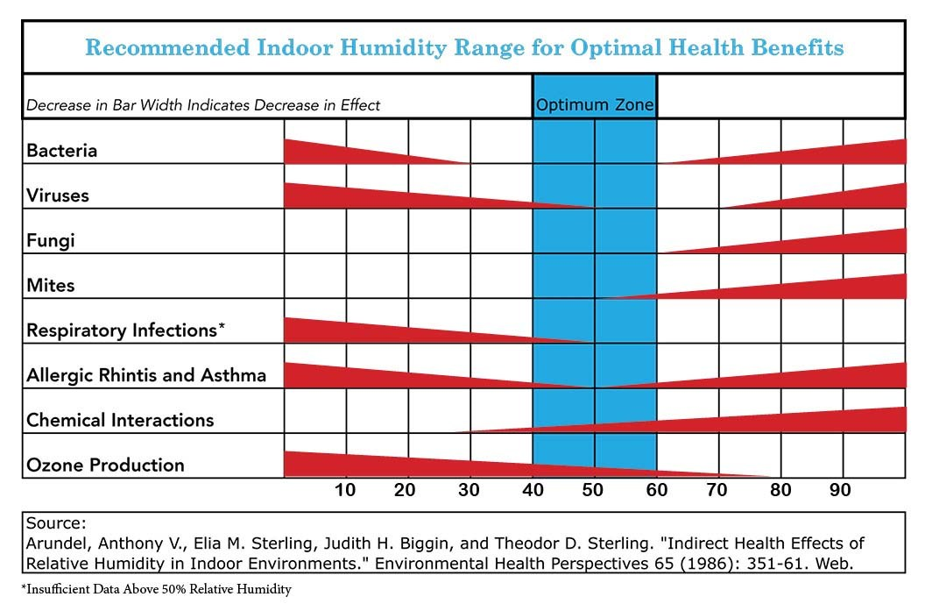
Optimum Indoor Humidity
Building Science 2018 ©The NEED Project

Slide 21
Blower Door Test
Measures the amount of air flow through a house
Used to determine:
How much air sealing is needed prior to weatherization
If there is enough air flow after weatherization
Building Science 2018 ©The NEED Project

Slide 22
Building Science Activities
Conduction – Insulbox and heating pad; measure with IR thermometer
Radiation – make predictions and test with IR thermometer
Convection – Home Airflow Simulation
Comparing Appliances – calculating payback period
Building Science 2018 ©The NEED Project

Slide 23
For More Information
The NEED Project
www.need.org
info@need.org
1-800-875-5029
Energy Information Administration
U.S. Department of Energy
www.eia.gov
Building Science 2018 ©The NEED Project

Slide 24
NEED IS SOCIAL!
Stay up-to-date with NEED. “Like” us on Facebook! Search for The NEED Project, and check out all we’ve got going on!
Follow us on Twitter. We share the latest energy news from around the country, @NEED_Project.
Follow us on Instagram and check out the photos taken at NEED events, instagram.com/theneedproject.
Follow us on Pinterest and pin ideas to use in your classroom, Pinterest.com/NeedProject.
Building Science 2018 ©The NEED Project

