Slide 1
EnergyWorks
Yes, Indeed it does!
Notes:
The Law of Conservation of Matter/Energy – energy (matter) is neither created nor destroyed; it merely changes form (state).
[Side note: Scientists no longer distinguish between energy and matter, as matter, mass, is probably made of really, really, really condensed energy, and they are related to each other by Einstein’s equation, E=mc², where E is energy, m is mass, and c is the speed of light.]
The amount of energy (matter) present in the universe remains the same all the time (called remaining constant)
Absolute zero is -273 °C or -459 °F. Absolute zero is an impossible temperature to reach because it means there is absolutely zero energy in the substance, and all substances have at least a little energy. Laboratories have been able to get very, very, very, very close to absolute zero, but they’re trying to move energy from a very low temperature to a higher temperature, and the colder something gets the harder this is to do.

Slide 2
What is Energy?
Energy is the ability to do work or cause a change
Law of Conservation of Matter/Energy
The more energy matter has, the more likely it is to be liquid or gas
“Absolute zero” means no energy – Zero degrees Kelvin – theoretical because all substances have some energy
Notes:
These two scales of temperature measure the same thing – changes in average kinetic energy of the particles of the substance. Ice requires the same amount of thermal energy to melt, and water requires the same amount of thermal energy to boil, regardless of the scale being used to measure the temperature. The change in energy from melting to boiling is the same, though the number of degrees is different. Thus, a Fahrenheit degree shows a smaller change in average kinetic energy than a Celsius degree does, because there are 180 incremental degrees from melting to boiling as compared to 100 on the Celsius scale.
When calculating the equivalent temperature from one temperature scale to another, the 5/9 fraction in the conversion equation comes from the ratio of Celsius to Fahrenheit degrees (or 9/5 for Fahrenheit to Celsius). The adding or subtracting 32 accounts for the fact that the Fahrenheit scale is offset from 0 by 32 degrees. Celsius shows melting at 0, Fahrenheit shows melting at 32.

Slide 3
Temperature Scales
Ratio is
5 Celsius to
9 Fahrenheit

Slide 4
Heat / Thermal Energy
Thermal energy is the internal energy of substances
Causes particle motion
Temperature ≠ heat!
Heat is a verb!
Energy always spontaneously transfers from high temperature to low temperature
Notes:
Thermal energy is the energy that causes the particles to move. The more thermal energy an object has, the more the particles are moving. Thus, the higher the thermal energy content, the more likely an object is to be a liquid or a gas.

Slide 5
Energy in States of Matter
((((((((((( ))))))))))))
((((((((((( ))))))))))))
((
((
((
))
((((((((((( ))))))))))))
((
))
(((( ))))
(((( ))))
(((( ))))
((((((((((( ))))))))))))
((
((
))
((
))
))
(((( ))))
(((( ))))
((((((((((( ))))))))))))
(((( ))))
(((( ))))
((((((((((( ))))))))))))
((
))
((
))
((
))
(((( ))))
Solid
(((( ))))
((((((((((( ))))))))))))
((((((((((( ))))))))))))
Gas
Liquid
((((((((((( ))))))))))))
Notes:
Little lightning bolts represent the attractive forces from one atom or molecule to another.
Solids have the least amount of energy of the three states; the particles are held in place by those attractive forces.
Liquid particles have enough energy to move around, but not enough to completely break free of the attractive forces.
Gas particles have enough energy to move around and break free of the attractive forces.

Slide 6
Transferring Thermal Energy
Transfer via Direct Contact
Convection
Radiation
Transfer via Flowing Fluid
Transfer via Energy Waves
Notes:
Thermal energy is transferred from one object or substance to another in three ways:
Conduction occurs when thermal energy is transferred between two objects that are in direct contact with each other. An example is a pan on an electric burner or hot plate.
Convection occurs when a fluid is warmed and then circulates, distributing thermal energy along the way. Ocean currents and a forced-air furnace are examples of convection.
Radiation is how we refer to infrared radiation. It is the thermal energy being sent out – radiated – from the source of heat. An example is a camp fire or the sun.

Slide 7
Thermal Energy Transfer Activity
Time to move it, move it!
This is a great way to model conduction, convection, and radiation
THIS IS FUN and maybe a little chaotic
Instructions listed in “notes” with this slide
Materials needed:
Wadded up scrap paper (lots of it, 2 or 3 pieces per student)
Two buckets
Willing participants
Notes:
Raid the recycling bin in your classroom for some scrap paper. It can still be recycled after this activity, that’s the beauty of it! Have your students crumble the paper up if getting extra energy out of their system is needed.
To model conduction, have your students stand in a line side-by-side across the room. Make sure they are close enough to be able to pass things to each other. Place one bucket on one end of the line and the other on the other end of the line. Place all the paper wads in one bucket. Students pass the paper wads along, depositing them into the buckets on the end, until the “heat” is evenly distributed along the line.
Convection is modeled by having the students move in a long, narrow circle. Place the buckets on opposite sides of the room and indicate a circular pathway the students should move in. Place all the “heat” (paper wads) in one bucket. Students circulate, picking up a piece of paper and depositing it into the other bucket. Continue doing this until the paper wads are evenly distributed between the two buckets and group of students.
Radiation is modeled in the most fun way of all! You will stand at the front of the room holding one bucket. Your students will be given “heat” (paper wads) evenly distributed – so 2 per student, 3 per student, until they’re evenly distributed. Then they will “radiate” them at you by throwing them toward you and your bucket. You will then radiate them back at the students, and so on, until the “heat” is evenly distributed.

Slide 8
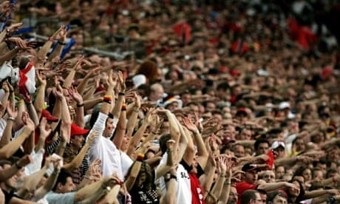
Before We Go Any Further…
Let’s talk about waves!
A wave is a disturbance in a medium. In this case, the disturbance is the people standing and the medium is the crowd of seated people.
Photograph: Reuters
Notes:
Waves often transfer energy from one place to another. If we imagine the lifting of the arms and standing of the people to be the “energy” in this video, then they are “passing” that energy from person to person as they lift their arms and stand, then sit back down again.
Waves have a frequency – which means how many complete waves pass a point in a certain time period, usually a second. They’re counted in Hertz, or Hz. Thus, 5 waves in one second is 5 Hz.
Waves have a wavelength – the distance from one wave to the same point on the next wave. The longer the wavelength, the lower the frequency. The shorter the wavelength, the higher the frequency. (Inverse relationship)
Waves have an amplitude – which means the extent to which the medium is disturbed. Imagine the people in the video only stood, and didn’t lift their arms. The amplitude would be less as compared to them standing AND lifting their arms above their head. The disturbance is greater in the arm-lifting, so the amplitude is greater.
Remember these terms, frequency, wavelength, and amplitude, as we talk about waves and energy. To learn more about waves, visit http://hyperphysics.phy-astr.gsu.edu/hbase/sound/trawvcon.html#c1

Slide 9
Light / Radiant Energy
Light is electromagnetic radiation
E-mags have an electric field component
E-mags also have a magnetic field component
When one field changes, it changes the other, propelling itself along.
Light travels in transverse waves.
Visible light is a very tiny sliver of the electromagnetic spectrum
Notes:
Electricity and magnetism are always related to each other. Electric and magnetic fields exist when electric or magnetic objects move. Moving an electric charge will generate a magnetic field, and moving a magnet will generate an electric field. Thus, electromagnetic radiation is able to propel itself through empty space. The medium that is being disturbed in electromagnetic radiation is the electric/magnetic field.
It’s kind of hard to understand, really, so don’t think about it too long. Reality is that electromagnetism is one of the four fundamental forces of nature that can’t really be explained, though it can be observed, measured, and predicted. (The other three are gravity, strong nuclear force, and weak nuclear force. Those are discussions for other times.)
The key to understand here is that light has both an electric component and a magnetic component, and those two are always changing according to the wavelength / frequency of the light.

Slide 10
Anatomy of a Transverse Wave
Notes:
In a transverse wave, the change, or oscillation, is perpendicular to the direction the wave is traveling. Notice the wave oscillates up and down but travels to the right of the frame.
In the case of light, the greater the amplitude, the brighter the light. As the wavelength increases (gets longer) the frequency decreases, and v/v.

Slide 11
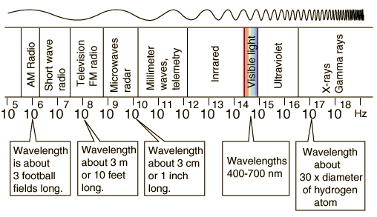
The Visible Spectrum
Low frequency, low energy
High frequency, high energy
Notes:
Visible light is a very tiny sliver of the entire electromagnetic spectrum. All of the types of waves listed here are part of the electromagnetic spectrum. Every color with which you’re familiar is in that tiny little sliver, with wavelengths of only 400-700 nanometers (one-billionth of a meter). That means upwards of 100 billion waves pass a point in one second. That’s a lot…
Like most stars, the sun emits a broad range of electromagnetic radiation, including radio, infrared, visible, ultra-violet, and gamma waves. Our eyes’ photoreceptors are designed to only respond to that narrow band of visible light. Other species’ vision may respond to a different range of wavelengths. For example, the honey bee’s vision is shifted toward the ultra-violet, meaning what we “see” as “yellow” might be seen as “red” by a honey bee.
The “brightness” or intensity of light depends on the amplitude of the wave. The brighter the light, the greater the amplitude.

Slide 12
Refraction & Reflection
Light changes its direction when changing medium (refraction)
Light can bounce off a surface (reflection)
Notes:
The photograph shows a piece of wood sticking out of water. The wood is straight, and goes down to the soil beneath the water as shown by the black line. However, the water refracts the light to make the wood look bent, as shown by the red line. The green line shows the reflection of the top part of the wood off of the surface of the water.
When light reflects, it bounces back at the same angle it came in. So if the light comes into the surface at 45 degrees, it will bounce off at 45 degrees.
The angle of refraction depends on the medium. Space has no refraction. Our atmosphere has a bit of a refraction, and water has more pronounced refraction. So does glass, and a really strong refraction is a prism, which bends the light so much it spreads out its individual colors.

Slide 13
Sound
Unlike light, sound requires matter to transmit its energy
Sound travels in longitudinal waves
Sound travels better in higher density materials
Humans hear sounds from 20 Hz to 20,000 Hz
Elephants hear sounds from 14 Hz to 12,000 Hz
Dogs hear sounds from 67 Hz to 45,000 Hz
Notes:
Sound waves are compressions. Thus the vibration is in the same direction as the direction the wave travels, called a longitudinal wave. This is why sound needs something with mass to transfer it. As you can imagine, as the density of the material increases, its ability to transmit sound also increases. This is because the particles in a dense material, like a piece of glass or tub of cold water, are closer together than they are in air, so they transfer the energy better.
One type of the energy waves generated by an earthquake is a longitudinal wave. It is transferred very well by rock layers because they are so dense.

Slide 14
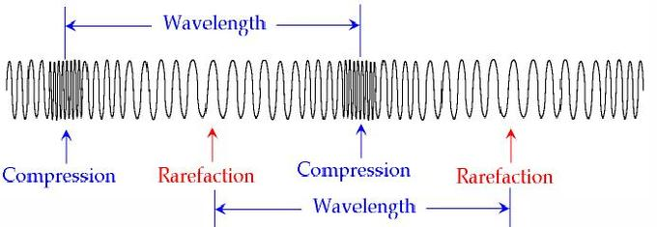
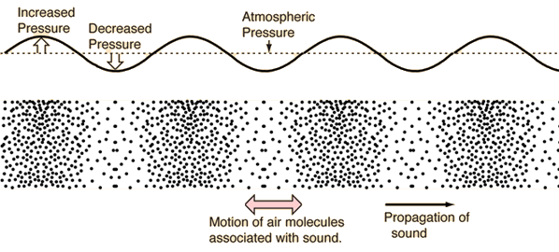
Anatomy of a Longitudinal Wave
Wave oscillates and travels in the same direction
Notes:
Measuring the amplitude of a longitudinal wave is tricky. It is related to how close together the compression region is. In other words, a more intense longitudinal wave has a greater compression effect on the medium. In the case of the spring above, the coils of the spring are most tightly compacted in a wave with higher amplitude. In the diagram of air, the air molecules would be most tightly compacted in a higher amplitude wave.
The energy of a very loud sound produces a very strong compression, which pushes the air molecules closer together. They carry the force of the sound wave to each other. This is why it is important to have ears covered when very loud sounds are nearby, such as at a pistol range or when explosives are being set off. The compression of the air with those very loud sounds could damage the ear drum.

Slide 15
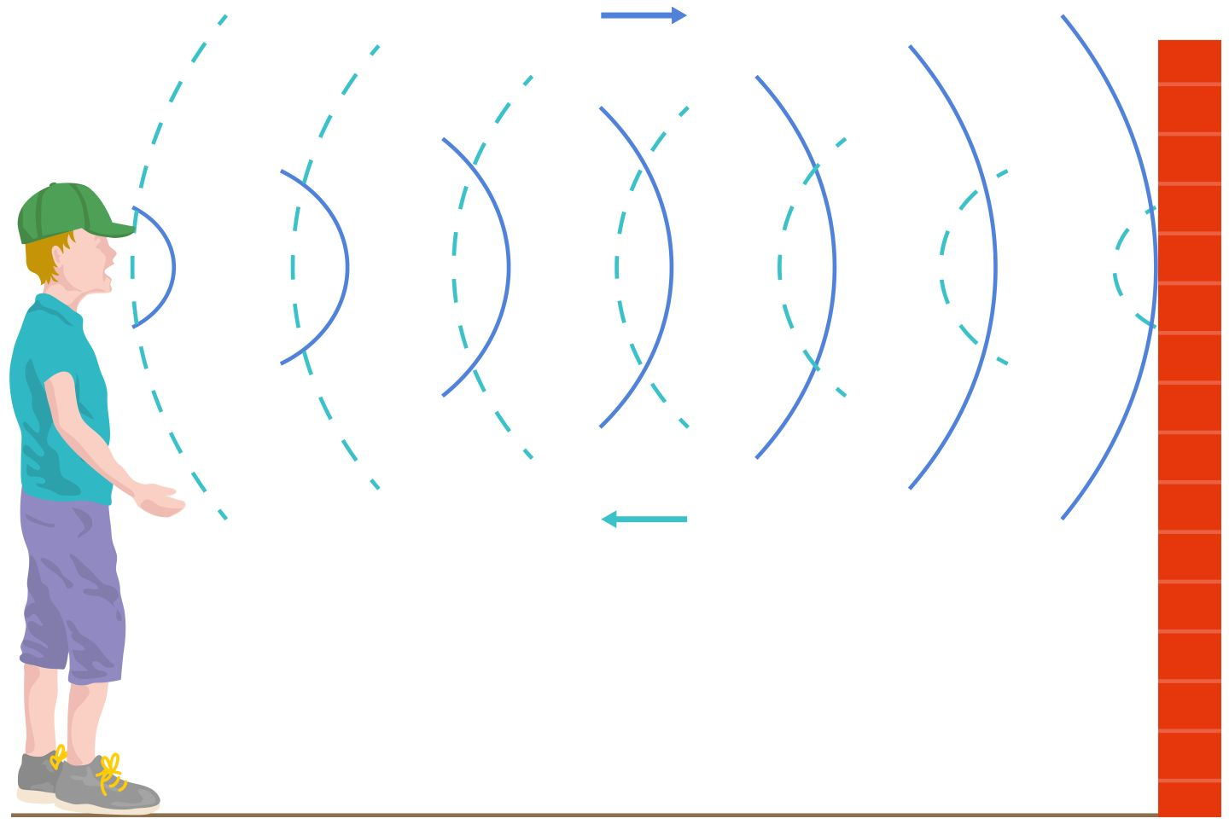
Sounds Reflect Too!
Sounds Reflect Too!
Sound reflection is called an echo
Smooth, hard surfaces reflect sound best
Soft surfaces absorb sound
Notes:
Sound diffuses, or spreads out, as it leaves the source. Thus, reflected sound waves will be quieter (lower in intensity, lower in amplitude) than the original sound was.

Slide 16
Motion / Kinetic Energy
All moving things have kinetic energy
At NEED, we use the word “motion” when talking about macroscopic, moving objects
Moving objects follow Newton’s Laws of Motion
A body in motion stays in motion unless acted on by an external force. A body at rest stays at rest unless acted on by an external force.
An object’s acceleration is proportional to the force acting on it.
For every action force, there is an equal and opposite reaction force.

Slide 17
It’s All About Balance
Propulsion
Friction / Drag
Gravity
Support
Support
Notes:
An object at rest or moving at a constant speed has all of its forces balanced. Gravity and the support force (the ground, the floor, etc.) balance out, otherwise either the floor collapses or the object is propelled up into the air. If the girl wants to ride her bike at a steady speed, she just has to pedal enough to overcome the friction of the tires on the street and air drag. If she wants to slow down or stop, she uses her brakes to increase friction. If she wants to speed up, she pedals harder to increase her propulsion force.

Slide 18
It Has Potential
Moving requires energy; the energy of motion is kinetic energy
Kinetic energy must come from somewhere
Stored energy = Potential Energy
Much of child’s play involves gravitational or elastic potential energy
Notes:
We use potential energy all the time, mostly in the form of chemical energy, which is energy stored in the bonds of molecules like sugar or gasoline. When kids play, the potential energy they use is probably due to climbing a ladder on a slide, or pulling back a swing, or throwing a bouncy ball up in the air. Playgrounds are full of potential energy in the form of gravitational or elastic energy.
Gravitational energy is stored when an object is held up against gravity’s pull. Thus, simply holding an object above the floor imparts to it gravitational energy. This energy is transformed into motion energy when the object is dropped.
Elastic energy involves things being stretched or compressed with a force. A superball, when thrown hard against a wall or the ground, compresses a bit then bounces back into shape. The compression and rebound are how the energy is stored in the ball. Pull-back cars and wind-up toys store energy in a spring, and when let go the spring propels the toy.
Beyond playtime, we use gravitational energy when using water to generate electricity. If the river is flowing swiftly enough, a dam is not needed because the flow of the water down to the ocean is strong enough. But sometimes a dam is built to impart to the water enough energy to adequately generate electricity.
Elastic energy is used any time we stretch something, like a rubber band or a bow string when engaging in archery. Stringed musical instruments use elastic energy to generate sound.

Slide 19
Transformations are Science in Disguise
This large rock in Colorado has gravitational energy.
A big push would send the rock tumbling (DO NOT try this at home, or anywhere else).
If the rock falls, the gravitational energy is transformed into kinetic energy as motion.
Notes:
We transform energy from one type to another all the time. You’re doing it right now. Your cells are taking the energy from your food and changing it into other forms it needs, including heat to keep you warm. The rock in the photograph is being supported high on a cliff, but if someone pushed hard enough the rock would fall. (Since this is at Garden of the Gods National Monument, I hope no one does that!) As an object falls, its gravitational energy is changed into motion energy, and just before reaching the ground, all the of the gravitational energy has been transformed into motion.

Slide 20
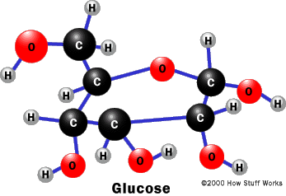
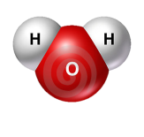
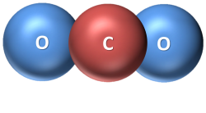
Growth
Thermal Energy
Chemical Energy
Nuclear Energy
Photosynthesis
Radiant Energy
Thermal Energy
nomnomnom
nomnomnom
nomnomnom
6
6
6
Thermal Energy
Note: Not to scale. ☺
Notes:
When things grow, there is a lot going on! The little circular guy at the right represents any cell at all, because all cells grow. He is eating glucose, which is produced by plants. The glucose contains chemical energy that the cell uses.
Growth requires energy. Using radiant energy from the sun, green plants produce glucose via photosynthesis. Glucose provides most of the energy that all cells use. Cells use that energy during respiration to power other processes, like assembling proteins, repairing cell damage, and functioning as part of a tissue (like nerve, muscle, bone, etc.). The radiant energy from the sun is stored as chemical energy in the glucose produced during photosynthesis.
Note that in each transformation, some energy is also transformed into heat.

Slide 21
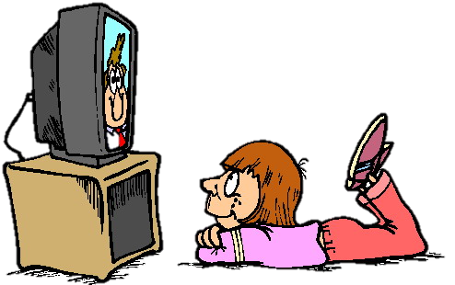
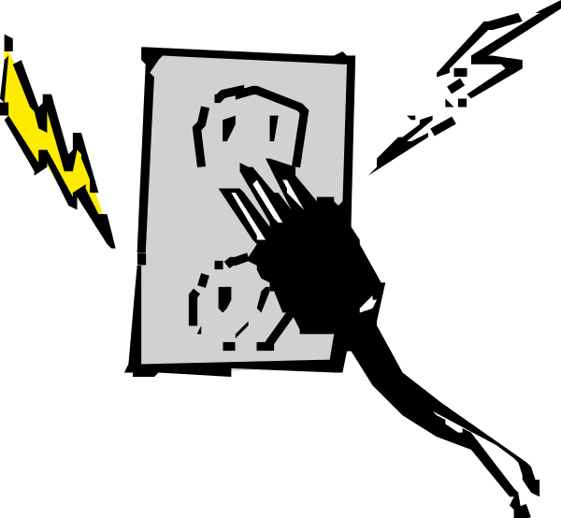
Technology
Thermal Energy
Electrical Energy
Chemical Energy
Thermal Energy
Sound Energy
Electrical Energy
Radiant Energy
Notes:
Energy is needed to power the technology we use every day. Technology makes our lives safer, more comfortable, and more enjoyable.
Most electrical power plants use some kind of chemical energy (coal, natural gas, trash) to generate electricity. Much of the energy in a power plant is not used and is released as heat. When we use electricity in our technology, the devices get hot as they change the electrical energy into the kinds of energy we need and enjoy, such as radiant energy in a television or motion energy in a fan.

Slide 22
For More Information
The NEED Project
www.need.org
info@need.org
1-800-875-5029
Energy Information Administration
U.S. Department of Energy
www.eia.gov

Slide 23
NEED IS SOCIAL!
Stay up-to-date with NEED. “Like” us on Facebook! Search for The NEED Project, and check out all we’ve got going on!
Follow us on Twitter. We share the latest energy news from around the country, @NEED_Project.
Follow us on Instagram and check out the photos taken at NEED events, instagram.com/theneedproject.
Follow us on Pinterest and pin ideas to use in your classroom, Pinterest.com/NeedProject.
EnergyWorks 2018 ©The NEED Project

