Slide 1
Nuclear Power in Perspective and Intro to Nuclear Reactors

Slide 2
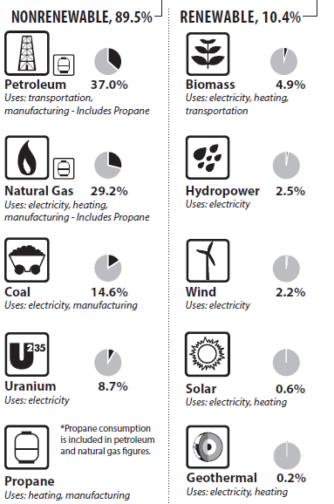
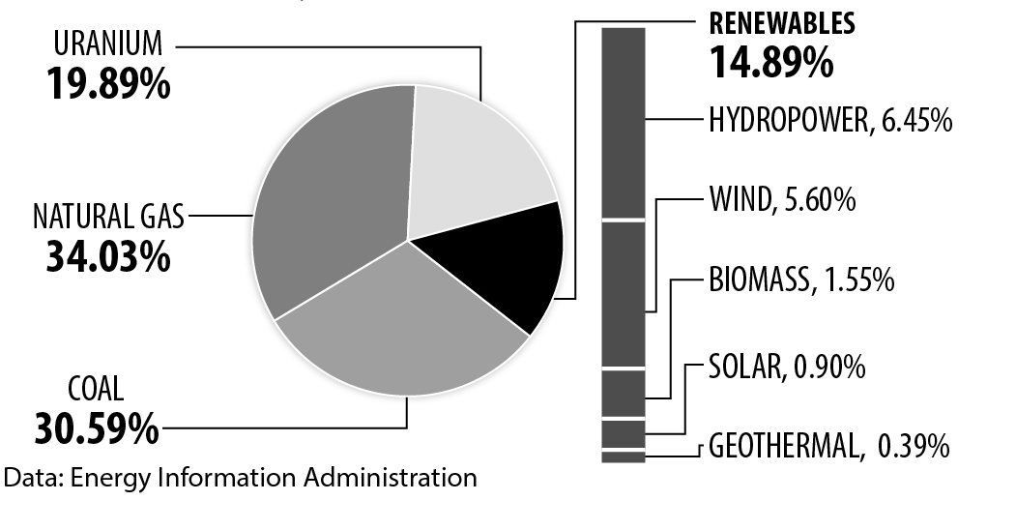
U.S. Energy Consumption by source, 2016
U.S. Electricity Production by source, 2016
Data: Energy Information Administration *Total does not equal 100% due to independent rounding.

Slide 3
Top 5 Nuclear Electricity Generating Countries, 2015
Source: U.S. Energy Information Administration, International Energy Statistics
Nuclear Reactors 2018 ©The NEED Project
Notes:
The United States generates more electricity from nuclear than any other country. However for some countries like France, nuclear energy makes up a higher percentage of the country’s electricity production.

Slide 4
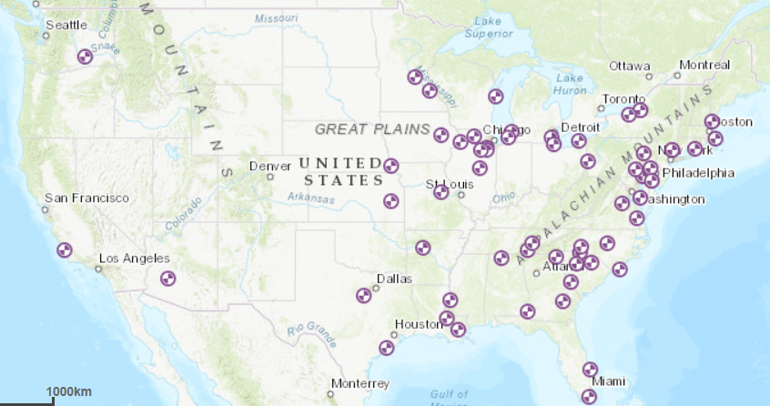
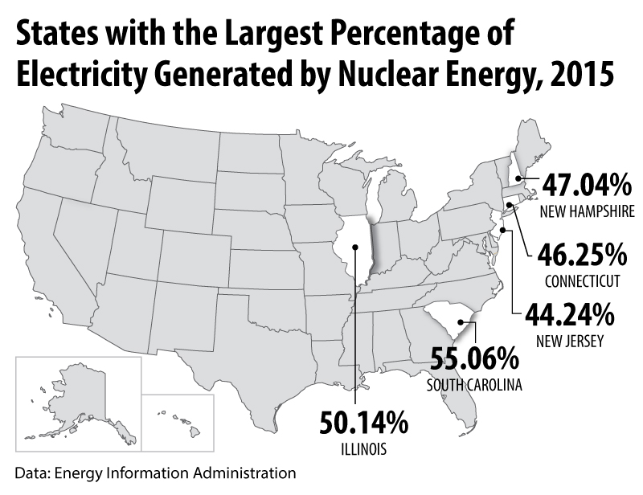
Nuclear Energy Production
Although the national percentage of nuclear generated electricity is about 20%, it varies from state to state.
U.S. Nuclear Power Plants, 2018
Source: EIA U.S. Energy Mapping System
Nuclear Reactors 2018 ©The NEED Project

Slide 5
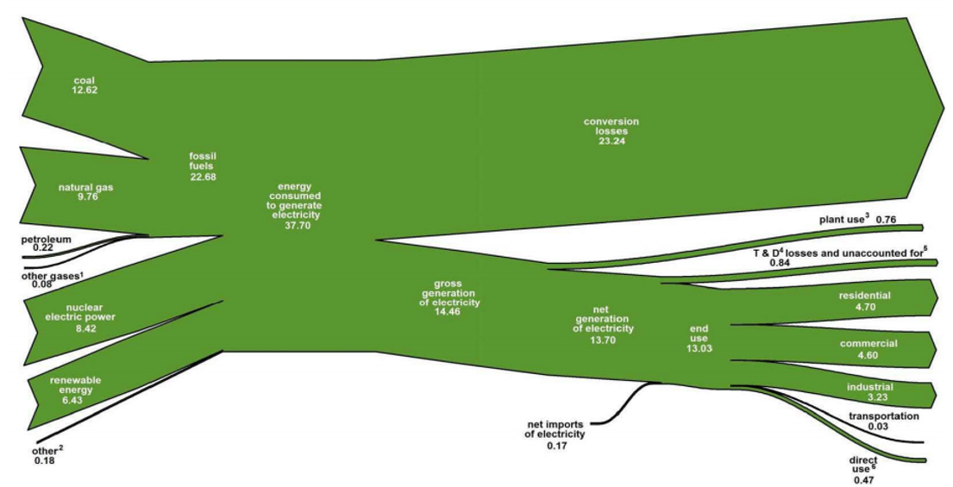
U.S. Electricity Flow 2017
Quadrillion Btu
Nuclear Reactors 2018 ©The NEED Project

Slide 6
U.S. Capacity Brought Online by Fuel Type
Nuclear Reactors 2018 ©The NEED Project

Slide 7
Food for thought…
Efficient vehicles
Reduced use of vehicles
Efficient buildings
Efficient coal power plants
Gas instead of coal power plants
Capture CO2 at base load power plant
Nuclear power for coal power
Wind power for coal power
Photovoltaic power for coal power
Capture CO2 at H2 plant
Capture CO2 at coal-to-synfuels plant
Wind H2 in fuel-cell car for gasoline in hybrid car
Biomass fuel for fossil fuel
Of the 15 methods (wedges) proposed by a Princeton University study to stabilize Carbon Dioxide emissions, 13 of them relate energy use.
Implementation of any 7 would accomplish the goal of stabilizing emissions.
Nuclear Reactors 2018 ©The NEED Project

Slide 8
Aerial View of Watts Bar Nuclear Plant

Slide 10
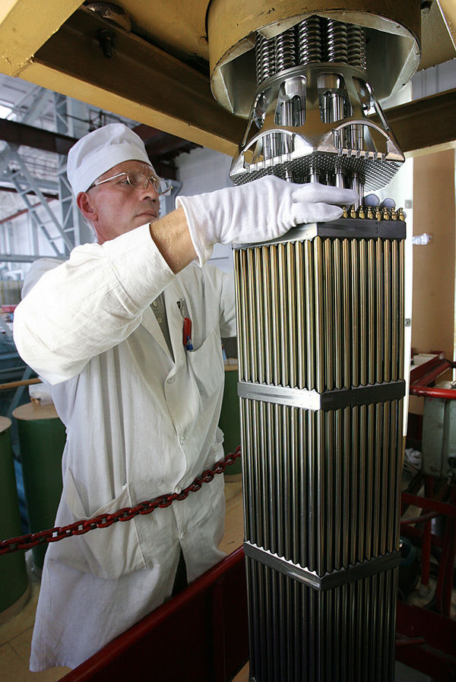
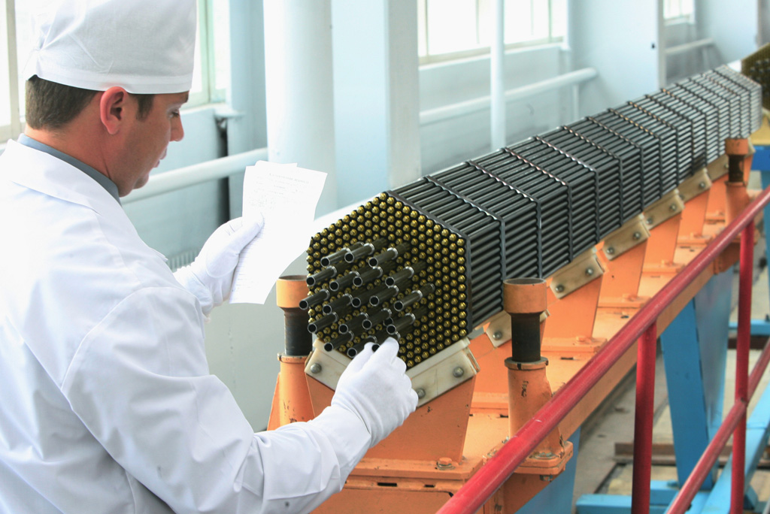
Fuel Rod Assembly
Courtesy of Wikimedia Commons
Nuclear Reactors 2018 ©The NEED Project

Slide 11
Reactor Coolant System

Slide 12
Steam Generator

Slide 13
Reactor Vessel

Slide 14
Re-circulating Pump (Vessel, Piping, Pumps…)

Slide 15
Steam-driven Turbine

Slide 16
Spent Fuel Pool Photo courtesy of NRC

Slide 17
Cooling Tower

Slide 18
Containment

Slide 19
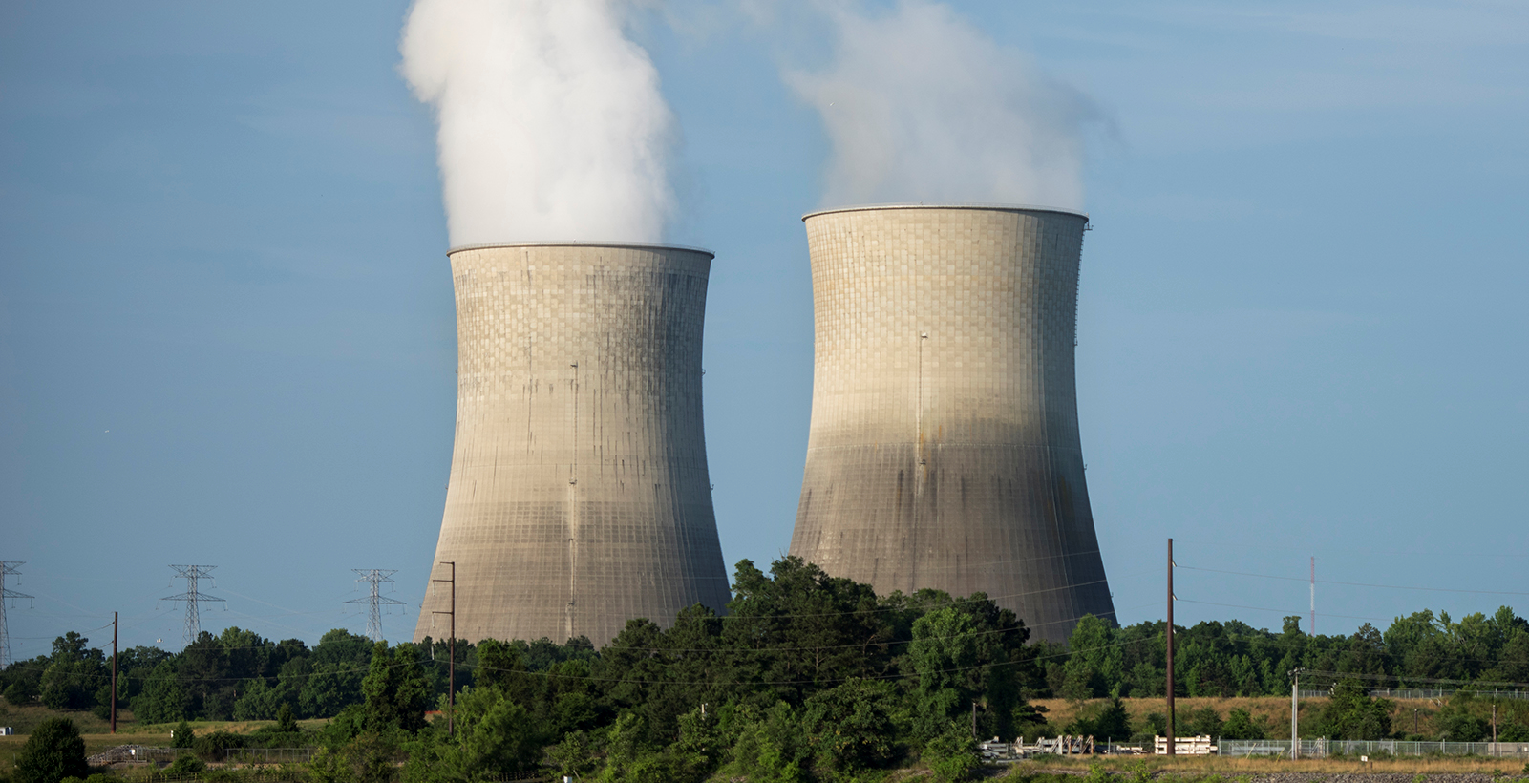
Watts Bar Nuclear Plant Facts
Located in Spring City, TN
Last new commercial nuclear power plant in U.S.
Unit 1 came online in May 1996, Unit 2 in 2016
Each unit can generate 1,150 megawatts of electricity
Unit 1 & 2 combined can supply electricity to 1.3 million homes daily
Watts Bar Nuclear Plant supports ~1,000 full-time jobs
https://www.tva.gov/Energy/Our-Power-System/Nuclear/Watts-Bar-Nuclear-Plant
Nuclear Reactors 2018 ©The NEED Project

Slide 20
Nuclear Reactor Facts – Watts Bar
Containment Building 210’ – 250’ Tall, 130’ – 175’ diameter
Control Rods: 45 – 92 per assembly
Fuel Pellets: 1/3” dia, ½” long, less than 1/3oz. = 1600lbs of coal, 3.5 brls of oil, 15K cf gas
314 – 350 pellets per rod
Fuel rods made from Zircaloy (metal alloy), pellets and helium
Fuel rod assembly =176-236 rods, 13’8” long, 8x8 rods sqr., 1300lbs
Reactor will hold 157-217 fuel rod assemblies = 32k – 52k rods = 10,048,000 – 18.2 million pellets per reactor
Nuclear Reactors 2018 ©The NEED Project

Slide 21
Three Mile Island-2 (TMI-2) – Middleton, PA

Slide 22
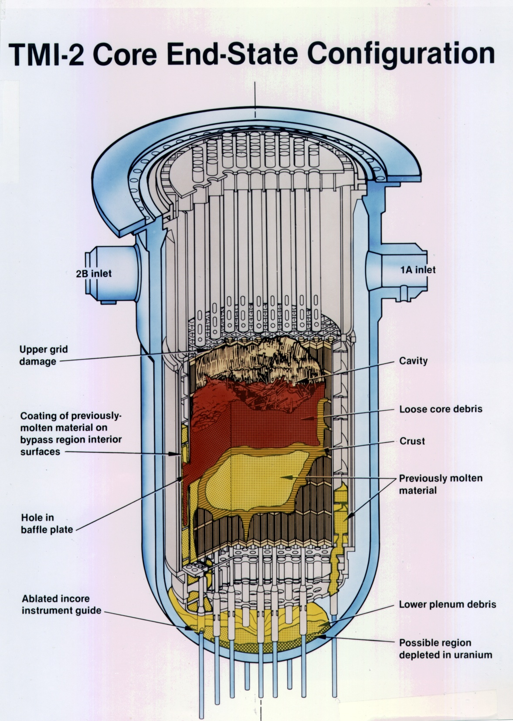

Slide 23
Chernobyl April 26, 1986

Slide 24
Cross Section of Chernobyl

Slide 25
Chernobyl Post-Accident
31 immediate fatalities (all but one due to radiation exposure)
>200 people hospitalized due to exposure
135,000 people evacuated (though none immediately)
~50 million curies of radioactive material released
Nuclear Reactors 2018 ©The NEED Project

Slide 26
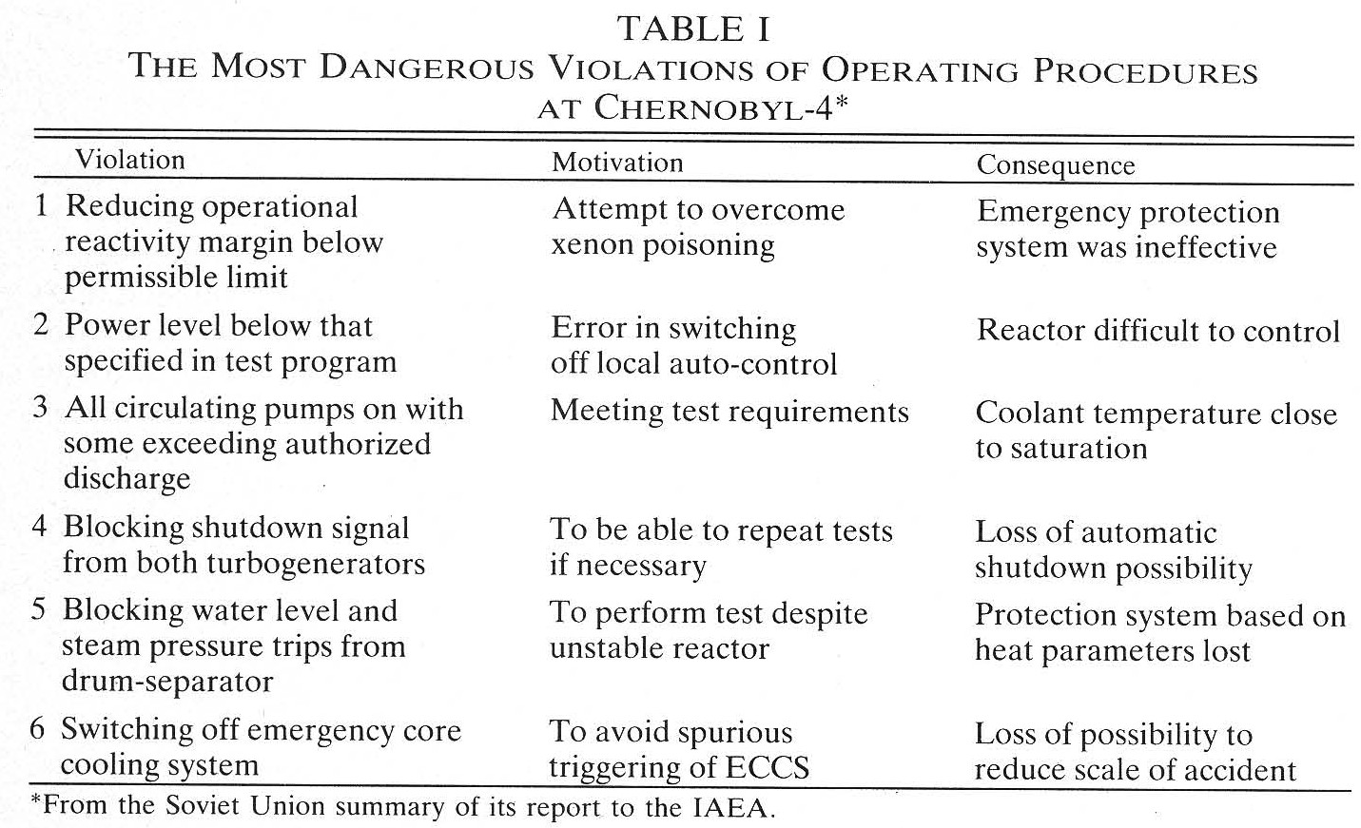
Any of the first 5 would have prevented accident
Nuclear Reactors 2018 ©The NEED Project

Slide 27
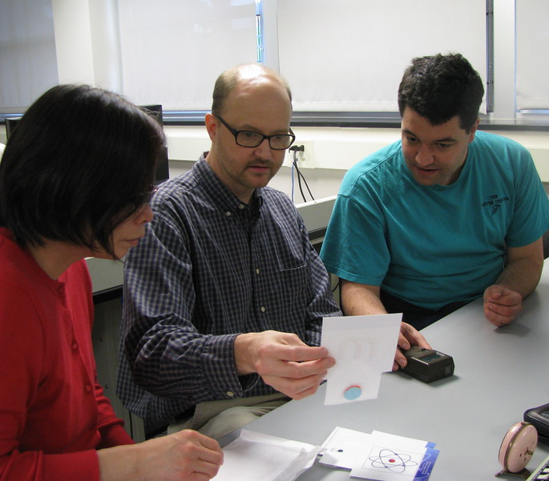
For More Information
The NEED Project
www.need.org
info@need.org
1-800-875-5029
Energy Information Administration
U.S. Department of Energy
www.eia.gov
Nuclear Reactors 2018 ©The NEED Project

Slide 28
NEED IS SOCIAL!
Stay up-to-date with NEED. “Like” us on Facebook! Search for The NEED Project, and check out all we’ve got going on!
Follow us on Twitter. We share the latest energy news from around the country, @NEED_Project.
Follow us on Instagram and check out the photos taken at NEED events, instagram.com/theneedproject.
Follow us on Pinterest and pin ideas to use in your classroom, Pinterest.com/NeedProject.
Nuclear Reactors 2018 ©The NEED Project

