Slide 1
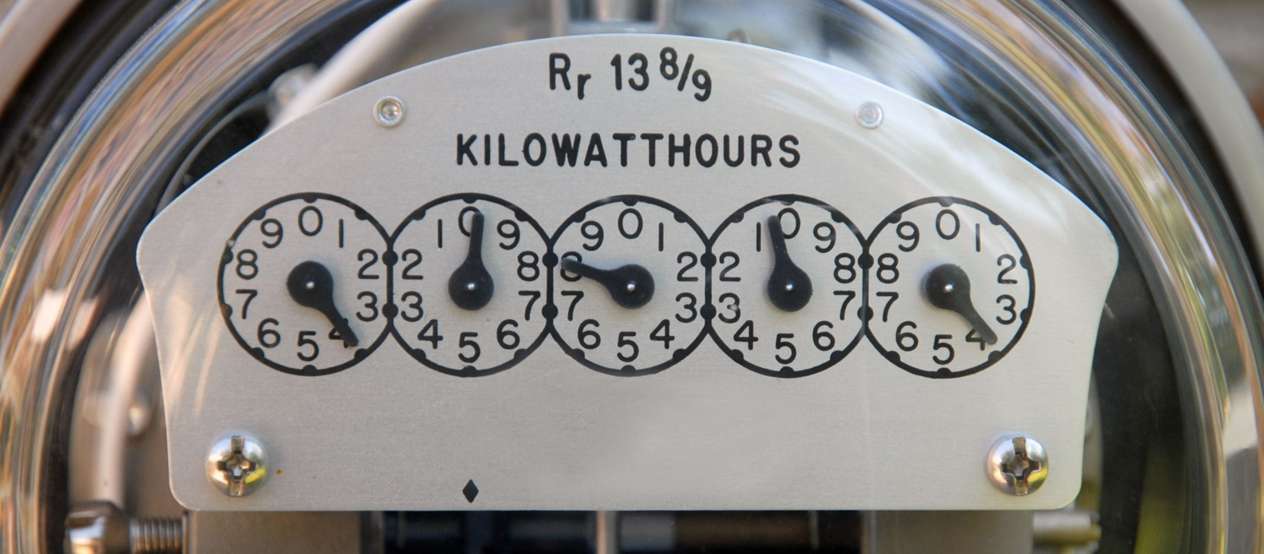
Exploring Energy Efficiency & Conservation

Slide 2
What is Energy Efficiency and Conservation?
Energy Efficiency and Conservation is doing more with the same amount of energy or less energy.
Energy Efficiency and Conservation saves money and makes buildings more comfortable, healthy, and safe.

Slide 3
Efficiency vs. Conservation
Efficiency
Conservation
Energy efficiency involves the use of technology that requires less energy to perform the same function.
Focuses on the equipment or machinery being used
One example is installing LED light bulbs throughout the house
Energy conservation includes any behavior that results in the use of less energy.
Focuses on the behavior of people
One example is using daylighting through windows rather than turning on the lights

Slide 4
Benefits of Energy Management
Reduces consumption
Increases comfort & safety
Reduces pollution
Makes our economy stronger
Increases our energy security

Slide 5

National ENERGY STAR® Program
Joint program of the U.S. Environmental Protection Agency and the U.S. Department of Energy
National symbol for energy efficiency
Products and/or buildings must meet certain standards to display label
For homes & businesses

Slide 6
How Efficient are U.S. Schools?
Average annual energy bill to run America's schools: $6 billion
A typical school district with 3,000 students spends $400,000 on energy per year.
The least efficient schools use 3x more energy than the best energy performers.
Top performing ENERGY STAR® labeled schools cost $0.40/square foot less to operate than the average schools.
Luckily, energy is a manageable expense

Slide 7
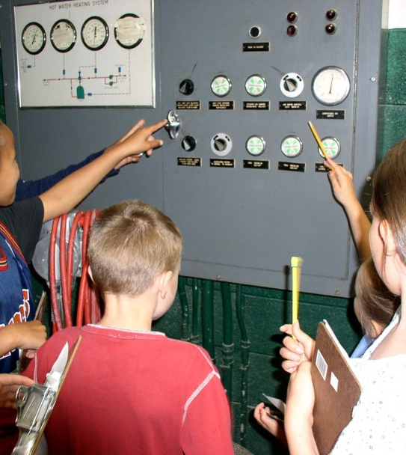
When we look for ways to save energy in a school, we must keep in mind…
The health and safety of the occupants.
Indoor air quality – adequate ventilation.
The comfort of the occupants.

Slide 8
How Does Your School Use Energy?
Energy System Components
Building Envelope
Heating, Ventilation and Air Conditioning (HVAC)
Lighting
Electric Appliances

Slide 9
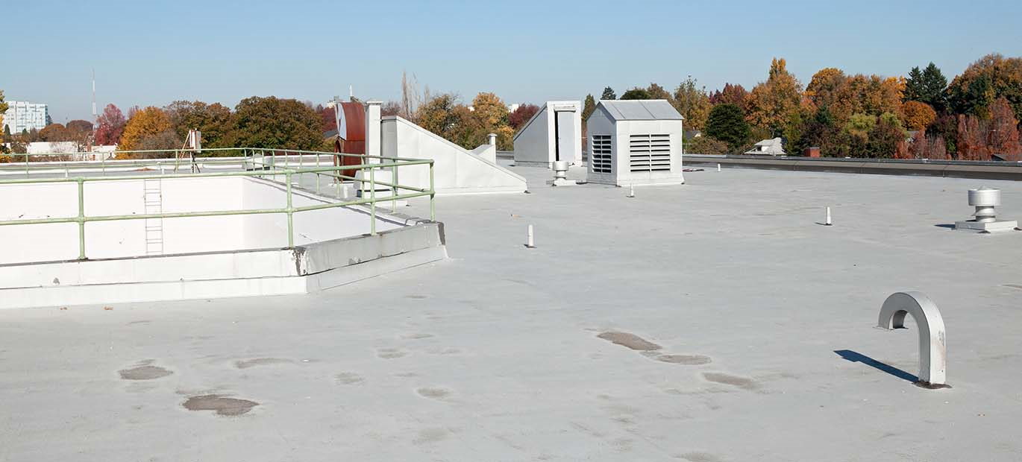
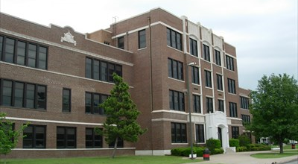
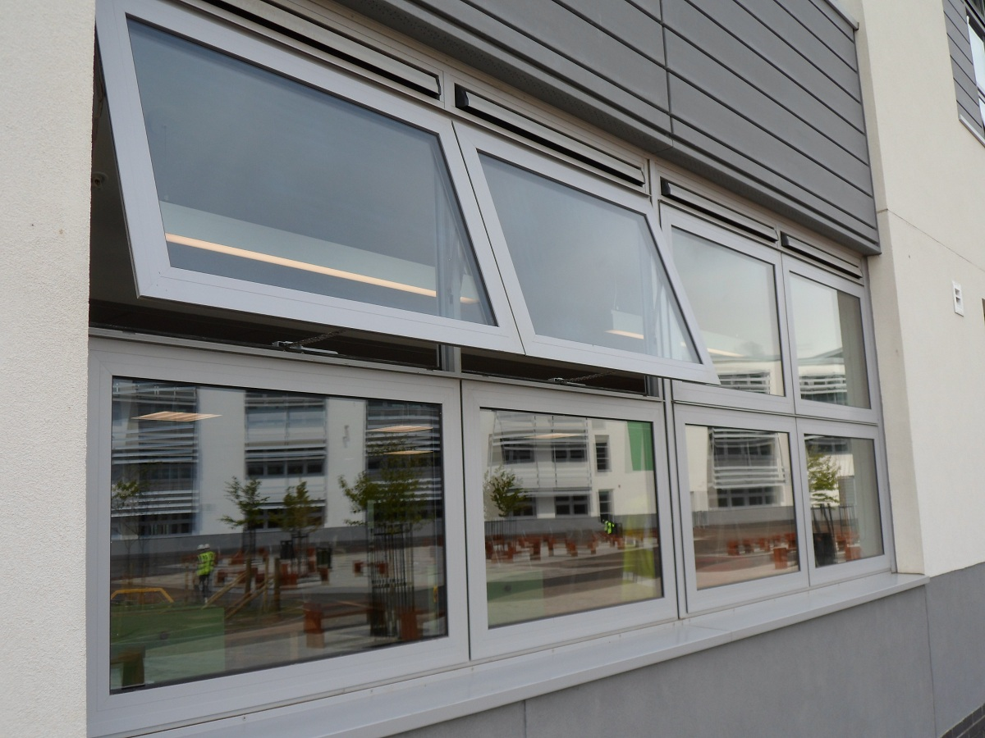
The Building Envelope
Any part of the building which creates a boundary between indoor and outdoor space.
Walls
Roofs
Ceilings
Doors
Windows
Notes:
The transfer of heat, air, and moisture into and out of the home is largely governed by the building envelope, which is made up of all the components that separate the inside of the home from outdoors. Siding, windows, doors, and roofs have an important role to play, as does how tightly the various parts of the building are sealed to one another.

Slide 10
The Building Envelope
The envelope should limit:
  The amount of thermal energy conducting through.
  The amount of air that moves in and out of the building.

Slide 11
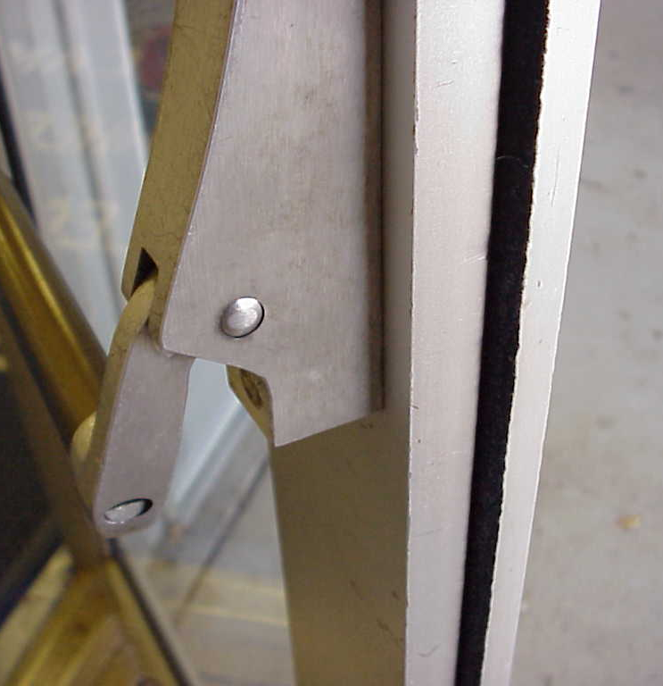
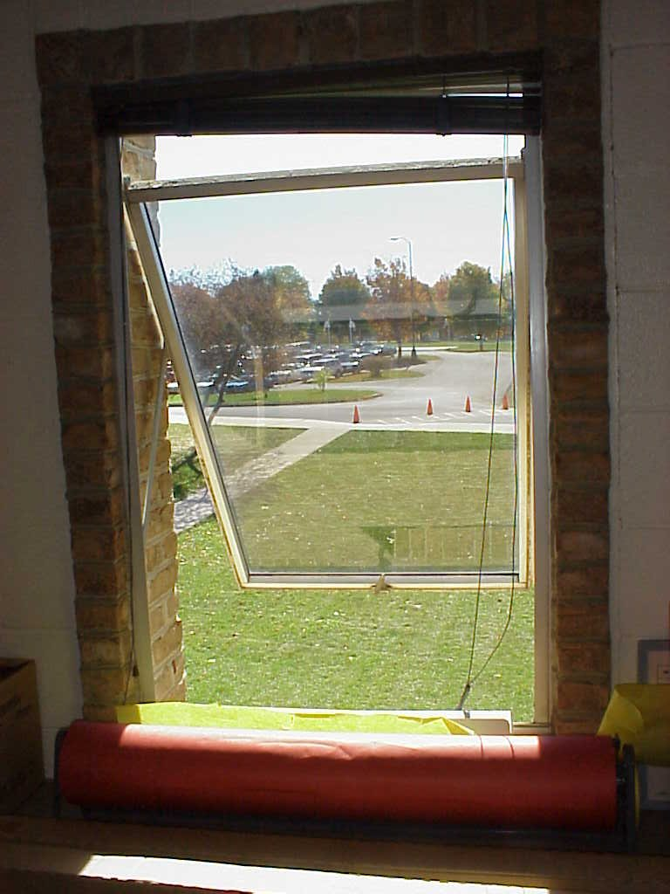
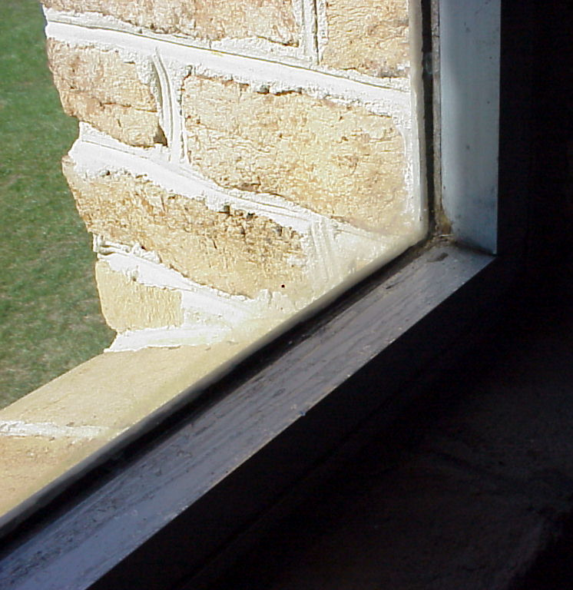
Savings Opportunities: Building Envelope
Inadequate weatherstripping
Windows left open
Single Pane Window

Slide 12
HVAC
Heating System (boiler, furnace)
Ventilation System
Air Conditioning (chillers)
Hot Water
Thermostats
Ducts and Pipes

Slide 13
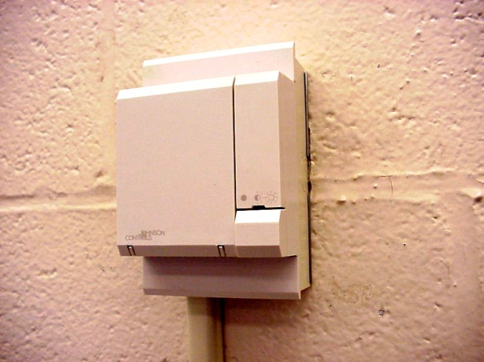
Building Automation System (BAS)
Provides school personnel with real time energy and performance data to manage the building’s energy needs.
Temperature Sensor

Slide 14
Types of Lighting Found in Schools
Incandescent
Fluorescent
High Intensity Discharge (HID)
Light Emitting Diode (LED)
Lighting accounts for 9 percent of a school’s energy use, which translates to about 17% of the school’s electricity bill.

Slide 15
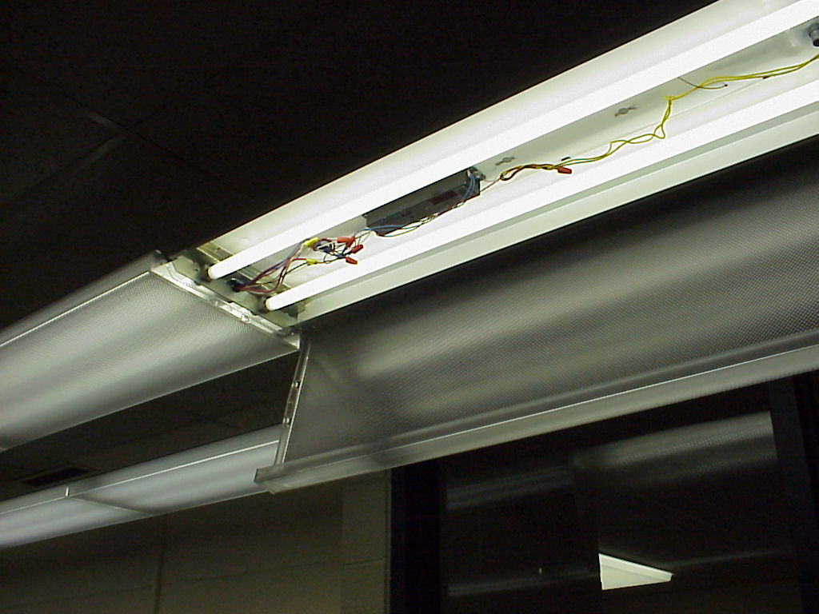
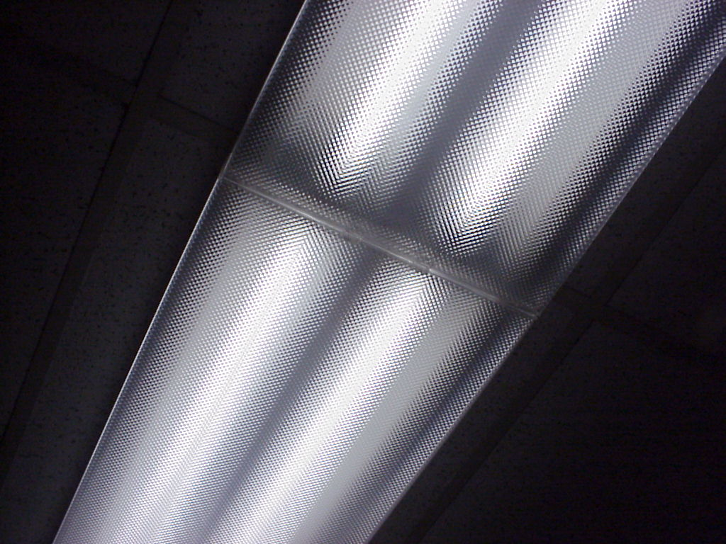
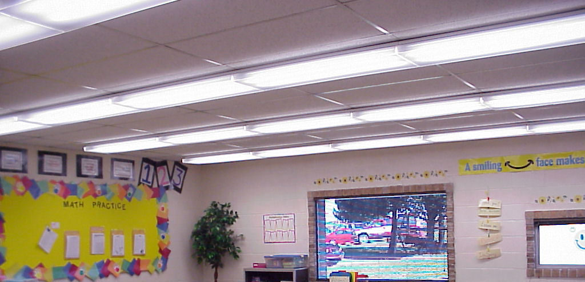
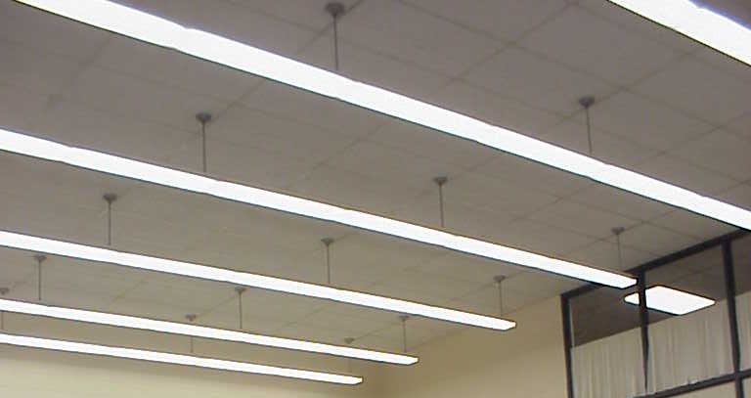
Fluorescent

Slide 16
Ballast
Required for operation of fluorescent lamps
Provides initial arc to start lamp
Regulates current during operation
Two main types:
  magnetic
  electronic
Fluorescent lights with electronic ballasts are more energy efficient than those with magnetic ballasts.
Notes:
There are two types of ballasts, magnetic and electronic. Magnetic ballasts produce a frequency of 60 Hertz (Hz), which means the light is flickering on and off 60 times a second. Electronic ballasts produce a frequency of at least 20,000 Hz. Fluorescent lights with electronic ballasts are more energy efficient than those with magnetic ballasts.

Slide 17
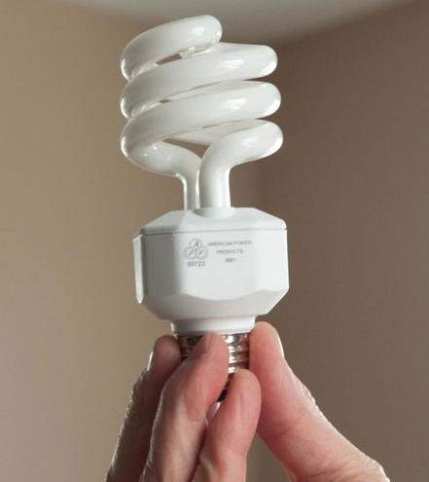
Compact Fluorescent
Miniature fluorescent with built in ballast
Ideal for replacement of incandescent lamps
Saves up to 75% on energy use
Last 7-10x longer than an incandescent
Low thermal energy output
Improved color rendition

Slide 18
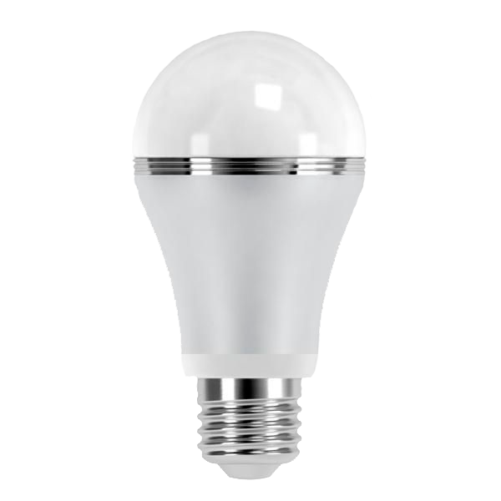
Light Emitting Diodes (LEDs)
Energy Star bulbs rated at 25,000 hours.
Can use up to 50% less energy than a CFL.
Widespread use over the next 20 years could reduce lighting energy demand by 33%.
Currently more expensive to purchase compared to incandescent and CFLs.

Slide 19
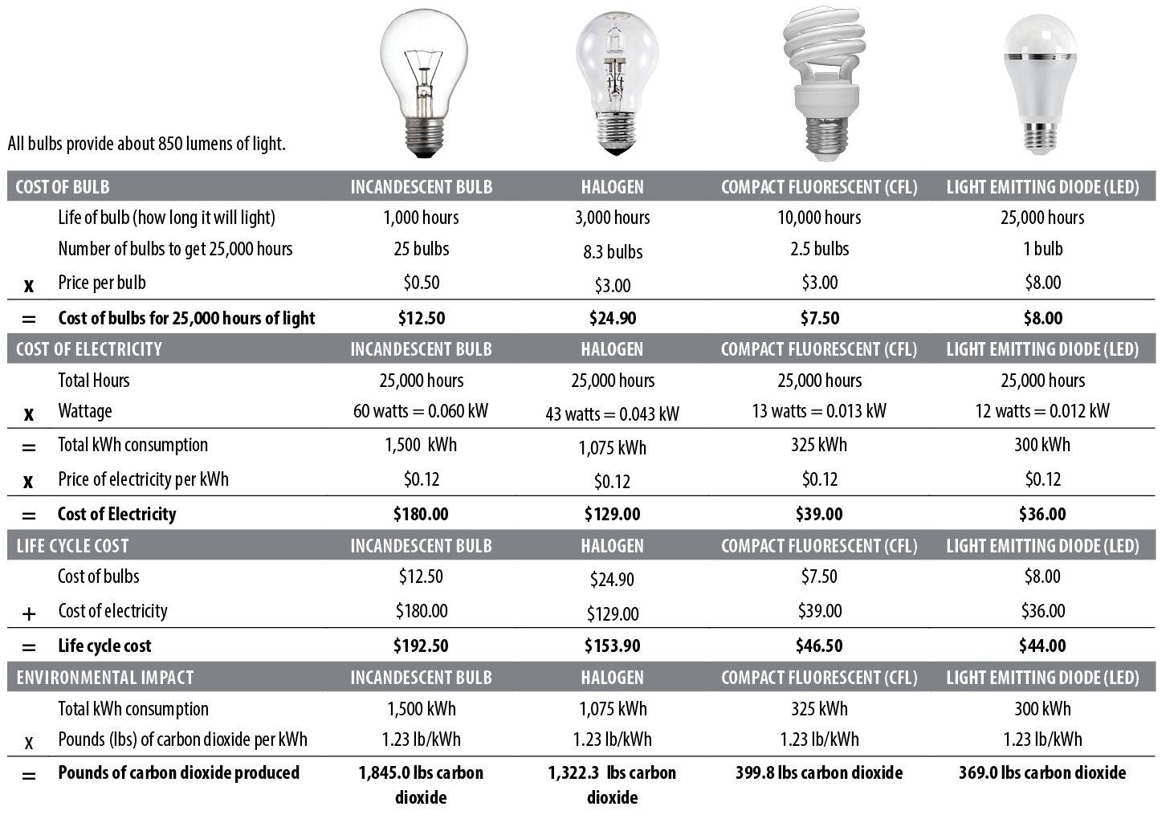
Comparing Light Bulbs Answer Key

Slide 20
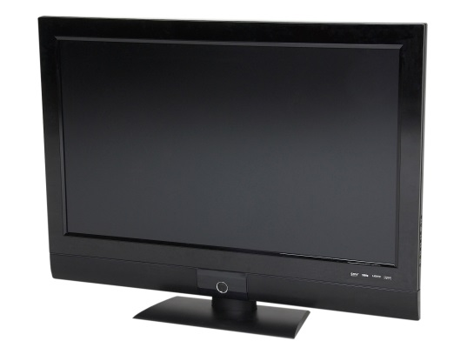
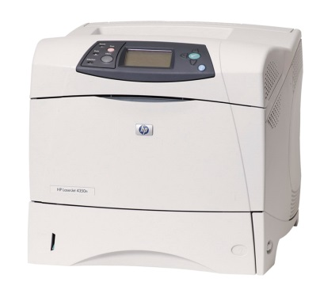
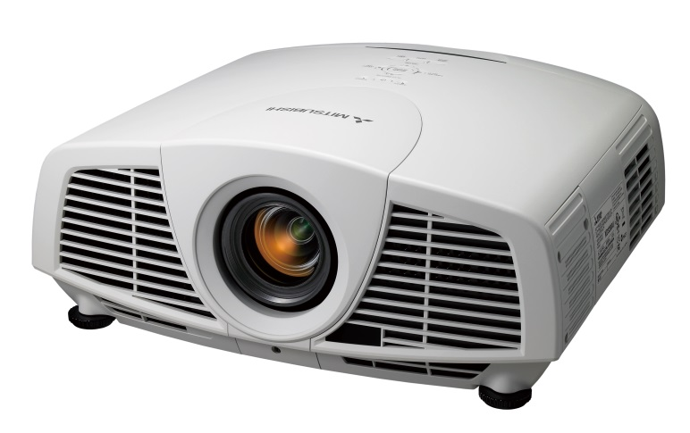
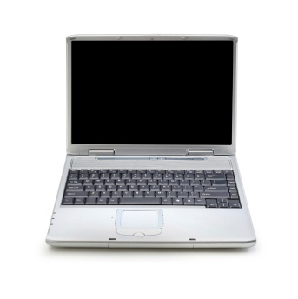
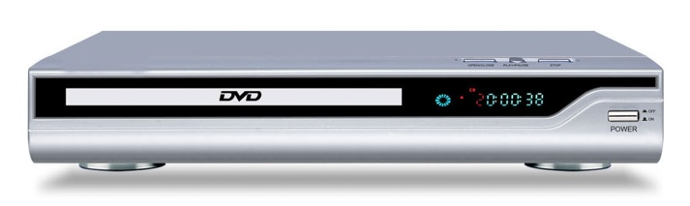
Electric Appliances in Schools
Electric Space Heaters
Air Conditioning
Electric Water Heaters
Refrigerators/Freezers
Lighting
Computers and Office Equipment

Slide 21
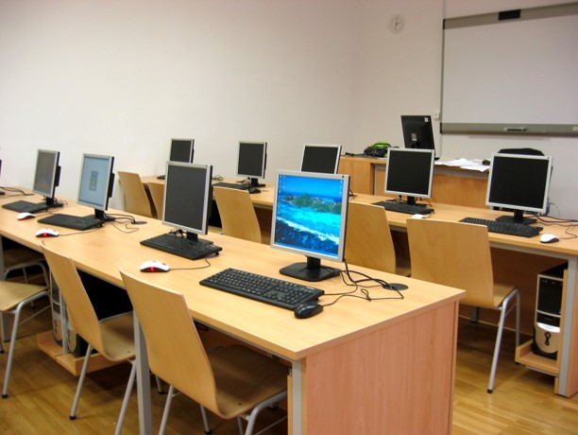
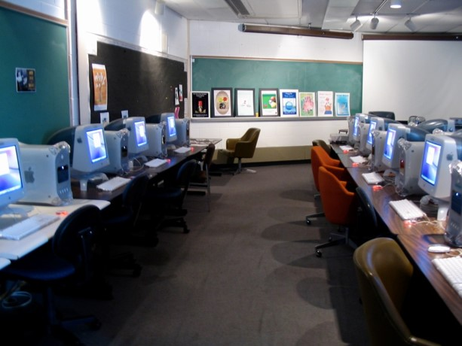
Savings Opportunities: Electric Appliances
Monitors with Screen Savers, Power Saving Options Not Enabled

Slide 22
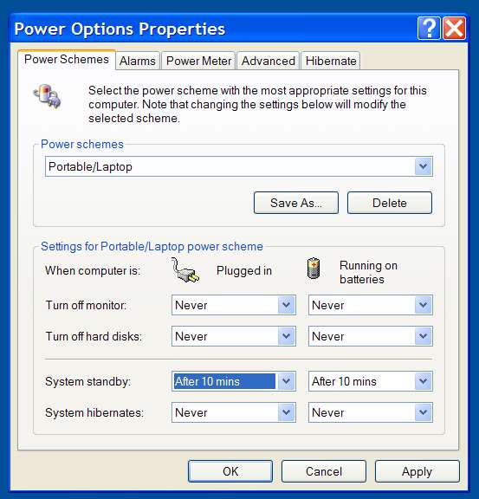
Personal Computers
Enable Power Management Settings
Set your computer to automatically go into STANDBY mode after 10 minutes.
To bring it back up, either move your mouse or hit the power button (depending on your machine).
Disable screensavers!

Slide 23
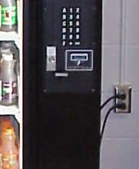
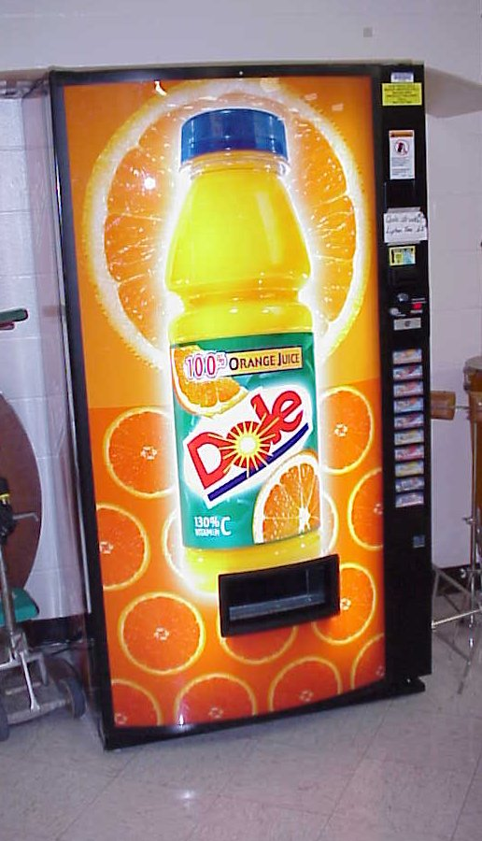
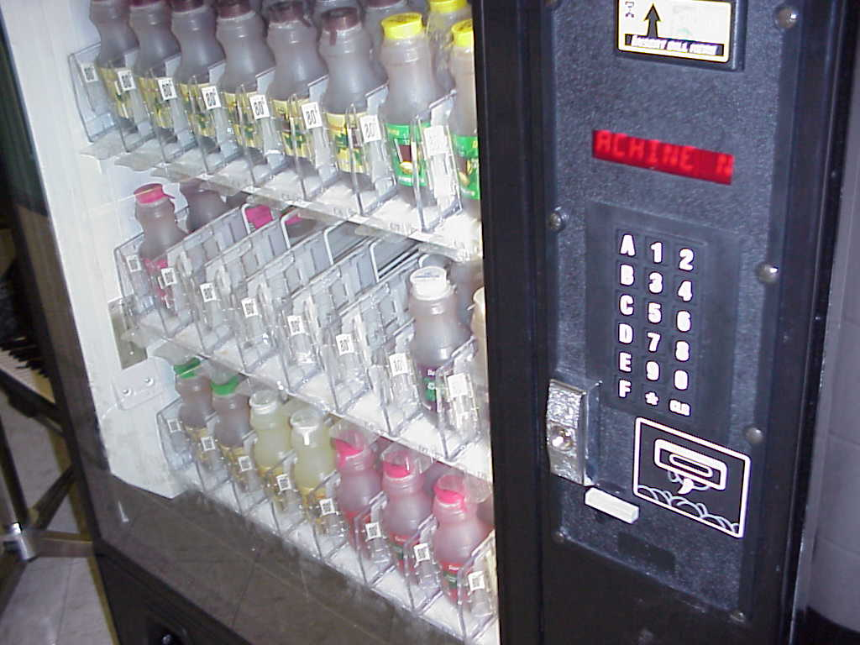
Saving with Vending Machines
Unplug during school breaks/vacation
Install timers

Slide 24
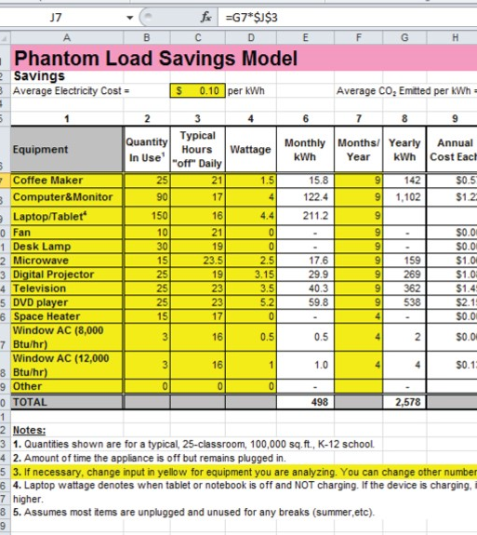
Plug Loads
Students count electrical devices
Students estimate number of hours per week device is used
Excel spreadsheet uses formulas to compute cost

Slide 25
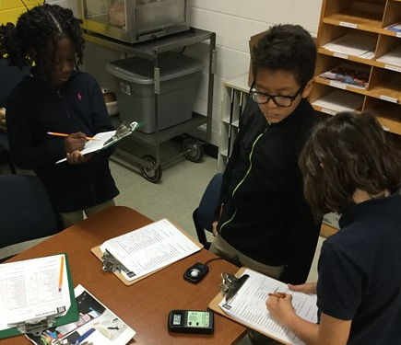
Student Energy Audit
Investigate your building and look for the following:
  Fluorescent light ballast type
  Light levels
  Humidity levels
  Temperature
  Electricity usage
Reporting Form (Before and After)

Slide 26
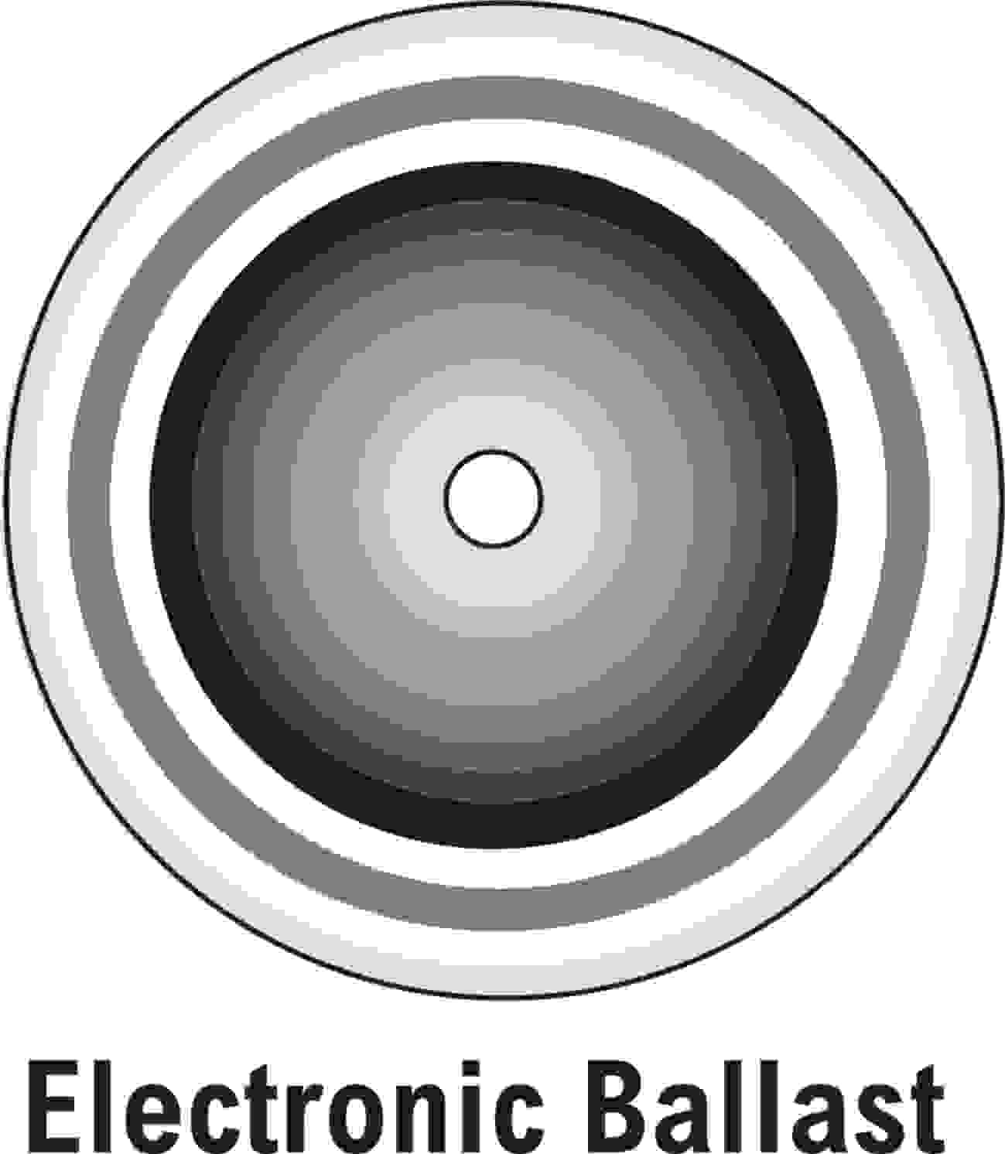
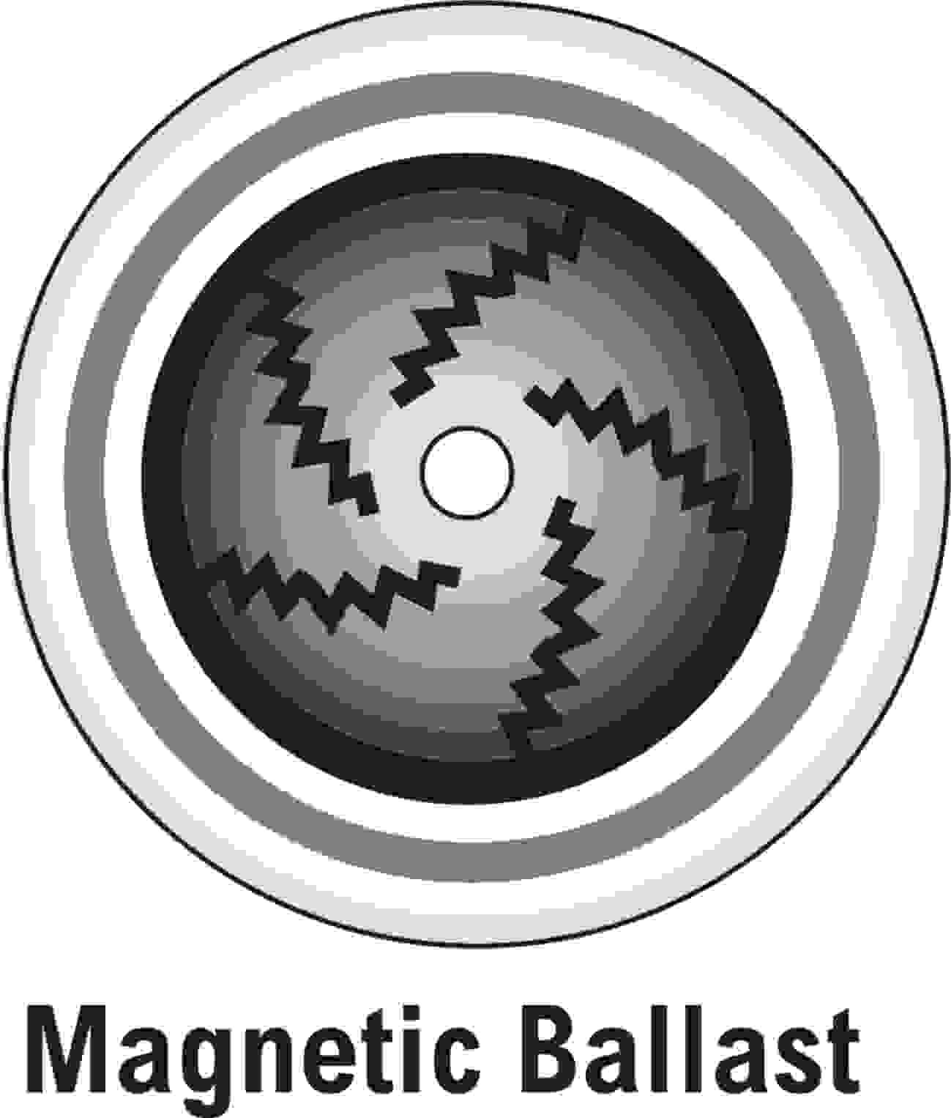
Determining Ballast Type
A flicker checker is a small plastic top-like device used to identify ballast type. A gray scale pattern indicates an electronic ballast, while a checkerboard pattern indicates a magnetic ballast.

Slide 27
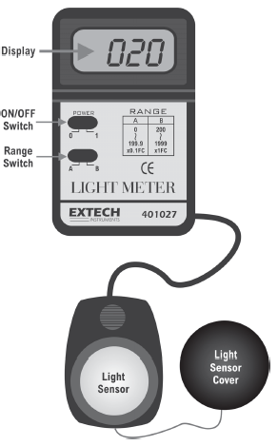
Light Meter
A light meter measures the amount of light in a space in units of foot candles. Spaces that are overly lit may be using more energy than necessary.

Slide 28
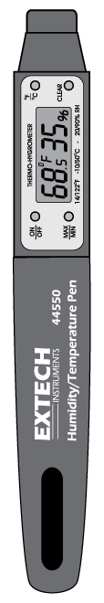
Hygrometer
A hygrometer measures relative humidity. Warmer air can hold more moisture, so if cold air is heated, it will feel very dry unless humidified.

Slide 29
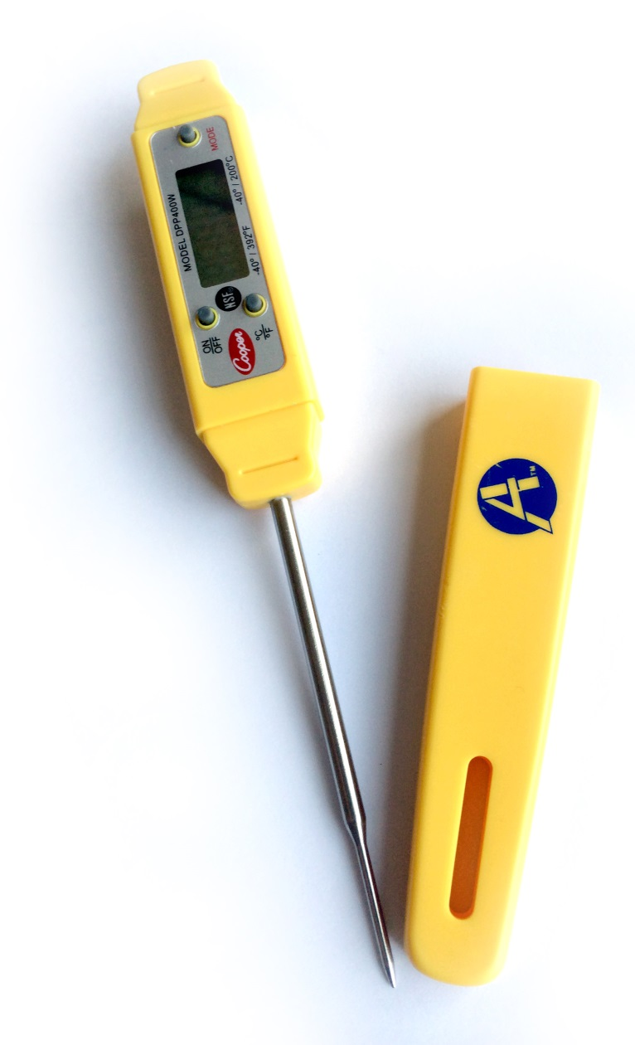
Digital Thermometer
The digital thermometer can be used to tell if a room is of the appropriate temperature, and compare how spaces may be infiltrated by thermal energy or moving air. Waterproof versions can also help check the temperature setting of your water heating system.

Slide 30
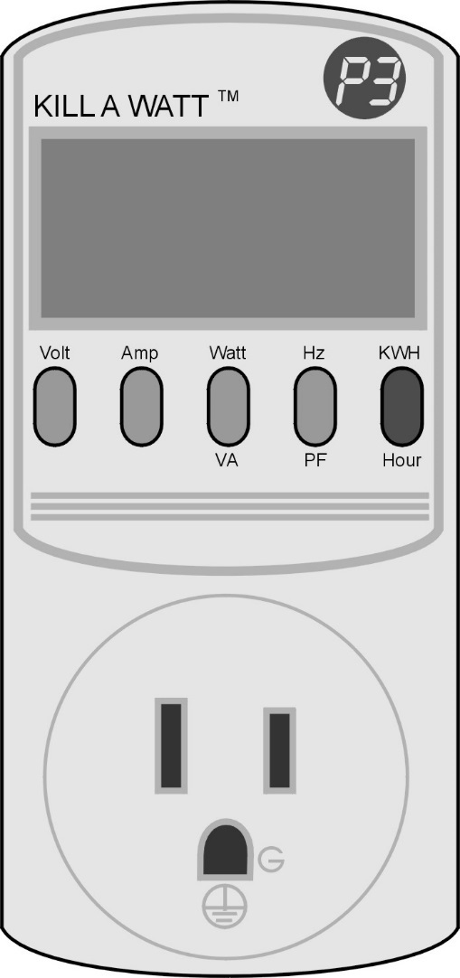
Kill A Watt meter
This tool allows you to measure how much power (Watts) an electrical device uses at any given time. By changing the display, it will also measure kWh consumed over a period of time.

Slide 31
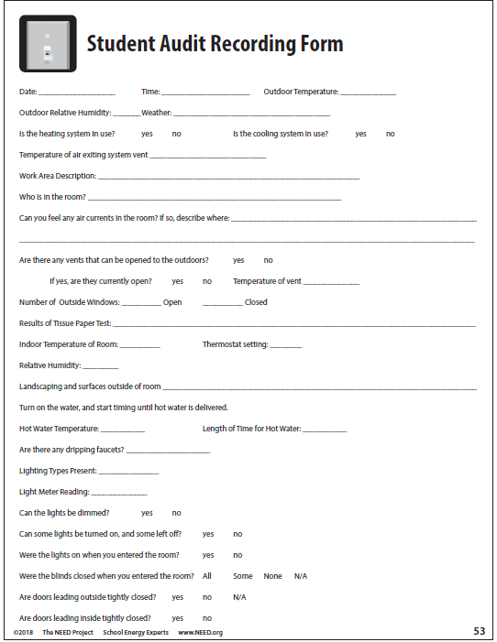
Energy Efficiency: The Assessment

Slide 32
Energy Efficiency: Take Action
Awareness Campaign
What Makes a Campaign Effective?
Clearly defined message
Motivational components
Delivering message via multiple media
Persistence in delivering message

Slide 33
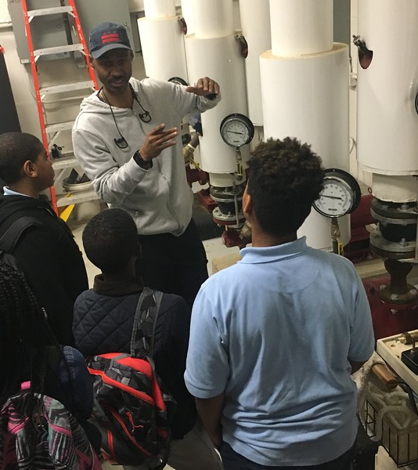
For More Information
The NEED Project
  www.need.org
  info@need.org
  1-800-875-5029
Energy Information Administration
  U.S. Department of Energy
  www.eia.gov

Slide 34
NEED IS SOCIAL!
Stay up-to-date with NEED. “Like” us on Facebook! Search for The NEED Project, and check out all we’ve got going on!
Follow us on Twitter. We share the latest energy news from around the country, @NEED_Project
Follow us on Instagram and check out the photos taken at NEED events, instagram.com/theneedproject
Follow us on Pinterest and pin ideas to use in your classroom, Pinterest.com/NeedProject
©2018 Energy Efficiency & Conservation - The NEED Project

