Slide 1
Exploring Coal

Slide 2
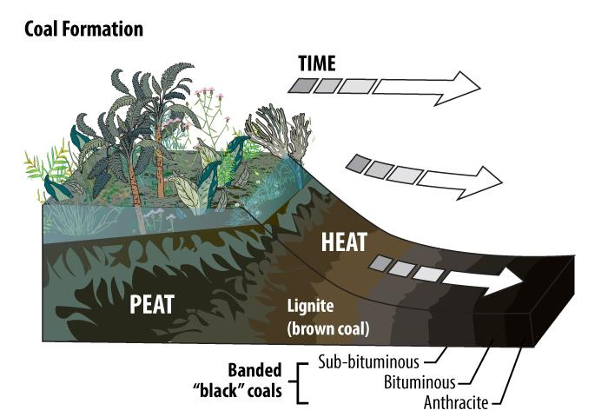
Coal Formation and Composition
Notes:
Coal’s origins are unique. While the story behind oil and natural gas stretches back hundreds of millions of years, coal’s story begins somewhat more recently. Some coal formed hundreds of millions of years ago, but some may have formed as recently as several hundred thousand years ago. Most coal used for energy production was formed millions of years ago.
The ingredients to make a good coal seam are rich plant life, stagnant water, and time. As the Earth changed, areas of land that contained lots of plants were engulfed and eventually consumed by a swamp. As layers and layers of sediment were added on top of the swamp, the dead trees and other plant matter were covered and subjected to great pressure. The plants and swampy ground changed into peat. In some places, the pressure has only been adequate enough to form peat, but not coal.
Increased pressure and time will allow peat to eventually change into coal. The quality of the coal, and its energy content, are dependent upon the amount of pressure put on the coal, as well as the amount of moisture that remains within the coal.

Slide 3
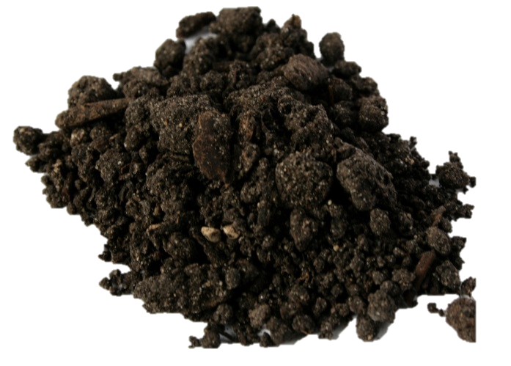
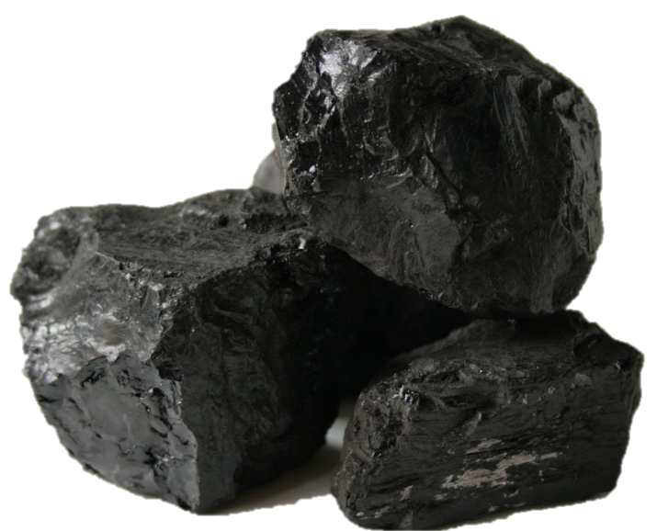
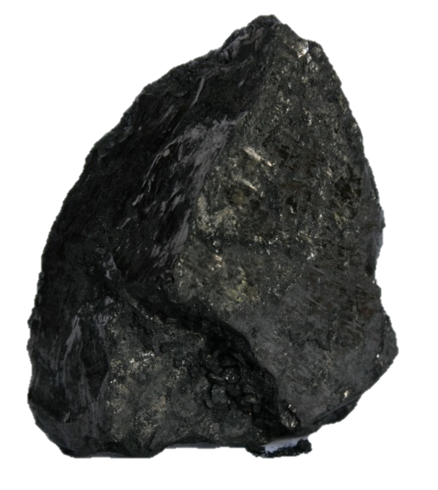
Progression of Coal Formation
Increasing Energy Content
Peat
Bituminous
Lignite
Anthracite
Increasing Time and Pressure
Notes:
Coal actually starts as peat. Peat is brown and crumbly and can itself be burned as a fuel. However it has a high moisture content and its energy density is relatively low.
The lowest grade of coal is lignite. Lignite in the US is found primarily in Texas and it has a brown/black color and is dull. Lignite is 25-35% carbon and has the highest moisture content.
(not pictured) The second lowest rank of coal is sub-bituminous. It has 35-40% carbon.
Bituminous coal is the second highest rank. It is black or very dark gray and is 45-86% carbon. Almost half the coal mined in the US is bituminous.
Anthracite is the hardest, shiniest, and rarest type of coal. It is also the highest rank at 86-97% carbon and has very little moisture.

Slide 4
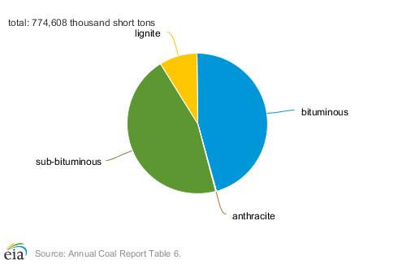
U.S. Coal Production by rank, 2017
Notes:
Coal actually starts as peat. Peat is brown and crumbly and can itself be burned as a fuel. However it has a high moisture content and its energy density is relatively low.
The lowest grade of coal is lignite. Lignite in the US is found primarily in Texas and it has a brown/black color and is dull. Lignite is 25-35% carbon and has the highest moisture content.
(not pictured) The second lowest rank of coal is sub-bituminous. It has 35-40% carbon.
Bituminous coal is the second highest rank. It is black or very dark gray and is 45-86% carbon. Almost half the coal mined in the US is bituminous.
Anthracite is the hardest, shiniest, and rarest type of coal. It is also the highest rank at 86-97% carbon and has very little moisture.

Slide 5
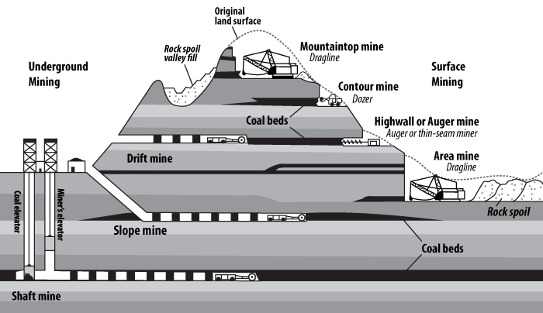
Coal Mining
Notes:
There are two major types of coal mines: Surface and Underground. Surface mines have also been called “strip” mines because the top layers of soil are stripped away to reach the coal beneath.
Underground mines require an access point called a shaft to reach the coal seams underground.

Slide 6
Top Ten States Coal Reserves, 2017
Estimated Recoverable Reserves
State | Million Short Tons
Montana | 74,443
Illinois | 37,669
Wyoming | 35,576
West Virginia | 16,520
Kentucky | 13,947
Ohio | 11,256
Pennsylvania | 11,057
Colorado | 9,464
Texas | 9,064
New Mexico | 6,753
Source: EIA
Notes:
Most of the country’s coal reserves are located west of the Mississippi River.

Slide 7
United States Coal Production
State | Share of total U.S. Consumption, 2017
Wyoming | 41%
West Virginia | 12%
Pennsylvania | 6%
Illinois | 6%
Kentucky | 5%
In 2017, about 757 million short tons of coal were produced in 24 states.
These five states produced about 71% of total U.S. coal production.
Source: EIA
Notes:
The two largest coal mines in the United States are the North Antelope Rochelle and Black Thunder mines in Wyoming. Almost half of the coal mined in the US came from Wyoming. Twenty-four states produce coal.

Slide 8
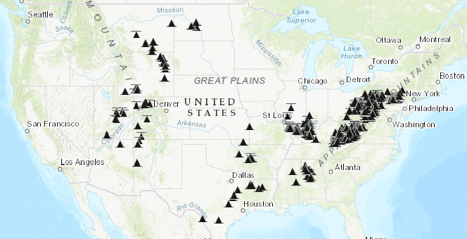
All U.S. Coal Mines (surface and underground)
Source: EIA U.S. Energy Mapping System
https://www.eia.gov/state/maps.php

Slide 9
International Coal Production
Source: EIA
Notes:
The US has the world’s largest reserves, but China produces more coal than any other country. Australia is the world’s largest exporter of coal.

Slide 10
U.S. Coal Consumption by Sector, 2016
Source: EIA
*Total does not equal 100% due to independent rounding.
Notes:
Almost all the coal used in the U.S. is burned to generate electricity. Other uses include steel and cement production. 100 years ago, homes may have used coal for heat, and steam engines burned coal. Today, virtually no homes burn coal, and steam engines have been replaced with diesel electric engines.

Slide 11
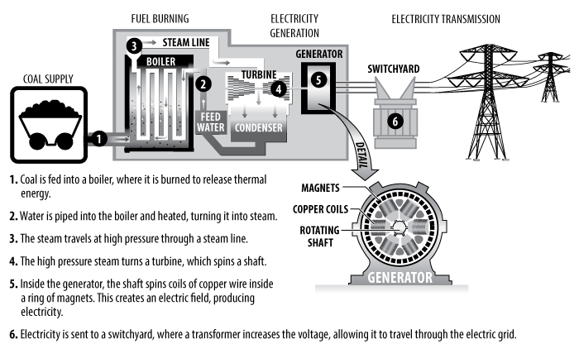
Burning Coal to Generate Electricity
Notes:
All power plants with steam turbines function the same way in that the fuel is used to heat water into steam, which turns the turbine attached to a generator. Coal power plants are excellent baseload fuel sources because coal burns at a consistent rate.

Slide 12
Coal Concerns
Production Risks
Fire
Reclamation
Pollutants

Slide 13
Production Risks
Respiratory health – especially coal dust
Working with large machinery
Monitoring dangerous gas levels
Coal beds frequently contain methane
Carbon monoxide from machinery
Maintaining awareness of surroundings
Image credit: Pennenergy.com
Notes:
Mining industry is heavily regulated and safety is a major concern. While the industry is much safer now, deaths and injuries still do occur.

Slide 14
Coal Fires
Coal fires occur in all coal-bearing parts of the world
Can be naturally-occurring or the result of human activity
Spontaneous in presence of oxygen at depth
Lightning
Surface fires
Endanger miners
Release pollutants
Cause sinkholes
Collapse of coal pillars in underground coal fire near Centralia, PA, has caused subsidence. The fire has been burning continuously since 1962.
Image credit: USGS

Slide 15
Mine Reclamation
Land reclamation - restored land at the Seneca Yoast coal mine.
Image credit: Peabody Energy via WikiMedia Commons
Notes:
Reclamation plans are submitted and approved even before mining begins. The funds to pay for reclamation must be set aside in a bond by the mining company to ensure money is available to pay for reclamation when the mine stops producing.
In both underground and surface mines, piles of waste material, called culm, must be removed to reduce heavy metal and acid runoff.
When a surface mine stops production, the overburden is replaced, graded, and covered with topsoil. Next, fertilizing, seeding, and planting with native vegetation, crops, and/or trees takes place. The site is monitored for years to make sure reclamation has been successful.

Slide 16
Pollutants and Emissions from Coal
Notes:
Coal contains significant amounts of sulfur and nitrogen. When burned, sulfur and nitrogen react with oxygen to form sulfur dioxide and nitrogen oxides. These products of combustion of coal are harmful because when they mix with water they form sulfuric, sulfurous, and nitric acids in precipitation, known as acid rain.

Slide 17
Pollutants and Emissions from Coal
Notes:
Coal is a carbon-based fuel, and when it burns it produces carbon dioxide, a greenhouse gas. Man-made sources of carbon dioxide have been shown to cause global climate change. Carbon dioxide absorbs and traps thermal energy, increasing the temperature of the atmosphere and leading to irreversible climate change. Ocean water also dissolves carbon dioxide; increasing ocean levels of CO₂ result in greater acidification of the water which is putting stress on fragile marine environments like coral reefs.

Slide 18
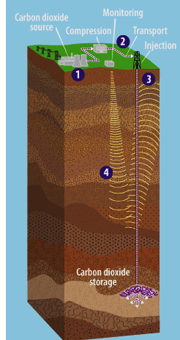
Carbon Capture and Storage
Carbon dioxide is captured at its source of production.
Compressed CO2 is transported via pipeline.
CO2 is pumped to suitable geologic formations underground.
Monitoring ensures CO2 does not leak from its storage site.
Image source: http://www.epa.gov/climatechange/kids/solutions/technologies/ccs.html

Slide 19
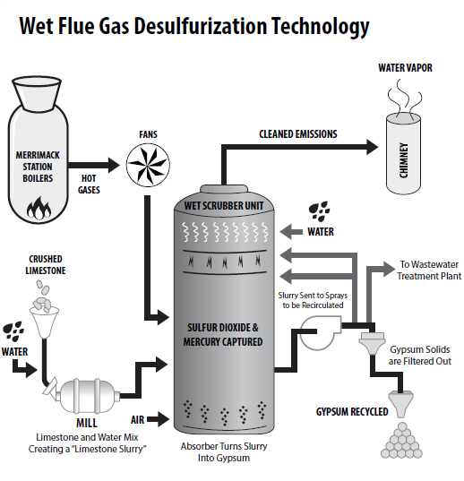
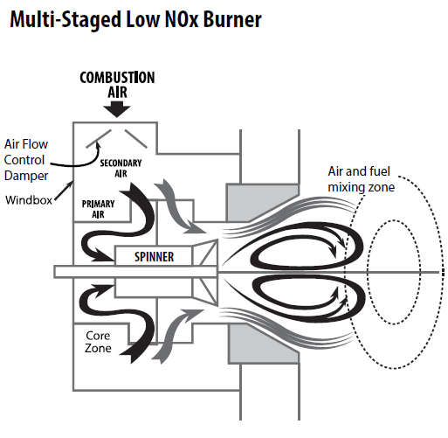
Cleaner Coal Technology
Notes:
Coal contains sulfur, nitrogen, and heavy metals, especially mercury, that are environmentally harmful when burned and released into the atmosphere. Scrubber and cleaner coal technologies have been implemented to reduce harmful emissions from coal boilers.

Slide 20
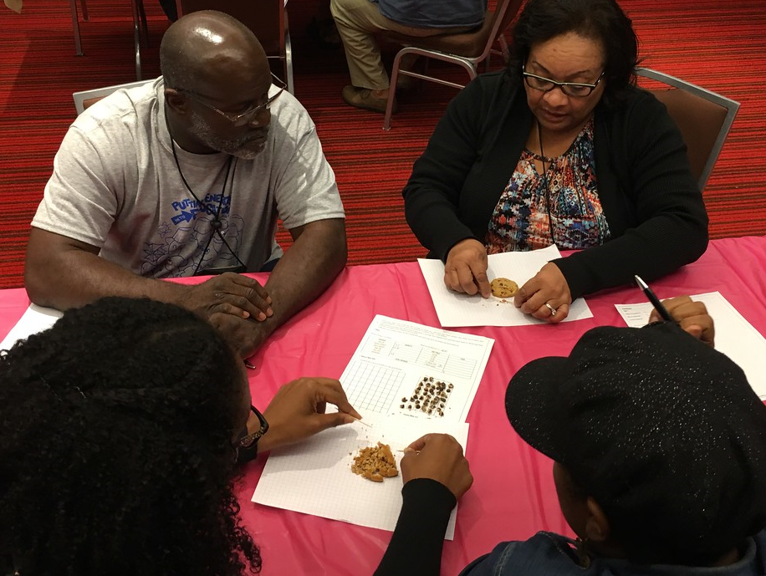
For More Information
The NEED Project
www.need.org
info@need.org
1-800-875-5029
Energy Information Administration
U.S. Department of Energy
www.eia.gov
NEED’s Cookie “Mining” Challenge

Slide 21
NEED IS SOCIAL!
Stay up-to-date with NEED. “Like” us on Facebook! Search for The NEED Project, and check out all we’ve got going on!
Follow us on Twitter. We share the latest energy news from around the country, @NEED_Project.
Follow us on Instagram and check out the photos taken at NEED events, instagram.com/theneedproject.
Follow us on Pinterest and pin ideas to use in your classroom, Pinterest.com/NeedProject.
Exploring Coal - 2018 ©The NEED Project

