Slide 1
Hydrogen
A Fuel for Today and Tomorrow

Slide 2
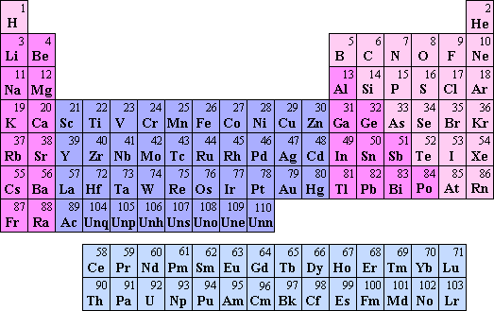
Hydrogen is a Unique Energy Source
Element #1 on the periodic table
Diatomic molecule (H2) - 2 protons, 2 electrons
Highest energy content by WEIGHT, lowest by VOLUME
Most abundant element in the universe
Abundant on earth, but only bound to other elements

Slide 3
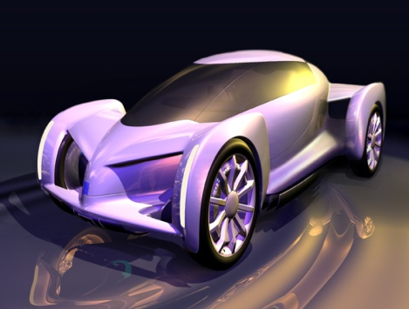
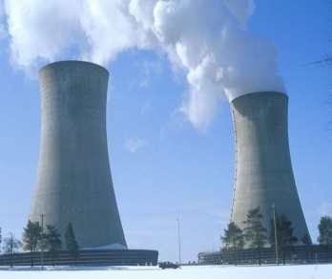
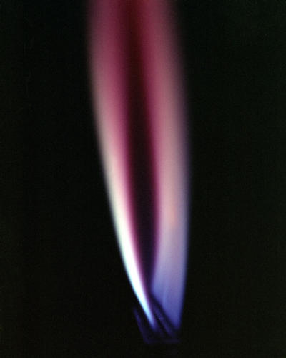
Why Hydrogen?
Transportation
.
It’s abundant, clean, efficient, and can be derived from diverse domestic resources.
Biomass
Hydro
Wind
Solar
Geothermal
HIGH EFFICIENCY & RELIABILITY
Nuclear
Oil
Distributed Generation
ZERO/NEAR ZERO EMISSIONS
Coal
With Carbon Sequestration
Natural Gas

Slide 4
Hydrogen is an Energy Carrier
Energy carriers move energy in a usable form from one place to another.
Electricity is an energy carrier; so are gasoline and hydrogen
Hydrogen allows us to store energy from many sources and bring it to where we need it.
Energy
Hydrogen

Slide 5
Hydrogen is a Versatile Energy Source
Transportation Fuel
Improved range compared to plug-in electric
Internal combustion engines
Applicable to most modes of transportation
Buildings
Combined heat and power generation (CHP)
Fuel cells – backup and primary power
Industry
Hydrogen important in chemical processes
Additional revenue stream opportunities

Slide 6
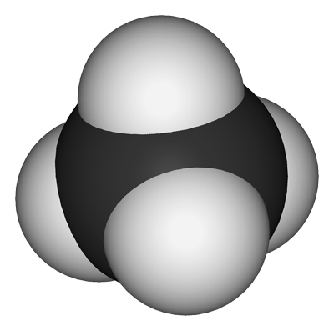
Sources of Hydrogen
H
Hydrogen is not found on Earth in pure elemental form
Hydrogen is most prevalently bonded to oxygen and carbon
Water, natural gas, and crude oil are great sources of hydrogen
C
H
H
H

Slide 7
Hydrogen Production Methods
Image credit: Department of Energy, Office of Energy Efficiency and Renewable Energy

Slide 8
Steam Methane Reforming (SMR)
Steam-methane Reforming Reaction
Thermal Energy + CH₄ (g) + H₂O (g) → 3 H₂ (g) + CO (g)
Water-gas Shift Reaction
CO (g) + H₂O (g) → CO₂ (g) + H₂ (g) + Thermal Energy

Slide 9
Anatomy of a Fuel Cell
Anode: Site of oxidation – electrons removed from hydrogen, form H+
PEM: Proton Exchange Membrane – only allows H+ through
Cathode: Site of reduction – electrons rejoin H+ and combine with O2 to form H2O
Image credit: FuelEconomy.gov

Slide 10
Hydrogen Fuel Cells Are Ideal for Transportation
Comparatively low operating temperature (80 °C)
80 °C is a low temperature for fuel cell operation
Low temperature limits CHP applications compared to other fuel cell types
Quick startup, lower thermal stresses
Efficient at low loads (typical operating region for vehicles)

Slide 11
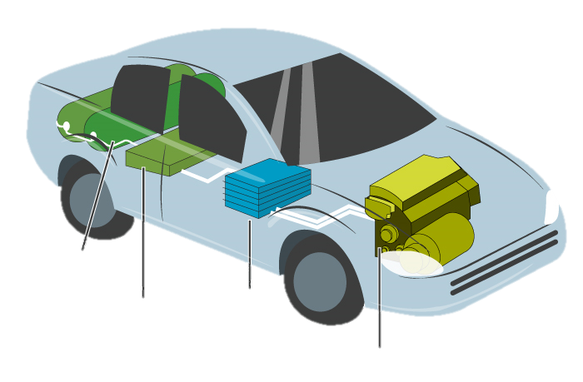
Hydrogen Fuel Cell Vehicles
Hydrogen Tank
Battery
Fuel Cell Stack
Electric Motor

Slide 12
Challenges of Hydrogen
Infrastructure – lack of fuel availability prevents widespread use of FCEV’s; lack of FCEV purchases prevents development of infrastructure
Storage – to achieve 300+ mile range, little cargo space in vehicle (energy density)
Fuel Cell Life – PEM fuel cells in vehicles last about 4,000 hours
Perceived Safety – compared to gasoline, hydrogen is safer, but misconceptions persist

Slide 13
Current Hydrogen Fuel Use for Transportation in the U.S.
39 fueling stations
- 35 in California, 2 in South Carolina, and 2 in the Northeast
Fewer than 10 hydrogen fuel cell vehicles purchased each year
Three different FCEV models for 2017
Honda Clarity
Toyota Mirai
Hyundai Tucson
Down from six in 2016

Slide 14
Hydrogen Storage
High-pressure storage tanks
Tanks must be very strong.
Tank size to achieve 300+ mile vehicle range is prohibitively large
Liquid hydrogen
Higher density
Very low temperature (about -253° C)
Metal hydrides
Hydrogen combines chemically with some metals
More efficient storage than high-pressure tanks
Carbon nanotubes
Microscopic tubes of carbon, 2 nm in diameter
Store hydrogen in their microscopic pores

Slide 15
Hydrogen Storage
Hydrogen storage takes place…
On-board a vehicle
At production sites, in transit, and at refueling stations
Hydrogen can be stored in its pure form, or can be reformed on board a vehicle from other fuels

Slide 16
Fuel Cell Life
While fuel cells do wear out over time, A PEM fuel cell in a vehicle should have a 4,000 hour service life, while stationary applications should last 40,000 hours.

Slide 17
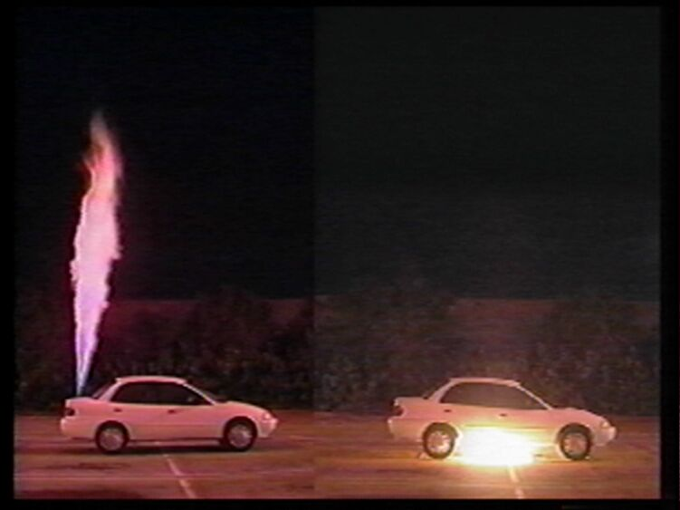
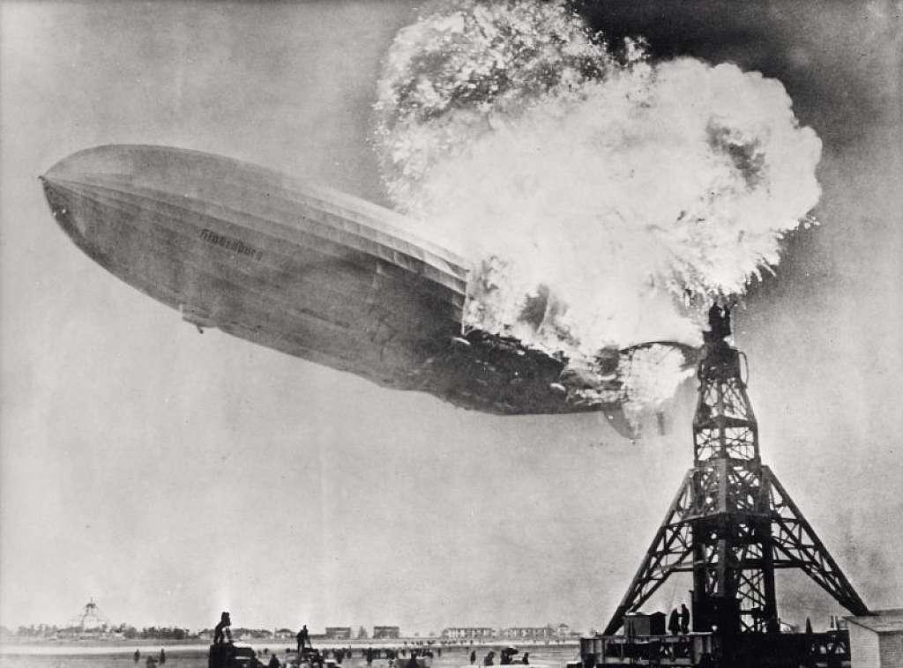
Hydrogen Flammability
Hydrogen Gasoline
Three Seconds
One minute
A fuel leak from a HCFEV would place the flame above the vehicle, whereas a gasoline leak places the flame below the vehicle.
Image from Washington State University, 2017

Slide 18
So – why hydrogen?
Energy security
Diverse domestic sources
Flexibility of system
Economic security
International leadership in technical
development and deployment
Price stability
Environmental security
Potential to meet GHG targets
Urban air quality improvements
Reduction in air pollutants

Slide 19
The NEED Project acknowledges…
Catherine E. Grégoire Padró
Los Alamos National Laboratory
Dr. Rajat K. Sen, Patty Kappaz
Sentech, Inc.

Slide 20
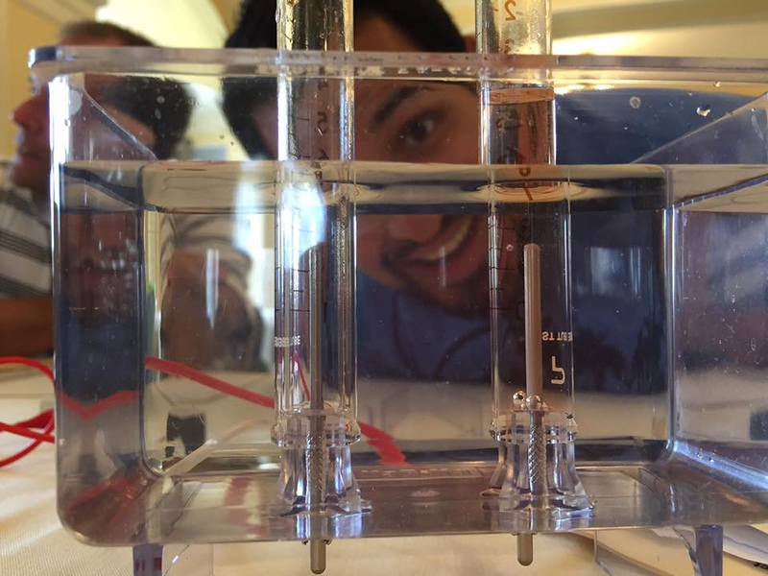
For More Information
The NEED Project
www.need.org
info@need.org
1-800-875-5029
Energy Information Administration
U.S. Department of Energy
www.eia.gov

Slide 21
NEED IS SOCIAL!
Stay up-to-date with NEED. “Like” us on Facebook! Search for The NEED Project, and check out all we’ve got going on!
Follow us on Twitter. We share the latest energy news from around the country, @NEED_Project.
Follow us on Instagram and check out the photos taken at NEED events, instagram.com/theneedproject.
Follow us on Pinterest and pin ideas to use in your classroom, Pinterest.com/NeedProject.
Hydrogen 2018 ©The NEED Project

