Slide 1
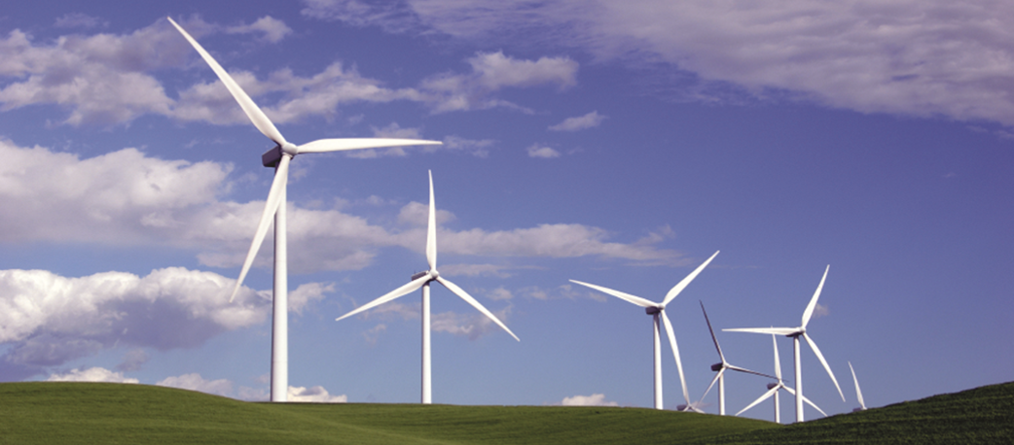
Exploring Wind Energy

Slide 2
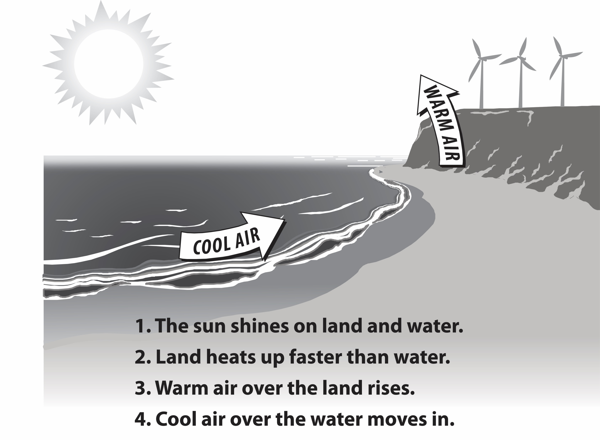
What Makes Wind
Notes:
Heat from the sun causes convection in the atmosphere, meaning the heated air rises. These currents create zones of high and low air pressure within the atmosphere. As the heated air rises, it creates a low pressure zone near the ground. Air from surrounding cooler areas rushes in to balance the pressure. These horizontal pressure differences account for the ambient wind and more intense storm wind.

Slide 3
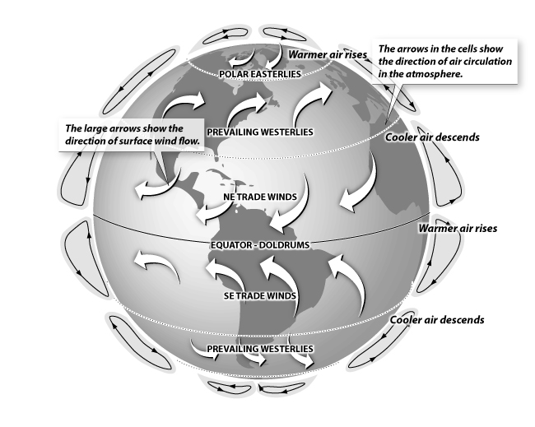
Global Wind Patterns
Notes:
Prevailing winds are caused by the temperature differences between the Earth’s poles and its equatorial regions, as well as Earth’s rotation. The Earth’s atmosphere has several very large and steady prevailing patterns, such as the polar easterlies and the northeast trade winds. Winds are named based on the direction they originate from. In North America, one of the prevailing dominant wind paths track in an arc from the prairies to the Great Lakes and the eastern seaboard – this wind travels in a westerly direction.
Wind energy is also affected by other factors. Air currents move faster and more consistently at higher altitudes–think of the blustery conditions at the tops of tall buildings or on mountain tops. Similarly, wind tends to gather energy when it moves unimpeded over longer distances, which is why very flat regions, such as the prairies, tend to be highly exposed to intense winds.

Slide 4
History of Wind Energy
5000 BC
Sailboats used on the Nile indicate the power of wind
500-900 AD
First windmills developed in Persia
1300 AD
First horizontal-axis
windmills in Europe
1850s
Daniel Halladay and
John Burnham build
Halladay Windmill; start US Wind Engine Company
Late 1880s
Thomas O. Perry
conducted 5,000
wind experiments;
starts Aermotor Company
1888
Charles F. Brush
used windmill to generate electricity
in Cleveland, OH
Early 1900s
Windmills in CA
pumped saltwater
to evaporate ponds
1941
In VT, Grandpa’s
Knob turbine
supplies power to
town during WWII
1979
First wind turbine
rated over 1 MW
began operating
1985
CA wind capacity
exceeded 1,000 MW
1993
US WindPower developed
first commercial variable-speed wind turbine
2004
Electricity from
wind generation
costs 3 to 4.5 cents per kWh
2013
Wind power provided
over 17% of renewable
energy used in US
2016
Block Island Offshore Wind Farm was brought online (US’s first offshore wind farm)
Notes:
5000 BC - The history of wind energy is certainly long, beginning thousands of years ago. It is estimated that as early as 5000 B.C. sail boats were in use on the Nile as boatmen realized the power of the wind.
500-900 AD - The first windmills were developed in Persia for pumping water and grinding grain.
About 1300 - The first horizontal-axis windmills appeared in Western Europe.
1850s - Daniel Halladay and John Burnham worked to build and sell the Halladay Windmill, which was designed for the American West. It had an open tower design and thin wooden blades. They also started the U.S. Wind Engine Company.
Late 1880s - Thomas O. Perry conducted over 5,000 wind experiments trying to build a better windmill. He invented the mathematical windmill, which used gears to reduce the rotational speed of the blades. This design had greater lifting power, smoother pumping action, and could operate in lighter winds. Perry started the Aermotor Company with LaVerne Noyes.
The development of steel blades made windmills more efficient. Six million windmills sprang up across America as settlers moved west. Homesteaders purchased windmills from catalogs, traveling salesman, or they built their own. Mills were used to pump water, shell corn, saw wood, and mill grain.
1888 - Charles F. Brush used the first large windmill to generate electricity in Cleveland, Ohio. Windmills that produce electricity started to be called "wind turbines." In later years, General Electric acquired Brush's company, Brush Electric Co.
1893 - In Chicago, Illinois, the World's Columbian Exposition (aka the Chicago World Fair) highlighted 15 windmill companies who showcased their goods.
Early 1900s - Windmills in California pumped saltwater to evaporate ponds to produce salt for consumption.
1941 - On a hilltop in Rutland, Vermont, "Grandpa's Knob" wind turbine supplied power to the local community for several months during World War II. It had 53-meter blades and was the Smith-Putnam wind turbine.
1979 - The first wind turbine rated over 1 megawatt began operating. The cost of electricity from wind generation was about 40 cents per kilowatt-hour.
1985 - Many wind turbines were installed in California in the early 1980s to help meet growing electricity needs and take advantage of government incentives. By 1985, California wind capacity exceeded 1,000 megawatts, enough power to supply 250,000 homes. These wind turbines were inefficient compared to today’s turbines.
1993 - U.S. WindPower developed one of the first commercially available variable-speed wind turbines, the 33M-VS. The final prototype tests were completed in 1992. The $20 million project was funded mostly by U.S. Windpower, but also involved Electric Power Research Institute (EPRI), Pacific Gas & Electric, and Niagara Mohawk Power Company.
2004 - Electricity from wind generation cost 3 - 4.5 cents per kilowatt-hour.
2011 - Wind power provided 12.8 percent of the renewable energy consumed in the U.S. In the U.S., wind power produced enough electricity on average to power the equivalent of over 10 million homes.

Slide 5
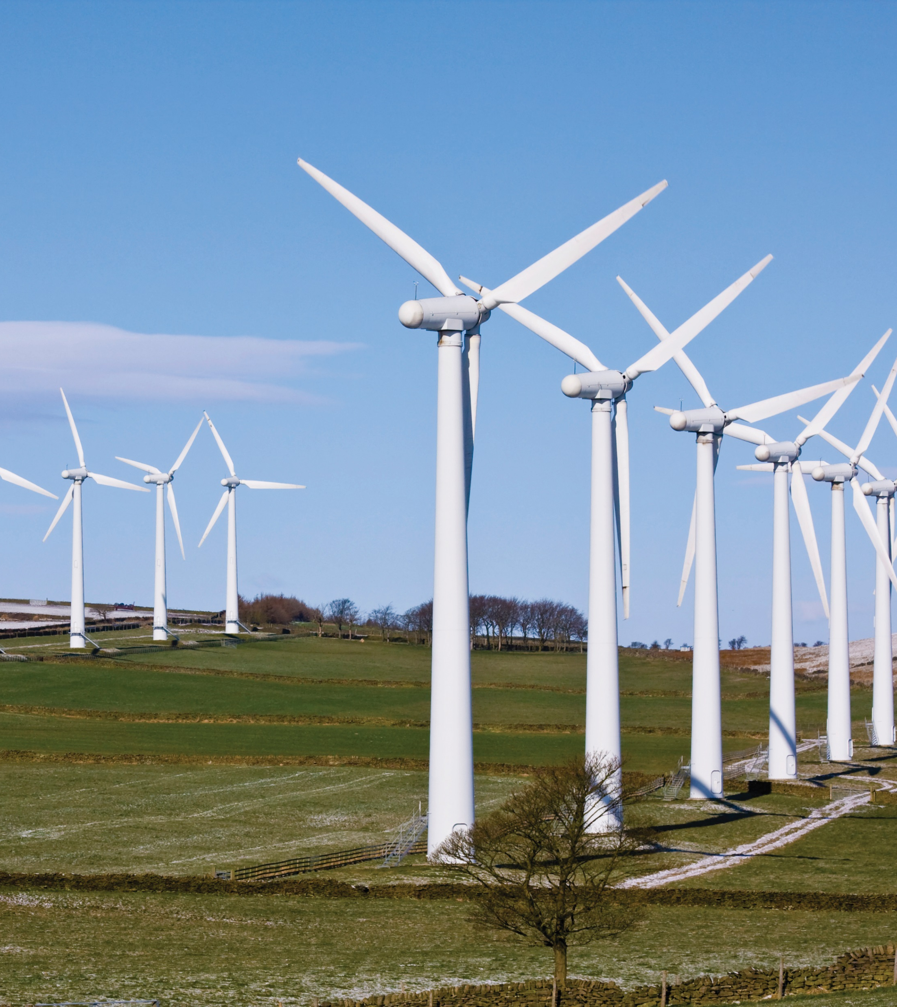
Why Wind Energy?
Clean, zero emissions
NOx, SO2, CO, CO2
Air quality, water quality
Climate change
Reduce fossil fuel dependence
Energy independence
Domestic energy—national security
Renewable
No fuel-price volatility
Notes:
Wind energy is a renewable source of energy, and is considered renewable because it is derived from the sun and is capable of being replenished on a reasonable time scale.
Although wind is a zero emissions electrical generation option, there are emissions in the construction and development of wind projects—concrete, transportation of components, etc.

Slide 6
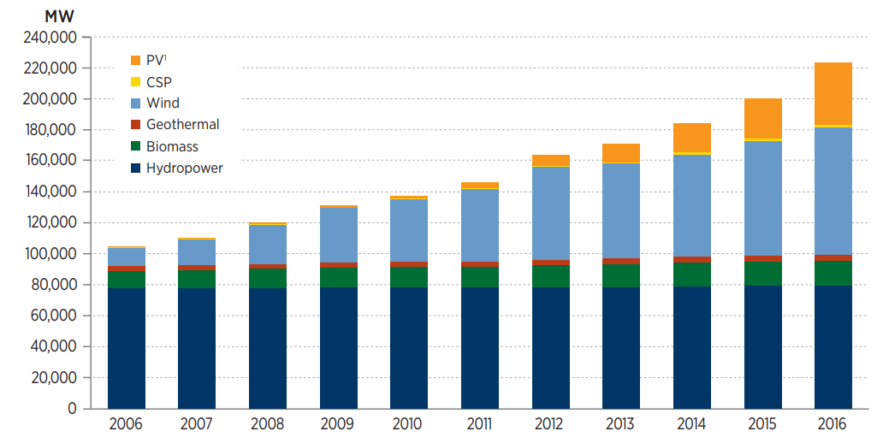
Renewable Electric Capacity Worldwide
US DOE, EERE 2016 Renewable Energy Data Book
Notes:
Wind energy is one of the fastest growing energy resources in the world. U.S. wind electricity capacity grew 8.2 GW in 2016.

Slide 7
U.S. Electricity Generation from Non-Hydro Renewables
Notes:
In the past several years wind has shown tremendous growth as a source for electricity among renewables in the United states.

Slide 8
Top Wind Power Producing States, 2016
Rank | State | Thousand MWh |  | Rank | State | Thousand MWh
1 | Texas | 57,551 |  | 14 | Wyoming | 4,363
2 | Iowa | 20,049 |  | 15 | New York | 3,946
3 | Oklahoma | 19,526 |  | 16 | Nebraska | 3,793
4 | Kansas | 14,113 |  | 17 | New Mexico | 3,614
5 | California | 13,698 |  | 18 | Pennsylvania | 3,472
6 | Minnesota | 10,637 |  | 19 | South Dakota | 3,145
7 | Illinois | 10,627 |  | 20 | Idaho | 2,427
8 | Colorado | 9,425 |  | 21 | Montana | 2,130
9 | North Dakota | 8,080 |  | 22 | Maine | 1,614
10 | Washington | 8,042 |  | 23 | Wisconsin | 1,521
11 | Oregon | 7,163 |  | 24 | West Virginia | 1,432
12 | Indiana | 4,903 |  | 25 | Ohio | 1,255
13 | Michigan | 4,693
Notes:
Texas leads the country in installed wind capacity with around 25% of current capacity.

Slide 9
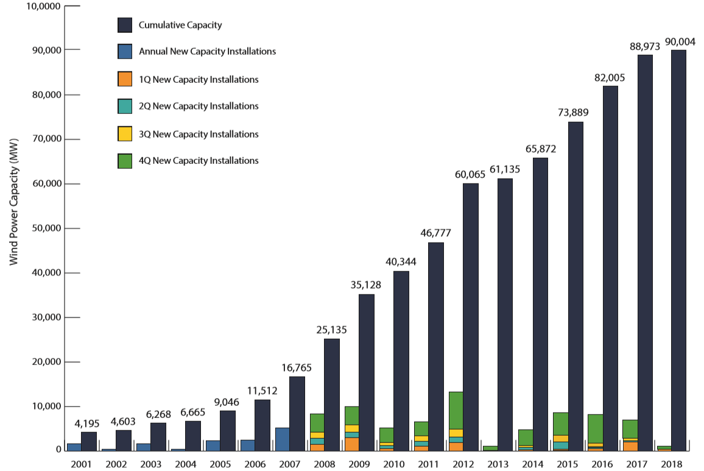
Annual Installed U.S. Wind Power Capacity
American Wind Energy Association | U.S. Wind Industry Second Quarter 2018 Market Report | Public Version
Notes:
In terms of US electric capacity, for the past 20 years (on average) wind energy is the fastest growing energy source in the country.

Slide 10
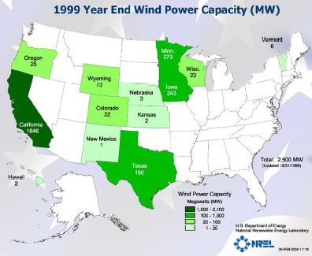
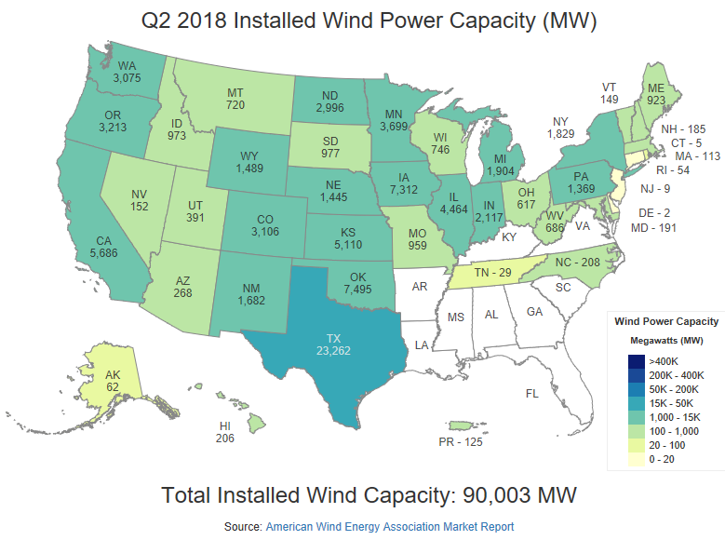
Installed Wind Capacities |1999-Present
1999 Total: 2,500 MW
As of 5/2/2018 Total: 90,003 MW
Notes:
Texas, Iowa, and Oklahoma are the leaders in installed wind capacity with many states significantly increasing their wind capacities in the last 12 years.
Projects tend to be located in areas with good resources that are near existing transmission lines.

Slide 11
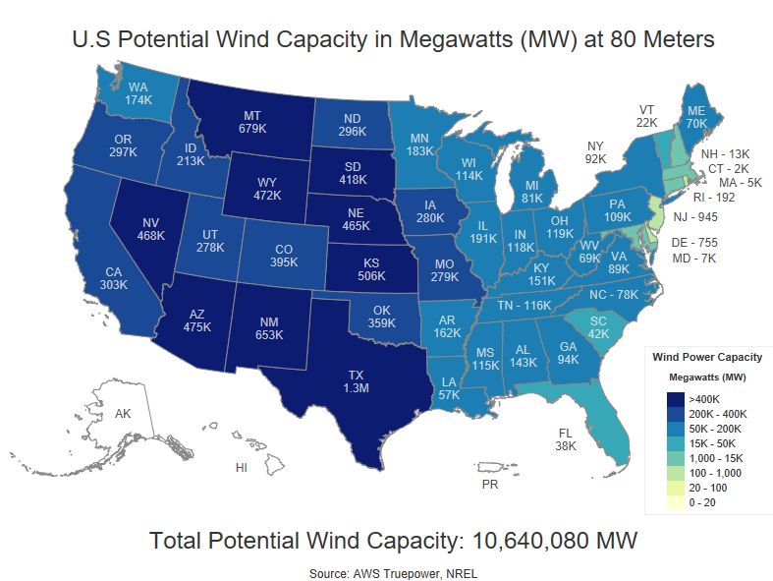
Wind Energy Potential by State
Notes:
Many states have the potential to do much more with wind power than they do. Some states that appear much lower on the previous list of installed wind capacity, appear higher on this list. Why is this? Often, geography plays a big part.

Slide 12
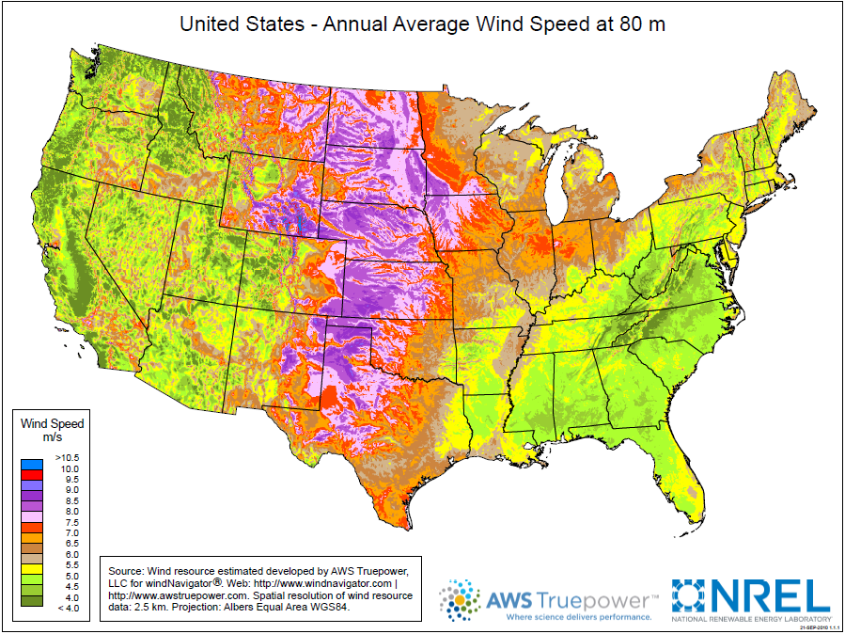
U.S. Wind Resource Map
Notes:
The upper Midwest state of North Dakota has been called the Saudi Arabia of wind. Although there are large wind resources in the state, large population centers are far away and transmission lines are small, making it difficult and costly to transport large amounts of energy from North Dakota to other places.
The Southeast has very little wind development and also has low wind resources. Offshore wind may bring additional installations to coastal states in the future.

Slide 13
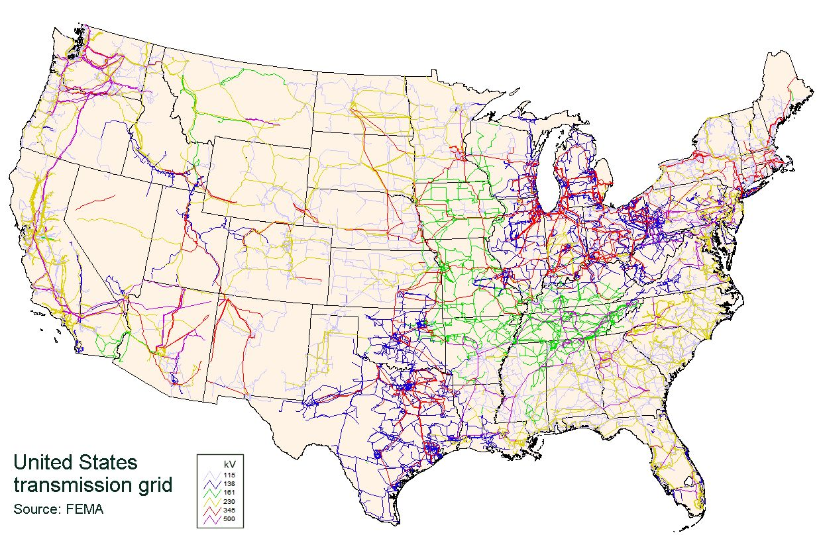
Transmission Challenges
Notes:
One of the major issues facing commercial wind energy is transmission. It is a long and expensive process to build new transmission lines, but some of the best wind resources are in areas with smaller populations and limited transmission capability.

Slide 14
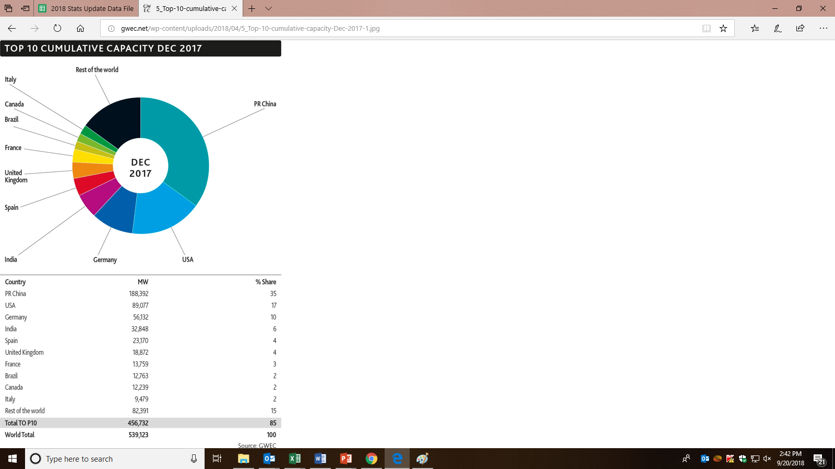
China Leads the World in Wind Capacity
Source: Global Wind Energy Council
Notes:
China has more than double the wind generating capacity than any other country.

Slide 15
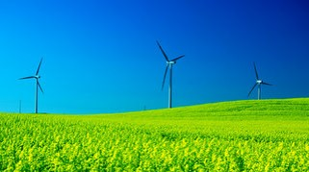
Why Such Growth? …costs are low!
Increased Turbine Size
R&D Advances
Manufacturing Improvements
1979
40 cents/kWh
2000
4 - 6 cents/kWh
2004
3 - 4.5 cents/kWh
2017
Less than 5 cents/kWh
Notes:
The rapid growth in wind power can be attributed to two things–reduction in cost of electricity produced and more interest in renewable technologies. Between 2004 and 2011, an increase in price can be attributed to higher rates of demand than supply of turbines and rising commodity prices including a rise in the price of steel.

Slide 16
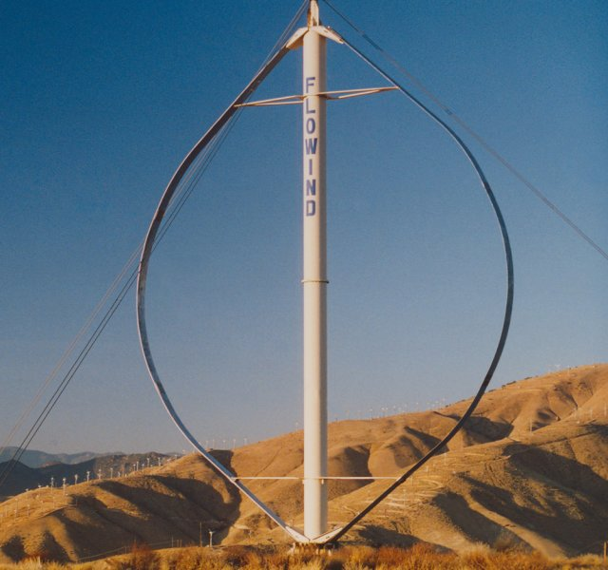
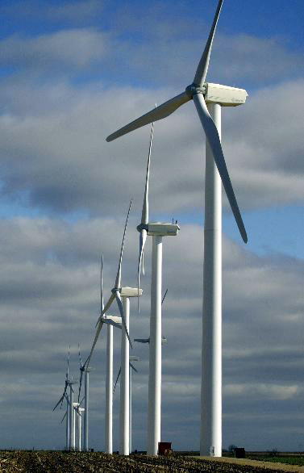
Modern Wind Turbines
Turbines can be categorized into two classes based on the orientation of the rotor.
Notes:
Turbines can spin on a vertical axis (left photo) or horizontal axis (right photo).

Slide 17
Vertical-Axis Turbines
Advantages
Disadvantages
Omni-directional
accepts wind from any direction
Components can be mounted at ground level
ease of service
lighter weight towers
Can theoretically use less materials to capture the same amount of wind
Rotors generally near ground where wind is poorer
Centrifugal force stresses blades
Poor self-starting capabilities
Requires support at top of turbine rotor
Requires entire rotor to be removed to replace bearings
Overall poor performance and reliability
Notes:
Vertical-axis machines have blades that go from top to bottom and the most common type, the Darrieus wind turbine, looks like a giant, two-bladed eggbeater. This type of vertical wind turbine typically stands 100 feet tall and 50 feet wide. New design concepts come to market on a regular basis. Vertical-axis wind turbines make up only a very small percent of the wind turbines used today.

Slide 18
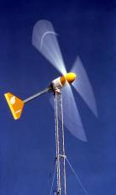
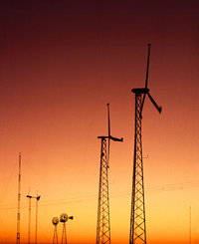
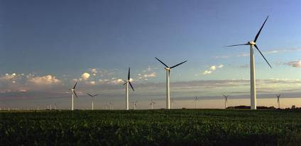
Horizontal-Axis Wind Turbines
Small (<10 kW)
Homes
Farms
Remote Applications (e.g., water pumping, Telecom sites, ice making)
Intermediate(10-250 kW)
Village Power
Hybrid Systems
Distributed Power
Large (250 kW-2+ MW)
Central Station Wind Farms
Distributed Power
Schools
Notes:
Most wind turbines being used today are the horizontal-axis type. Horizontal-axis wind turbines have blades like airplane propellers. Wind turbines stand tall and wide to capture more wind—providing more “swept area” where the blades make contact with the wind.
A one megawatt (1 MW) wind turbine will typically generate enough power for about 250 homes. This depends on the type of device and where it is located.
Most large turbines that you see today are rated at 1.5 megawatts. This means at peak output (high winds) it will be producing about 1.5 megawatts of electricity.

Slide 19
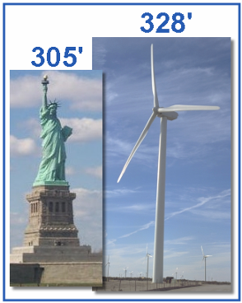
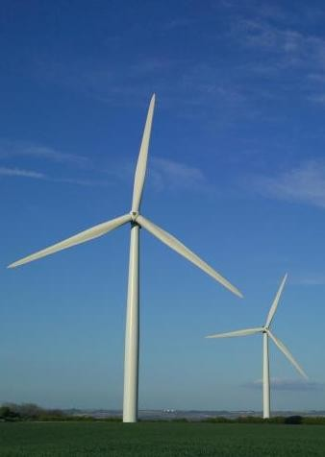
Large Wind Turbines
Common Utility-Scale Turbines
328’ base to blade
Each blade is 112’
200 tons total
Foundation 20’ deep
Rated at 1.5-2 megawatts
Supply power to about 500 homes
Notes:
A typical U.S. large-scale horizontal wind turbine stands 80-100 meters (262-328 feet) tall and has three blades that are each 34-55 meters (112-181 feet) long. They weigh 200-400 tons and produce enough electricity to power 500 homes.
The largest turbine currently in production is the Enercon E-126 which as a capacity of 7.58 MW.
The E-126 tower stands 135 meters (443 feet) tall and has a blade diameter of 127 meters (417 feet).
A number of companies are developing 10 MW turbines mostly for use in offshore applications.

Slide 20
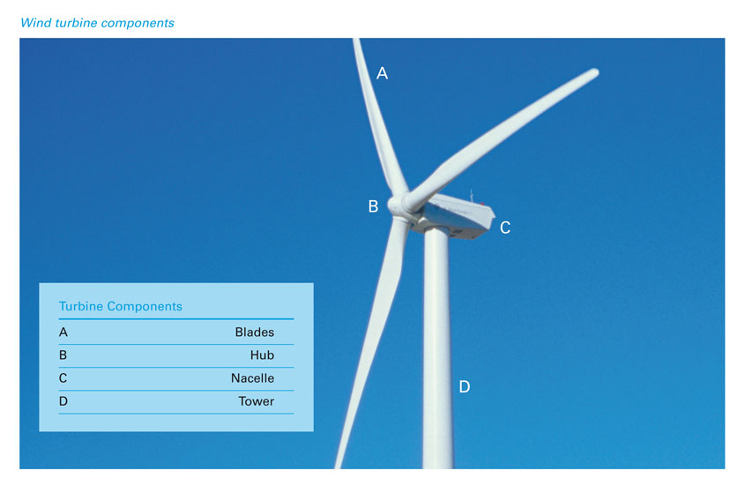
Wind Turbine Components
Notes:
Regardless of the size, all turbines have the same parts.
Blades on modern turbines are similar to airplane blades, lifted by the wind.
The hub connects the blades to the shaft and generator.
The nacelle houses the generator.
The tower holds the turbine high above anything that might cause turbulence in the air such as trees and buildings. Towers can be lattice or monopole for large turbines. Most modern day turbines have monopole towers made of steel.

Slide 21
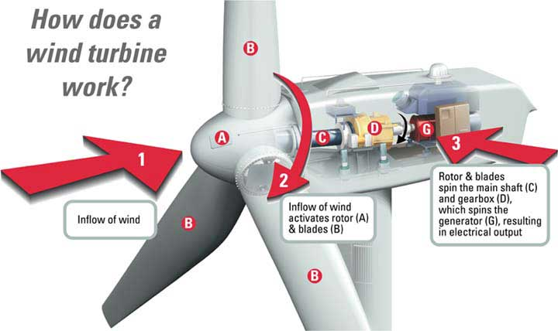
Notes:
Comparing large turbines to small turbines:
Large turbine blades can be actively pitched by hydraulics and spin at 12-20 RPM—much slower than a small wind turbine.
Large turbines have a driveshaft attached to the gearbox—that step up the rotations from 12-20 RPM to 1600 RPM for the generator.
The generator is what creates electricity, turning coils of wires inside magnets.
Small wind turbines use vanes (typically) to track the wind while large turbines use an anemometer and hydraulics to face the turbine into the wind.
Large turbines are highly computerized and automated, sensing weather conditions and turning themselves off if there is a problem.
Large turbines are often connected by computers to a central control location.

Slide 22
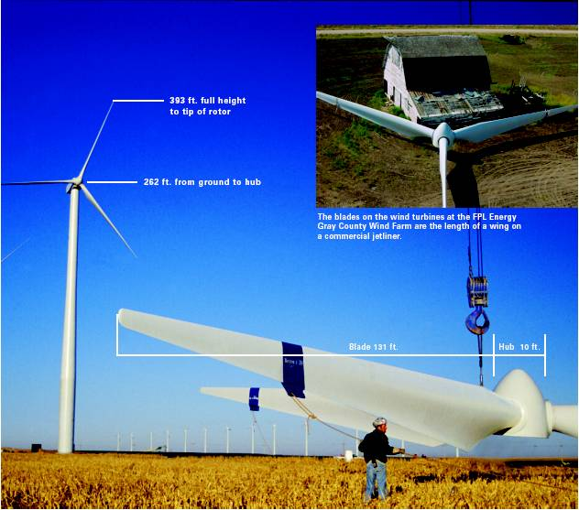
Installation of Wind Turbines
Notes:
Large scale turbines are brought to the construction site in multiple pieces and assembled on site. Specialized trucks transport the components to these often remote locations because, even though the turbine is disassembled, individual pieces are still very large. Towers are transported in 65- to 100-foot long sections. Blades are transported one or two blades per truck.
Prior to erecting the tower, concrete foundations are poured to hold the turbine securely in place.
Once the components arrive at the site, large cranes are used to assemble the pieces, stacking the tower and nacelle first. The blades are attached to the hub on the ground and lifted on to the front of the nacelle.
Note the size comparison to the barn in the upper right hand corner.

Slide 23
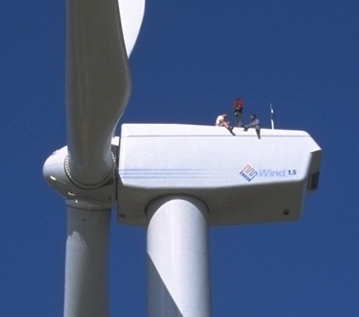
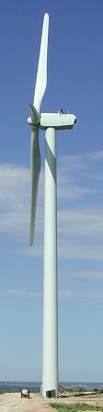
Wind Turbine Perspective
Workers
Blade
112’ long
Nacelle
56 tons
Tower
3 sections
Notes:
Large turbines have ladders or lift systems inside the tower so technicians can access the nacelle and perform maintenance. When work must be performed on the outside of the nacelle, safety harnesses are worn.

Slide 24
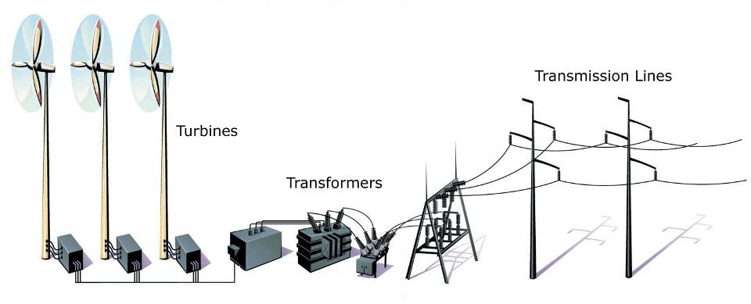
Wind Farms
Notes:
Wind farms are like power plants, with a number of turbines wired together before going to the transformer.
The transformer steps up the voltage before the electricity goes out on transmission lines and the electricity grid.
Some wind farms are very large. The largest wind farm in the U.S. is currently the Alta Wind Energy Center in California with 390 turbines and a 1,020 MW capacity. Large farms such as this can provide as much electricity as a traditional power plant when the wind is blowing.

Slide 25
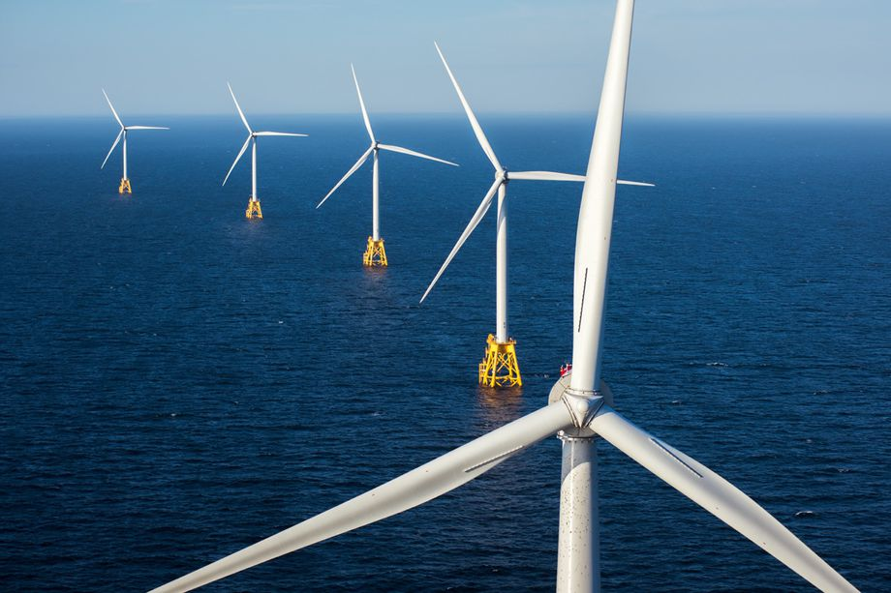
Offshore Wind Farms
The first U.S. offshore wind farm is Block Island Wind Farm, located off the coast of Rhode Island. This five-turbine, 30 megawatt wind farm began operation in 2016.
Photo of Block Island Wind Farm
Notes:
Many developers would like to move wind farms offshore because wind is faster, smoother and can be close to major population centers on the coast. The Bureau of Ocean Energy Management at the Department of the Interior has been granted authority to regulate offshore wind development in federal waters.
U.S. offshore wind development is still in early stages of development. Block Island Wind Farm (30 MW) located off the coast of Rhode Island began operation in 2016. Other offshore construction is also expected to begin on the coast of Virginia.

Slide 26
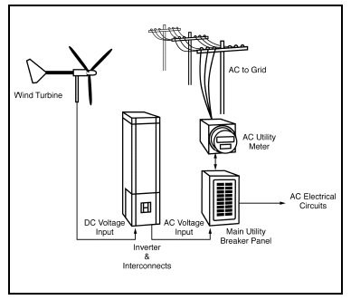
Residential Wind Systems and Net Metering
AC to Grid
Wind Turbine
AC Utility Meter
AC Electrical Circuits
DC Voltage Input
AC Voltage Input
Main Utility Breaker Panel
Inverter & Interconnects
Notes:
"Net metering" is a method of metering the energy consumed and produced at a home or business that has its own renewable energy generator, such as a wind turbine. With net metering capability, excess electricity produced by the wind turbine will spin the electricity meter backwards. This provides the customer with a credit to pull from when more electricity is needed. The customer is sometimes provided with full retail value for all the electricity produced. Not all utilities allow for net metering.
Under existing federal law (PURPA, Section 210), utility customers can use the electricity they generate with a wind turbine to supply their own lights and appliances, offsetting electricity they would otherwise have to purchase from the utility at the retail price. But if the customer produces any excess electricity (beyond what is needed to meet the customer’s own needs) and net metering is not allowed, the utility purchases that excess electricity at the wholesale or “avoided cost” price, which is much lower than the retail price. The excess energy is metered using an additional meter that must be installed at the customer’s expense.
Net metering simplifies this arrangement by allowing the customer to use any excess electricity to offset electricity needs used at other times during the billing period. In other words, the customer is billed only for the net energy consumed during the billing period.
These small installations are often referred to as distributed power. Distributed power is generating capacity that is not located near a baseload power plant.

Slide 27
Potential Impacts and Issues
Property Values
Noise
Visual Impact
Land Use
Wildlife Impact
Properly siting a wind turbine can mitigate many of these issues.
Notes:
Proper siting of wind turbines is the best way to address many of the potential issues that arise. Siting turbines away from populated areas can address issues of noise and visual impact while siting turbines away from preservation areas and wetlands with a focus on siting in areas which already have seen development (ranching, farming, resource extraction, etc.) can address land use issues. In fact, wind farms have been seen in many places as an additional use of farming and ranching land since those activities can still take place on land below the turbines.
An in-depth study was completed by the Renewable Energy Policy Project in 2003 on the effect of wind development on local property values. There was no evidence of reduction of value of 25,000 property transactions.

Slide 28
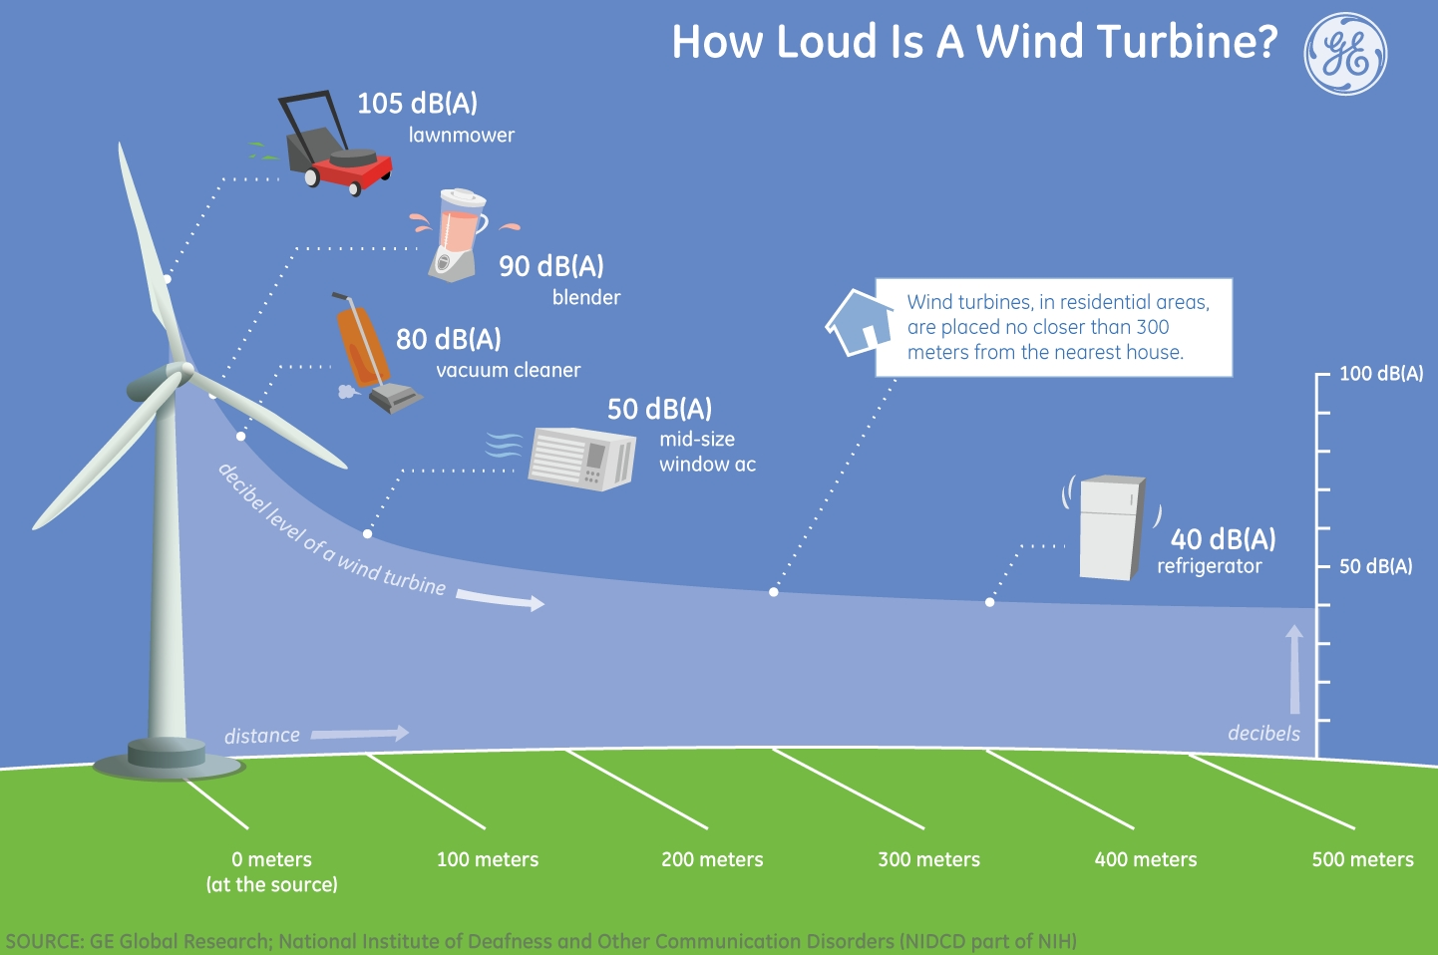
Impacts of Wind Power: Noise
Notes:
In the past, turbines have been perceived as noisy machines. While modern day turbines do produce some noise, when sited at a proper distance from homes and businesses, the noise level is less than many household appliances.

Slide 29
Wildlife Impacts
2400 M
Source: U.S. Fish and Wildlife · U.S. only, as of 2017
Notes:
According to U.S. Department of Energy, over the last decade, the wind community has learned that wind farms and wildlife can coexist successfully. Wind energy development’s overall impact on bird and bat populations is low when compared to other human related activities. Despite this, the wind industry is continually working to reduce wildlife death associated with wind turbines. Steps to reduce wildlife mortality include wildlife studies during the siting of wind farms to avoid major migration routes or high concentrations of bird and bat populations. Today’s turbines are designed with slower moving blades and are on monopoles which do not encourage birds to roust on the towers.

Slide 30
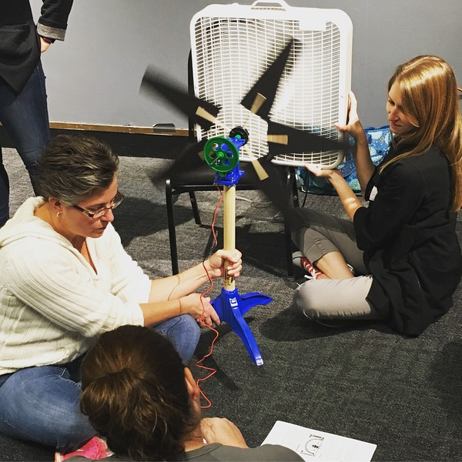
For More Information
The NEED Project
www.need.org
info@need.org
1-800-875-5029
Energy Information Administration
U.S. Department of Energy
www.eia.gov

Slide 31
NEED IS SOCIAL!
Stay up-to-date with NEED. “Like” us on Facebook! Search for The NEED Project, and check out all we’ve got going on!
Follow us on Twitter. We share the latest energy news from around the country, @NEED_Project.
Follow us on Instagram and check out the photos taken at NEED events, instagram.com/theneedproject.
Follow us on Pinterest and pin ideas to use in your classroom, Pinterest.com/NeedProject.
Exploring Wind - 2018 ©The NEED Project

