Slide 1
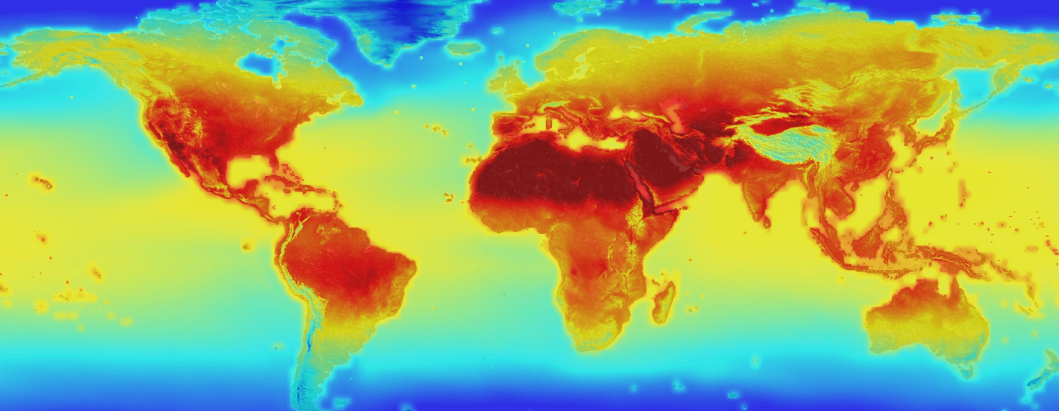
Introduction to Climate Science
Notes:
Image source: NASA https://climate.nasa.gov/news/2293/nasa-releases-detailed-global-climate-change-projections/

Slide 2
Climate vs. Weather
Climate
Aggregated data
What to expect
Weather
Single data points
What we’re getting
Annual or monthly averages
Daily occurrences
Notes:
It is important to understand that climate science is based on climate data, an aggregation of many, many weather data points. Today’s weather can be wildly variable. Historically, climate did not change much. However, global climate is changing. Effects of climate change – increased, wide-spread droughts, greater incidents of extreme weather events, melting ice sheets, and warming ocean temperatures – are on the rise.

Slide 3
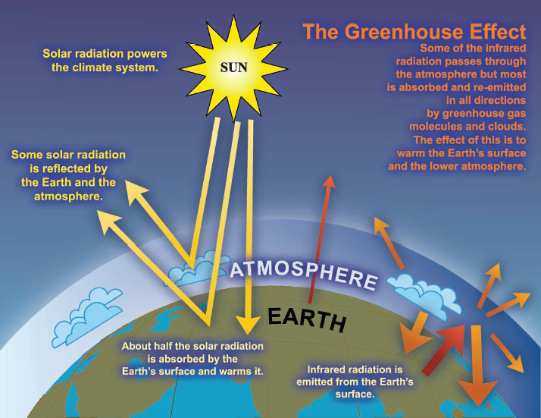
The Greenhouse Effect
Graphic source: IPCC
Notes:
The greenhouse effect is what keeps us alive. Without some form of it, the earth would be much too hot during the day and much too cold at night to support our lives. Compare temperatures on the moon, which is about the same distance from the sun but has no atmosphere: The sunny part of the moon reaches 260° Fahrenheit, and the part of the moon in darkness can be as cold as -280° Fahrenheit (127 °C and -173 °C, respectively).

Slide 4
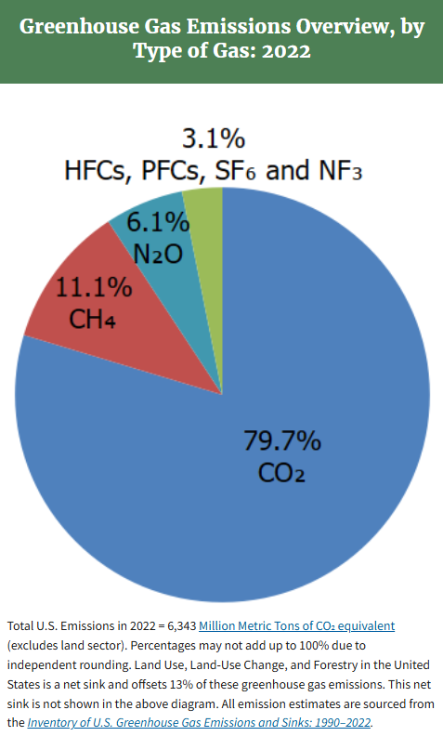
What are Greenhouse Gases?
Gases in the atmosphere that absorb and retain thermal energy
Three major, many minor GHGs in our atmosphere work together to maintain the greenhouse effect
Major GHGs
  Water vapor
  Methane
  Carbon dioxide
Minor GHGs
  F-gases: HFCs, PFCs, SF₆, and NF₃
  Nitrous oxide
Notes:
A greenhouse gas is one that will absorb and hold thermal energy. There are many gases that have this capability, but the most concerning are carbon dioxide and methane.

Slide 5
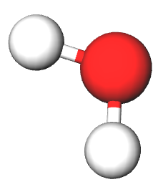
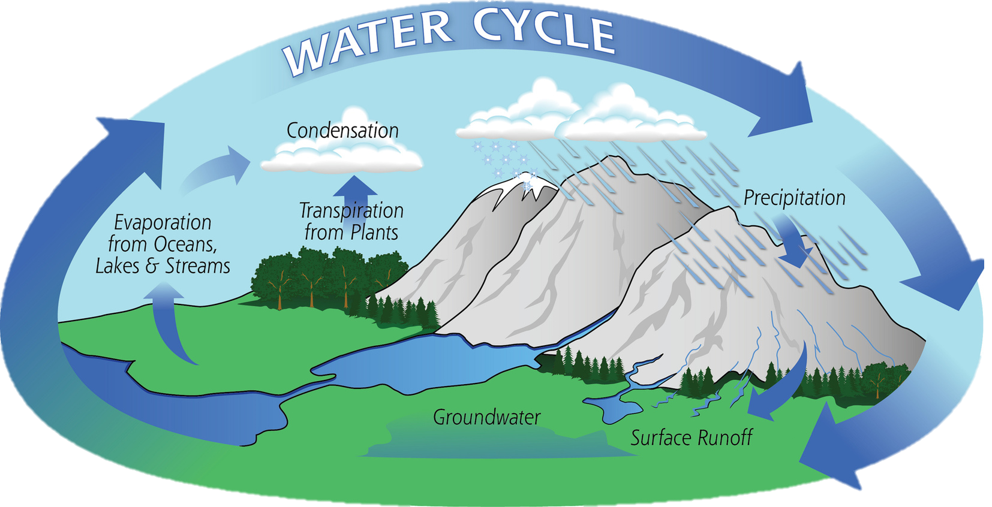
Water Vapor
Chemical formula H₂O
Excellent GHG
Not counted in emissions
Water cycle
Notes:
Water vapor is the gas that started the greenhouse effect billions of years ago. Without it, life would not have evolved as it did. While water vapor is a byproduct of fossil fuel combustion, we are not concerned with its concentration because the atmosphere cannot hold infinite amounts of water. If the atmosphere becomes saturated with water vapor, fog or precipitation will form, removing some water from the atmosphere.

Slide 6
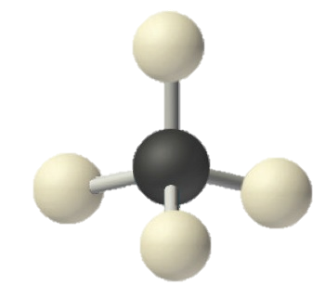
Methane
Chemical formula CH₄
A.k.a. “natural gas”
Natural product of anaerobic decomposition (biological wastes, landfill gas, swamp gas)
Tightly associated in coal deposits
Dissolved in crude oil
Onshore and offshore deposits alone – visible under water
At least 22x more effective as a greenhouse gas than carbon dioxide
As global temperatures rise, permafrost line migrates and CH₄ released
Notes:
Methane is increasingly becoming a concern for climatologists. Increased use of natural gas has caused an increase in the volume of methane forced through pipelines, leading to increased methane leaks. Furthermore, as surface temperatures increase, the permafrost line has been migrating northward; dead, buried vegetation previously frozen in the ground is now thawing and decaying, releasing methane. The only good news here is that methane is not as persistent in the atmosphere. However, when it breaks down, one product is carbon dioxide.

Slide 7
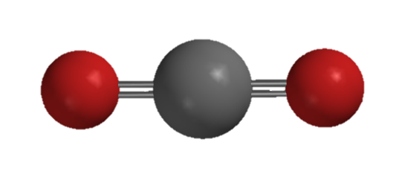
Carbon Dioxide
Chemical formula CO₂
Primary focus of climate change mitigating action
Byproduct of aerobic respiration and hydrocarbon combustion
C₆H₁₂O₆ + 6 O₂ → 6 CO₂ + 6 H₂O
CH₄ + 2 O₂ → CO₂ + 2 H₂O
2 C₈H₁₈ + 25 O₂ → 16 CO₂ + 18 H₂O
2 C₁₄H₃₀ + 43 O₂ → 28 CO₂ + 30 H₂O
Notes:
Carbon dioxide is a normal, naturally-occurring compound. Pre-industrial levels of CO2 as measured in ice cores in Greenland indicate that an atmospheric concentration of about 280 ppm was fairly constant with minor fluctuations before the industrial revolution. However, as fossil fuel combustion has increased, so has the concentration of carbon dioxide. The chemical reaction equations are, in order, top to bottom: Cellular respiration of glucose; combustion of methane; combustion of octane, a component of gasoline; combustion of tetradecane, one hydrocarbon found in diesel fuel and jet fuel.

Slide 8
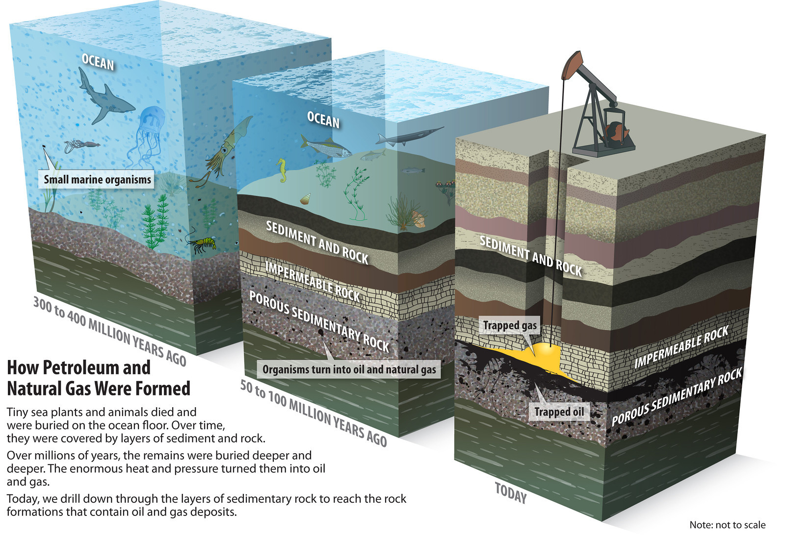
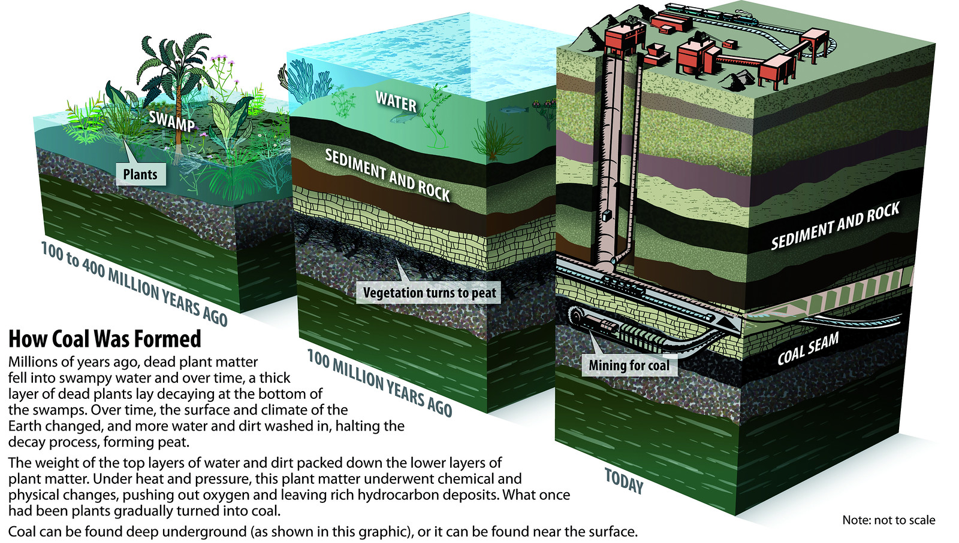
Fossil Fuels
Fossil fuels are hydrocarbons; burning them produces CO₂
Notes:
About 80% of our total energy use is from fossil fuels. Petroleum and natural gas deposits were formed primarily from marine organisms that pre-date the dinosaurs. However, methane also occurs tightly associated with coal, and can also exist independent of petroleum and coal.

Slide 9
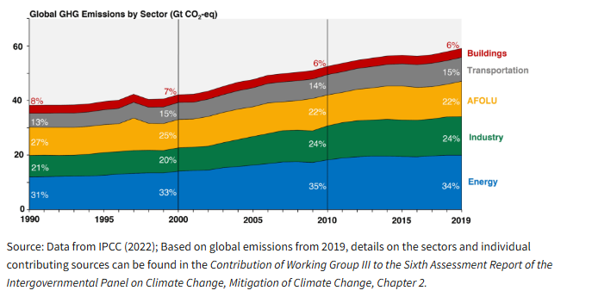
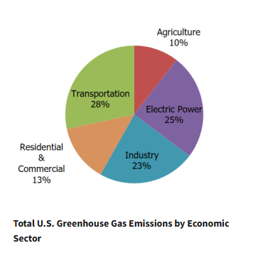
Source: EPA
Notes:
The graphic on the left represents global emissions while the graph on the right is for the US only. Electrification of passenger vehicles and transitioning to cleaner sources, like nuclear, solar, and wind for electrical power generation, are expected to reduce US greenhouse gas emissions.

Slide 10
CO₂ Concentration and Temperature Anomaly vs Time
Notes:
This is the “hockey stick graph” where temperature anomalies and CO2 concentrations are superimposed. The temperature anomaly is the annual average compared to expected temperature based on all climate data. Temperatures were at or below normal until about 1985, and then remained above normal ever since.

Slide 11
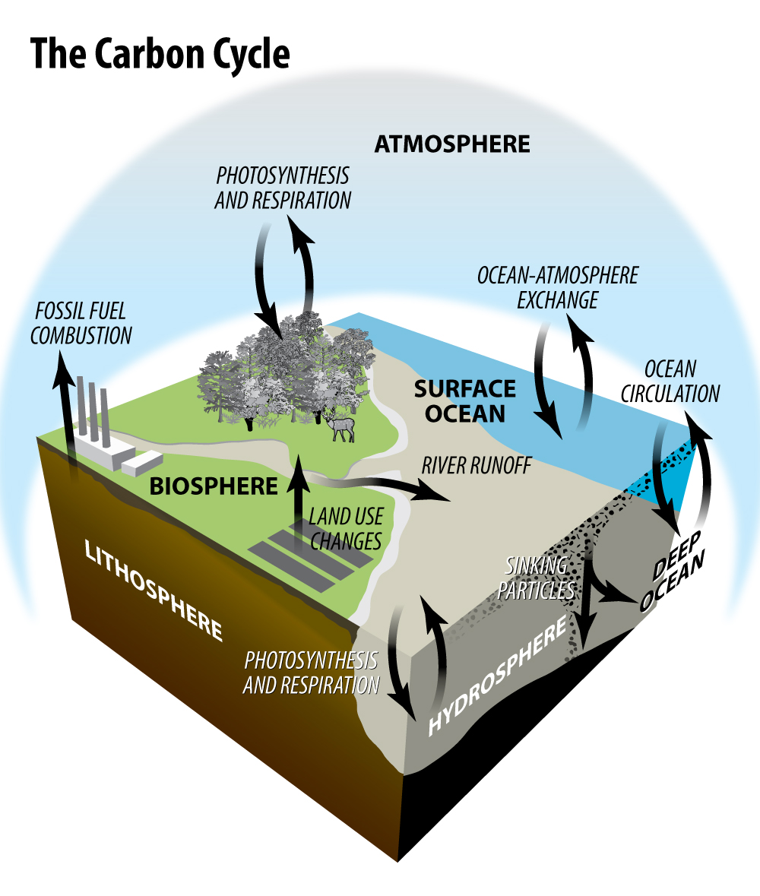
The Carbon Cycle
Carbon cycles between reservoirs or sinks in the Carbon Cycle.
The lithosphere stores the most carbon, some of which is found in fossil fuels. The hydrosphere is the second largest reservoir, followed by the atmosphere, and then the biosphere.
Notes:
Without removing fossil fuels from the lithosphere, carbon cycles through the other reservoirs regularly and each keeps the other in check.

Slide 12
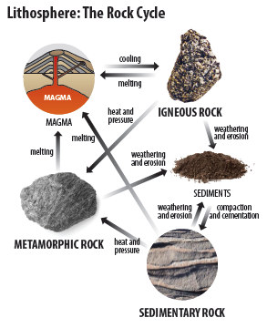

The Lithosphere
Largest carbon reservoir
Carbon is found primarily in rocks and minerals
Carbon is also found in the form of fossil fuels: petroleum, natural gas, and coal
Prior to the Industrial Revolution carbon left the lithosphere slowly through weathering and volcanism (natural processes)
Notes:
Carbon stored in the lithosphere, in the form of fossil fuels, was from the biosphere millions of years ago. Removing it from the lithosphere essentially loads the carbon cycle on the front end. The biosphere cannot adjust as quickly as the atmosphere and hydrosphere.

Slide 13

The Hydrosphere
Second largest reservoir of carbon
Most of the carbon in this reservoir is found in the world’s oceans, but also in fresh water sources
A subsystem of this reservoir includes marine plants and animals
Notes:
The hydrosphere (oceans and lakes) absorbs carbon dioxide from the atmosphere. When it does, the pH decreases because the equilibrium between carbonic acid, H2CO3, and water/carbon dioxide, is disrupted. (H2O + CO2 ↔ H2CO3).

Slide 14

The Atmosphere
A smaller amount of carbon is stored in the atmosphere
The only reservoir that exchanges significant amounts of carbon directly with all of the others
Water vapor varies widely from region to region and according to the time of year. The average is about one percent and can be anywhere from trace amounts to four percent of atmospheric volume.
Notes:
The atmosphere accepts CO2 from all the other carbon reservoirs, and transfers it to the other reservoirs. It is the most dynamic of the four carbon reservoirs.

Slide 15
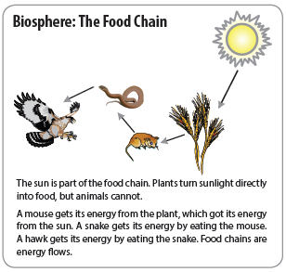

The Biosphere
One of the smallest reservoirs
Includes all things that are living, were alive a short time ago, or are derived from living organisms
Carbon in this reservoir is found mainly in the form of carbohydrates and proteins in both living and decaying organisms

Slide 16
Simulation Game Play
You will model one carbon atom moving through the carbon cycle. Each person will be assigned to a reservoir to start.
Fill out the top of your Carbon Tracking Sheet:
Record the round as “pre-industrial revolution” or “present day” based upon teacher instructions.
Record your starting location and read the poster to find out what type of molecule you are and in what item you are found.
Record how many atoms are present in your reservoir.

Slide 17

Game Play, Continued
When all at your poster are ready, each atom will draw a card from the stack:
Look at the Reservoir Instruction Sheet on the wall and compare cards. Determine who goes and who stays.
Before moving, record WHERE you are going or if you are staying on your Carbon Tracking Sheet.
When directed, go to your new reservoir or stay put.
Some people will not move!

Slide 18

Game Play, Continued
Again, fill out the top of your Carbon Tracking Sheet:
Read the poster to find out what type of molecule you are, in what item you are found, and the process by which you arrived.
Record how many atoms are present in your reservoir.
When all at your poster are ready, each atom will draw a card from the stack:
Look at the Reservoir Instruction Sheet on the wall and compare cards. Determine who goes and who stays.
Before moving, record where you will go, or if you will stay.
Wait for instructions to move.
Repeat for up to 10 rounds.

Slide 19
Stay up-to-date with NEED. “Like” us on Facebook! Search for The NEED Project, and check out all we’ve got going on!
Follow us on Instagram and check out the photos taken at NEED events, instagram.com/theneedproject
Follow us on Twitter. We share the latest energy news from around the country, @NEED_Project
We have great videos for you on our YouTube channel – activities, career interviews, and so much more! https://www.youtube.com/@NEEDproject

Slide 20
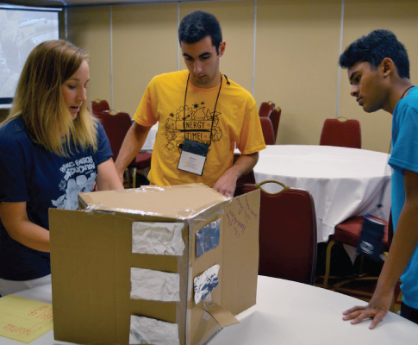



NEED’s 46th Annual Youth Awards Program for Energy Achievement
https://youthawards.need.org
Notes:
Free to participate, this program combines academic competition with recognition to acknowledge everyone involved in NEED during the year – and to recognize those who achieve excellence in energy education in their schools and communities. Students and teachers set goals and objectives and keep a record of their activities. Students combine their materials into presentations and submit them online by April 15th deadline.

Slide 21


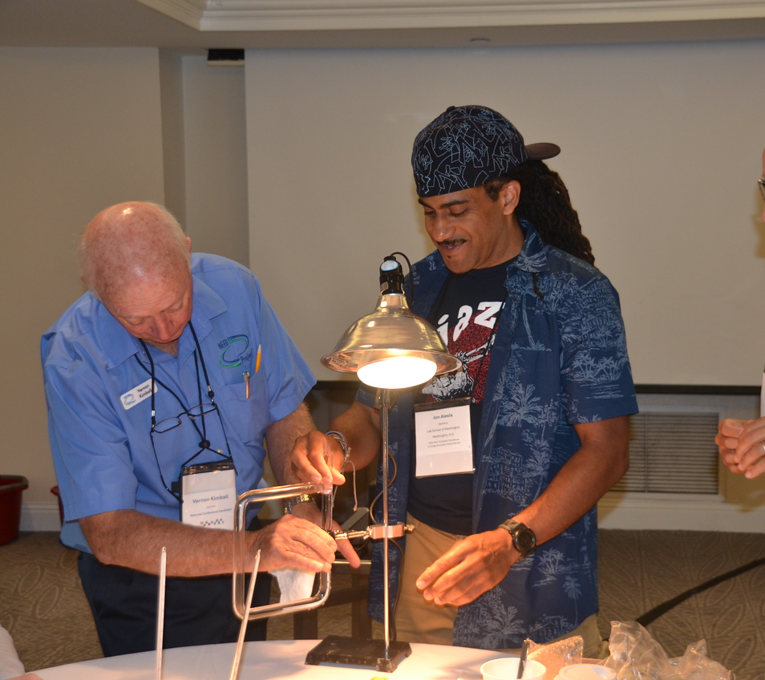



2026 NEED NATIONAL ENERGY CONFERENCE FOR EDUCATORS
July 12-16 · Nashville, TN
5 interactive days engaging with NEED’s curriculum and materials.
Great networking opportunity with K-12 educators from all over the country.
Receive training and materials to implement innovative hands-on energy units that meet state standards & can be utilized with students of all learning styles.
Scholarships for classroom teachers available!
Graduate credit available (additional fee).
Scan code to learn more
and apply today!
www.need.org/educators/national-energy-conference-for-educators

