Slide 1
Welcome 2022-2023 Program

Slide 2
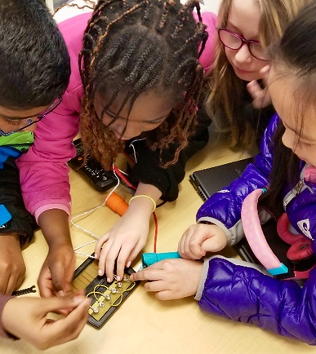
ESP Program
Energizing Student Potential is a collaborative educational initiative designed to empower students to explore opportunities in STEM fields and help them discover their own path to innovation through a variety of classroom subjects.
ESP is designed to help educators bring energy into the school and to provide all the tools and resources necessary for students and educators to learn together, explore energy together, and teach their local communities about energy while learning about energy careers as well.

Slide 3
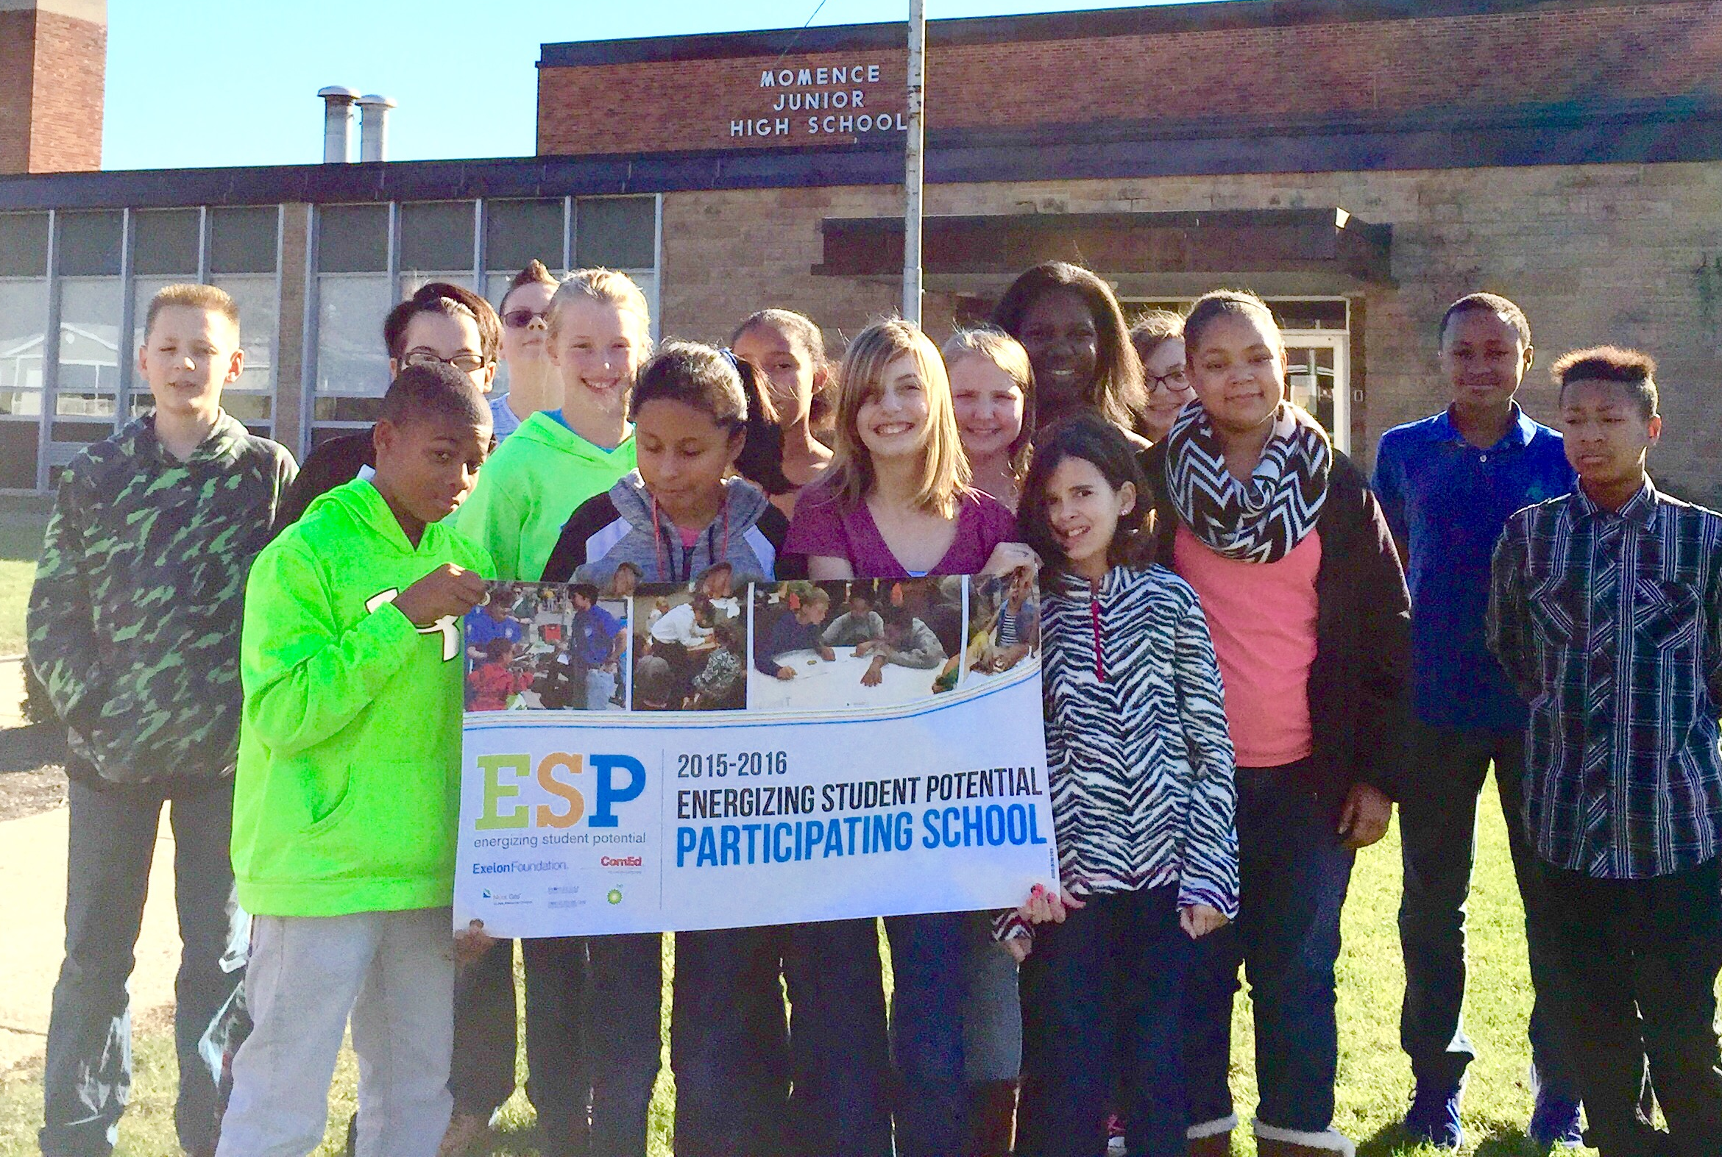
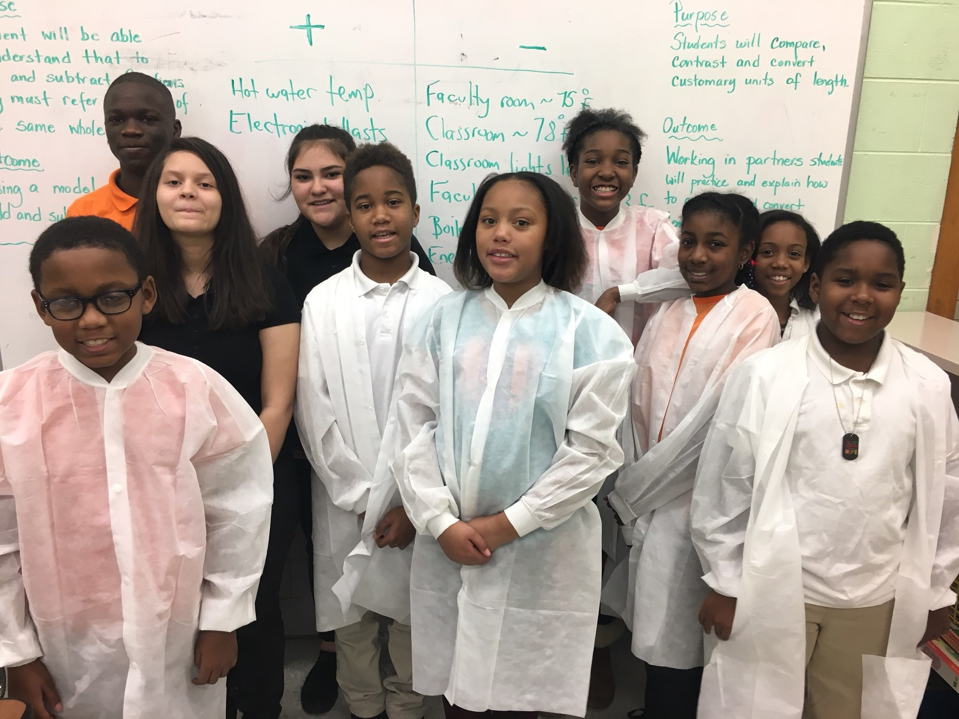
The ESP Program is designed for you to…
Incorporate the program’s energy-focused curriculum and related activities with your students between now and June 2023.
Work with students to complete an Energy Innovation Challenge.
Optional - Host an Energy Fair at your school for the local community. Schools will be provided an Energy Fair Kit!
Optional - Work with NEED to plan for an Educational Energy Audit experience for a select team of students.

Slide 4
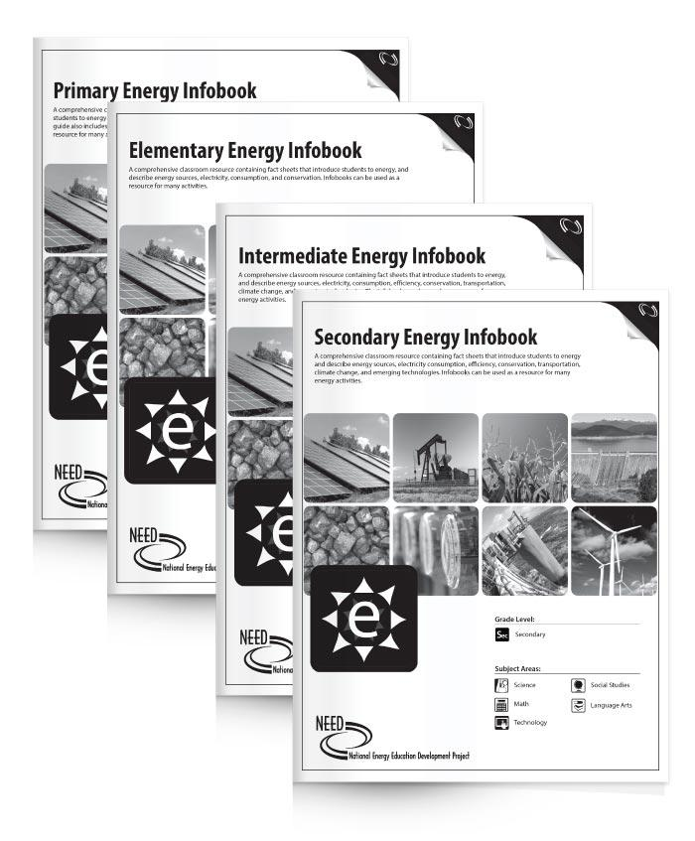
The Curriculum and Hands-on Kits
NEED curriculum and kits for the program will be showcased
throughout the workshop. All curriculum guides and kits are found online at shop.need.org.
Standards Correlations and Support
All NEED curriculum supports and is correlated to relevant national standards and state standards. For correlations, visit
www.need.org/curriculumcorrelations.
Curriculum Guides
NEED has hundreds of teacher and student guides for
teaching the science of energy, sources of energy, electricity and transportation, and efficiency and conservation.
All educators participating in the program will receive a class-set of NEED’s Energy Infobooks at their selected appropriate grade level. These student readers serve as the text for a comprehensive energy education program.
All NEED curriculum is available for free PDF download or as an e-publication.

Slide 5
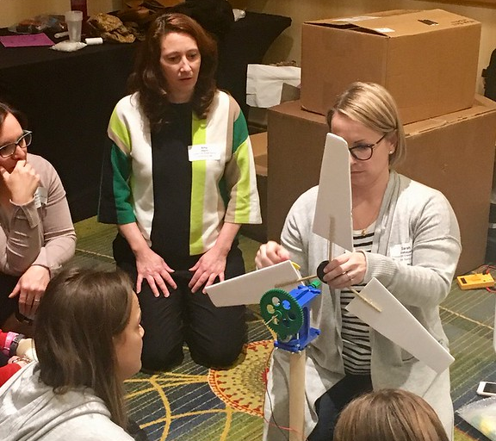
What will you receive?
Teacher Training Workshops with stipends and sub pay
Teacher selected energy kits
Energy Fair kit if hosting an Energy Fair
Student Resources
Opportunity to have an Educational Energy Audit
Opportunity to apply for a mini-grant up to $400

Slide 6
Teacher Selected Energy Kits
You may select two energy kits! Each kit is available at the primary, elementary, intermediate, and secondary level. View kits at shop.need.org
Science of Energy
Solar
Wind
Hydropower
Exploring Oil & Natural Gas
Climate Science
Additional kit opportunity!
Energy Efficiency & Conservation kits are available to schools who sign up for an Educational Energy Audit!
NEED will be emailing a link to you to make your kit selections.

Slide 7
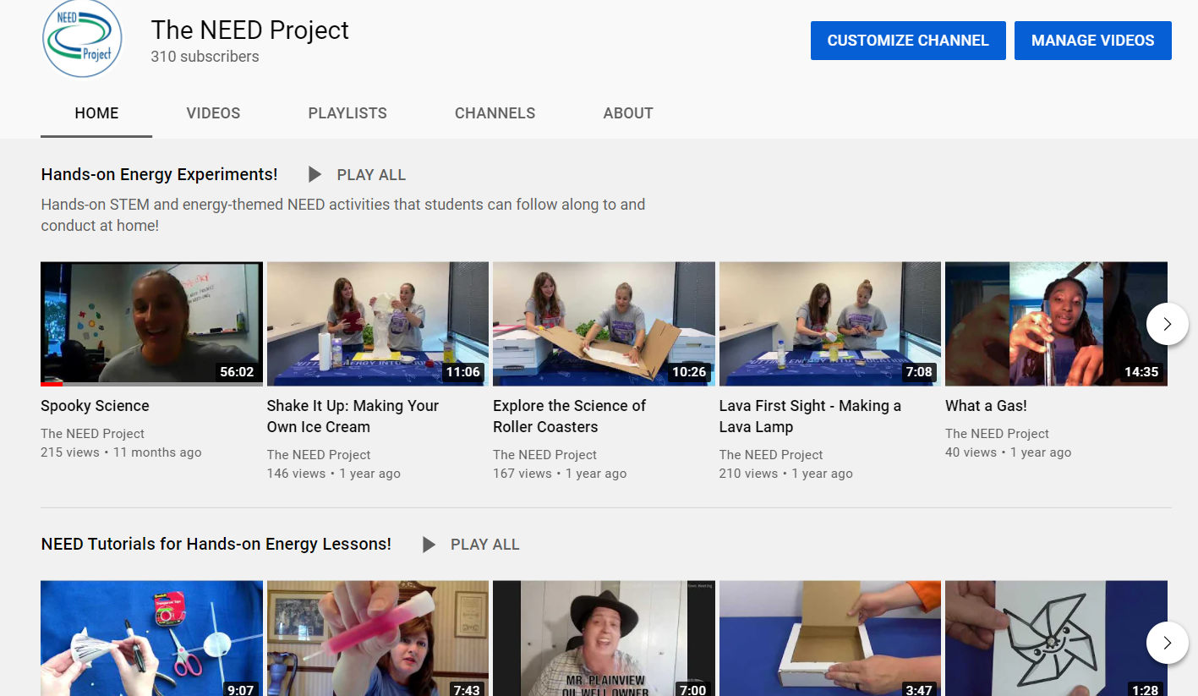
Hands-on Video Resources
NEED YouTube Channel: www.youtube.com/user/NEEDProject

Slide 8
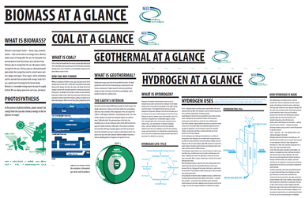
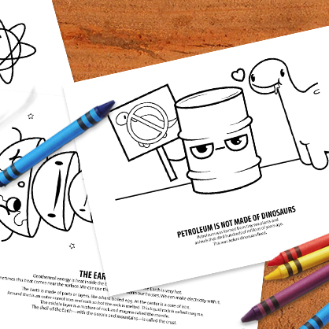
Awesome Extras
PowerPoints · Coloring Pages · Energy Graphics · and more!
www.need.org/awesomeextras

Slide 9
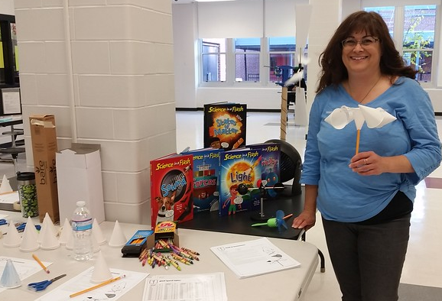
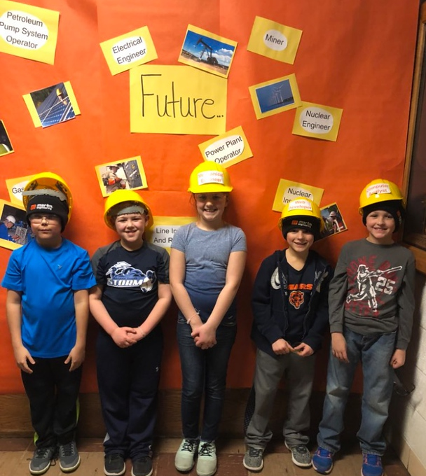
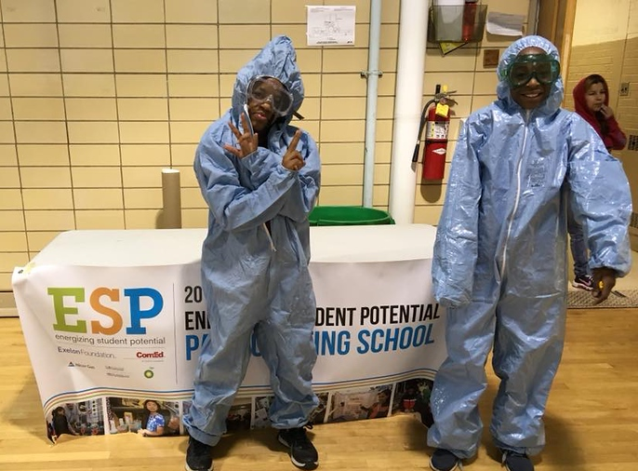
Energy Fair - Optional
Work with students, faculty, parents, and community members to plan and implement an energy-focused STEM project in your school/community.
Let NEED know the date, time, and location.
NEED will provide you with a link to input your Energy Fair date and details so we may send an Energy Fair Kit to you.

Slide 10
Energy Fair Kit – What’s Inside?
• Energy Conservation Contract – Students will complete this activity with their family and will create an exhibit for the Energy Fair to have attendees complete the contract as well.
• Energy Information Exhibits– Students will create informational exhibits for attendees to tour. Topics will include:
o Energy Efficiency and Conservation
o Nuclear Energy
o Petroleum
o Natural Gas
o Transportation Fuels
o Electricity
o Heating and Cooling
o Hot Water Heating
o Lighting
o Wind
o Solar
o Plug Loads
• Bumper Stumpers – A NEED game to unscramble energy “vanity plates”
• Seven Games from NEED’s Energy Carnival
• Facts of Light station and information that includes light bulb comparisons for students and those attending the Energy Fair
• Energy House – Lessons for a small group of students to build and demonstrate an energy efficient home.
• Energy Linked In Designs – Students will create Linked In pages for themselves using career information from all partners in order to learn more about natural gas, electric power, refining, petroleum, nuclear, renewables and more.
• Energy Safety – Students will create exhibits safety information from all partners in order to learn more about safety in electric power, natural gas and the workplace.

Slide 11
Mini-Grant Application - Optional
An opportunity to request up to $400 in additional classroom grant funds for field trips, supplies, or other resources specific to engaging students in the ESP Program. NEED will email you a link to apply.
Include in your request
Total amount requested
Budget: List items you would like to purchase including costs
Who you would like the check made out to
School/District
Other school organization such as PTO
Have NEED purchase materials, you provide links to items requesting
Opt for an Amazon eGift card to be emailed to you (must provide receipts of purchases)

Slide 12
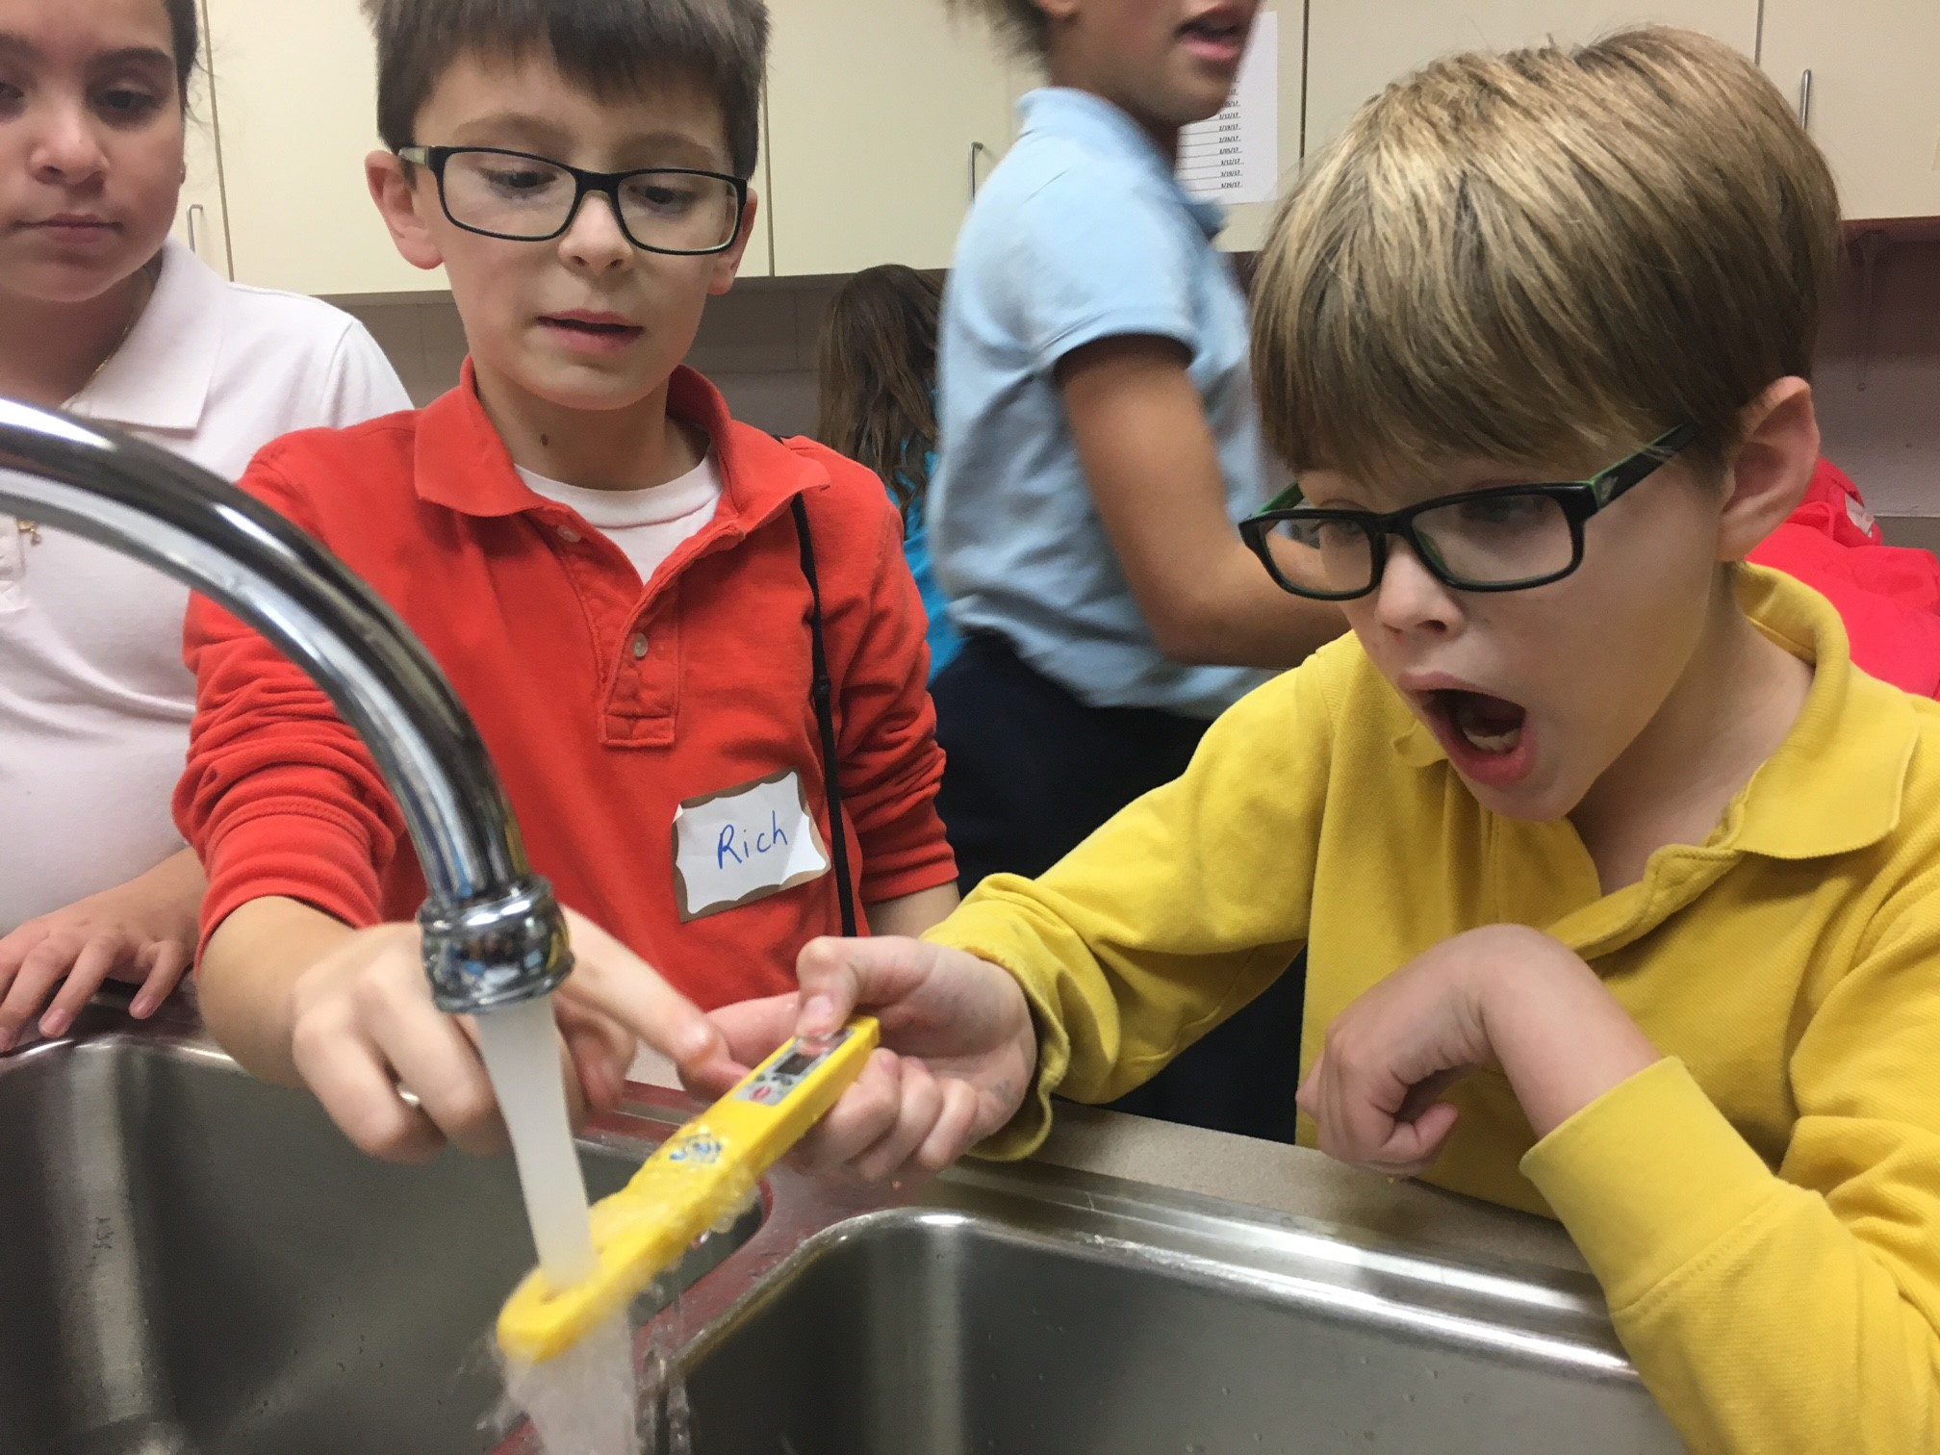
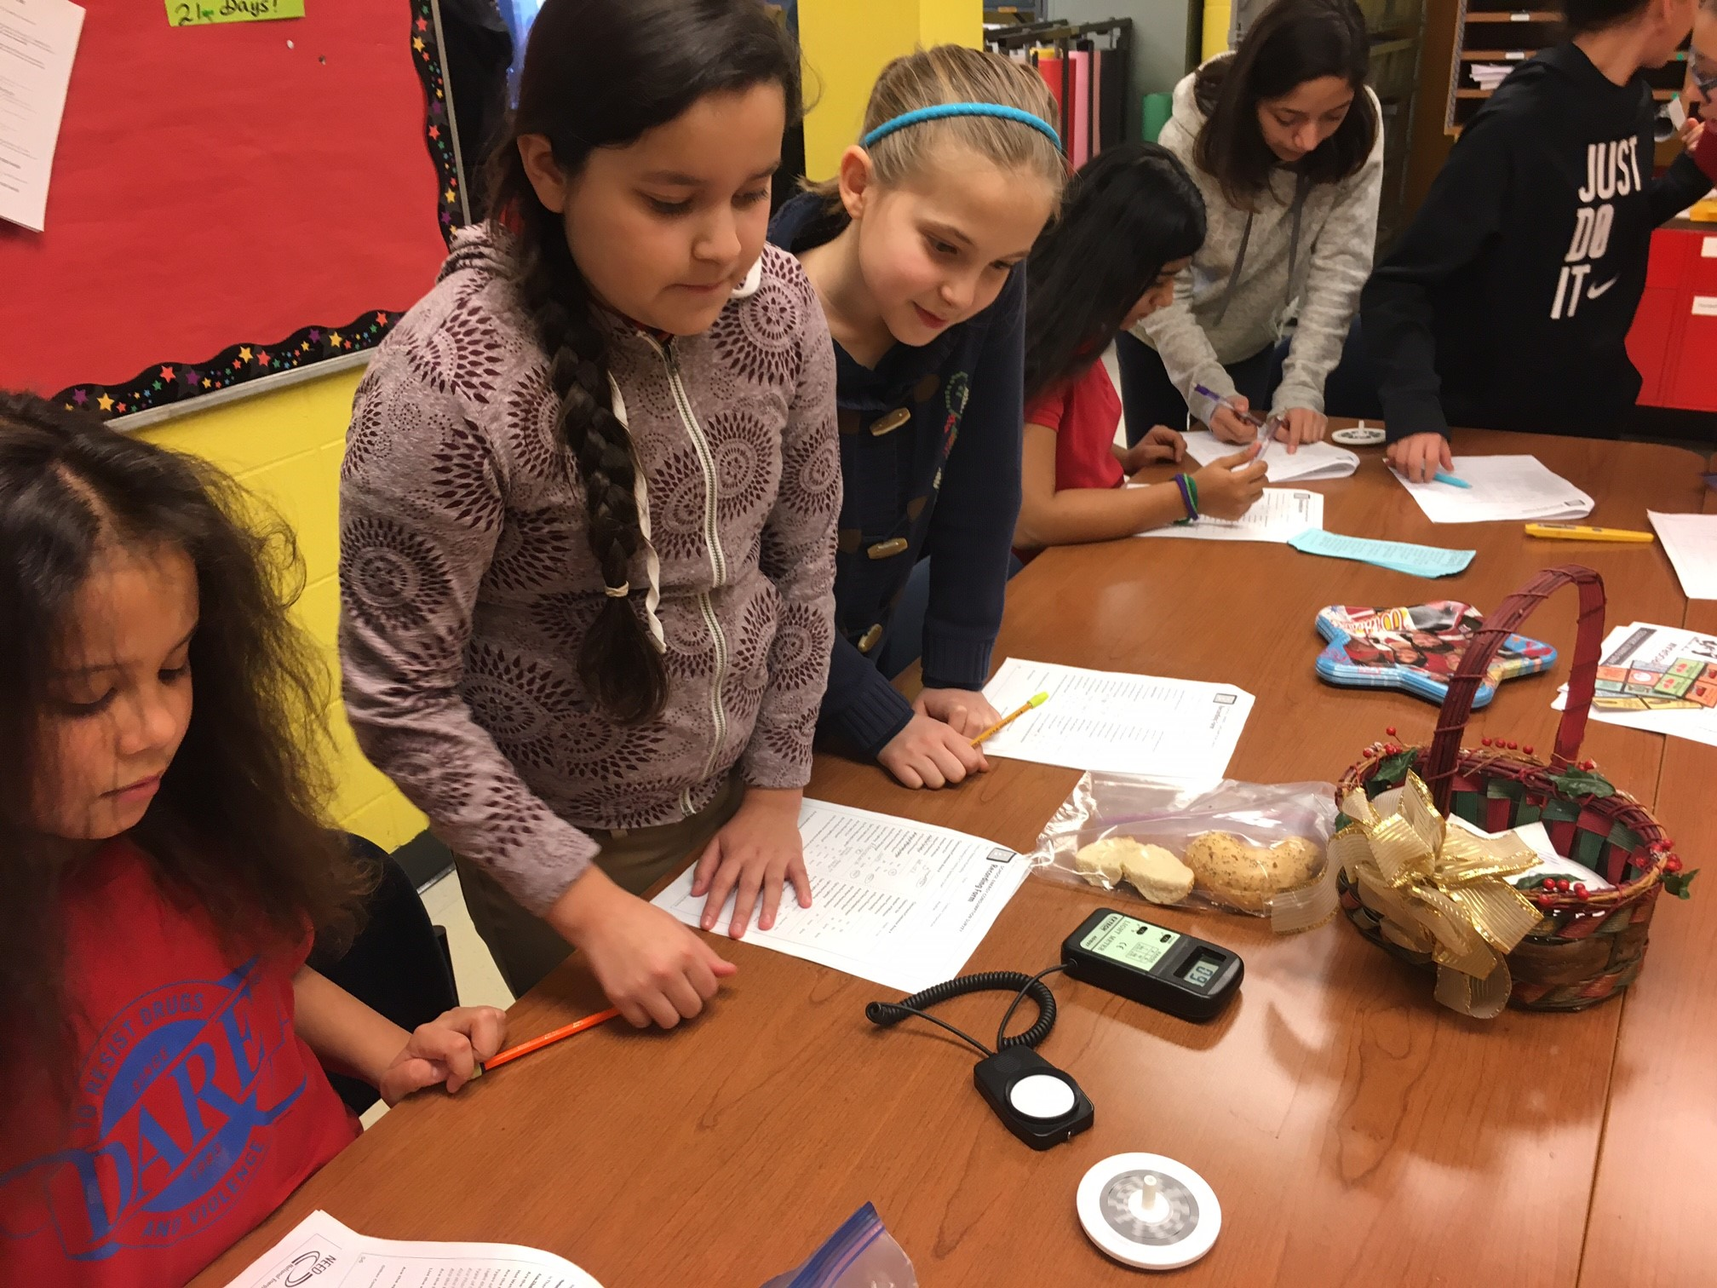
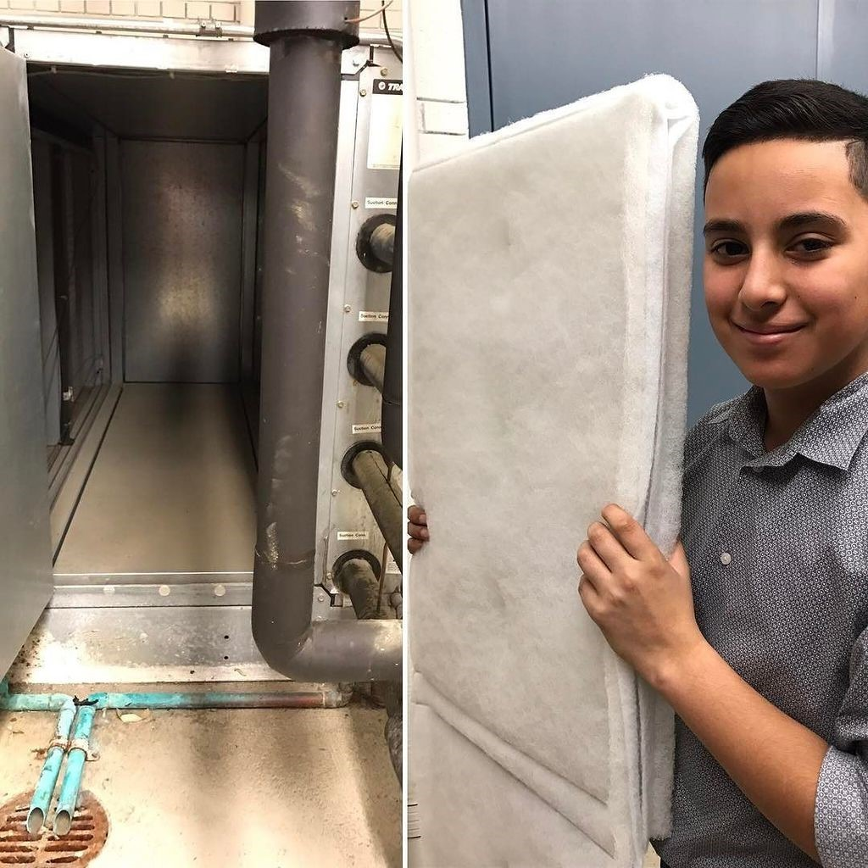
Educational Energy Audit Optional
Virtual or in-person educational energy audit options!
Students explore the school laboratory learning about energy efficiency and conservation utilizing audit tools such a light meter, hygrometer, IR thermometer, and Kill A Watt®
Participating schools will receive an energy efficiency and conservation kit!
NEED will email you a link to sign up. *Keep in mind your school calendar to not schedule on a day that school is not in session, state testing, etc.

Slide 13
Exelon Innovation Challenge
The Task
Build upon the energy and climate lessons you may have already explored OR introduce climate science to your students.
Students will work together as a team to create a digital project and short pitch to discuss how your community could begin to combat climate change. The digital presentation or video should be no more than 3 minutes.
Students can present their “pitches” to judges and their peers in a virtual “Think Tank” and take part in some hands-on energy fun.

Slide 14
What we need from you
Teach energy in your classroom, club, or afterschool program.
Have participating students complete the Exelon Innovation Challenge. Consider submitting a Youth Awards project by April 15th to receive local and national recognition for your program!
Evaluations – please complete training evaluations and the end of program year teacher and student evaluation.
Stay in touch! Share with us any questions or concerns you have about the program. We’re here to assist and support you and your students! Share photos of your students engaged in the lessons, Energy Fair photos, Educational Energy Audit photos, etc. Use #energizingSTEM

Slide 15
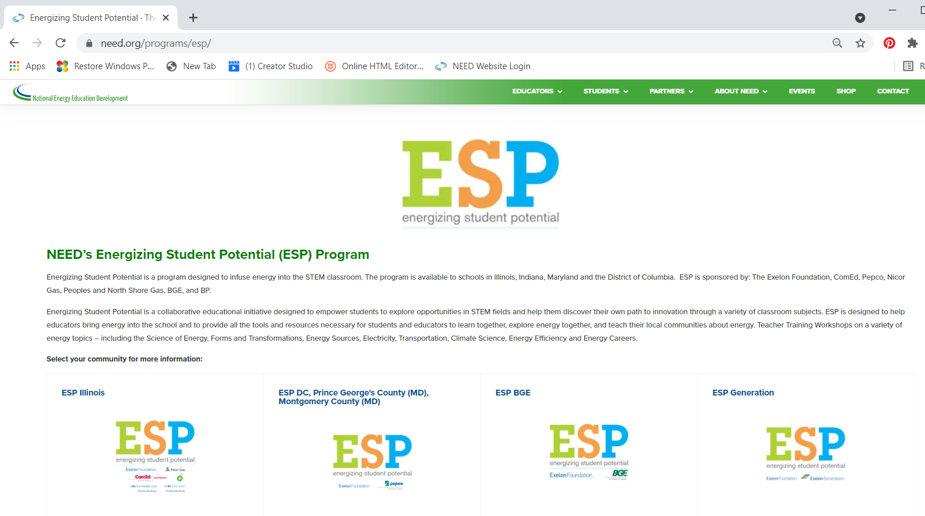
Where is the ESP Program Information?
www.need.org/esp

Slide 16
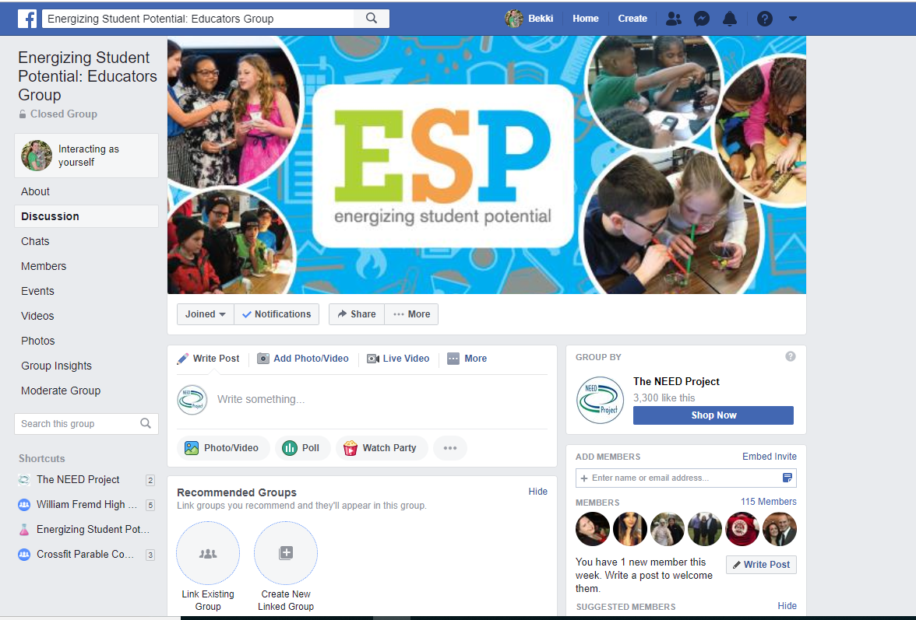
We’re Social!
Use #energizingSTEM when you post to social media
@NEEDProject
@theneedproject
@NEED_Project

Slide 17
ESP Program Sponsors

