Slide 1
Exploring Biomass
Garbage, wood, landfill gas…it’s all biomass!

Slide 2
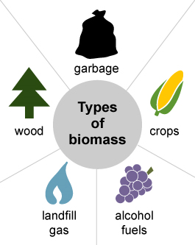
What is Biomass
Biomass is any organic matter – wood, crops, seaweed, animal wastes – that can be used as an energy source.
People have used biomass longer than any other energy source.
Exploring Biomass 2018 ©The NEED Project
Notes:
Biomass is a renewable energy source because its supplies are not limited. We can always grow trees and crops, and waste will always exist.

Slide 3
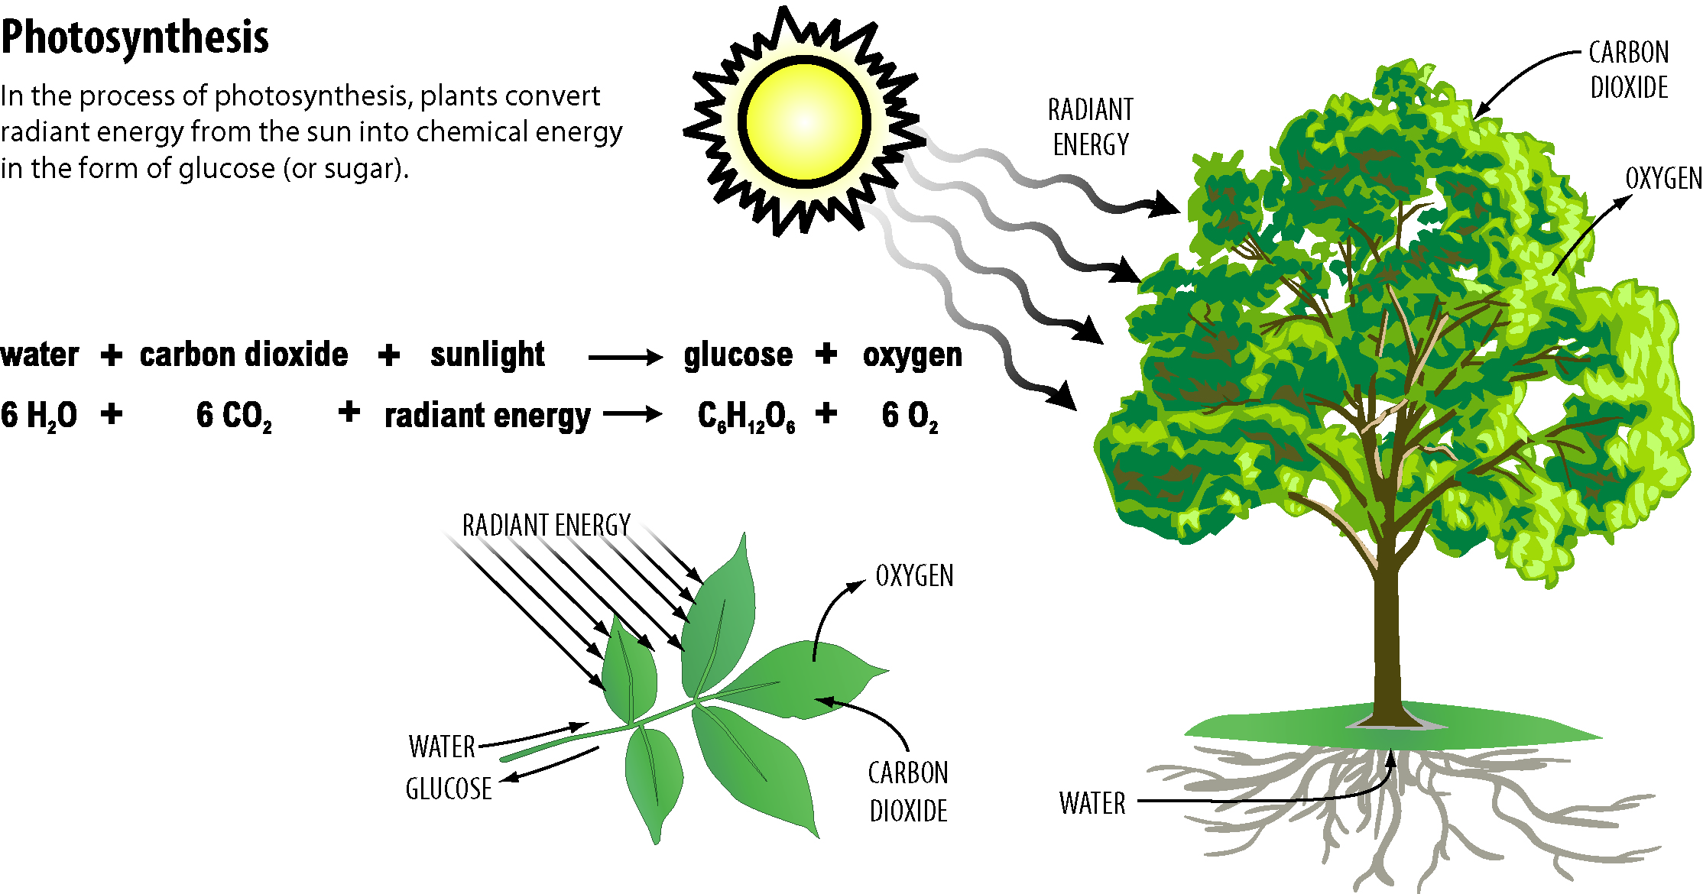
Biomass and the Environment
Biomass can pollute the air when it is burned, though not as much as fossil fuels.
Burning biomass fuels does not produce pollutants like sulfur, which can cause acid rain.
Growing plants for biomass fuel may help to reduce greenhouse gases, since plants use carbon dioxide and produce oxygen as they grow.
Exploring Biomass 2018 ©The NEED Project

Slide 4
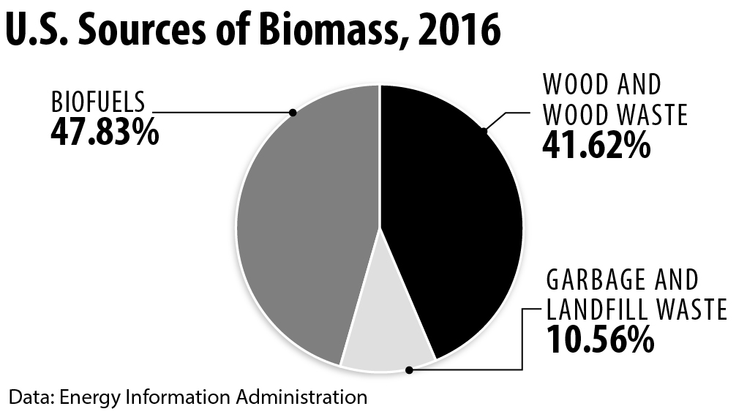
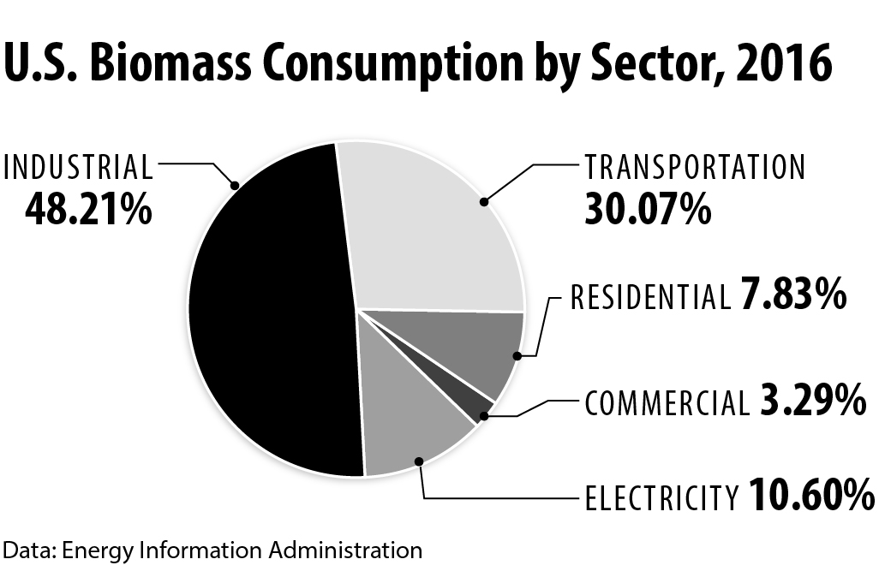
Using Biomass Energy
There are many sources of biomass used in the U.S. today.
Two sources, wood and biofuels, make up the majority of consumption.
Other biomass sources include crops, garbage, landfill gas, and byproducts from agriculture.
There are four ways to convert biomass energy into a usable energy source:
-Fermentation
-Burning
-Bacterial Decay
-Conversion
Exploring Biomass 2018 ©The NEED Project
Notes:
Until the mid-1800s, wood gave Americans 90 percent of the energy they used. Today, biomass provides us almost five percent of the energy we use. It has been replaced by coal, natural gas, petroleum, and other energy sources.

Slide 5
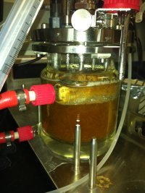
Fermentation
There are several types of processes that can produce an alcohol (ethanol) from various plants, especially corn.
The two most commonly used processes involve using yeast to ferment the starch in the plant to produce ethanol.
One of the newest processes involves using enzymes to break down the cellulose in the plant fibers, allowing more ethanol to be made from each plant, because all of the plant tissue is utilized, not just the starch.
Fermentation reactor at the National Renewable Energy Laboratory. Photo by Sarah Studer, DOE
Exploring Biomass 2018 ©The NEED Project

Slide 6
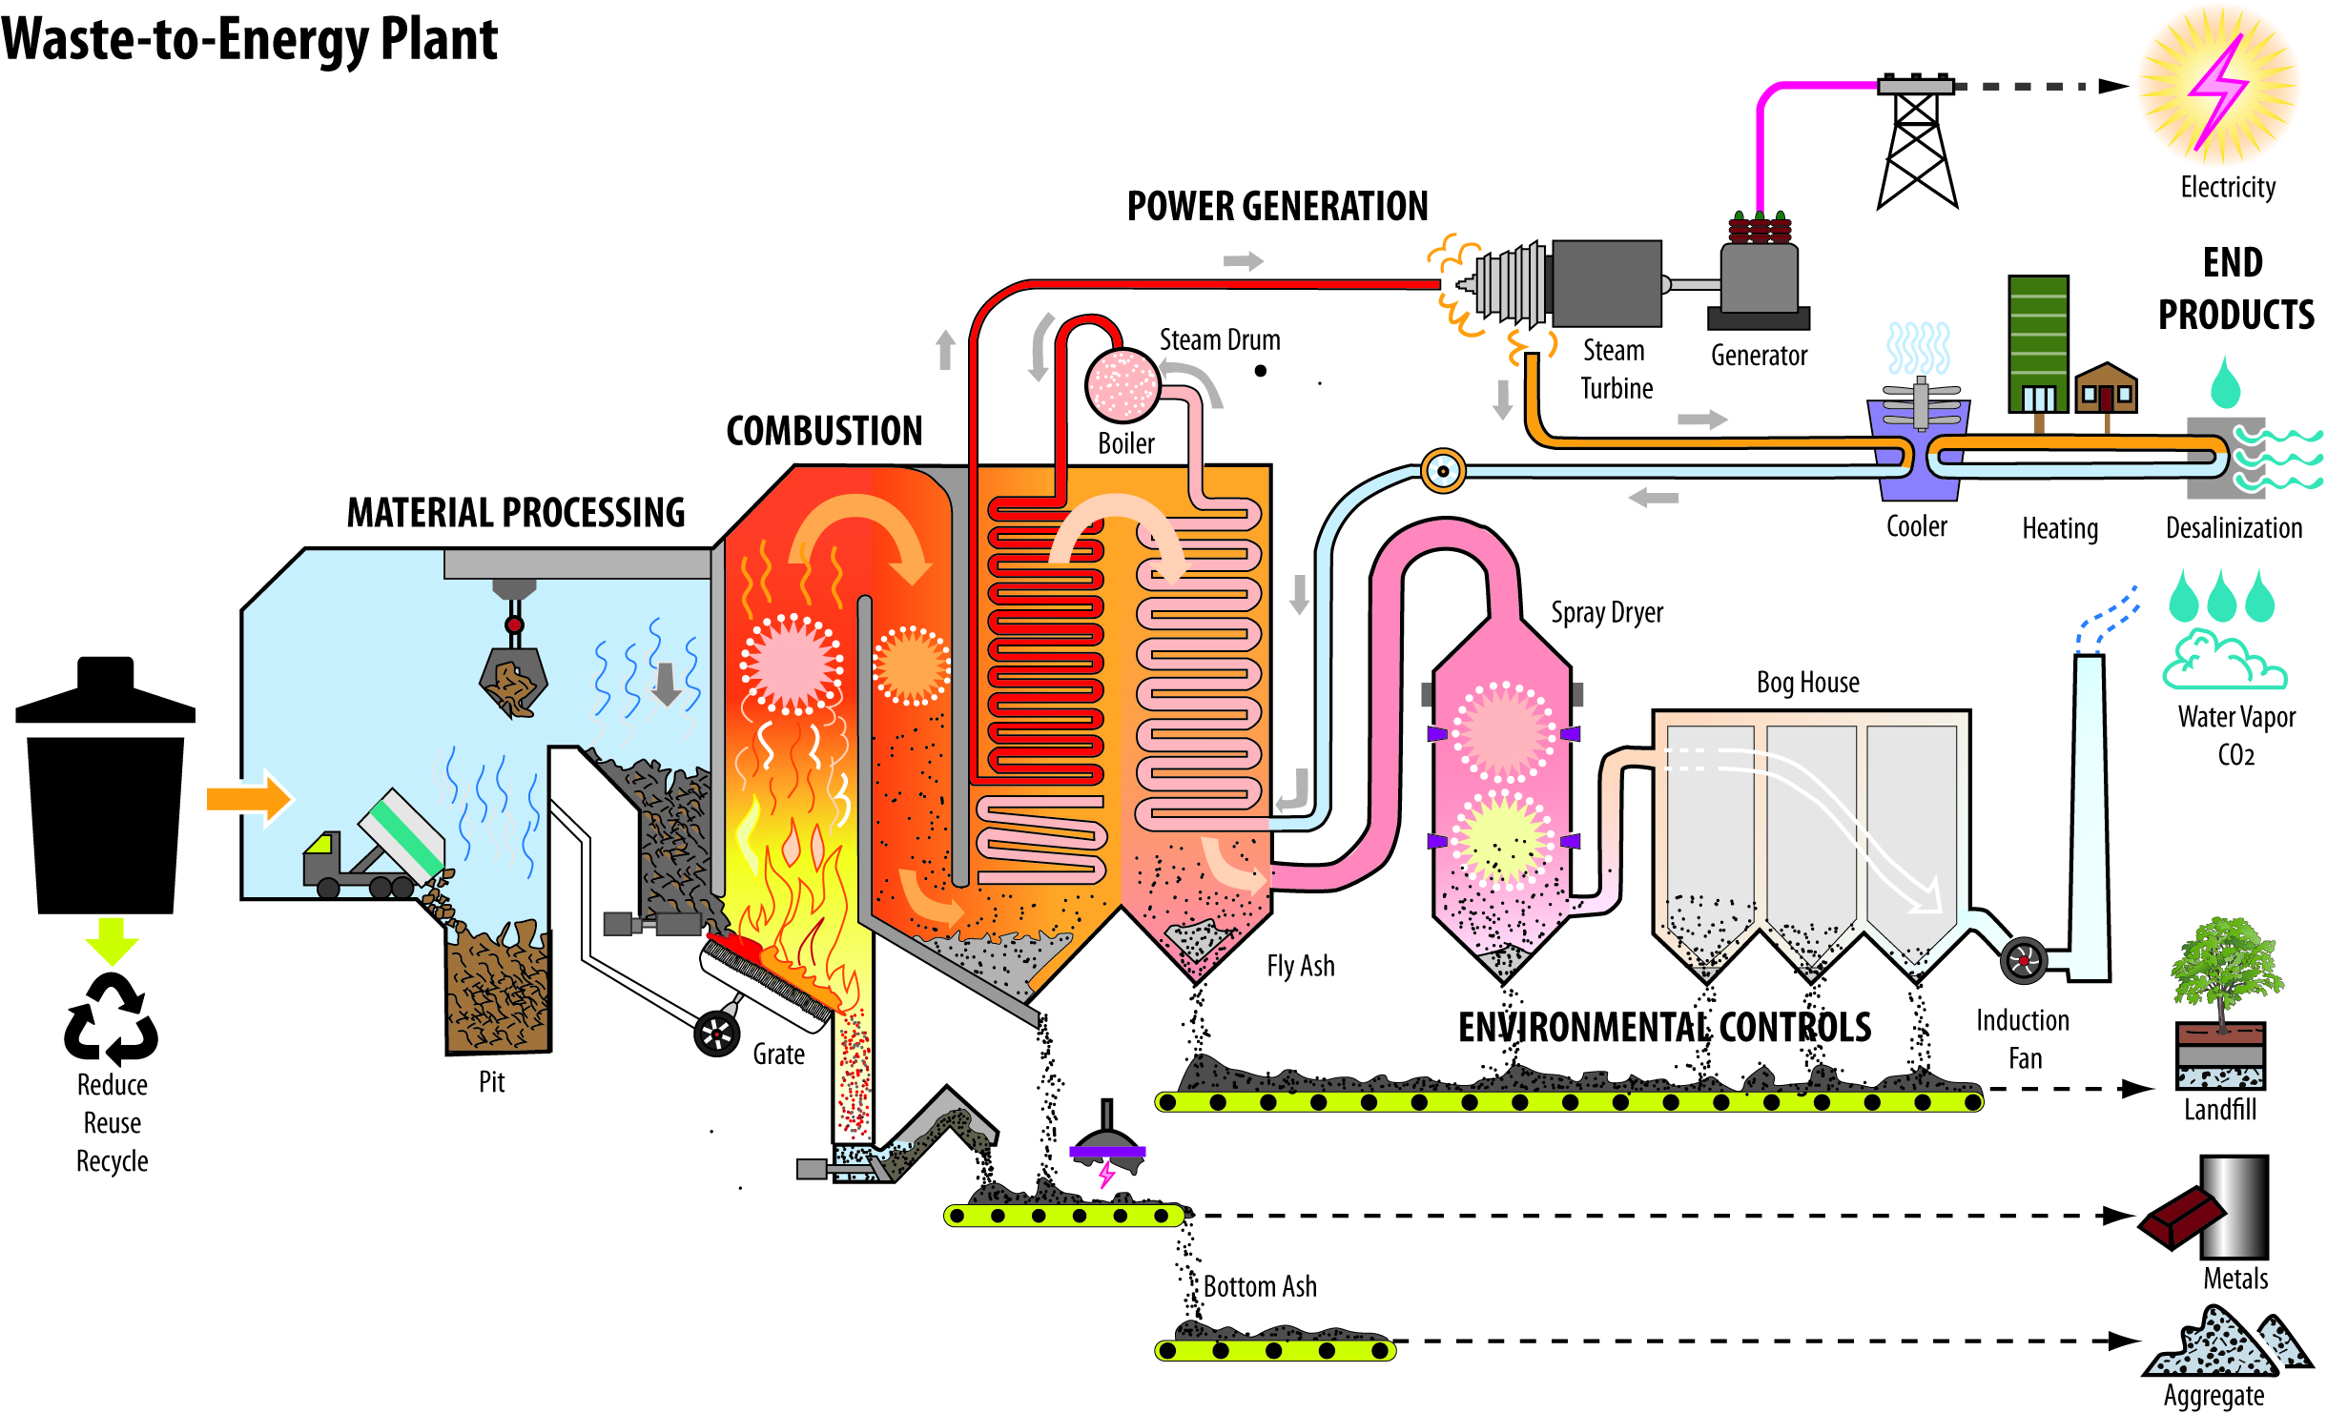
Burning
We can burn biomass in waste-to-energy plants to produce steam for making electricity, or we can burn it to provide heat for industries and homes.
Exploring Biomass 2018 ©The NEED Project

Slide 7
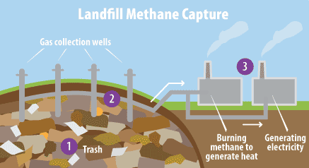
Bacterial Decay
Bacteria feed on dead plants and animals, producing methane.
Methane is produced whenever organic material decays.
Many landfills are recovering and using the methane gas produced by the garbage.
Image courtesy of EPA
Exploring Biomass 2018 ©The NEED Project

Slide 8
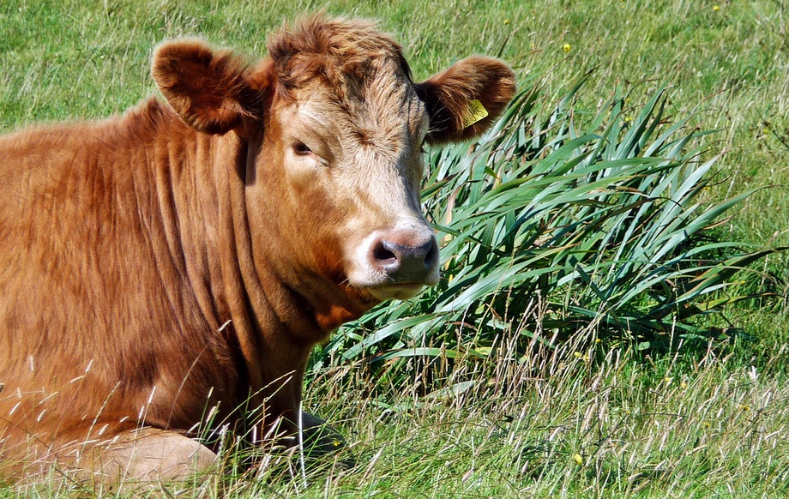
Conversion
Biomass can be converted into gas or liquid fuels by using chemicals or heat.
In India, cow manure is converted to methane gas to produce electricity.
Methane gas can also be converted to methanol, a type of alcohol made from fermenting wood.
Exploring Biomass 2018 ©The NEED Project

Slide 9
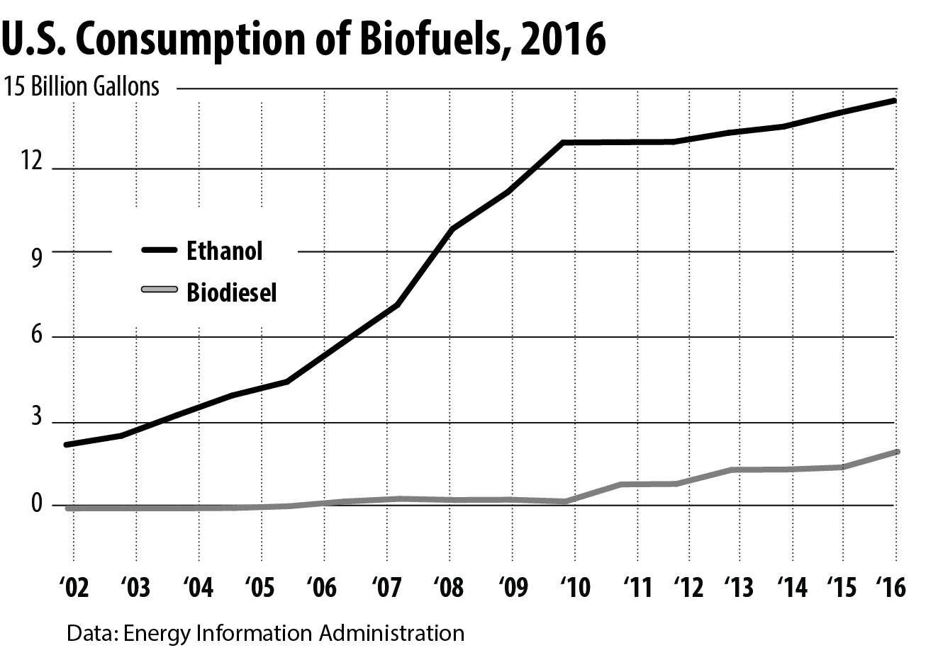
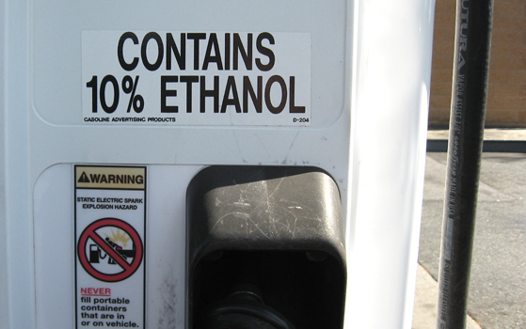
Biofuels: Ethanol
Ethanol is an alcohol fuel (ethyl alcohol) made by fermenting the sugars and starches found in plants and then distilling them.
Any organic material containing cellulose, starch, or sugar can be made into ethanol.
The majority of the ethanol produced in the United States comes from corn.
New technologies are producing ethanol from cellulose in woody fibers from trees, grasses, and crop residues.
Today nearly all of the gasoline sold in the U.S. contains around 10 percent ethanol and is known as E10.
Exploring Biomass 2018 ©The NEED Project

Slide 10
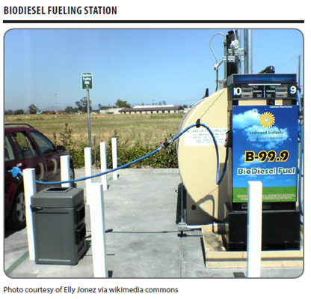
Biofuels: Biodiesel
Biodiesel is a fuel made by chemically reacting alcohol with vegetable oils, animal fats, or greases, such as recycled restaurant grease.
Most biodiesel today is made from soybean oil.
It is one of the fastest growing transportation fuels in the U.S.
Biodiesel contains virtually no sulfur, so it can reduce sulfur levels in the nation’s diesel fuel supply.
Exploring Biomass 2018 ©The NEED Project

Slide 11
For More Information
The NEED Project
www.need.org
info@need.org
1-800-875-5029
Energy Information Administration
U.S. Department of Energy
www.eia.gov
Exploring Biomass 2018 ©The NEED Project

Slide 12
NEED IS SOCIAL!
Let’s be Facebook (@needproject) official!
Events, energy news, and more!
Follow us on Twitter (@NEED_Project)! We share the latest energy news from around the country.
Follow us on Instagram (@theneedproject) and check out photos from workshops and when we go live for hands-on experiments.
Follow us on Pinterest and pin ideas to use in your classroom.
www.pinterest.com/needproject
Subscribe to our YouTube channel. Hands-on energy lesson tutorials, interviews with energy career professionals, & more!
www.youtube.com/user/needproject
NEED is social! ©The NEED Project

