Slide 1
Exploring Nuclear Energy

Slide 2
Nuclear Fusion and Fission
Nuclear Fusion
Nuclear Fission
Small nuclei into large
Immense temperature and pressure
Core of stars
Large nuclei into small
Critical mass to sustain
Two isotopes we use
Iron is the “dead end” of both fusion and fission – it is the lowest energy nucleus and cannot be split or fused.

Slide 3
Global Total Primary Energy Supply (TPES) by fuel, 2017 Nuclear provides 5% of total energy and 10% of global electricity generation.
Data: International Energy Agency

Slide 4
Top 5 Nuclear Generating Countries, 2016
Country | Total Generation (bKwh) | Nuclear Electricity Generation (bKwh) | Share of country’s total generation
United States | 4,095 | 805 | 19.67%
France | 529 | 386 | 73.04%
Slovakia | 25 | 13 | 54.25%
Belgium | 79 | 41 | 51.90%
Hungary | 30 | 15 | 50.23%
Data: International Energy Agency

Slide 5
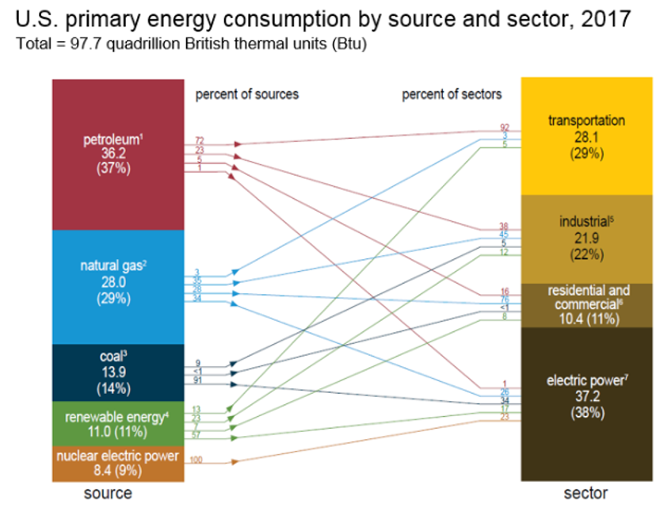
U.S. Primary Energy Consumption by Source and Sector

Slide 6
U.S. Electricity Production, 2017
Data provided by US EIA Net Generation by Energy Source

Slide 7
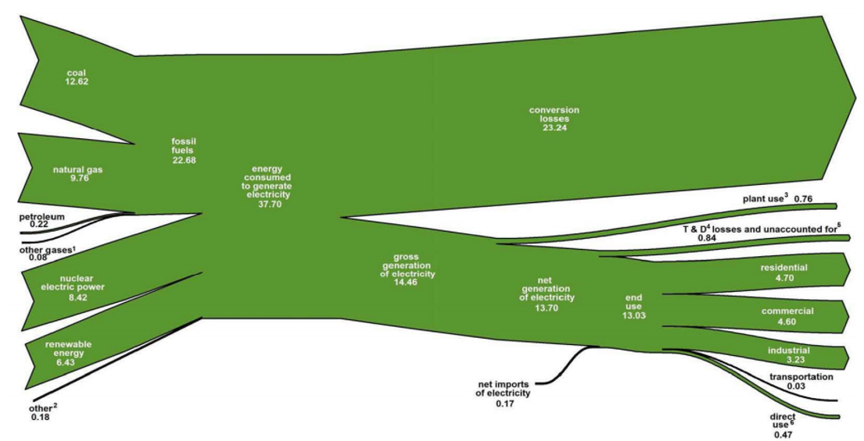
U.S. Electricity Flow 2017 Quadrillion Btu
Data: Energy Information Administration

Slide 8
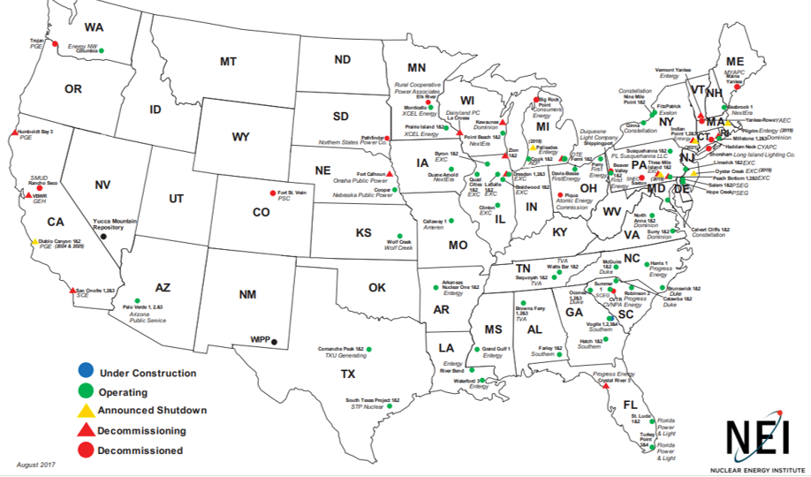
Nuclear Energy Production
State | % Electricity from Nuclear
U.S. Total | 20.02%
South Carolina | 58.14%
New Hampshire | 57.11%
Illinois | 53.43%
Connecticut | 48.38%
New Jersey | 45.64%
Maryland | 44.26%
Pennsylvania | 41.56%
Tennessee | 40.74%
New York | 32.97%
Virginia | 32.68%
North Carolina | 32.42%
Alabama | 30.64%
Arizona | 30.56%
Michigan | 28.82%
Data: Nuclear Energy Institute

Slide 9
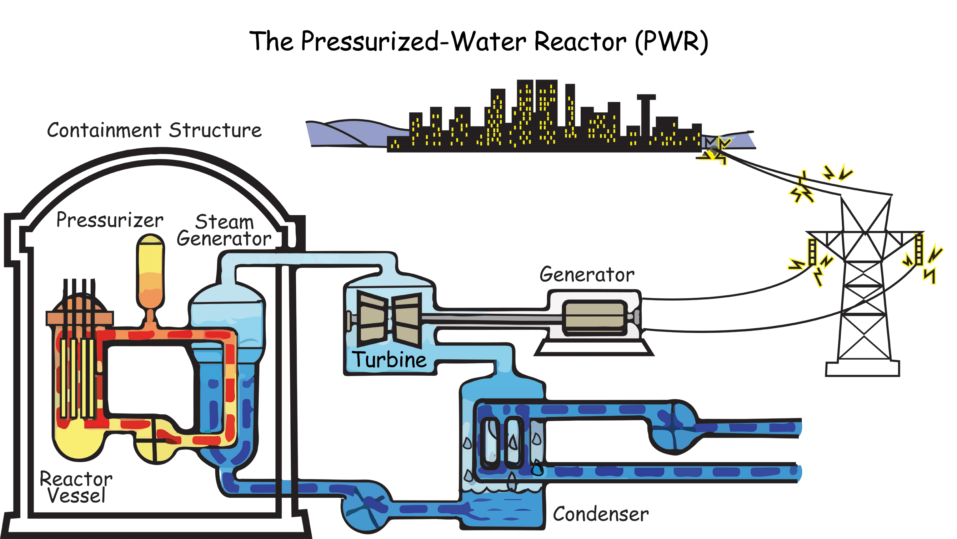
Anatomy of a Nuclear Power Plant
Source: NRC

Slide 10
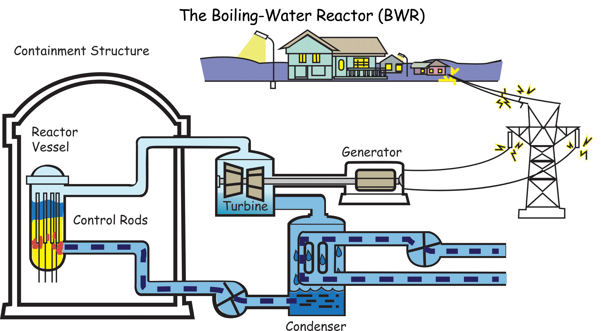
Anatomy of a Nuclear Power Plant
Source: NRC

Slide 11
Advantages of Nuclear Power
Clean
Plentiful Supply
High energy content in uranium
Small fuel pellet
Can provide base load power
Energy savings in transportation
Operating cost is low after construction

Slide 12
Drawbacks to Using Nuclear Power
Initial construction costs
Radioactive waste byproduct
Storage
Natural disasters
Public perception

Slide 13
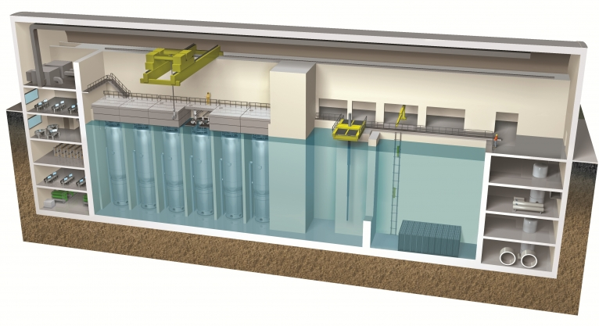
New Nuclear Technologies
Modular, small-scale reactors
Breeder reactors
http://www.energy.gov/science-innovation/energy-sources/nuclear
Image courtesy of Department of Energy

Slide 14
Food for thought…
Of the 15 methods (wedges) proposed by a Princeton University study to stabilize Carbon Dioxide emissions, 13 of them relate to energy use. Implementation of any 7 would accomplish the goal of stabilizing emissions.
Efficient vehicles
Reduced use of vehicles
Efficient buildings
Efficient coal power plants
Gas instead of coal power plants
Capture CO₂ at base load power plant
Nuclear power for coal power
Wind power for coal power
Photovoltaic power for coal power
Capture CO₂ at H₂ plant
Capture CO₂ at coal-to-synfuels plant
Wind H₂ in fuel-cell car for gasoline in hybrid car
Biomass fuel for fossil fuel

Slide 15
For More Information
The NEED Project
www.need.org
info@need.org
1-800-875-5029
Energy Information Administration
U.S. Department of Energy
www.eia.gov

