Slide 1
Exploring Geothermal
Heat within the earth

Slide 2
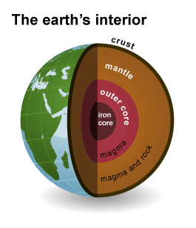
What is Geothermal
Geothermal energy comes from the heat within the Earth. The word geothermal comes from the Greek words geo, meaning earth, and therme, meaning heat.
Geothermal energy is generated in the Earth’s core, almost 4,000 miles (6,400 km) beneath the Earth’s surface.
We can dig wells and pump the heated, underground water to the surface.
People around the world use geothermal energy to produce electricity, to heat homes and buildings, and to provide hot water for a variety of uses.
Exploring Geothermal 2020 ©The NEED Project
Notes:
Geothermal energy is called a renewable energy source because the water is replenished by rainfall and the heat is continuously produced deep within the Earth.

Slide 3
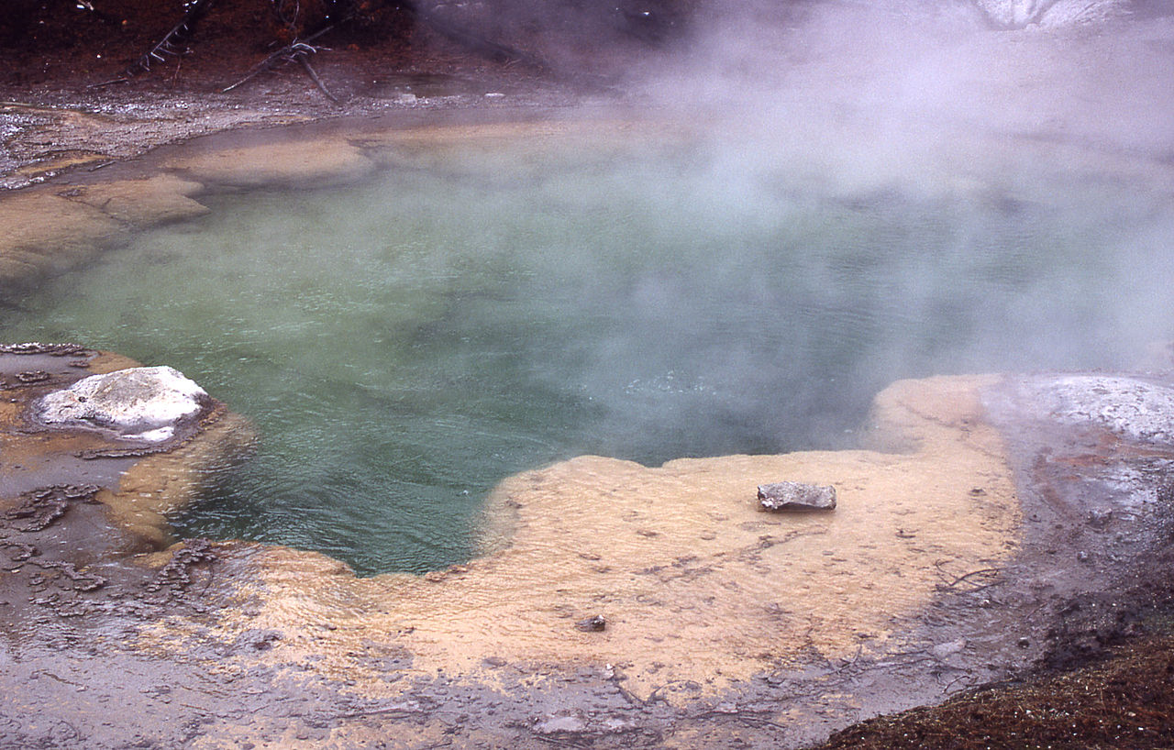
History of Geothermal
Geothermal energy was used by ancient people for heating and bathing. Even today, hot springs are used worldwide for bathing.
The first successful American geothermal plant began operating in 1960 at The Geysers in northern California.
There are now geothermal power plants in seven states, with more in development.
Emerald Spring, Norris Geyser Basin, Yellowstone National Park, Wyoming
Image Wikimedia Commons
Exploring Geothermal 2020 ©The NEED Project

Slide 4
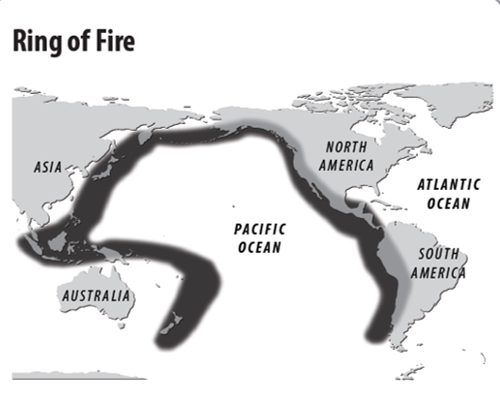
Where is Geothermal Energy Found?
The hottest geothermal regions are found along major plate boundaries where earthquakes and volcanoes are concentrated.
Most of the world’s geothermal activity occurs in an area known as the Ring of Fire, which rims the Pacific Ocean and is bounded by Indonesia, the Philippines, Japan, the Aleutian Islands, North America, Central America, and South America.
Most of the geothermal activity in the world occurs around the Pacific Ocean in an area called the Ring of Fire.
Exploring Geothermal 2020 ©The NEED Project
Notes:
Geologists use different methods to find geothermal reservoirs. The only way to be sure there is a reservoir is to drill a well and test the temperature deep underground.

Slide 5
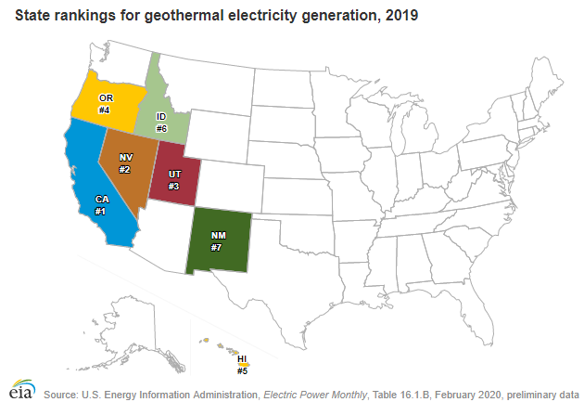
Hydrothermal Resources
There is more than one type of geothermal energy, but only one kind is widely used to make electricity. It is called hydrothermal energy.
Hydrothermal resources have two common ingredients: water (hydro) and heat (thermal).
Depending on the temperature of the hydrothermal resource, the heat energy can either be used for making electricity or for heating.
Exploring Geothermal 2020 ©The NEED Project

Slide 6
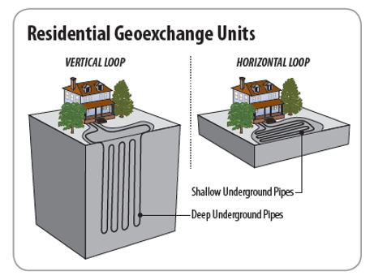
Low Temperature Resources: Heating
(50-300°F, 10-150°C)
This low temperature geothermal energy is used for heating homes and buildings, growing crops, and drying lumber, fruits, and vegetables.
In the U.S., geothermal heat pumps are used to heat and cool homes and public buildings.
Each year about 50,000 geoexchange systems are installed in the U.S.
Almost 90 percent of the homes and businesses in Iceland use geothermal energy for space heating.
Exploring Geothermal 2020 ©The NEED Project
Notes:
Hydrothermal resources at low temperatures are located everywhere in the United States, just a few feet below the ground.

Slide 7
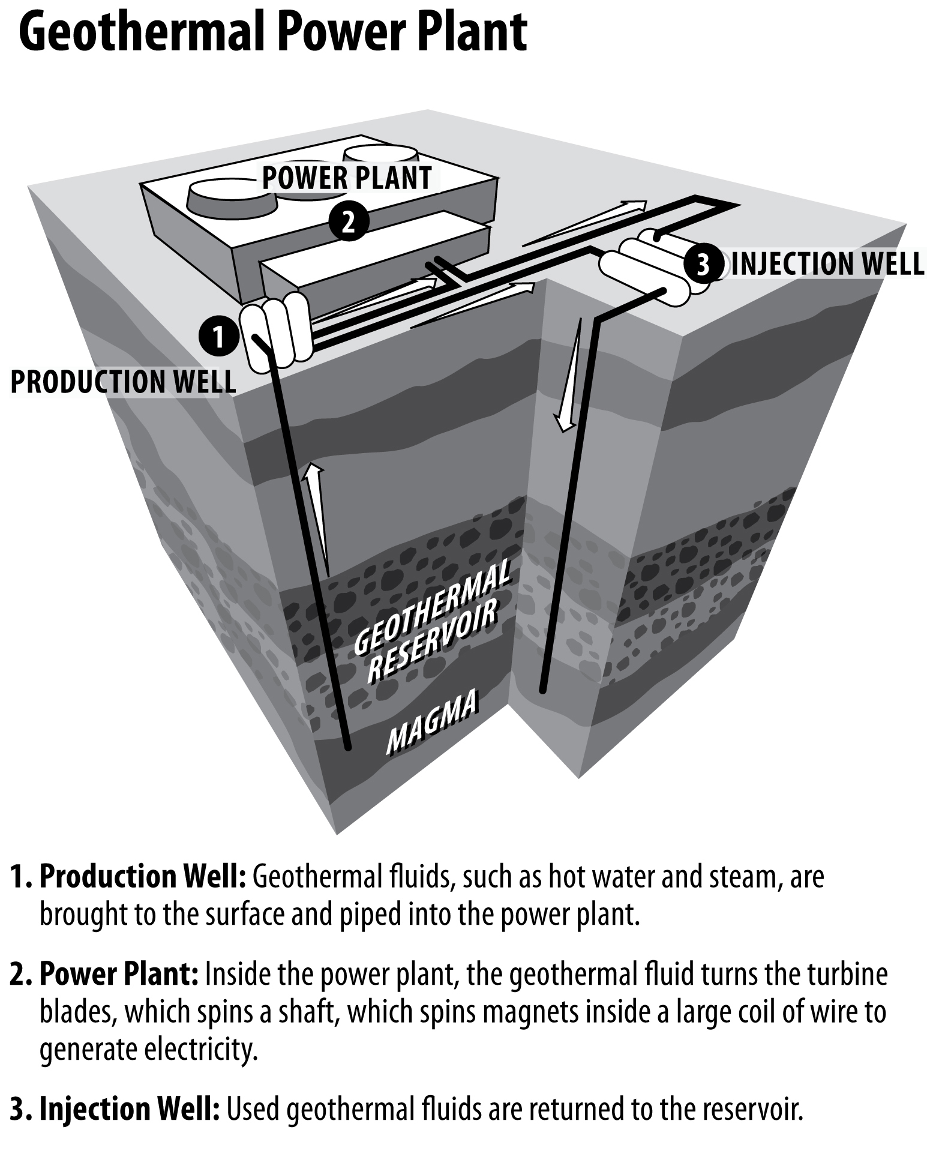
High Temperature Resources: Electricity
(250-700°F, 150-370°C)
Hydrothermal resources at high temperatures can be used to make electricity.
These high-temperature resources may come from either dry steam wells or hot water wells. Geothermal wells are one to two miles deep.
Dry steam plant: the steam from the geothermal reservoir is piped directly from a well to a turbine generator to make electricity.
Hot water plant: some of the hot water is turned into steam. The steam powers a turbine generator just like a dry steam plant. When the steam cools, it condenses to water and is injected back into the ground to be used over and over again.
Exploring Geothermal 2020 ©The NEED Project

Slide 8
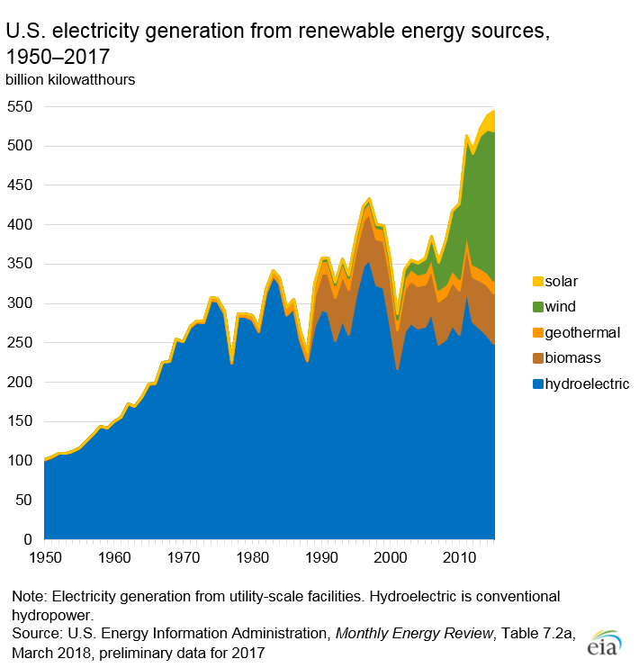
Geothermal Electricity Generation
The United States leads the world in the amount of electricity generated with geothermal energy.
Today, geothermal produces almost 16 billion kilowatt-hours, or less than one percent of the electricity produced in the United States.
In 2015, 22 countries (including the U.S.), generated a total of about 76 billion kWh of electricity from geothermal energy.
Geothermal energy is cheap—once a new power plant is built, it can make electricity for less cost than a coal or natural gas plant
Exploring Geothermal 2020 ©The NEED Project

Slide 9
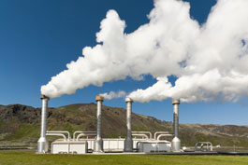
Geothermal and the Environment
Geothermal energy does little damage to the environment.
Geothermal power plants are clean. They produce almost no emissions because they do not burn a fossil fuel like coal, gas, or oil to generate electricity and they don’t have to transport fuel, like most power plants.
Geothermal power plants are compatible with many environments. They have been built in deserts, in the middle of crops, and in mountain forests.
Geothermal features in national parks are protected by law.
Geothermal power plant emitting steam. The steam is turned into water and put back into the Earth.
Image source EIA: Stock photography (copyrighted)
Exploring Geothermal 2020 ©The NEED Project

Slide 10
For More Information
The NEED Project
www.need.org
info@need.org
1-800-875-5029
Energy Information Administration
U.S. Department of Energy
www.eia.gov
Exploring Geothermal 2020 ©The NEED Project

Slide 11
NEED IS SOCIAL!
Let’s be Facebook (@needproject) official!
Events, energy news, and more!
Follow us on Twitter (@NEED_Project)! We share the latest energy news from around the country.
Follow us on Instagram (@theneedproject) and check out photos from workshops and when we go live for hands-on experiments.
Follow us on Pinterest and pin ideas to use in your classroom.
www.pinterest.com/needproject
Subscribe to our YouTube channel. Hands-on energy lesson tutorials, interviews with energy career professionals, & more!
www.youtube.com/user/needproject
NEED is social! ©The NEED Project

