Slide 1
Energy 101
An Introduction to Energy and Energy Sources

Slide 2
What is energy?
Ability to do work or cause change
Produces Warmth
Produces Light
Produces Sound
Produces Movement
Produces Growth
Powers Technology
Notes:
Energy is the ability to do work or cause change. Energy produces warmth, light, sound, movement, and growth. Energy powers technology.
Go over the definition of energy. Have students apply this information to the next slide – where we get our energy.

Slide 3
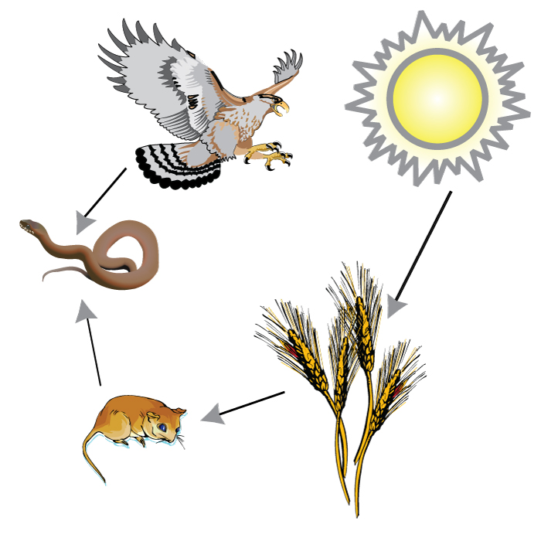
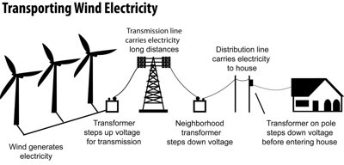
Where Do We Get Our Energy?
Notes:
Energy consumption is how much energy we consume or use. Turn to your neighbor and brainstorm the number of ways you have used energy since leaving your home this morning. Where do you get your energy to move, make noise, think, and grow? Yes, the food you eat is your fuel. The food you eat got its fuel from the sun. The sun is a key factor in photosynthesis, and in the creation of many of our energy sources. Where do we get the energy to power the lights in this room, however? There are many sources of energy, and of electricity. Today we will talk about those sources and how they are used in the United States.

Slide 4
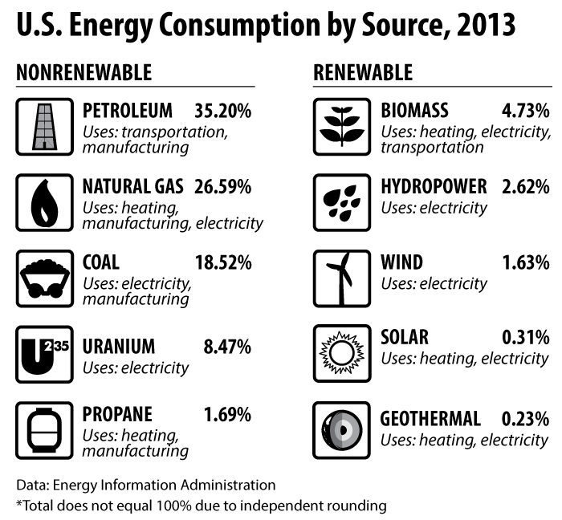
Notes:
So where do we get the energy to heat our homes, manufacture goods, and drive our cars? There are many energy sources. Nonrenewable energy source supplies are limited, and people can’t make more in a short time. Renewable energy sources are ones that there is a continual supply of, and are not in danger of depleting the supply. Why do you think Petroleum is our number one source of energy? It is a very valuable transportation fuel. Take a minute to write down the sources and their energy consumption percentages.

Slide 5
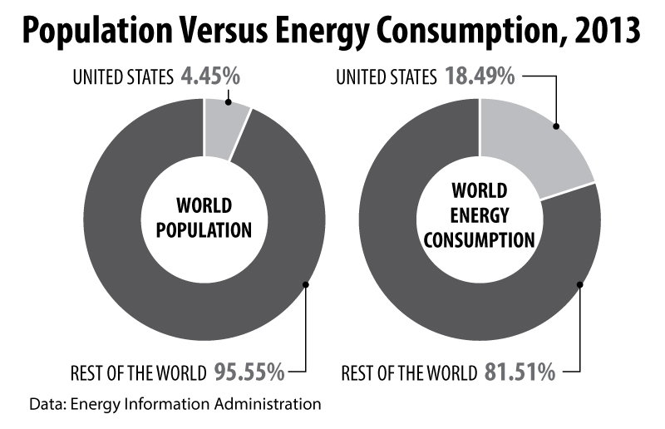
Notes:
We have 4.6% of the World Population, yet consume 21% of the energy.
What factors do you think contribute to this difference? (rich country, many cars, lots of technology and items that use electricity, areas that use a lot of heat and areas that use a lot of air conditioning…)
What are some things we can do to balance out our energy use? (use more efficient appliances, use more efficient cars, use alternative fuel sources, buy renewable energy, reduce, reuse, recycle, repair, walk instead of drive, carpool, buy Energy Star appliances)

Slide 6
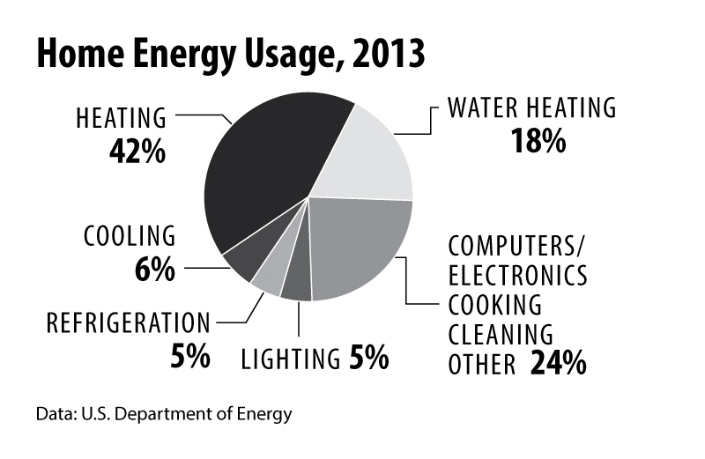
Home Energy Consumption
Notes:
In a typical home, almost half of the energy used is for heating and cooling. How could location play a factor in changing these numbers? Would coastal California have the same heating/cooling percentages as Vermont? What could you do to help reduce some of these costs?

Slide 7
Coming Soon…
You will be creating your own digital media presentations using graphics you find and graphics you create!

