Slide 1
Liquefied Natural Gas

Slide 2
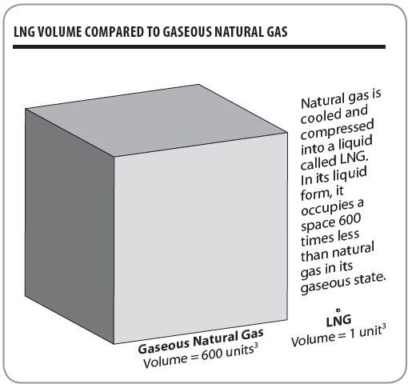
LNG

Slide 3
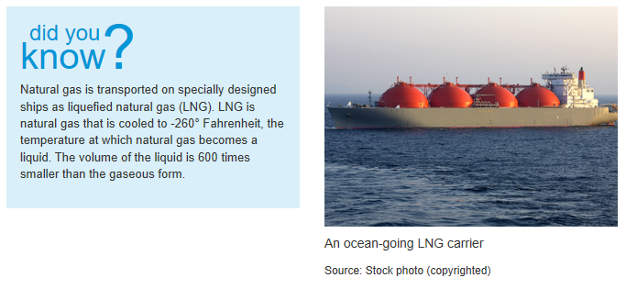
Source: EIA
https://www.eia.gov/energyexplained/natural-gas/liquefied-natural-gas.php

Slide 4
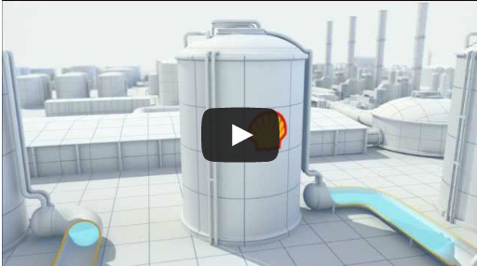
LNG Animation
Exploration
Production
Liquefaction
Storage
Transportation
Regasification
Distribution
End Use

Slide 5
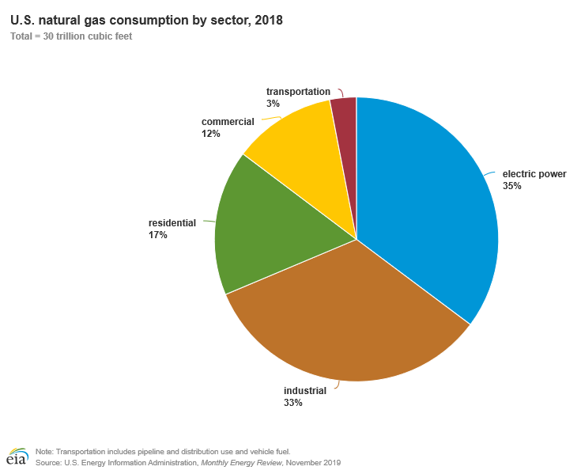
Natural Gas Consumption by Sector, 2018

Slide 6
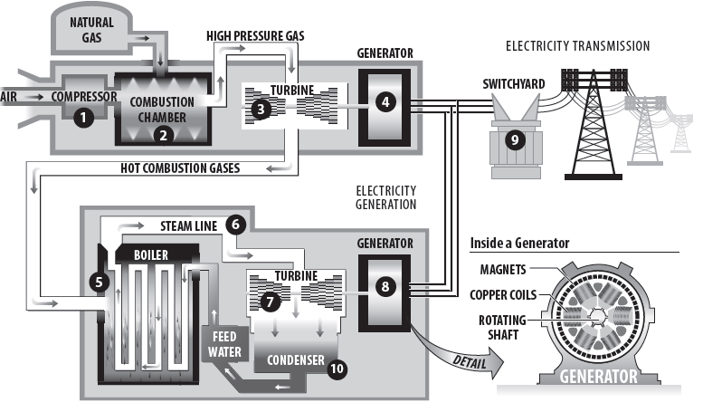
Combined Cycle Power Station

Slide 7
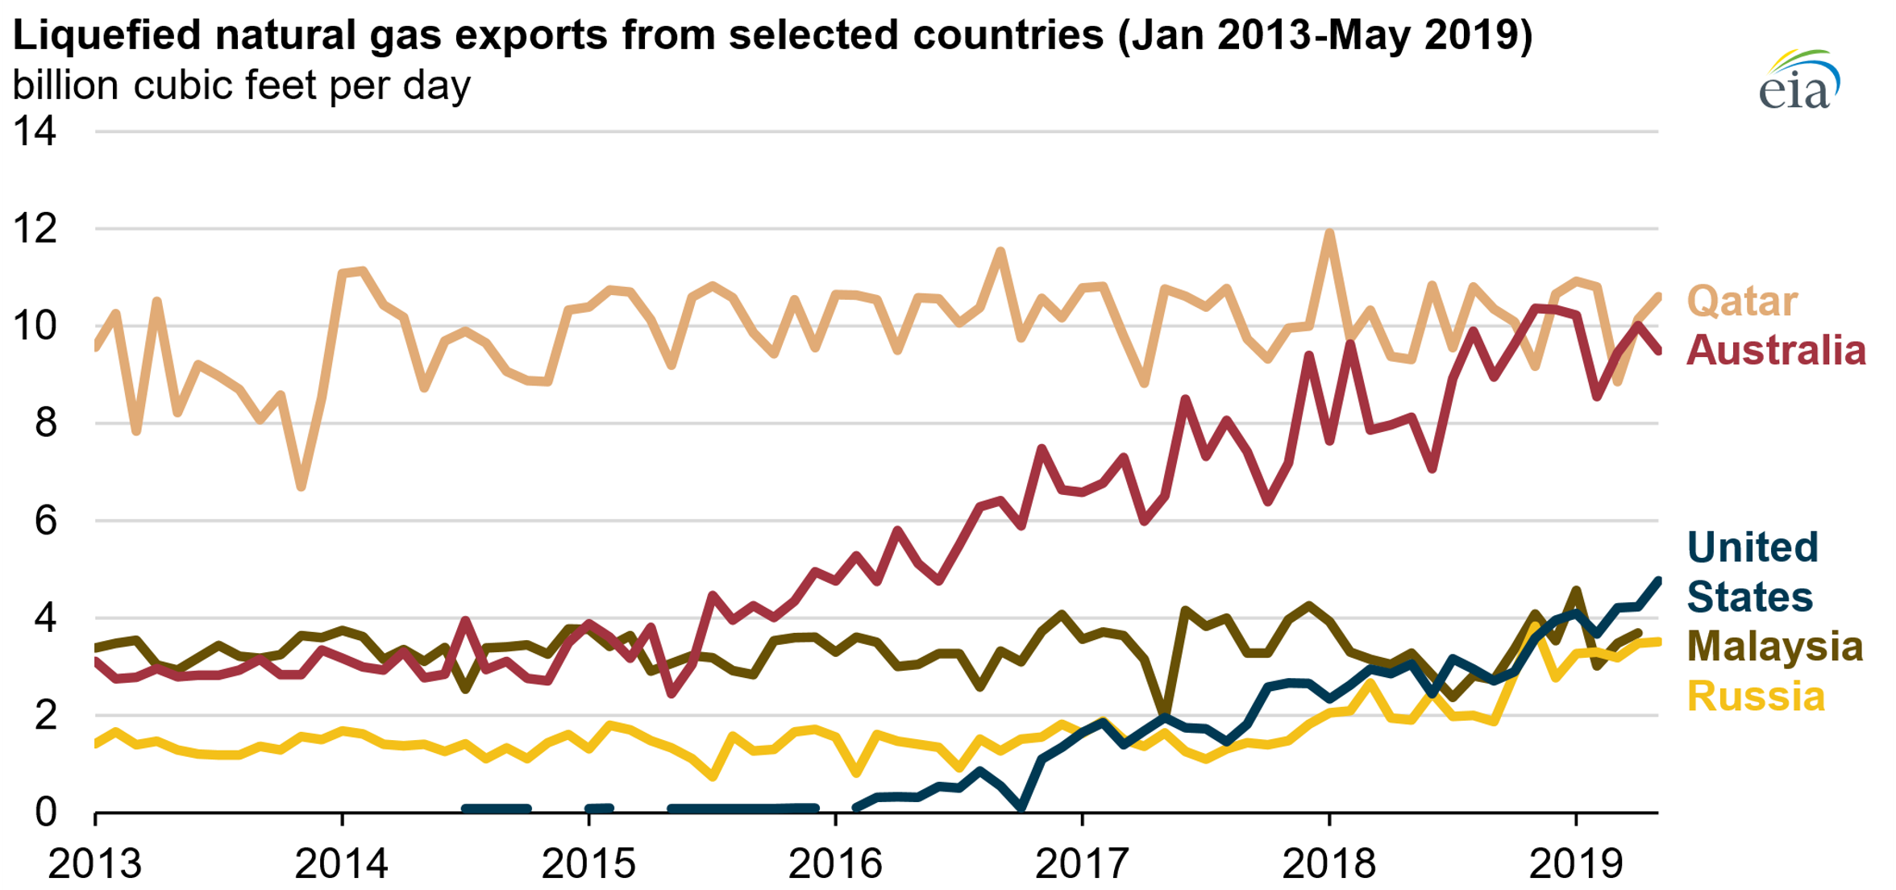
LNG Exporters
Australia is on track to surpass Qatar as the world’s largest liquefied natural gas (LNG) exporter.
Source: EIA
Data and graphs courtesy of EIA

Slide 8
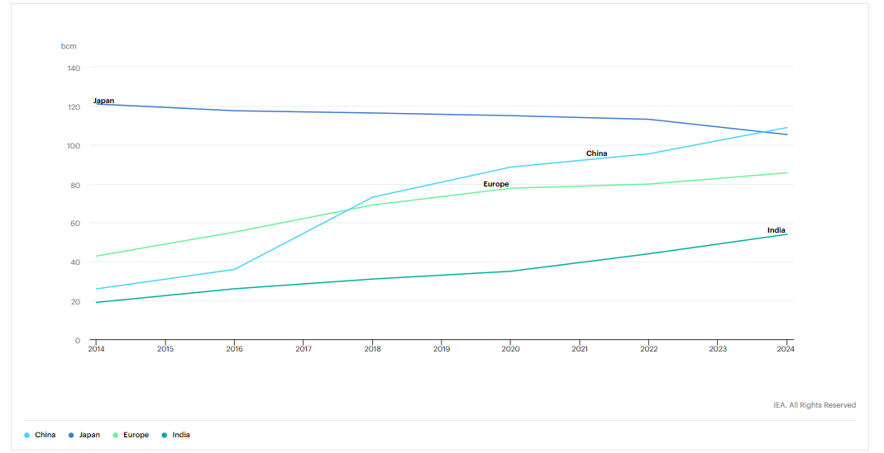
LNG Importers
LNG imports for a selection of importers, 2014-2024
Last updated 26 Nov 2019
Graph courtesy of IEA

Slide 9
For More Information
The NEED Project
www.need.org
info@need.org
1-800-875-5029
Energy Information Administration
U.S. Department of Energy
www.eia.gov

Slide 10
NEED IS SOCIAL!
Let’s be Facebook (@needproject) official!
Events, energy news, and more!
Follow us on Twitter (@NEED_Project)! We share the latest energy news from around the country.
Follow us on Instagram (@theneedproject) and check out photos from workshops and when we go live for hands-on experiments.
Follow us on Pinterest and pin ideas to use in your classroom.
www.pinterest.com/needproject
Subscribe to our YouTube channel. Hands-on energy lesson tutorials, interviews with energy career professionals, & more!
www.youtube.com/user/needproject
NEED is social! ©The NEED Project

