Slide 1
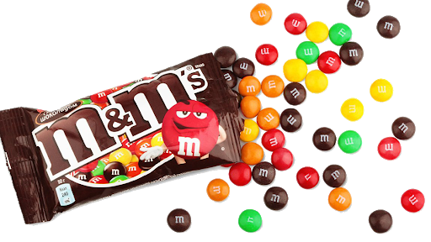
Candy Collector: Part 1
Put M&M’s in one bowl.
Have a second “discard” bowl and a cup to the side.
For 15 seconds (one year), move M&M’s (energy) from the full bowl to the cup.
Use your straw to transfer candy. NO HANDS!
Transfer as many M&M’s as you can from the bowl to the cup.
Discard ALL candy into the “discard” bowl.
Repeat for 3 more “years” (15 seconds each).
Notes:
This activity teaches the ideas of renewable and non-renewable resources. Do not tell students what the candy represents other than “energy,” the idea is to let them discover it. During part 1, they will try to use as much as energy as possible, especially if you build it up as a bit of a competition.

Slide 2
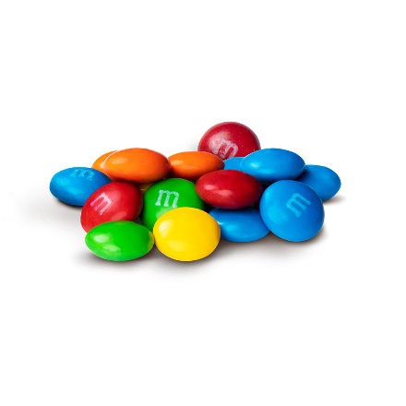
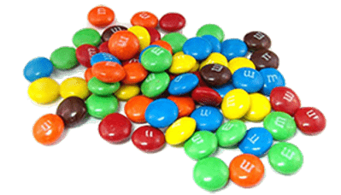
Candy Collector
Year 1
DISCARD
Notes:
Discard the cup M&M’s into the discard bowl before the next year. They should see their original stock start to run out.

Slide 3
How many M & M’s did you remove during year 1?
Notes:
🍐 This is a Pear Deck Number Slide
🍐 To edit the type of question, go back to the "Ask Students a Question" in the Pear Deck sidebar.

Slide 4
Candy Collector
Year 2
DISCARD
Notes:
Discard the cup M&M’s into the discard bowl before the next year. They should see their original stock start to run out.

Slide 5
Candy Collector
Year 3
DISCARD
Notes:
Discard the cup M&M’s into the discard bowl before the next year. They should see their original stock start to run out.

Slide 6
How many M & M’s did you remove in during year 3?
Notes:
🍐 This is a Pear Deck Number Slide
🍐 To edit the type of question, go back to the "Ask Students a Question" in the Pear Deck sidebar.

Slide 7
How did your strategy change by the end?
Notes:
🍐 This is a Pear Deck Text Slide
🍐 To edit the type of question, go back to the "Ask Students a Question" in the Pear Deck sidebar.

Slide 8
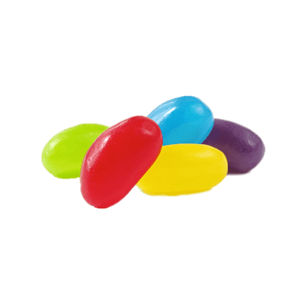
Candy Collector: Part 2
Put M&M’s and 4 Jelly Beans in one bowl.
Have a second “discard” bowl and a cup to the side.
For 15 seconds (one year), move M&M’s (energy) from the full bowl to the cup.
Use your straw to transfer candy. NO HANDS!
Transfer only 6 pieces of candy into the cup.
Discard M&M’s into the “discard” bowl.
Return Jelly Beans to the original bowl.
Repeat for 3 more “years” (15 seconds each).
Notes:
Before Part 2, discuss Part 1 with students. Ask if any students transferred all of their M&M’s. What could that represent in terms of energy? (Depleted resources, empty coal supplies, etc.)
Explain that the town that they are powering learned how to be more energy efficient and avoid depleting their resources. Now they only require 6 units of energy to keep the town running. Part of this efficiency includes the Jelly Beans that do not need to be discarded.

Slide 9
Candy Collector
Year 1
RETURN
DISCARD
Notes:
Discard the cup M&M’s into the discard bowl before the next year. They should see their original stock start to run out.

Slide 10
How many M & M’s did you remove during year 1?
Notes:
🍐 This is a Pear Deck Number Slide
🍐 To edit the type of question, go back to the "Ask Students a Question" in the Pear Deck sidebar.

Slide 11
How many Jelly Beans did you remove during year 1?
Notes:
🍐 This is a Pear Deck Number Slide
🍐 To edit the type of question, go back to the "Ask Students a Question" in the Pear Deck sidebar.

Slide 12
Candy Collector
Year 2
RETURN
DISCARD
Notes:
Discard the cup M&M’s into the discard bowl before the next year. They should see their original stock start to run out.

Slide 13
Candy Collector
Year 3
RETURN
DISCARD
Notes:
Discard the cup M&M’s into the discard bowl before the next year. They should see their original stock start to run out.

Slide 14
How many M & M’s did you remove during year 3?
Notes:
🍐 This is a Pear Deck Number Slide
🍐 To edit the type of question, go back to the "Ask Students a Question" in the Pear Deck sidebar.

Slide 15
How many Jelly Beans did you remove during year 3?
Notes:
🍐 This is a Pear Deck Number Slide
🍐 To edit the type of question, go back to the "Ask Students a Question" in the Pear Deck sidebar.

Slide 16
How did your strategy change over time?
Notes:
🍐 This is a Pear Deck Text Slide
🍐 To edit the type of question, go back to the "Ask Students a Question" in the Pear Deck sidebar.

Slide 17
Renewable vs. Non-Renewable
Renewable Sources
Sources of energy that can be regenerated in a short amount of time.
Jelly Beans
Non-Renewable Sources
Sources of energy that take MILLIONS of years to regenerate.
M&M’s
Notes:
Spark their background knowledge with just the title on the screen. Ask them to define the words based on background knowledge. Ask them which candy represented each word.

