Slide 1
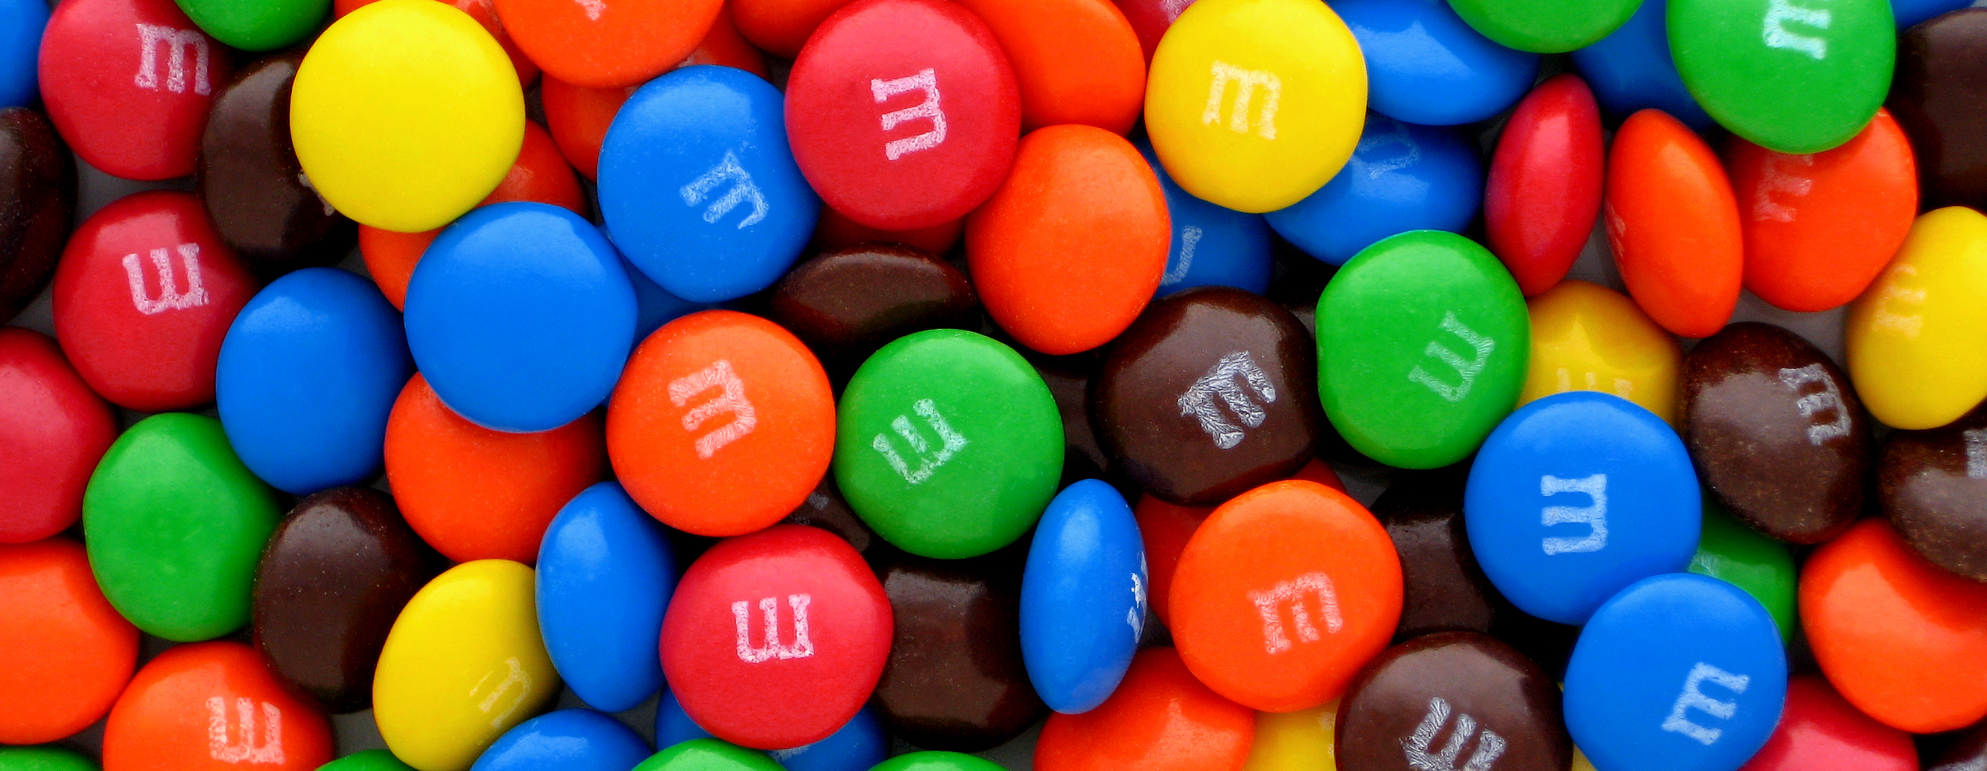
Candy Collector

Slide 2

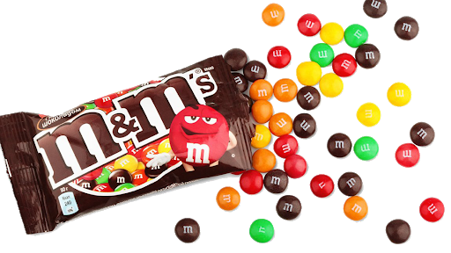
Candy Collector Part 1
Put all M&M’s into one bowl.
Place 2 other bowls to the side.
For 15 seconds (one year), move M&M’s (energy) from the full bowl to the next bowl.
Use your straw to transfer as much candy as possible between bowls. NO HANDS!
Discard ALL candy into the “discard” bowl.
Repeat for multiple “years” (15 seconds each).
2
Notes:
Part 1: Each student represents a town that requires a supply of energy. The town is powered by candy! As the town’s energy manager, each student’s job will be to transfer as many units of energy as they can in each 15 second year. Continue the following process for 4 full 15 second years:
Have students put all of the M&M’s in one of the plastic cups that they were provided.
Using only the straw provided, not their hands, the students will have 15 seconds to transfer as many M&M’s as possible from the 1st cup to the 2nd.
Encourage students to move as many M&M’s as possible and make a bit of a competition out of it. In between each 15 second long “year” ask students to brag about the number of M&M’s in the chat or verbally.
These M&M’s will be discarded into a 3rd cup and will not be returned to the original cup. This leaves the 2nd cup empty, allowing students to see how many they moved each year.
Ask students to describe how their strategy changed from year to year as they harvested units of energy. How did they become more efficient or effective?
Ask students if any of them used up their entire cup of energy. If they had M&M’s left over, have them predict how many more years the town would have been able to be powered.

Slide 3

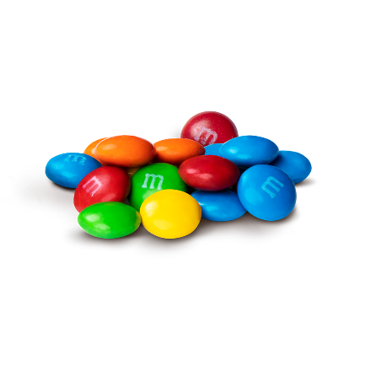
Year #1
1
12
2
STOP!
13
6
14
3
9
11
15
5
7
10
4
8
DISCARD
3
Notes:
Click the space bar once and the 15 second time will start. If you click it again, the animation will show students how to prepare their cups for the next year.
Treat the first year as an example/practice year.

Slide 4
Year #2
1
12
2
STOP!
13
6
14
3
9
11
15
5
7
10
4
8
DISCARD
4
Notes:
Click the space bar once and the 15 second time will start. If you click it again, the animation will show students how to prepare their cups for the next year.

Slide 5
Year #3
1
12
2
STOP!
13
6
14
3
9
11
15
5
7
10
4
8
DISCARD
5
Notes:
Click the space bar once and the 15 second time will start. If you click it again, the animation will show students how to prepare their cups for the next year.

Slide 6
Year #4
1
12
2
STOP!
13
6
14
3
9
11
15
5
7
10
4
8
DISCARD
6
Notes:
Click the space bar once and the 15 second time will start. If you click it again, the animation will show students how to prepare their cups for the next year.

Slide 7
Year #5
1
12
2
STOP!
13
6
14
3
9
11
15
5
7
10
4
8
DISCARD
7
Notes:
Click the space bar once and the 15 second time will start. If you click it again, the animation will show students how to prepare their cups for the next year.

Slide 8
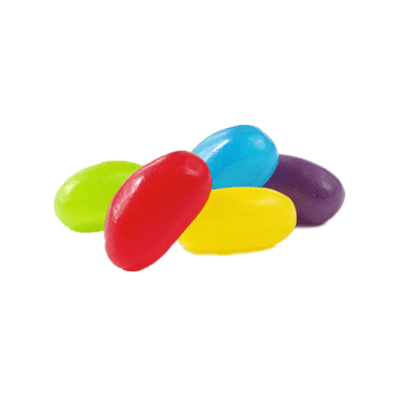
Candy Collector Part 2
Return all M&M’s and 3 Jellybeans to the original bowl.
Place 2 other bowls to the side.
For 15 seconds (one year), move M&M’s (energy) from the full bowl to the next bowl.
Use your straw to transfer only 6 pieces of candy. NO HANDS!
Discard M&M’s into the “discard” bowl.
Return Jellybeans to the original bowl.
Repeat for multiple “years” (15 seconds each).
8
Notes:
Part 2: Have the students return all of the M&M’s and 4 of their jellybeans into the 1st bowl. Since the town has been improving their energy technology, each student only needs to move 6 pieces of candy. They no longer need to use as much energy as possible. Continue the following process for 3 full 15 second years:
Have students put all of the M&M’s in one of the plastic cups that they were provided. Add 4 of the jellybeans to this cup.
Using only the straw provided, not their hands, the students will have 15 seconds to transfer 6 pieces of candy from the 1st cup to the 2nd as fast as they can.
Encourage students to put their hands up on screen when all 6 candies have been moved.
The M&M’s will be discarded into a 3rd cup and will not be returned to the original cup. The jellybeans will be returned to the 1st cup.
Ask students to describe how their strategy changed from year to year as they harvested units of energy. How did they become more efficient or effective?
Ask students to predict how many years it would take for the town to run out of energy. Since the jellybeans return, the amount of time increases considerably.

Slide 9
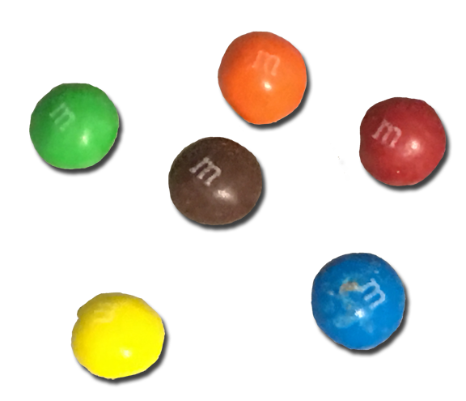
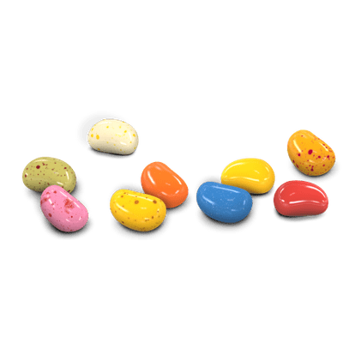
Year #1
1
12
2
STOP!
13
6
14
3
9
11
15
5
7
10
4
8
RETURN
DISCARD
9
Notes:
Click the space bar once and the 15 second time will start. If you click it again, the animation will show students how to prepare their cups for the next year.
Treat the first year as an example/practice year.

Slide 10
Year #2
1
12
2
STOP!
13
6
14
3
9
11
15
5
7
10
4
8
RETURN
DISCARD
10
Notes:
Click the space bar once and the 15 second time will start. If you click it again, the animation will show students how to prepare their cups for the next year.

Slide 11
Year #3
1
12
2
STOP!
13
6
14
3
9
11
15
5
7
10
4
8
RETURN
DISCARD
11
Notes:
Click the space bar once and the 15 second time will start. If you click it again, the animation will show students how to prepare their cups for the next year.

Slide 12
Renewable vs. Non-Renewable
Renewable Sources (Jellybeans)
Sources of energy that can be regenerated in a short amount of time.
Wind, Solar, Hydropower, Biomass, Geothermal
Non-Renewable Sources (M&M’s)
Sources of energy that take MILLIONS of years to regenerate.
Natural Gas, Petroleum, Nuclear, Coal, Propane
12
Notes:
Moral of the Story: Explain to the students that the jellybeans are renewable energy sources and the M&M’s are nonrenewable sources.
The nonrenewable M&M’s take so long to regenerate that they seem to run out in our lifetimes. Fossil fuels take millions of years to regenerate.
The renewable jellybeans took a short time to regenerate. They aren’t necessarily unlimited but can be replenished in a realistic time frame.

