Slide 1
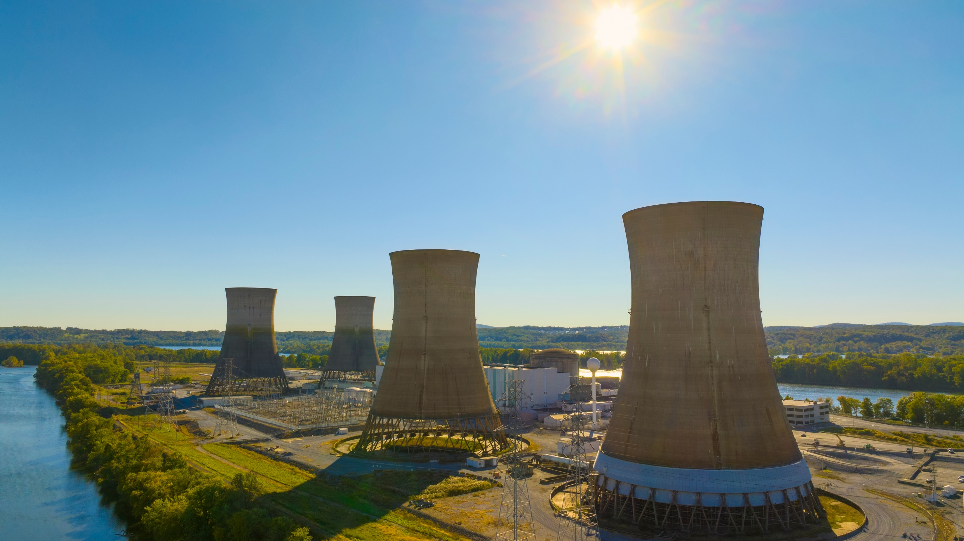
Nuclear Energy Career Roundup
Photos courtesy of Constellation, Adobe Photostock

Slide 2
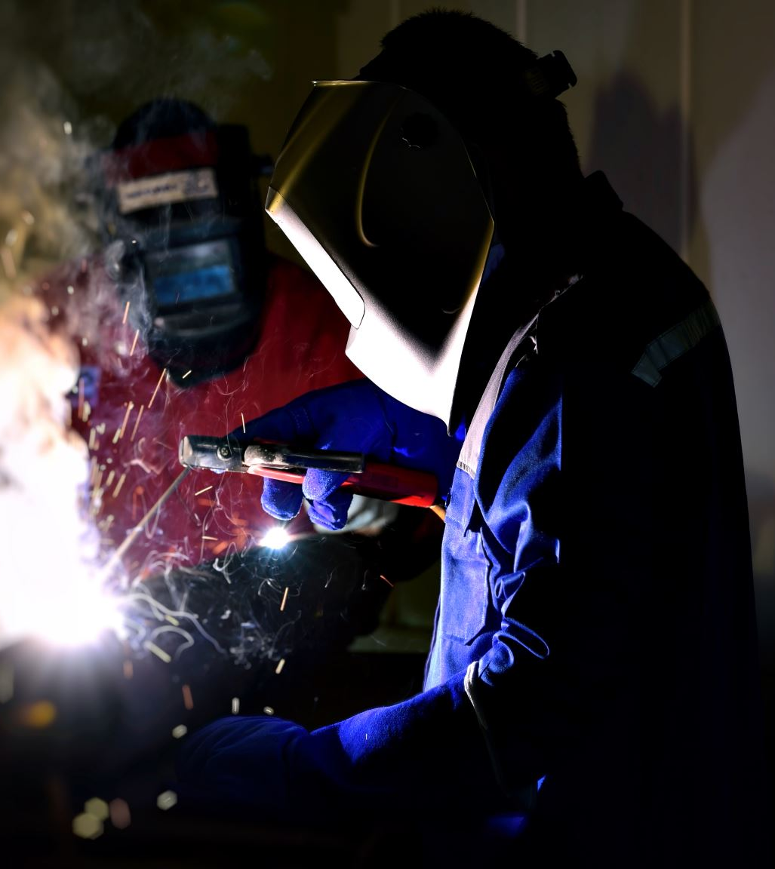

Welder
My job requires a high school diploma and training from a technical college, union apprenticeship, or other post-secondary program.
I must obtain a security clearance and pass a background check.
My job may have me working under water.
Knowing the properties of different metals and materials is important to do my job well.
I read blueprints and other construction documents regularly.
I can take a hint – I can easily put two and two together!

Slide 3
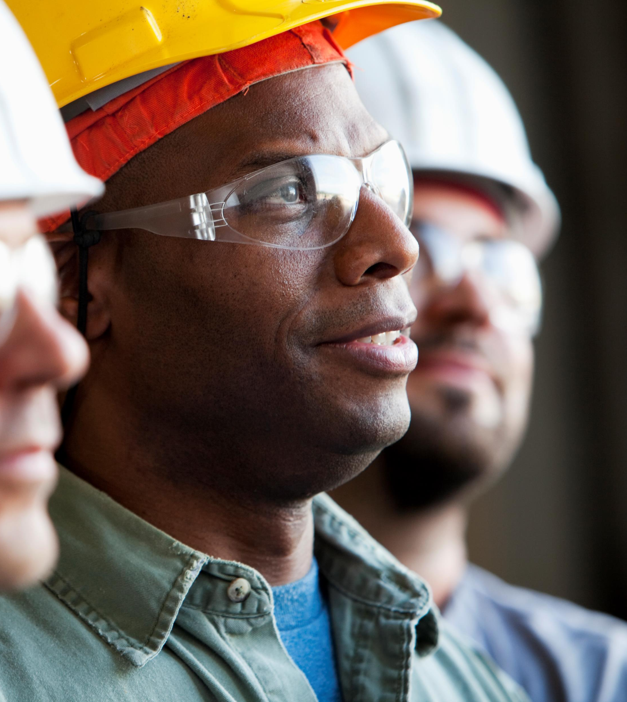
Mechanical Engineer
My job requires a bachelor’s degree for entry level positions. Additional engineering experience, internships, and certifications in engineering, power plant systems and performance can be helpful.
Before working in the field, I need to pass background checks and other tests to enable me to have access to the facility.
I play a role in designing, developing, and maintaining pressure vessels, pipes, heat exchangers, and pumps.
My job requires that I am comfortable with computer-aided design (CAD) and simulation software programs.
My job requires that I am good at identifying potential hazards and risks and propose safety solutions and measures to ensure that systems comply with all industry standards and procedures.
People say those in my career are so focused, we are like machines!

Slide 4
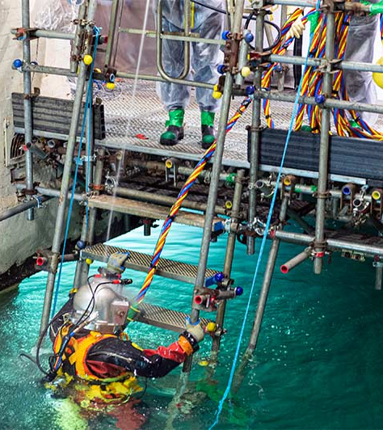
Commercial (Nuclear) Diver
My job requires a high school diploma and very specialized training programs and certifications.
I may be responsible for inspection, maintenance, restoration and repair, fuel assembly installation and removal, and even decommissioning equipment.
My job can expose me to very hazardous scenarios, and I must be very safety and detail oriented.
I must be able to complete construction and inspection tasks in tight spaces, under pressure, and under time constraints.
I must be able to move and carry heavy equipment above ground and under water.
I may be skilled at welding and construction, but the sea-saw is my favorite tool.

Slide 5
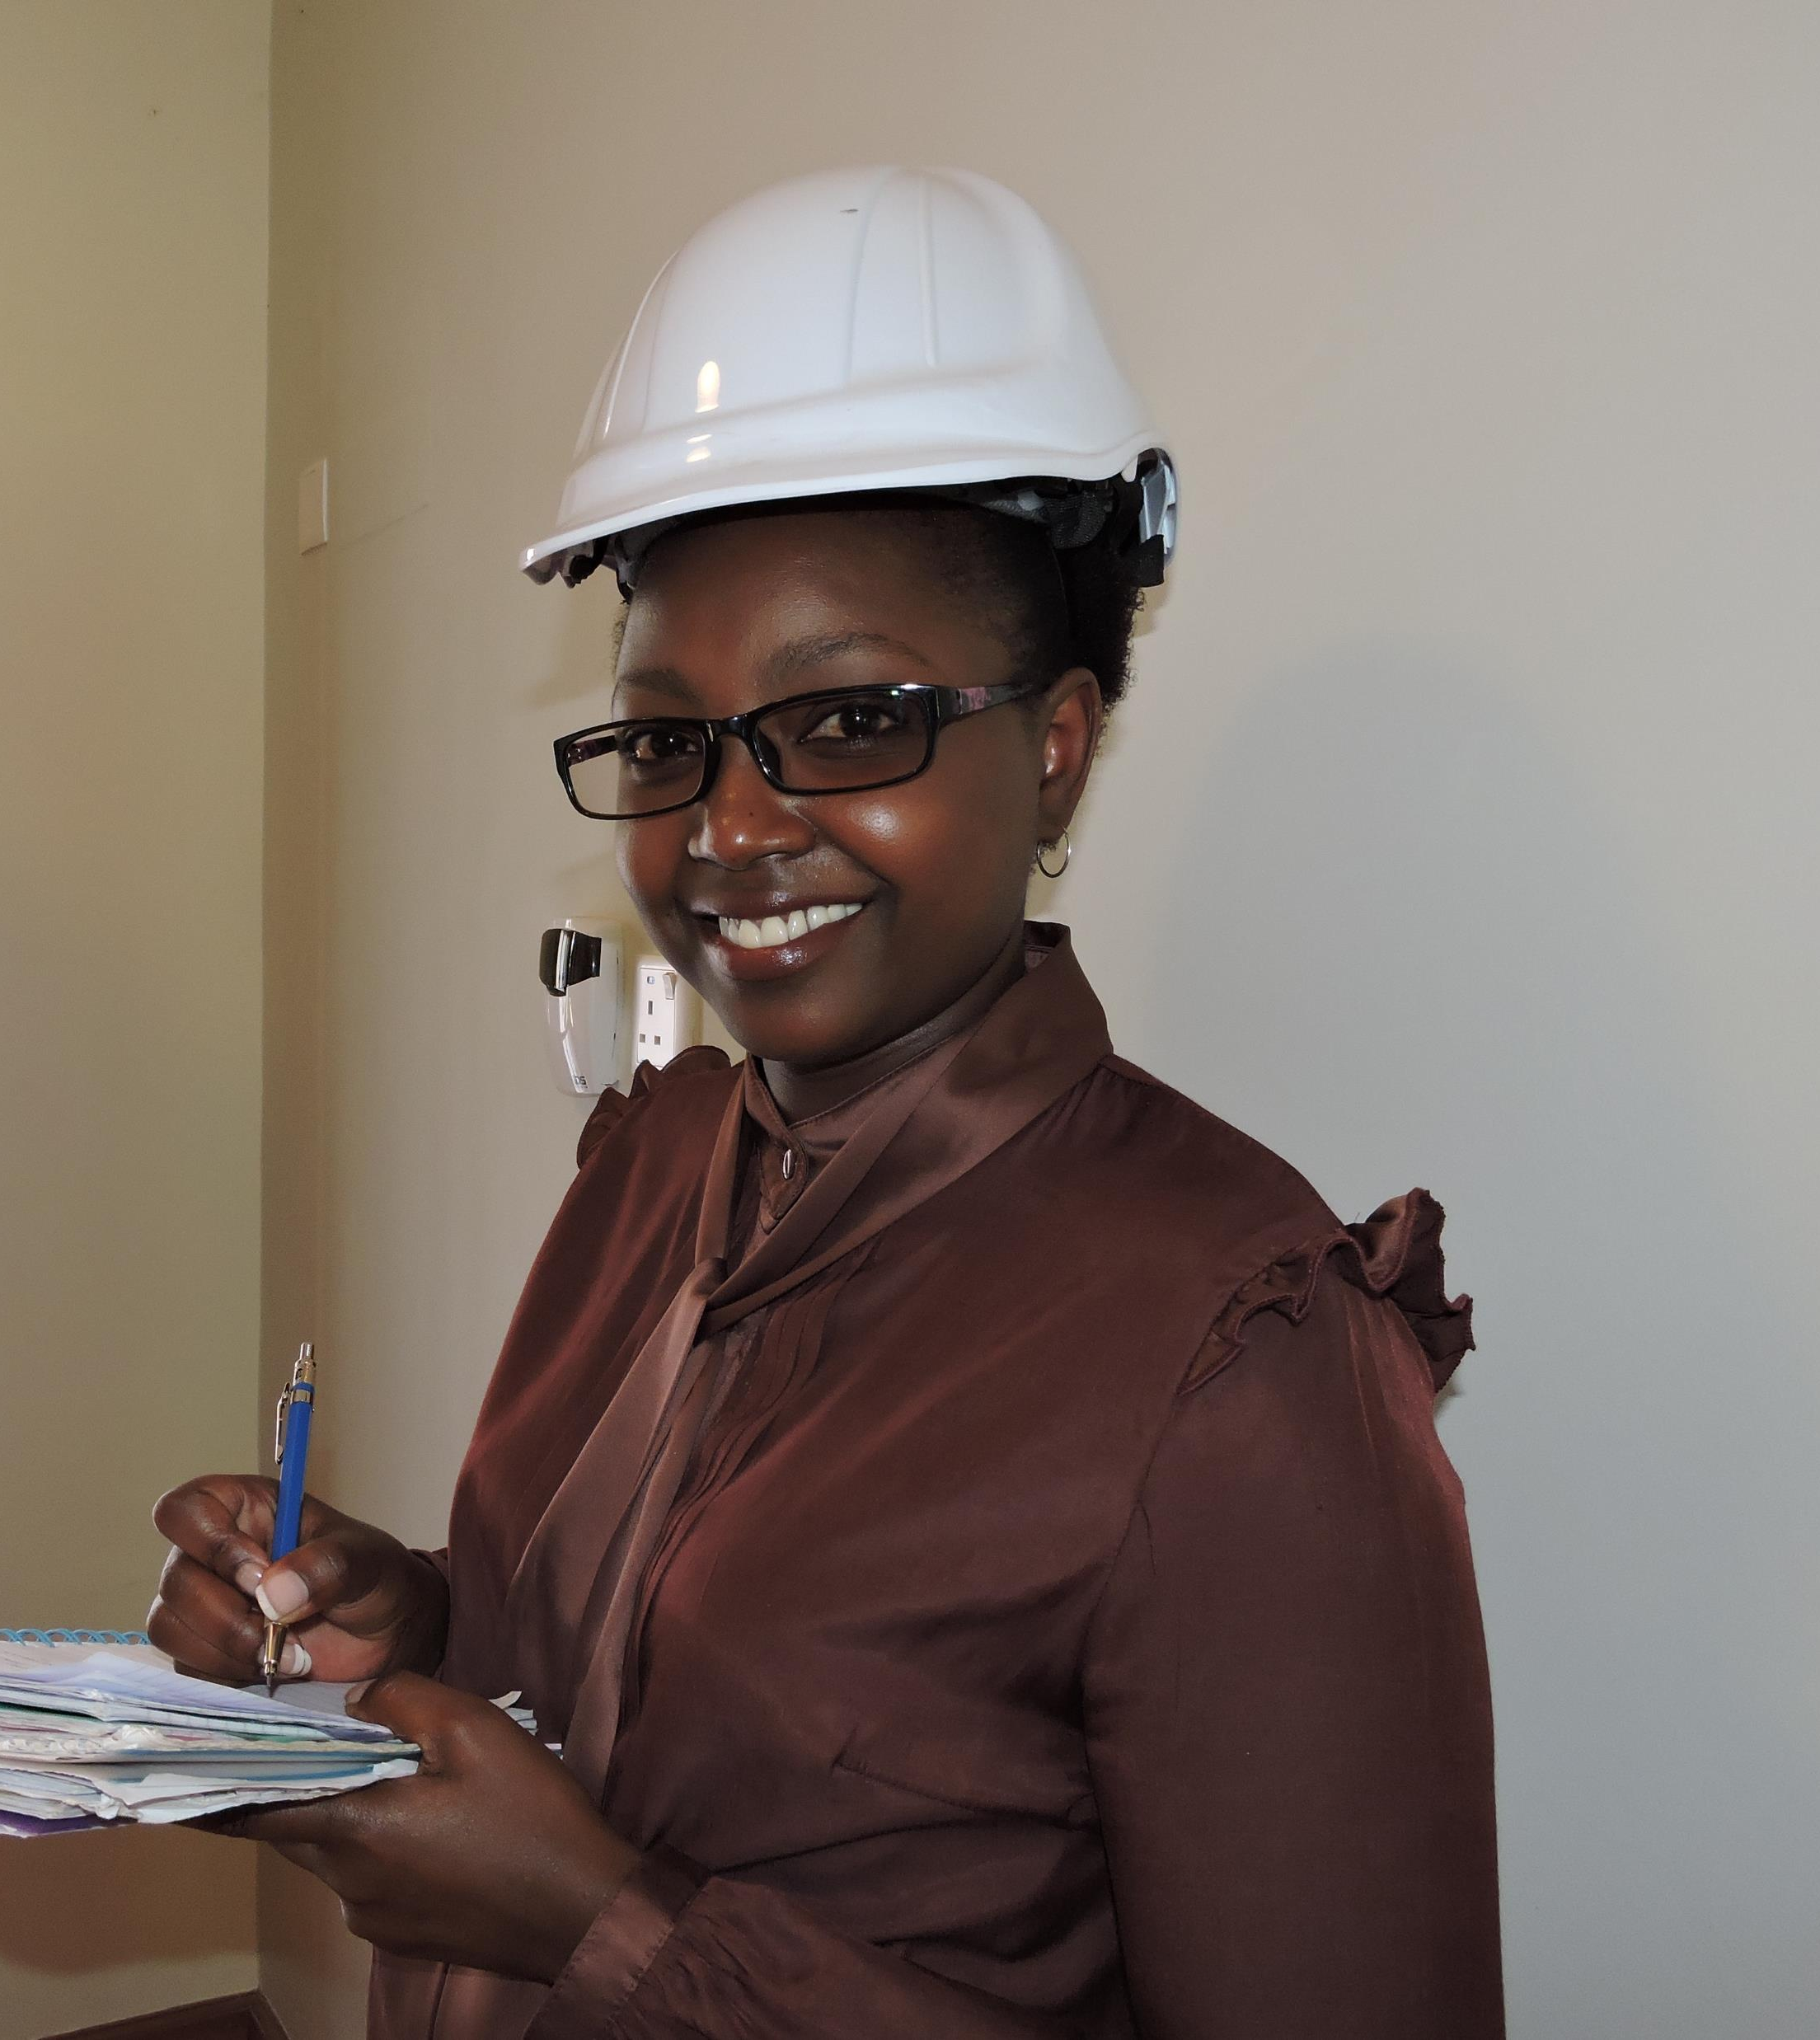
Safety Coordinator and Inspector
My job most often requires a bachelor’s degree. However, a technical degree and related experience can meet the requirements.
My job requires me to have an understanding of many different types of jobs and systems in a facility.
I work closely with management to analyze performance, and operations to make plans for improvements.
One important part of my job is conducting field observations of my coworkers.
I must possess strong communication skills and be good at motivating others.
You won’t find me without my PPE (personal protective equipment). Safety is always first!

Slide 6
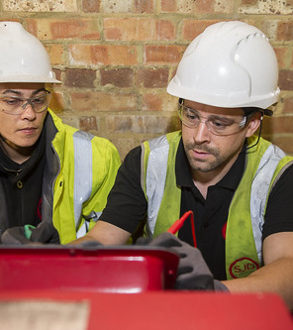
Electrician
My job requires a high school diploma plus training at a technical college or within an apprenticeship. Many locations require people in my job to be licensed and meet specified standards guidelines for safety.
I perform maintenance and repair for plant equipment.
I must be able to troubleshoot, test, and inspect systems in a highly skilled manner.
I work closely with engineers to make sure plans are followed and evaluated to minimize downtime and safety concerns.
I need to be able to quickly address and respond to emergency situations to prevent damage to the facility.
My calendar is always up-to-date because I like to stay current.
This Photo by Unknown Author is licensed under CC BY

Slide 7
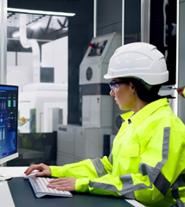
Nuclear Equipment Operator
My job requires a high school diploma, in addition to some college course work, power plant work experience, or Navy nuclear training.
In this position, I work hands-on with a team of licensed staff and can gain licensing required to eventually become a reactor operator.
I monitor, control, and start/stop to nuclear equipment from the control room.
I must participate in emergency planning and response and be part of the fire brigade if necessary.
I must keep lots of logs and have good communication skills.
Press “0” to speak with me about the plant equipment!

Slide 8
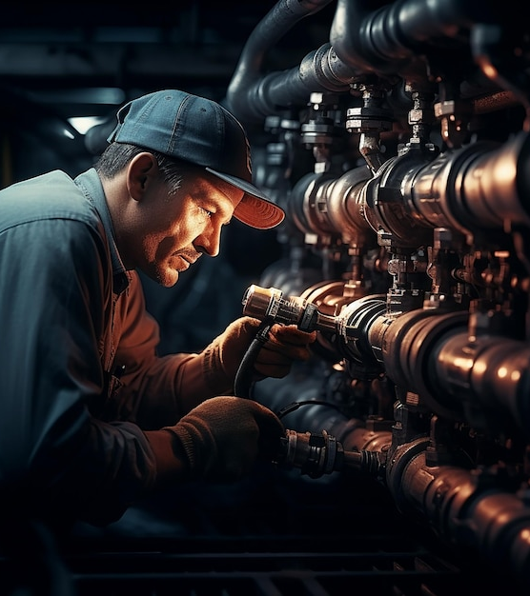
Pipefitter
My job title requires a high school diploma and an apprenticeship or certification.
I work with a team to plan for a pipe system layout, installation, or repair of pipeline systems that move water, steam, petroleum products, or gases
I work with plumbers, welders, and steamfitters to assemble, install, and repair the pipe system.
I study plans, inspect structures, and test systems using gauges, tests, and other tools.
I use a variety of power and hand tools, and my job is sometimes physically demanding.
I sometimes hang out where there’s not much elbow room.

Slide 9
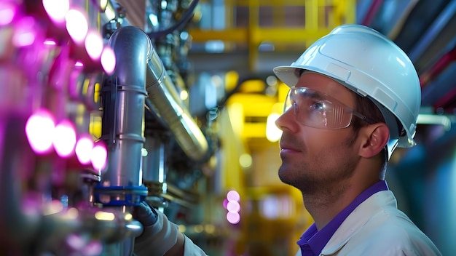
Nuclear Engineer
My job requires a bachelor’s degree. Graduate degrees and professional certifications are preferred and required in some positions.
I provide guidance and create plans for operation, maintenance, and long-term use of plant equipment to ensure it performs reliably and efficiently.
I sometimes work to investigate and test components in the facility and report results to other teams and regulators.
I recommend equipment and new protocols to improve performance, reduce costs, or correct flaws.
To do my job well, I need to be able to work on projects with others and to manage multiple tasks in one day. Time management and organization are critical.
People say I’m organized and good at problem solving, but I’m not fission for compliments!

Slide 10
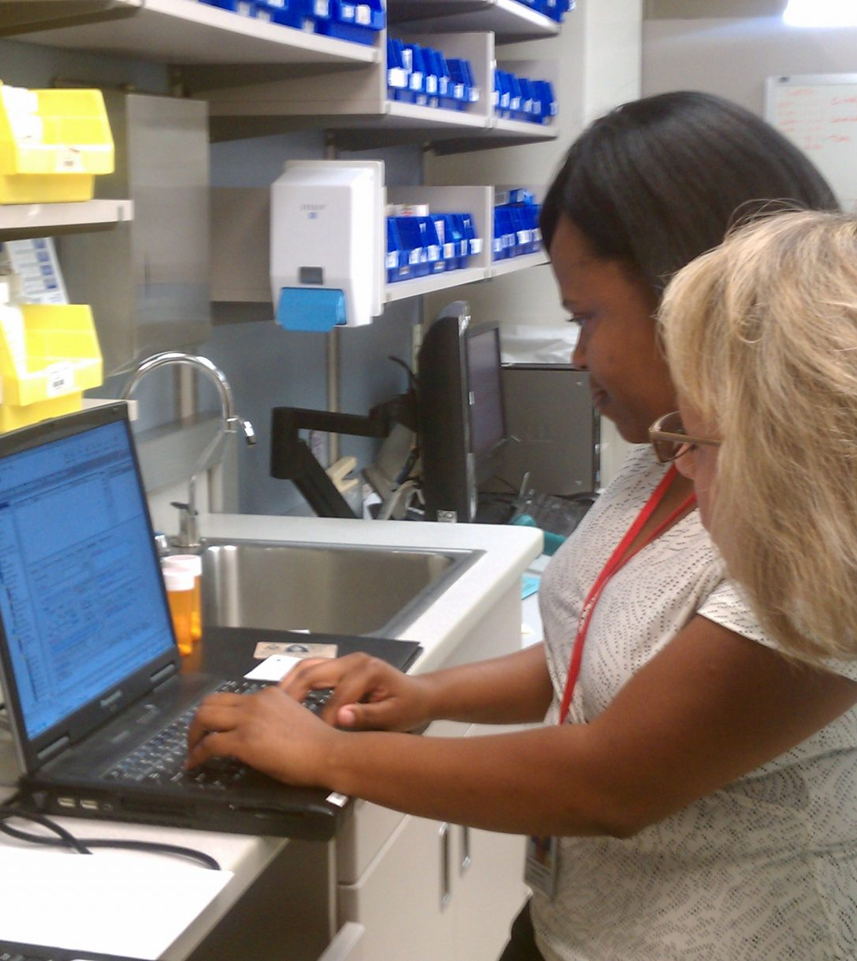
Health Physicist
My job requires a bachelor’s degree, though many have a master’s degree and/or special certifications.
I work in offices, laboratories, or in power plant facilities.
I monitor radiation levels of facilities, radiation equipment, and the people who work in a nuclear facility.
I work with a team to plan and develop protection programs and procedures for the company.
I must review and evaluate data and report information to important regulatory agencies to make sure the facility is meeting standards.
I radiate positive energy.
This Photo by Unknown Author is licensed under CC BY

Slide 11
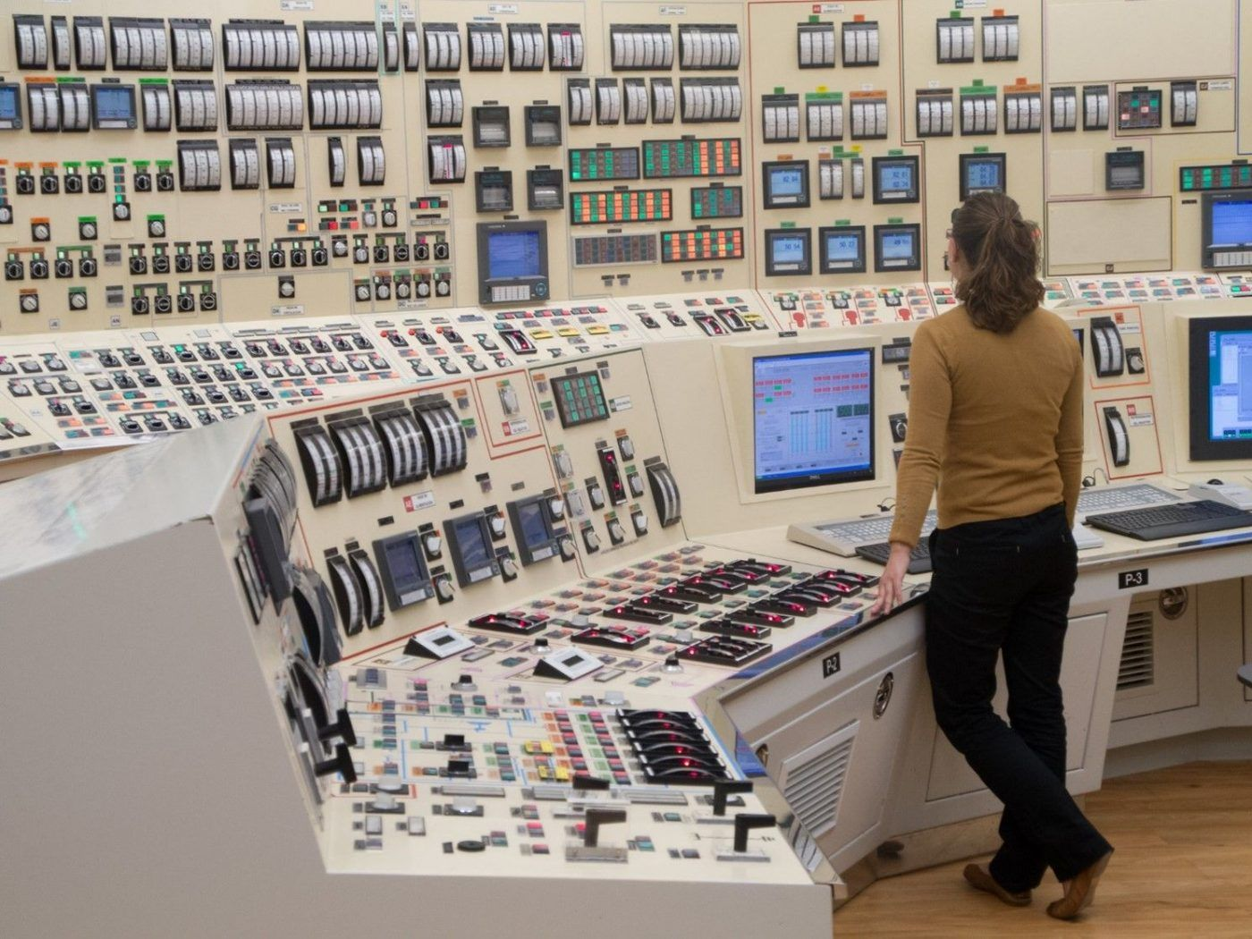
Reactor Operator
My job requires a high school diploma in addition to licensing training and months to years of experience.
Before working, I must pass several employment tests, a physical examination, and must regularly be reexamined to continue working.
I ensure the facility is operated in a safe, efficient, and conservative manner at all times, based upon established levels of operation and notify my supervisor if any thing unusual or unexpected is occurring.
I must be aware of what other workers are doing at all times and use effective communication skills.
I have to keep detailed logs of daily activities during my shift.
I often have to be on-call and ready for emergencies or work on holidays.
My job makes sure you have the power!

