Slide 1
Who Am I?
Energy Efficiency Career Roundup

Slide 2
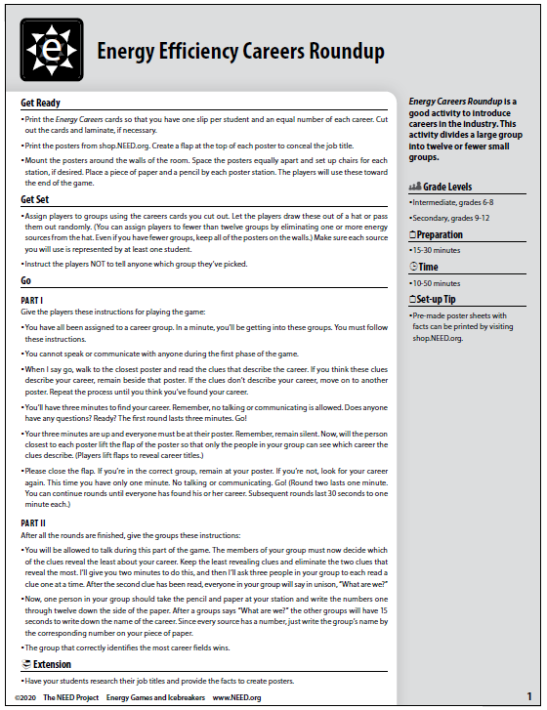
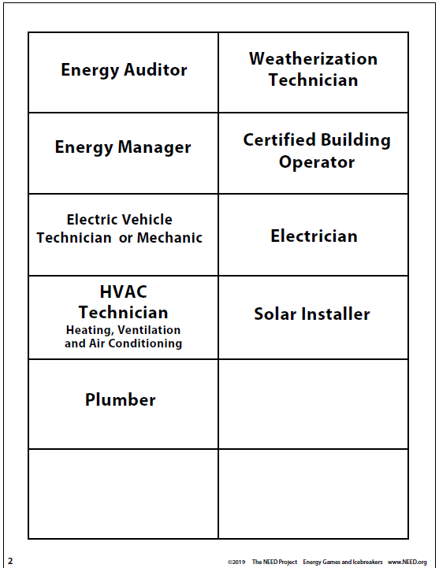

Slide 3
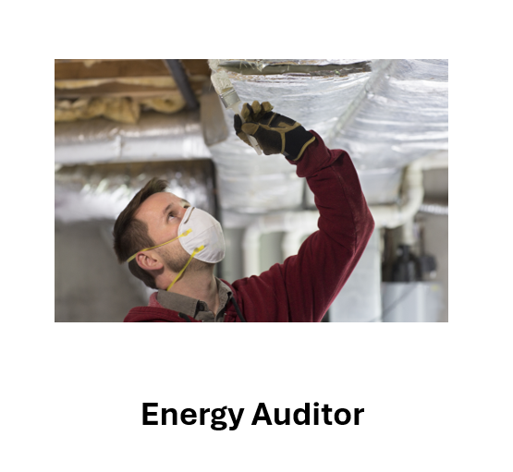
Energy Efficiency Career Roundup
I assess energy use in a building.
I make observations and take measurements related to energy use and indoor air quality.
High school diploma and some additional training or an associates/bachelor’s degree or equivalent on-the-job training is required for my job.
The ability to climb ladders and stairs, maneuver around industrial equipment, and accurately collect temperature, humidity, air flow, and other data are required.
I prepare reports that identify opportunities for energy savings and submit the findings to a supervisor or client.
Attention to safety is a priority in my work.

Slide 4
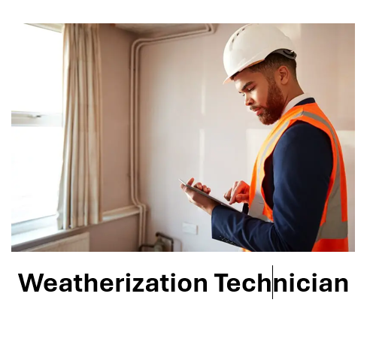
Energy Efficiency Career Roundup
I am an expert on residential and commercial heating and cooling
I inspect and perform routine maintenance on residential heating and cooling systems, referring repairs and other problems to an HVAC (Heating, Ventilation and Air Conditioning) technician.
A high school diploma is the minimum requirement, but an associates degree and additional technical training is often needed.
I check for air infiltration around windows and doors and adequate insulation in attic spaces.
I need to comfortable working in high and small places and climbing ladders, getting dirty, crawling around in tight spaces and working in very hot and cold weather.
Energy Efficiency Careers Roundup

Slide 5
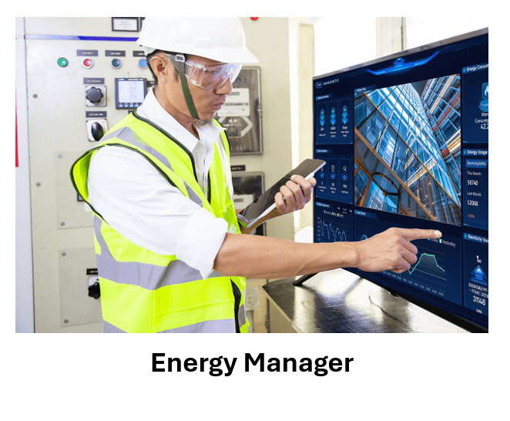
Energy Efficiency Career Roundup
I am employed by an organization or company to manage energy consumption in a building or group of buildings such as a school or college campus.
I evaluate energy use in the location and recommend ways to save money and manage energy use.
Post-secondary training or education such as a bachelor’s degree or apprenticeship are minimum requirements for my job.
I need to understand how financing, interest, and payback periods relate to a project. I need to understand and make financial calculations and decisions.
I may work for a company or organization and the sole professional in my role, or I may work as a consultant or contractor for several different clients.
Energy Efficiency Careers Roundup

Slide 6
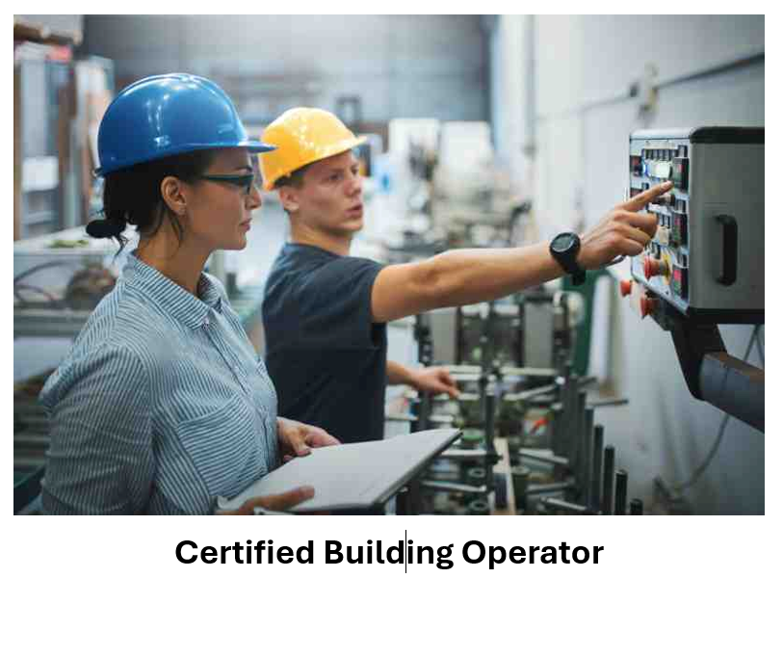
Energy Efficiency Career Roundup
I know how to operate a facility while keeping energy consumption down and comfort and indoor air quality good.
To get this certification, I must complete a series of courses and examinations successfully.
I incorporate energy-saving practices while operating and maintaining the systems in a building such as the HVAC (Heating, Ventilation and Air Conditioning) system, electrical, plumbing, etc.
My field requires a minimum of 2 years of work experience in building operation and maintenance.
I often have other training and certifications, such as HVAC technician or electrician.
Energy Efficiency Careers Roundup

Slide 7
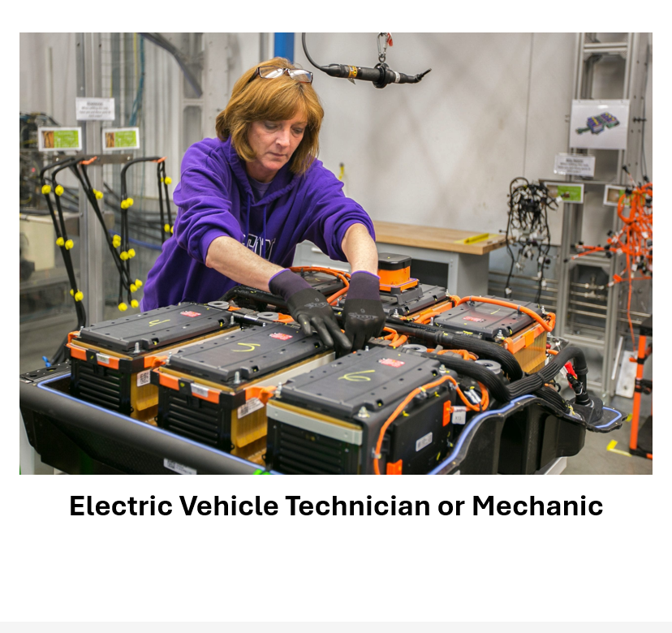
Energy Efficiency Career Roundup
I perform regular maintenance and occasionally fix things when something goes wrong and needs to be repaired.
I can become certified through a specialized program offering ASE (Automotive Service Excellence) Certification.
My position requires continuing education programs as technology changes.
I require a good understanding of electronic components.
I require strategic thinking to identify and solve issues related to my field.
Energy Efficiency Careers Roundup

Slide 8
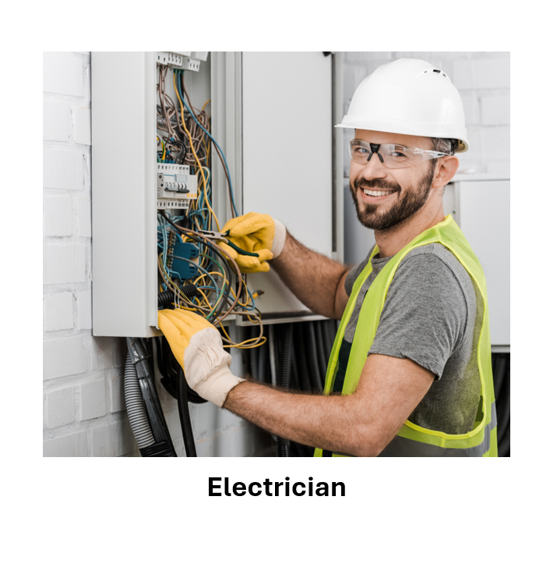
Energy Efficiency Career Roundup
I am trained and qualified to work with electrical wiring and devices in a safe way.
I may specialize in utility work, industrial controls, construction, renewable energy, repair, and other areas.
I go through an apprenticeship program that combines classroom training with field work experience.
A high school diploma is needed to enter an apprenticeship for my job.
I need to be constantly vigilant about safety because a mistake could be deadly.
Energy Efficiency Careers Roundup

Slide 9
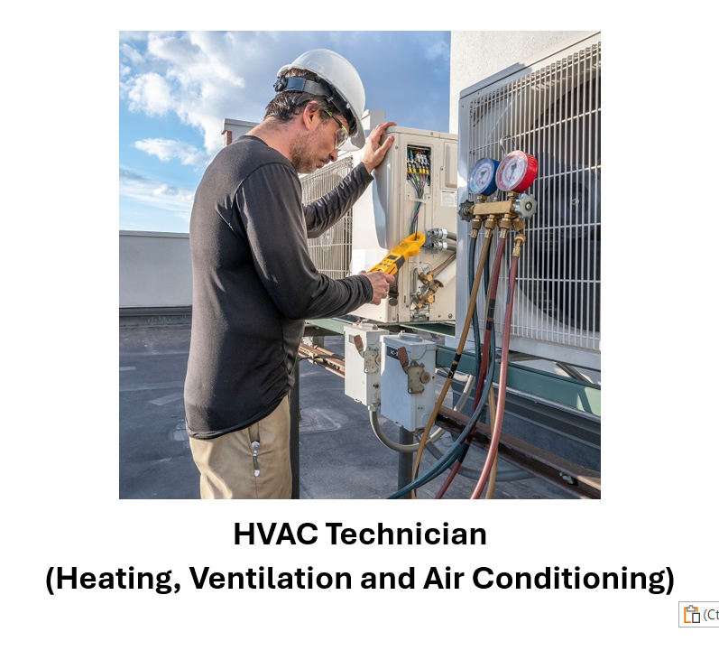
Energy Efficiency Career Roundup
I am trained to install, service, and repair heating, cooling, ventilation, and refrigeration equipment.
I may work in residential, commercial, or industrial settings, and may work on already installed equipment or install new equipment in old or new buildings.
A high school diploma and post-secondary training program are required for my job.
I need to be able to work under extreme temperatures and be able to complete work in tight spaces such as crawl spaces or small mechanical rooms.
I may need to attend training conducted by manufacturers of specific heating or cooling systems for my job.

Slide 10
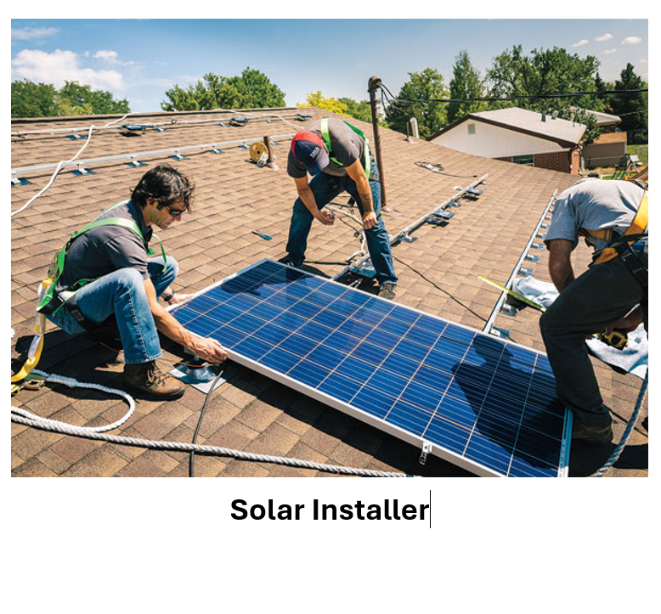
Energy Efficiency Career Roundup
I am trained to determine what size photovoltaic system a customer needs, identify the right placement for the system, and install and connect the system to the building and electrical grid.
I need to know federal, state, and local regulations regarding the system installation and make sure the work they do adheres to those regulations.
A high school diploma and additional on-the-job or post-secondary training is required.
Several technical and community colleges also have installation programs.
I must work on rooftops or other high places and need to be comfortable climbing ladders.
Energy Efficiency Careers Roundup

Slide 11
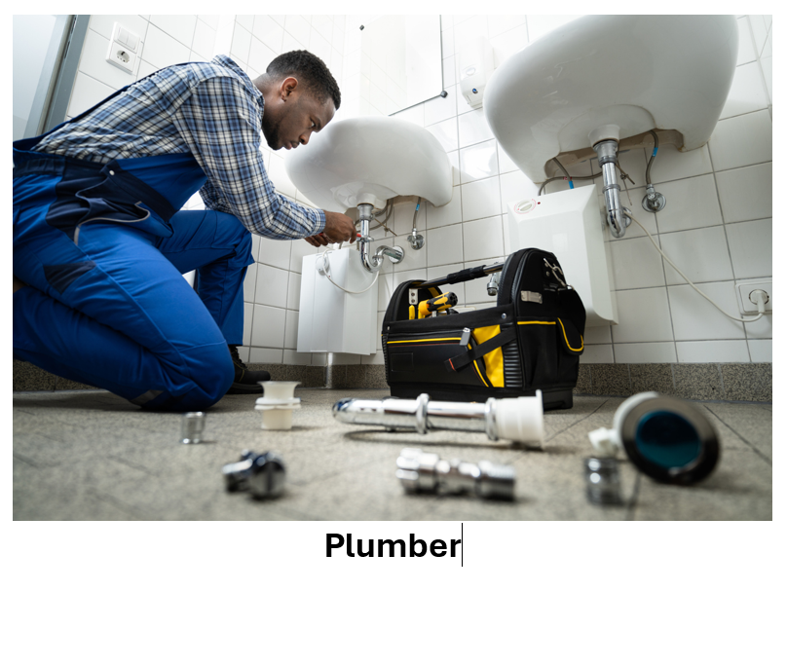
Energy Efficiency Career Roundup
I work with the pipes and devices that deliver clean water to your home and carry the wastewater away.
I might work for a water utility or municipality, or work for a private company doing work in a home or commercial building.
A high school diploma and an apprenticeship program are required for my job.
I need to work with oversized tools and know which materials are acceptable for which applications.
I can be called to emergencies at all kinds of crazy hours.
I may have special certifications to work with natural gas.
Energy Efficiency Careers Roundup

