Slide 1


Energy Enigma
Can you guess the energy sources?

Slide 2
Energy Enigma Overview
You will be divided into 10 teams, one to represent each energy source.
The object of the game is to conceal the identity of your energy source from the other teams, while also guessing the identity of the other teams’ sources.
There are three phases to Enigma:
Selecting clues
Gathering information
Making educated guesses

Slide 3
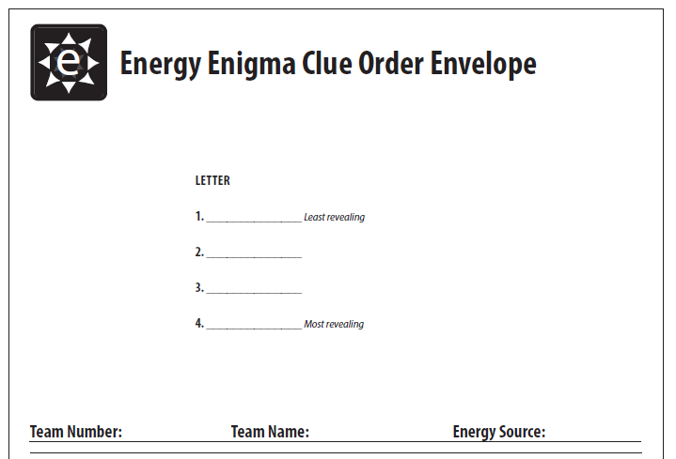
Step One: Choose Your Clues
As a team, decide which four clues are the least revealing of your energy source.
Order the clues in the way you would like them displayed to the other teams.
Write the letters of the clues on the front of the Clue Order Envelope and return it to the facilitator.

Slide 4
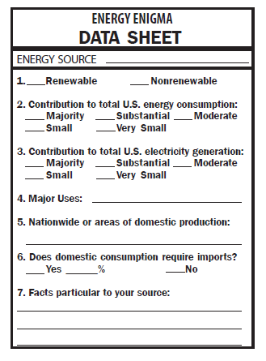
Step Two: Gather Information
You will be given three pages of information and a stack of 10 Enigma Data Sheets
Divide the Data Sheets among your team members
Fill in the Data Sheets using the Infosheets and graphs

Slide 5



Prepare for Step Three
You will be given a stack of ten Enigma Clue Cards. Number them 1-10.
Set aside your own energy source’s number, as you know this one!
We will play up to four rounds, with one clue per energy source in each round.

Slide 6
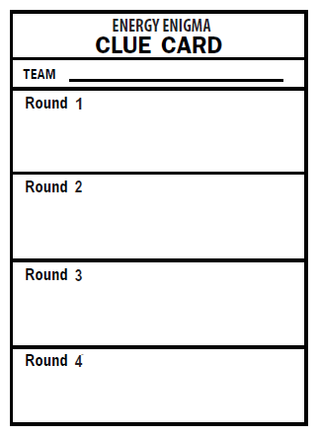

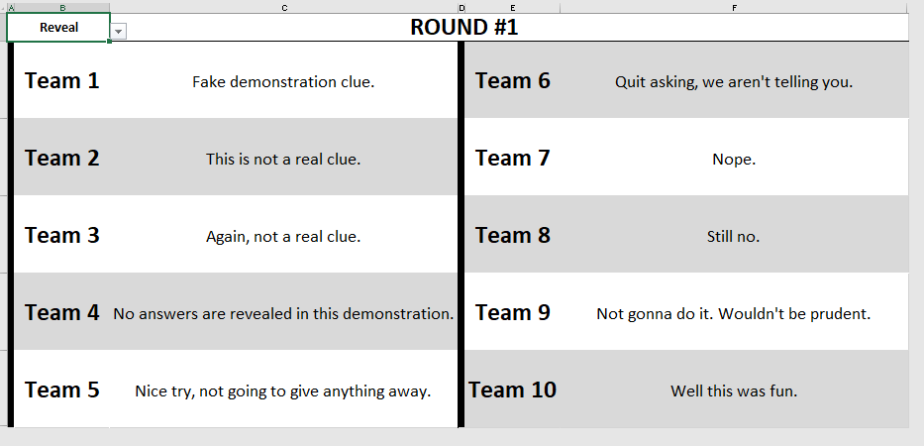
Step Three: Make Educated Guesses
1
Fake demonstration clue.
For each round, one clue per source will be displayed. Copy each into the Round 1 box on the corresponding Clue Card.
2
This is not a real clue.

Slide 7
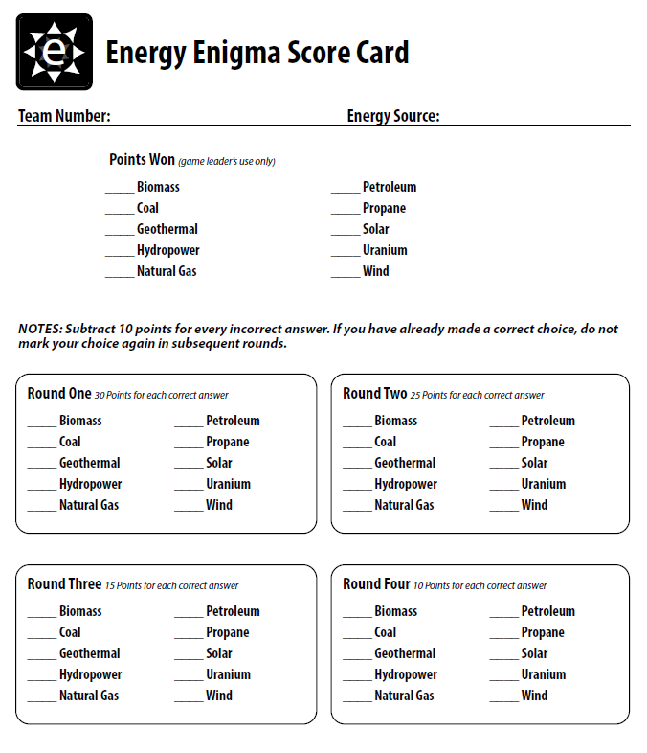
Scoring
If you are ready to make a guess about the energy source’s identity, write the number of the source on the line next to the name of the source for the round you are playing.
Each correct guess earns 30 points in round 1; 25 points in round 2; 15 points in round 3; and 10 points in round 4.
Incorrect guesses deduct 10 points each!

