Slide 1

Would You Rather…
Forms of Energy Edition

Slide 2
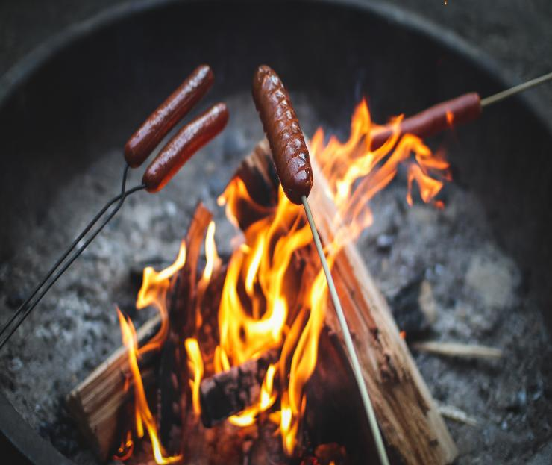
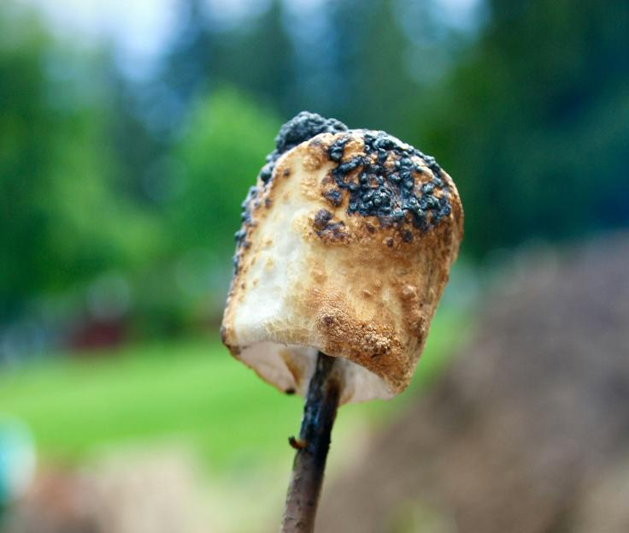
WOULD YOU RATHER…
OR
roast a hot dog
roast a marshmallow
Notes:
THERMAL ENERGY

Slide 3
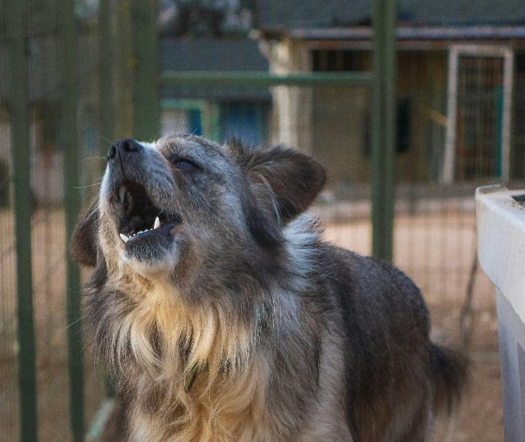

WOULD YOU RATHER…
OR
hear a dog barking
hear a baby crying
Notes:
SOUND ENERGY

Slide 4
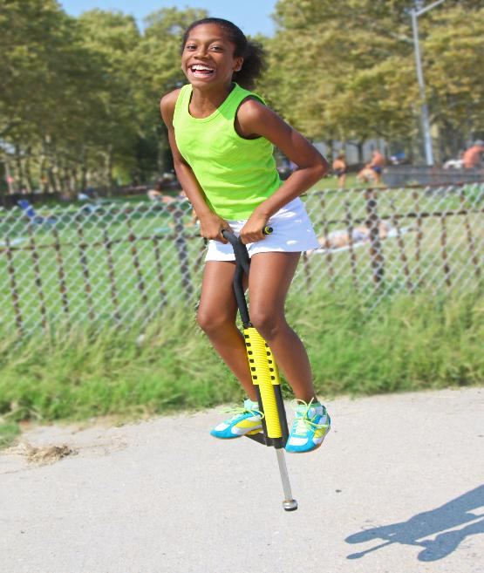

WOULD YOU RATHER…
OR
jump on a pogo stick
jump on a trampoline
Notes:
ELASTIC ENERGY

Slide 5
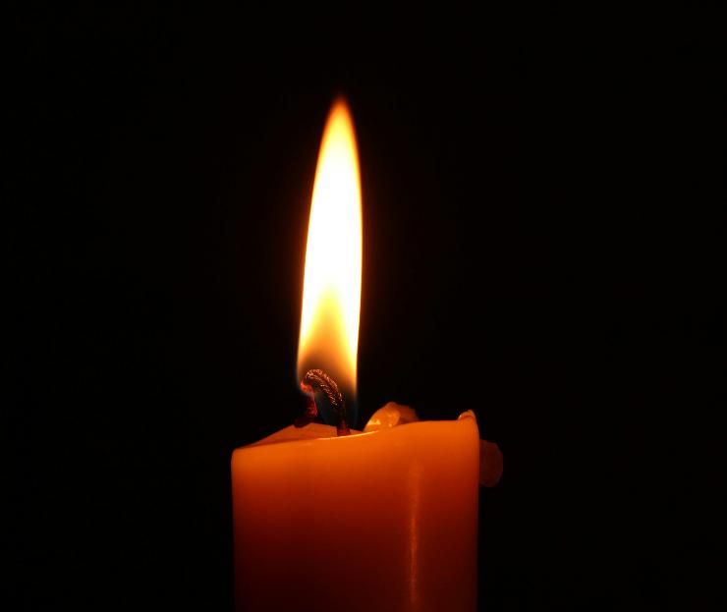

WOULD YOU RATHER…
OR
read by candlelight
read by flashlight
Notes:
RADIANT ENERGY

Slide 6
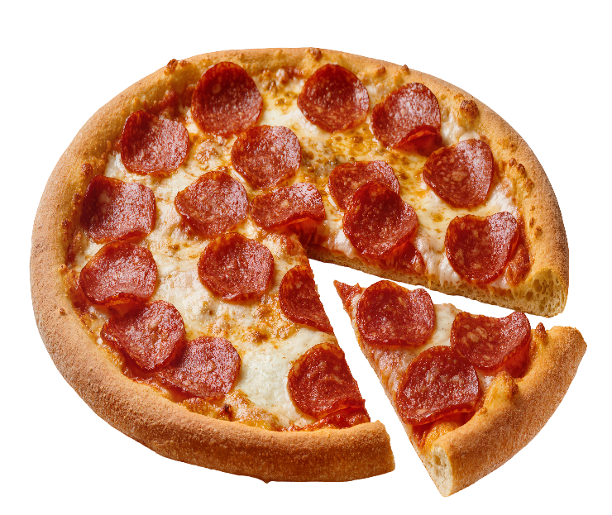
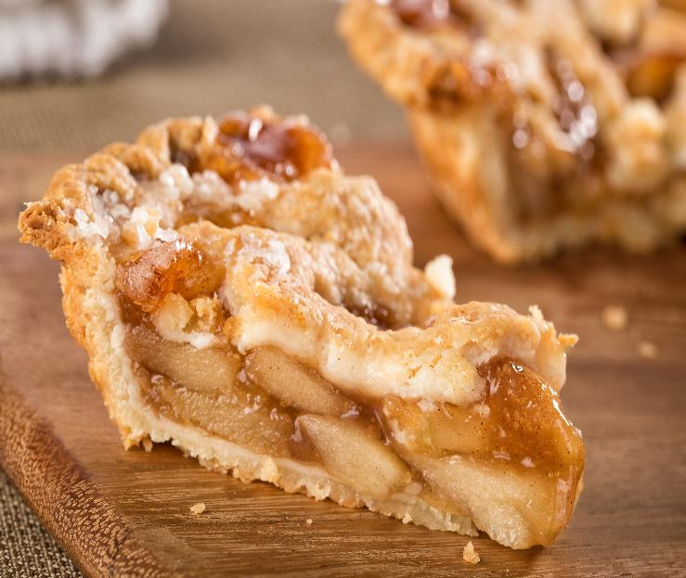
WOULD YOU RATHER…
OR
eat a piece of pizza
eat a piece of pie
Notes:
CHEMICAL ENERGY

Slide 7

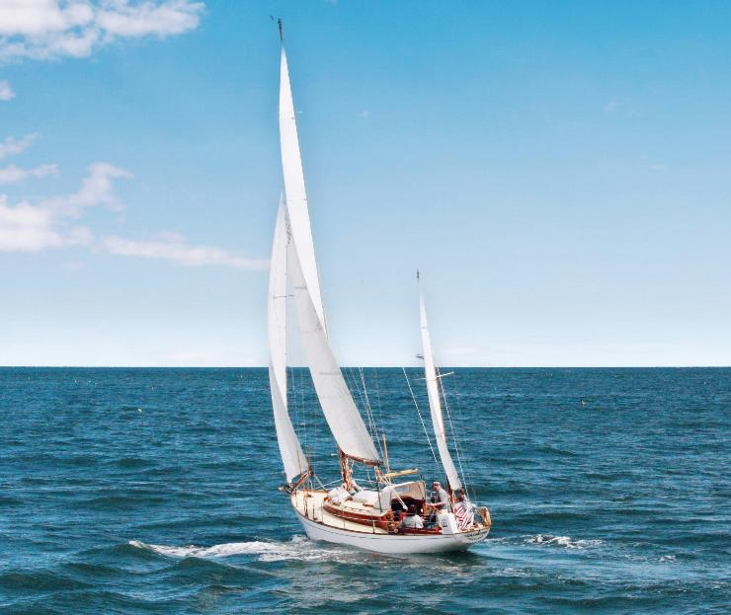
WOULD YOU RATHER…
OR
fly a kite
sail a boat
Notes:
MOTION ENERGY

Slide 8
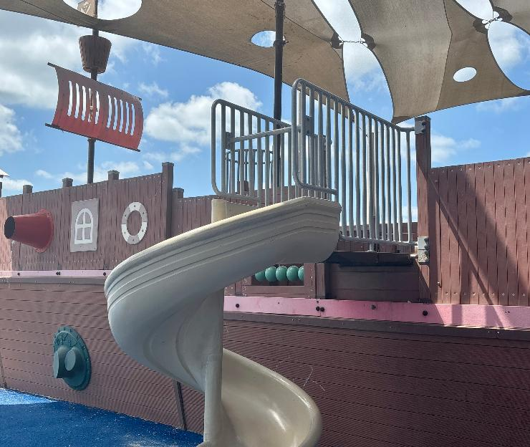
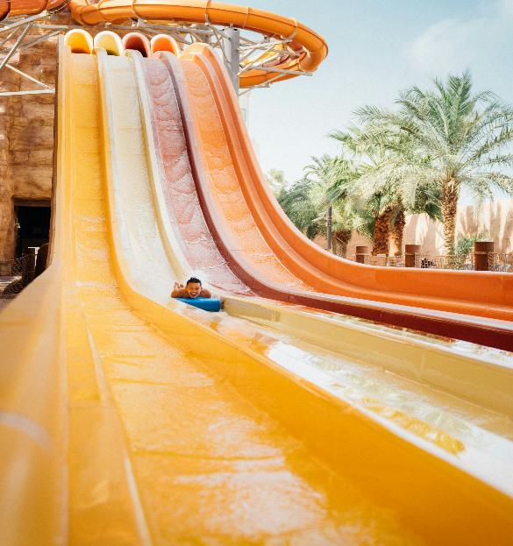
WOULD YOU RATHER…
OR
be at the top of a spiral slide
be at the top of a water slide
Notes:
GRAVITATIONAL POTENTIAL ENERGY

Slide 9
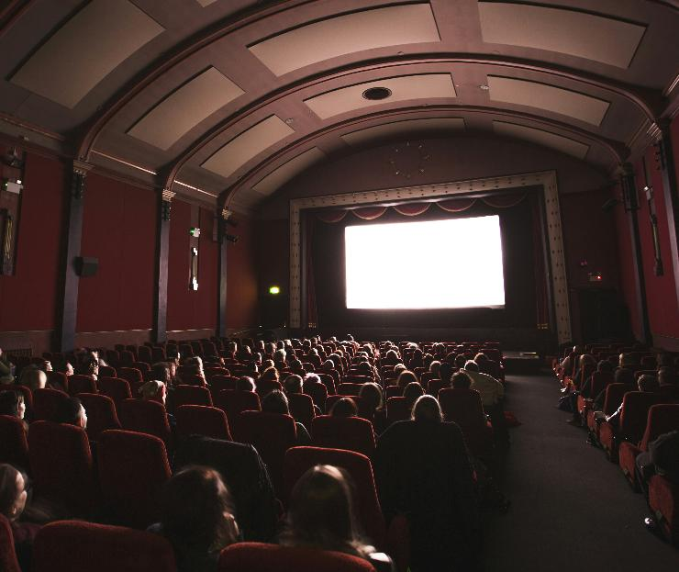

WOULD YOU RATHER…
OR
watch a movie
play a video game
Notes:
ELECTRICAL ENERGY

Slide 10
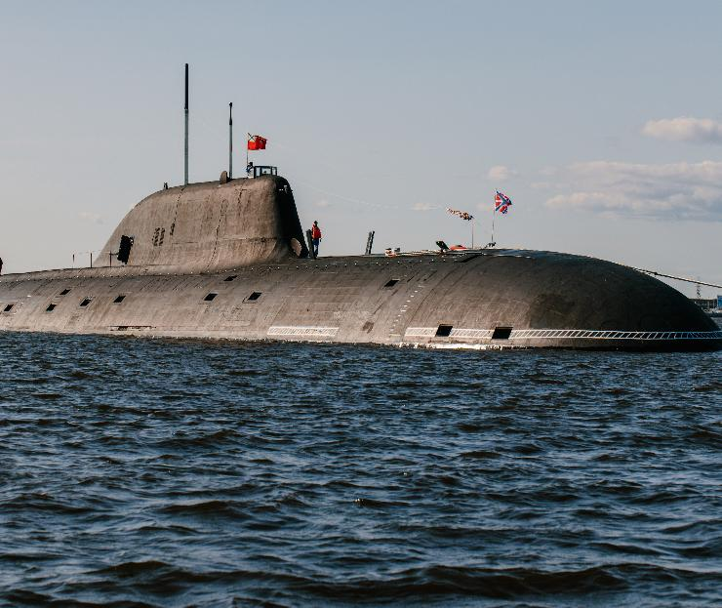
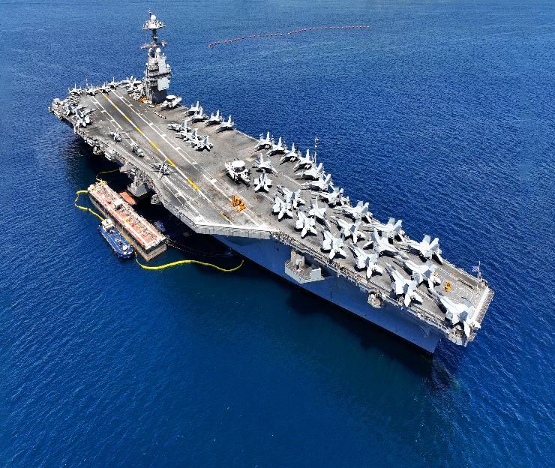
WOULD YOU RATHER…
OR
work on a nuclear-powered submarine
work on a nuclear-powered aircraft carrier
Notes:
NUCLEAR ENERGY

